Slide 1
ML Project Prediction of term deposit subscription
Valerio Botta

Slide 2
Introduction
Project Goal: predict if the client will subscribe (yes/no) a term deposit (column y)
Dataset: https://archive-beta.ics.uci.edu/ml/datasets/bank+marketing
ML Algorithms:
Logistic Regression
Neural network for classifiction
Decision Tree classifier
GitHub: https://github.com/valepoliba/ml_project

Slide 3
Dataset Analysis
Cleaning DataSet: the dataset was modified a specific class in order to obtain a “cvs” file without column separation, with comma delimiter between data and without blank space. Moreover, the name of few columns were changed replacing “.” with “_” because python produce an exception on dot simbol: 'emp_var_rate', 'cons_price_idx', 'cons_conf_idx'. At the end I performed a simple python script in order to check, for every column, null or empty string.
Analysis: the features columns are age, marital, job, default, housing, loan, campaign, previous, poutcome, emp_var_rate, cons_price_idx, cons_conf_idx.
Only 4640 people subscribed a deposit into a 41188 people’s dataset;
the frequency depends a great deal on the job title;
does not seem a strong predictor for the outcome variable;
most of the customers of the bank in this dataset are in the age range of 30–40.

Slide 4
Dataset Analysis

Slide 5
Implementation
The first operation split the dataset into test and train: 70% for train and 30% for test. Then, after the settings of Kfold (10 splits) I execute the model using the sklearn library. After I tried the cross-validation score using that model and the Kfold split, the fit method and the predict to obtain the value of the target column.
At this point I perform the accuracy of cross-validation, the accuracy of the predicted column, the confusion matrix and the roc curve to validate the results.

Slide 6
Logistic regression
After a few tests I decided to leave the default value of the algorithm except the max_iter parameter (1000 instead of 100).
Accuracy of K-fold validation: 89.88298165987328
Accuracy: 89.9571093307437
Execution time (second): 0:00:16.133801

Slide 7
Neural network for classification
activation=’logistic’: activation function for the hidden layer, logistic sigmoid function f(x)=1/(1+exp(-x));
alpha=1e-3: the L2 regularization terms;
max_iter=1000: max number of the iteration until converge;
random_state=1: random number generation for weights and bias initialization.
Accuracy of K-fold validation: 89.85142531777718
Accuracy: 89.89236869790402
Execution time (second): 0:01:46.224695

Slide 8
Decision tree classifier
criterion=’entropy’: the function to measure the quality of a split
max_depth=8: max depth of the tree;
min_samples_leaf=2: minimum number of sample required to be at a leaf node;
random_state=42: random number generation for weights and bias initialization;
max_leaf_nodes=52: max number of leaf nodes.
Accuracy of K-fold validation: 89.88540943360475
Accuracy: 90.17965525613013
Execution time (second): 0:00:09.367204

Slide 9

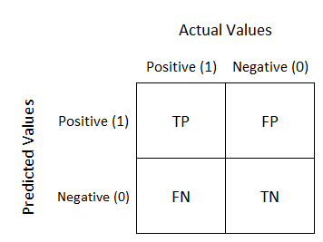
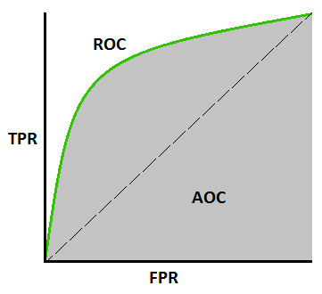
Error evaluation metrics
Accuracy: the number of correctly predicted data points out of all the data points
Confusion matrix: is a table that is used to define the performance of a classification algorithm.
ROC curve (receiver operating characteristic curve)

Slide 10

ML comparison

Slide 11
Conclusion
The K-fold accuracy is pretty the same, equal to 89.9% (rounding up).
The accuracy of the fit methods changes a bit. The worst is the neural network algorithm with 89.89% of accuracy, the better is the decision tree algorithm with 90.19%.
The same is the ROC curve area: a bit better in decision tree, a little worst in logistic regression.
An important difference is showed thanks to the confusion matrix. The decision tree algorithm is the worst because recognize less true positive and true negative values than the other two. The logistic regression and the neural network algorithms are similar.
The last important parameter is the execution time: the decision tree is the faster but gives not the best results, the logistic regression and the neural network gives the best results but the second one is very slow than the first one. The logistic regression requires, in this case and executed on my machine, a bit more of 16 seconds to finish, instead the neural network algorithm requires more than 1 minute and half.
At the end, the best algorithm in this case is the logistic regression.

