Slide 1


RESOLVER PROBLEMAS MEDIANTE BUSQUEDAS
RESOLVE PROBLEMS THROUGH SEARCHES
LISETH VALERIA QUIÑONES DEL CASTILLO

Slide 2
PROBLEM-SOLVING AGENTS
The resolving agents-problems are objective-based agents, whose main function is to decide ¿What to do? To find the sequence of actions that leads to desirable states.

Slide 3


Slide 4
Problems and well-defined solutions
A problem consists of four parts:
Initial state:
Objective Test:
Successor function:
Cost function:

Slide 5
Formulate problems
The process of removing details from a representation is called abstraction.
The abstraction is valid if we can extend any abstract solution to a more detailed solution in the world, that is, it is possible to use it if making each of the solutions is easier than in the original. If it were not for the ability to construct useful abstractions, intelligent agents would be totally absorbed by the real world.

Slide 6
EXAMPLES OF PROBLEMS
The world of the vacuum cleaner.
In this world there are two possible locations in which there may or may not be dirt and the agent is in one of the two. The world can assume 8 possible states. There are three actions that the agent can undertake in the world of the vacuum cleaner. The goal is to eliminate all the dirt.

Slide 7
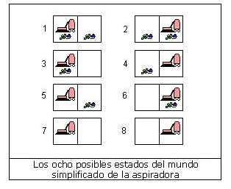
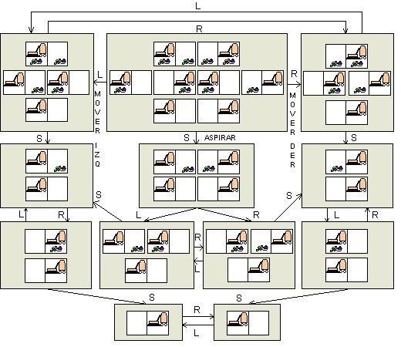


Slide 8
The tourist problems
The tourist problems are closely related to the problems of search for a route but with an important difference. Consider the following figure 3.2 at least once beginning and ending in Bucharest as in the search of routes the actions correspond to trips between adjacent cities, the space of states is however absolutely different. Each state must include not only the current location but also the cities that the agent has visited. the initial state would be Bucharest. A typical medium term would be in Vasliu and the test would check if the agent is in Bucharest and has visited the 20 cities.

Slide 9
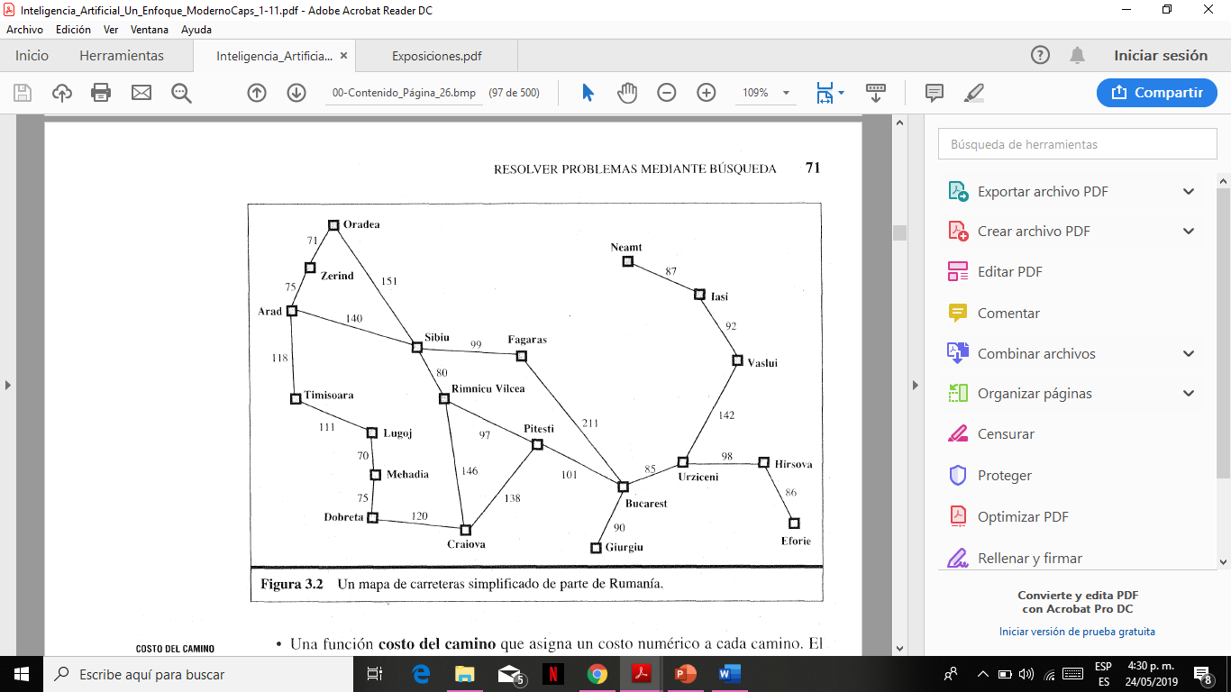

Slide 10
SEARCH FOR SOLUTIONS
Good part of the efforts invested in the search area have been in determining the right search strategy for a problem

Slide 11
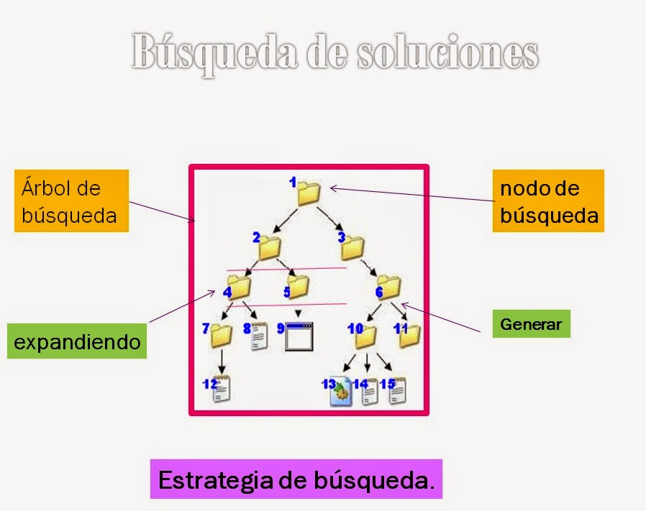

Slide 12
NON-INFORMED SEARCH STRATEGIES
This section deals with five search strategies encompassed under the name of uninformed search (also called blind search). The term means that they do not have additional information about the states beyond the one that provides the definition of the problem

Slide 13
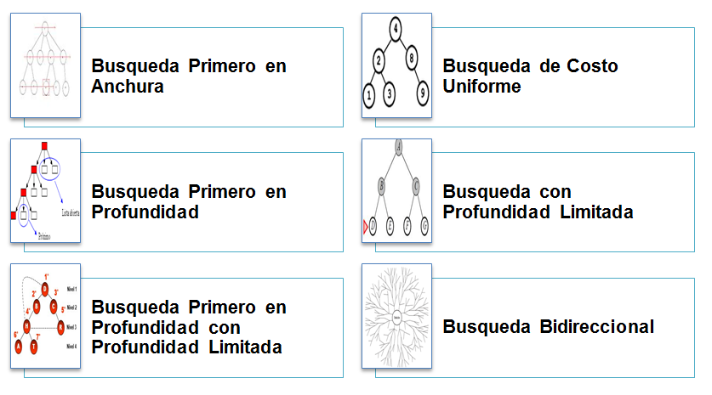

Slide 14
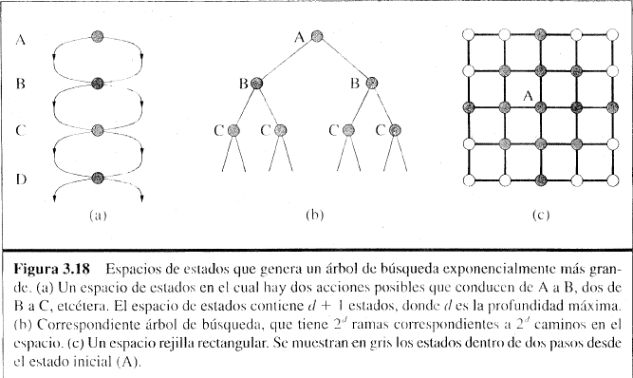
AVOID REPEATED STATES

Slide 15
SEARCH WITH PARTIAL INFORMATION
The agent can calculate exactly what the result state of any sequence of actions is and always knows what state it is in. Your perception does not provide any new information after each action. What happens when the knowledge of the states or actions is incomplete? We find that various types of incomplete lead to three different types of problems:

Slide 16
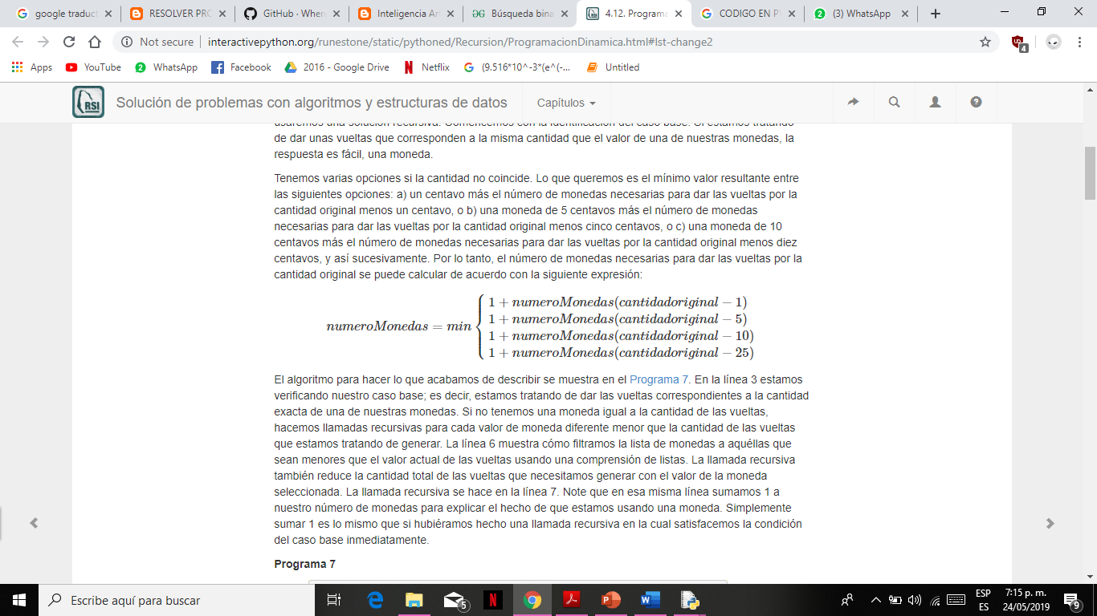
EXERCISES:
1. Among the following options determine the number of coin turns for 63 cents from this data: a) one cent plus the number of coins needed to go around for the original amount minus one cent, or b) a coin of 5 cents plus the number of coins needed to go around the original amount minus five cents, or c) a 10 cent coin plus the number of coins needed to go around the original amount minus ten cents, and so on. Therefore, the number of coins needed to go around the original amount can be calculated according to the following expression:

Slide 17
2. It is a dynamic programming algorithm to solve our problem of going around. returnsProgDin has three parameters: a list of valid values ​​of coins, the number of laps we want to complete and a list of the minimum number of coins needed to complete each value. When the function ends, minCoins will contain the solution for all values ​​from 0 to the value of turns. In this exercise you should use the list of the previous exercise and collect the same 63 cents.

Slide 18


