Slide 1



GITHUB API: GITHUB
COMMENTS IN JEKYLL
Tech Hangout #32
by Valera Rozuvan
11 December 2013

Slide 2

Transform your plain text into static websites and blogs.

Slide 3
Why?
Simple
No more databases, comment moderation, or pesky updates.
Static
Markdown (or Textile), Liquid, HTML & CSS go in. Static sites come out.
Blog-aware
Permalinks, categories, pages, posts, and custom layouts.
GitHub Pages
You can easily deploy your site using GitHub for free. Custom domain too.

Slide 4

Dr. Jekyll & Mr. Hyde

Slide 5
Installing Ruby & RubyGems
On Ubuntu 12.04 LTS this is very simple:
  $ sudo apt-get update
  $ sudo apt-get install curl
  $ curl -L https://get.rvm.io | bash -s stable
  $ source ~/.rvm/scripts/rvm
  $ rvm requirements
  $ rvm install ruby
  $ rvm use ruby –default
  $ rvm rubygems current

Slide 6
Installing Jekyll
This is the easy part ;)
$ gem install jekyll
Setting up a new blog
$ jekyll new myblog
$ cd myblog
$ jekyll serve

Slide 7
Hosting on GitHub
Every GitHub repository can have a special branch called gh-pages. You can place in this branch any static files (HTML, CSS, JavaScript, images, text, etc.) and it will be served from a server. The access URL is:
  http://user.github.io/repository
Do note that this is static hosting! No PHP, Python, etc. Also, there is a delay between the time you push to GitHub the gh-pages branch and the time it will become accessible via the access URL.

Slide 8
Deploying Jekyll to GitHub
The sources of the Jekyll blog will be placed in the master branch of our repository. Since we can't directly make GitHub serve Jekyll sources, we will tell Jekyll to generate all static content beforehand. The static content will be placed in the gh-pages branch.
To generate a Jekyll blog:
$ jekyll build \
> --source <source> \
> --destination <destination>

Slide 9


Slide 10
Tip
The best work-flow is to have two separate directories, each being a clone of the working GitHub repository. In one directory you have the master branch checked out, and in the other you have the gh-pages branch checked out. Then updating your blog is as simple as:
... edit <master_dir> content ...
$ jekyll build -s <master_dir> -d <gh_pages_dir>
$ cd <gh_pages_dir>
$ git commit -a -m "Updated blog."
$ git push origin gh-pages

Slide 11
Don't forget!
In _config.yml, set the baseurl option to /project-name – note the leading slash and the absence of a trailing slash.
When referencing JS or CSS files, do it like this: {{ site.baseurl }}/path/to/css.css – note the slash immediately following the variable (just before “path”).
When doing permalinks or internal links, do it like this: {{ site.baseurl }}{{ post.url }} – note that there is no slash between the two variables.

Slide 12


Slide 13




What about comments?

Slide 14

Can't we use GitHub to store comments?
Yes. Yes,
we can.
Each blog post is basically
a file in a commit. A commit
can have messages attached
to it. We can use the commit
messaging system as a
commenting system!

Slide 15

How do we access GitHub commit comments from our blog?
GitHub API to the rescue!

Slide 16
The technical details
Register a new OAuth GitHub application:
  https://github.com/settings/applications/new
Use the following URLs to make AJAX requests regarding commits, and their comments:
  https://api.github.com/repos/{{user}}/{{repository}}/commits?path=_posts%2F{{name of blog post file}}
  https://api.github.com/repos/{{user}}/{{repository}}/commits/{{commit hash}}/comments
Unfortunately, this method lacks authentication. GitHub limits unauthenticated requests to something like 60 requests per hour.

Slide 17

An awesome developer known by the GitHub
handle m2w developed just such a commenting
system. You can check it out at:
https://github.com/m2w/talaria

Slide 18
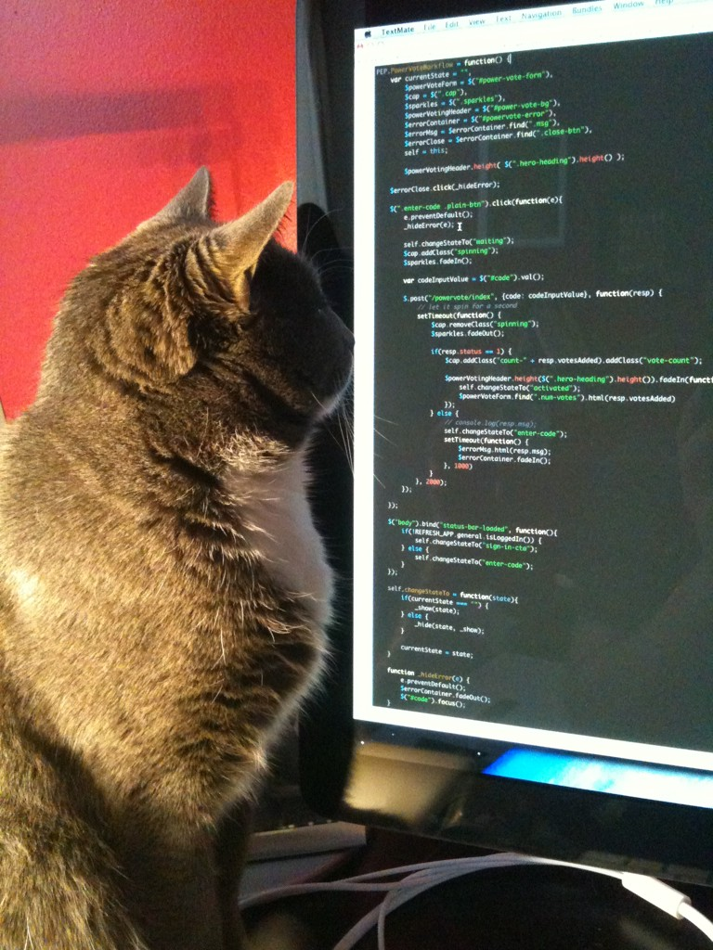
A bit of code
&
Demo

Slide 19
Useful links
http://goo.gl/pBXFGD [how to install Ruby and RubyGem on Ubuntu 12.04 LTS]
http://jekyllrb.com/docs/quickstart/
http://jekyllrb.com/docs/usage/
http://jekyllrb.com/docs/github-pages/
http://goo.gl/ffF9vC [creating GitHub pages manually]
https://github.com/m2w/talaria
http://blog.tibidat.com/talaria/
http://blog.tibidat.com/
https://github.com/settings/applications/new

Slide 20



Thanks!
ValeraRozuvan
valera-rozuvan
http://valera.rozuvan.net

Slide 21


