Slide 1



github.com/valera0798/ITISInformatics/tree/master/projects/CrossZeroDesktop

Slide 2
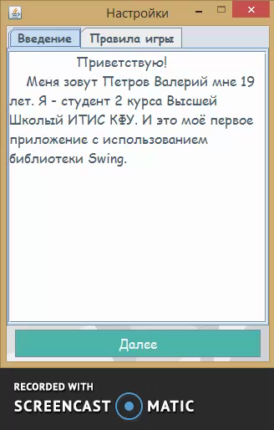
Intro and rules
Purposes
Introduce user to author.
Explain game rules.

Slide 3
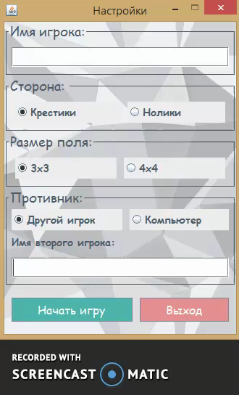
Settings
Purposes
Allow user to choose game mode.
And enemy type.

Slide 4
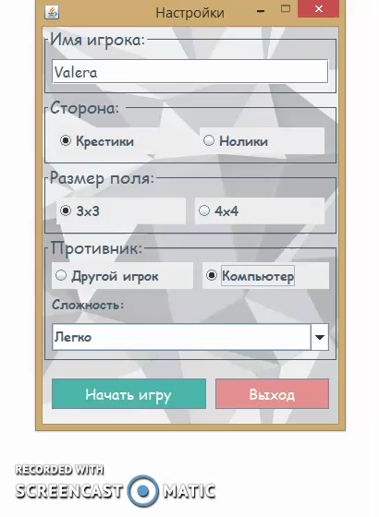
Game process - COMPUTER
Key points
Chose difficulty.
Play with computer!

Slide 5
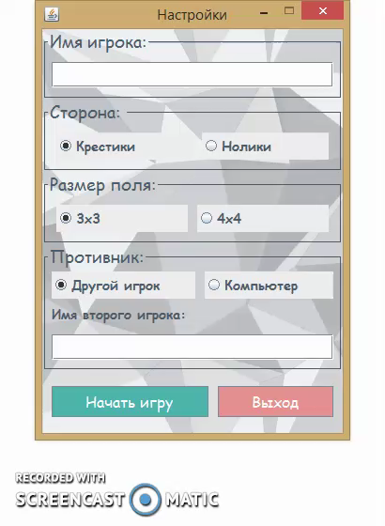
Game process - MAN
Key points
Enter players names.
Play on local computer!

Slide 6
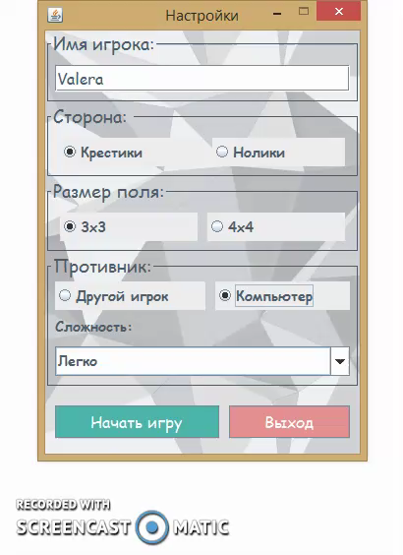
Game process - BONUSES
Play either cross or zero.
Unusual field size.

Slide 7
Used technologies
Development plan
Java.
Swing, AWT.
Create online mode.
Improve computer’s hard level.

Slide 8

github.com/valera0798/ITISInformatics/tree/master/projects/CrossZeroDesktop

