Slide 1



adventure_works
View in Power BI
Last data refresh:
9/3/2022 11:32:24 AM UTC
Downloaded at:
9/3/2022 11:34:12 AM UTC

Slide 2
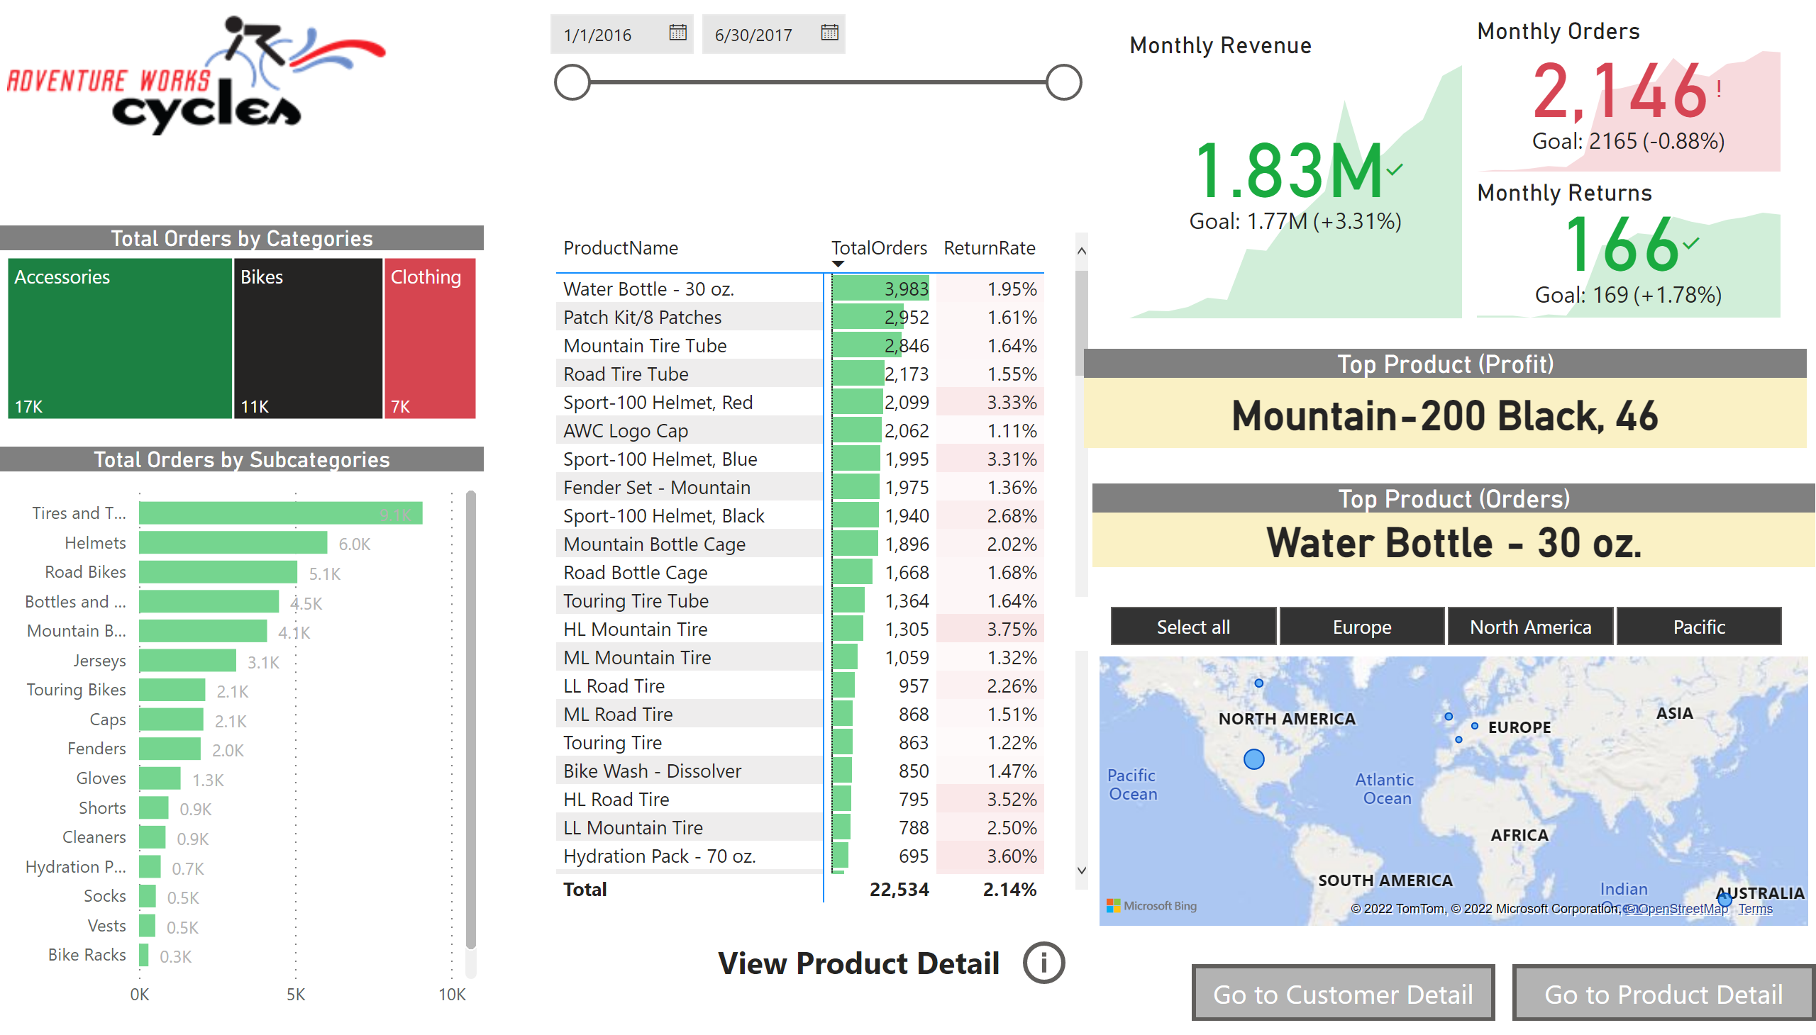
Exec Summary
Notes:
image
No alt text provided
Total Orders by Subcategories
No alt text provided
Total Orders by Categories
No alt text provided
pivotTable
No alt text provided
slicer
No alt text provided
Monthly Revenue
No alt text provided
Monthly Orders
No alt text provided
Monthly Returns
No alt text provided
Top Product (Orders)
No alt text provided
Top Product (Profit)
No alt text provided
map
No alt text provided
slicer
No alt text provided
actionButton
No alt text provided
textbox
No alt text provided
Exec Smmary
No alt text provided
Exec Smmary
No alt text provided

Slide 3
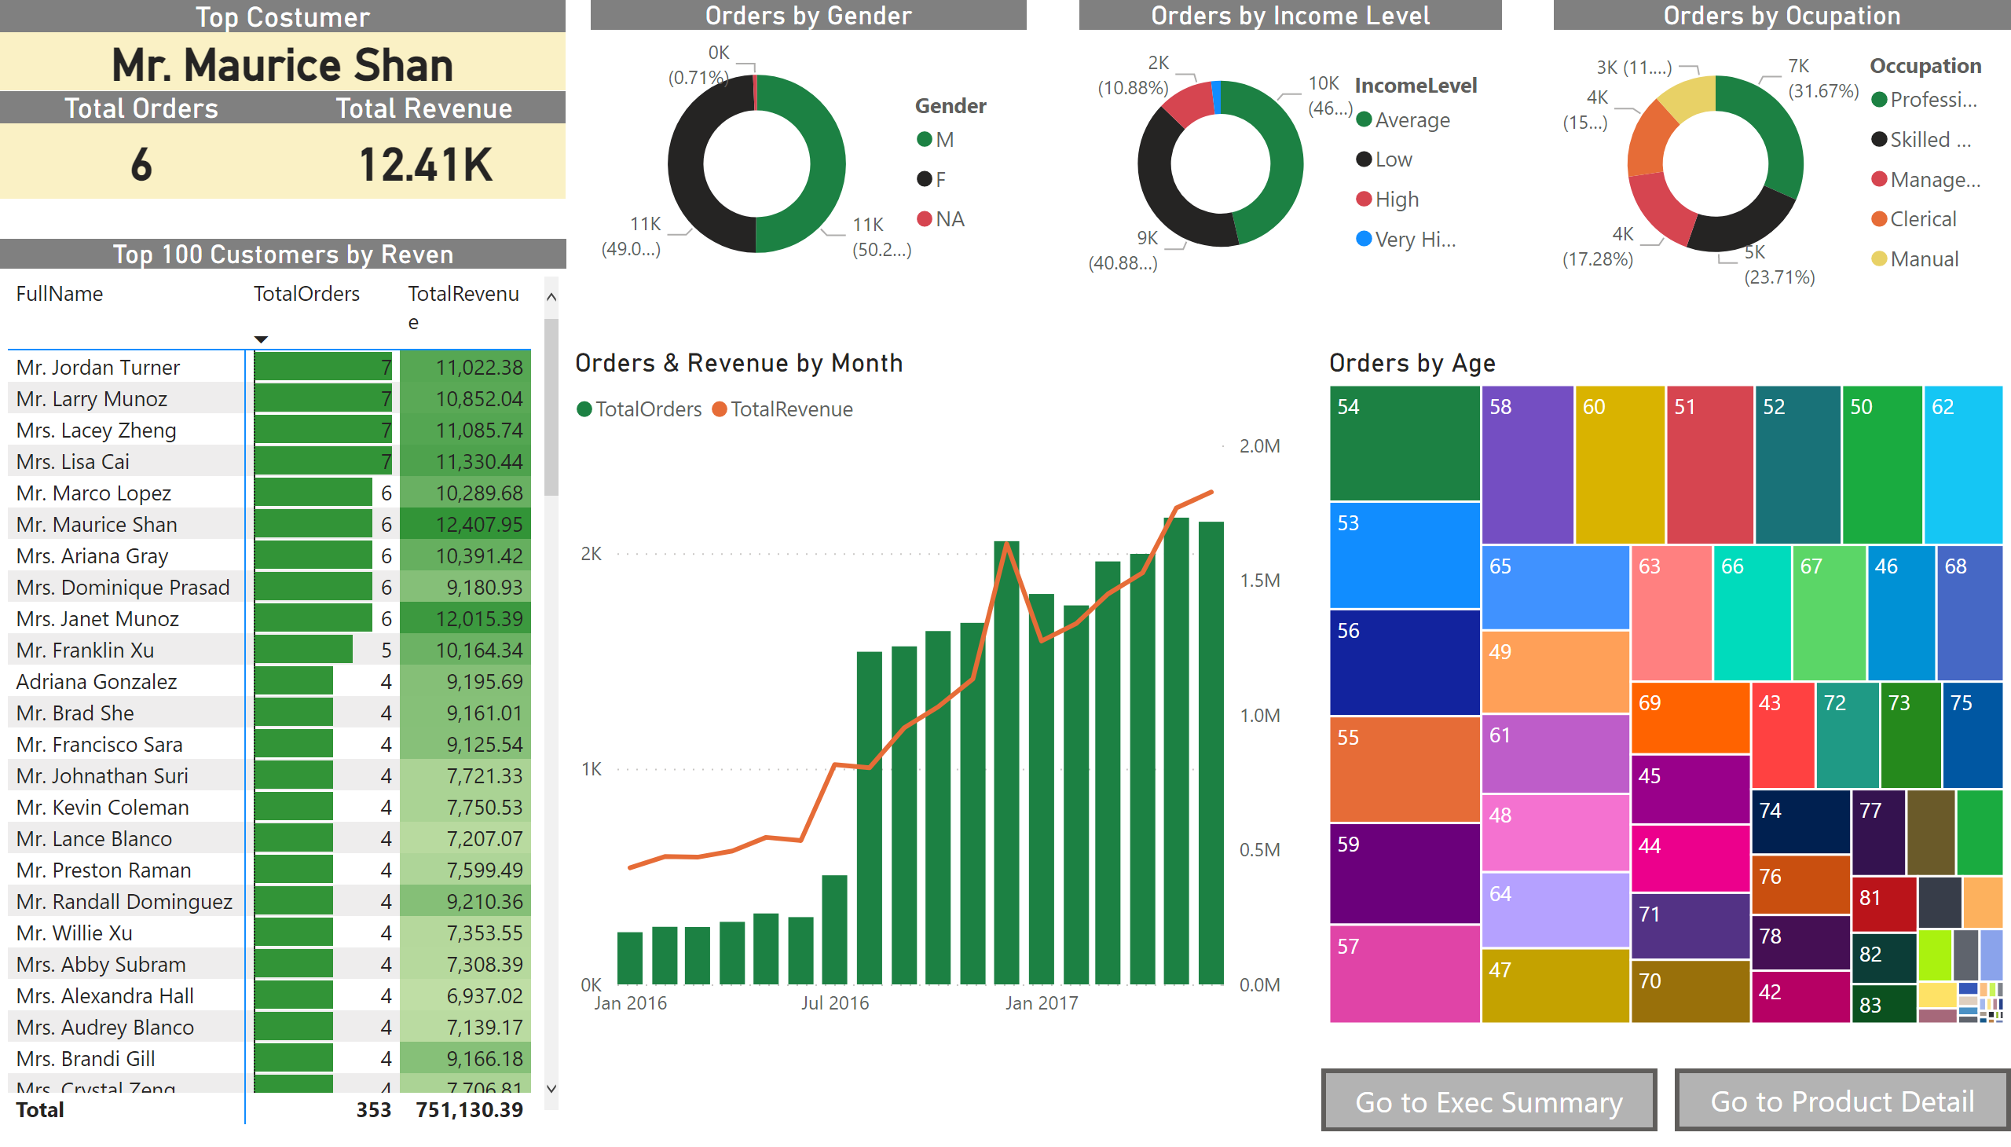
Costumer Detail
Notes:
Top 100 Customers by Reven
No alt text provided
Orders by Gender
No alt text provided
Orders by Income Level
No alt text provided
Orders by Ocupation
No alt text provided
Orders & Revenue by Month
No alt text provided
Orders by Age
No alt text provided
Top Costumer
No alt text provided
Total Orders
No alt text provided
Total Revenue
No alt text provided
Exec Smmary
No alt text provided
Exec Smmary
No alt text provided

Slide 4
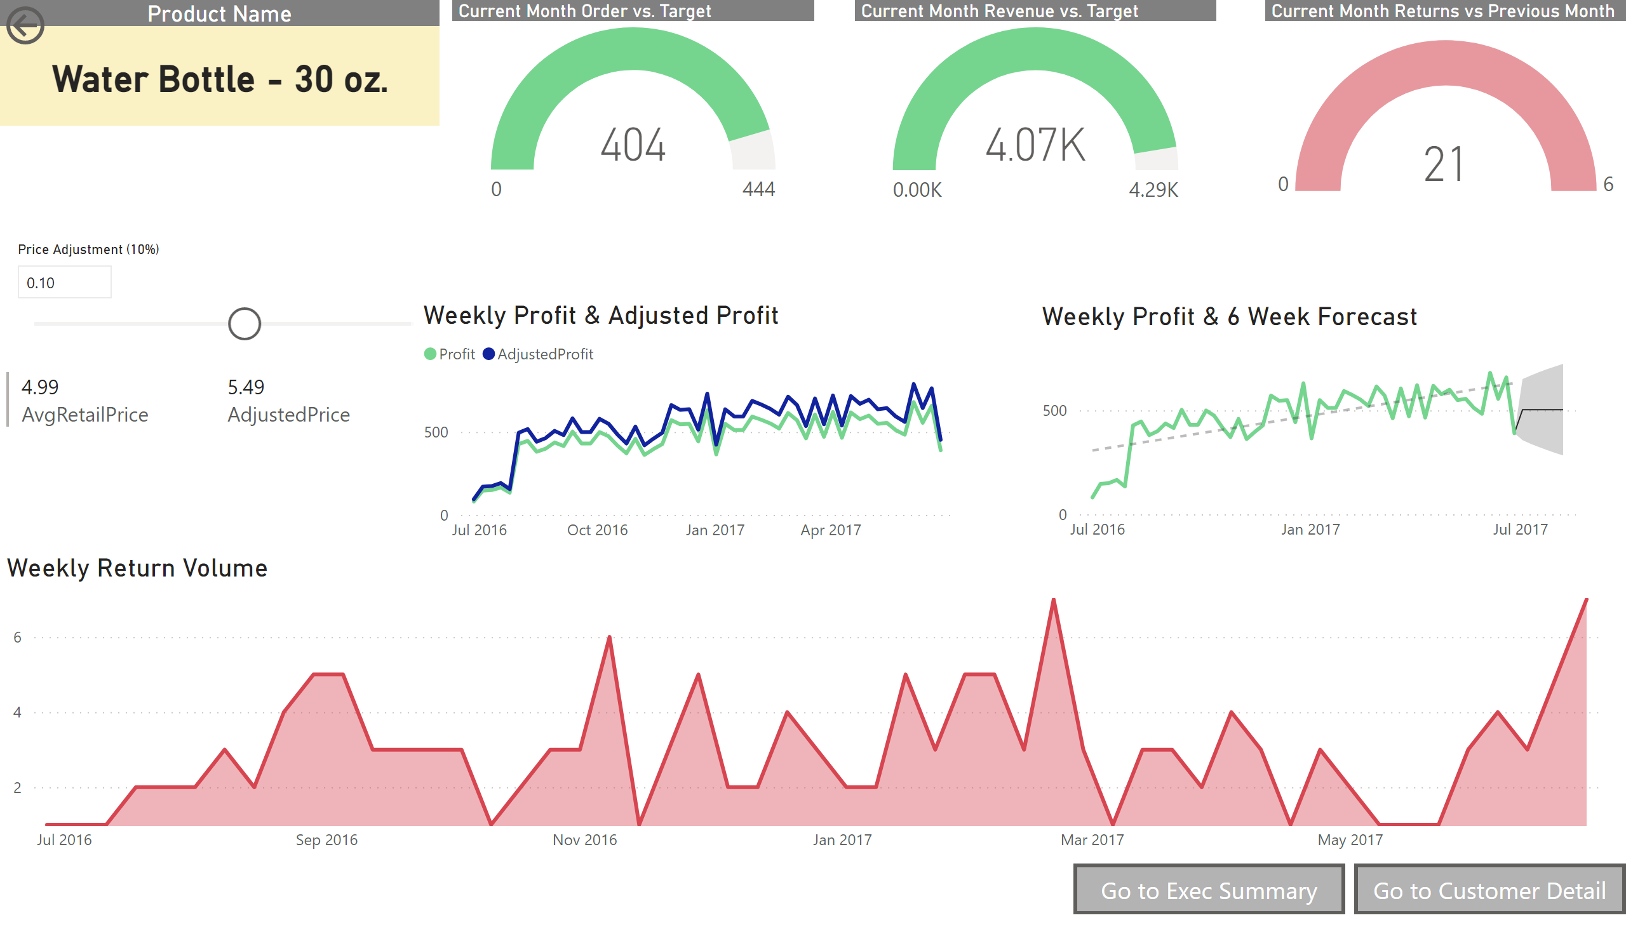
Product Detail
Notes:
Weekly Profit & 6 Week Forecast
No alt text provided
Weekly Return Volume
No alt text provided
Current Month Order vs. Target
No alt text provided
Current Month Revenue vs. Target
No alt text provided
Current Month Returns vs Previous Month
No alt text provided
Product Name
No alt text provided
actionButton
No alt text provided
slicer
No alt text provided
multiRowCard
No alt text provided
Weekly Profit & Adjusted Profit
No alt text provided
Exec Smmary
No alt text provided
Exec Smmary
No alt text provided

