Slide 1



Bike_Case_Study
View in Power BI
Last data refresh:
8/20/2022 2:34:04 PM UTC
Downloaded at:
8/20/2022 2:36:08 PM UTC

Slide 2
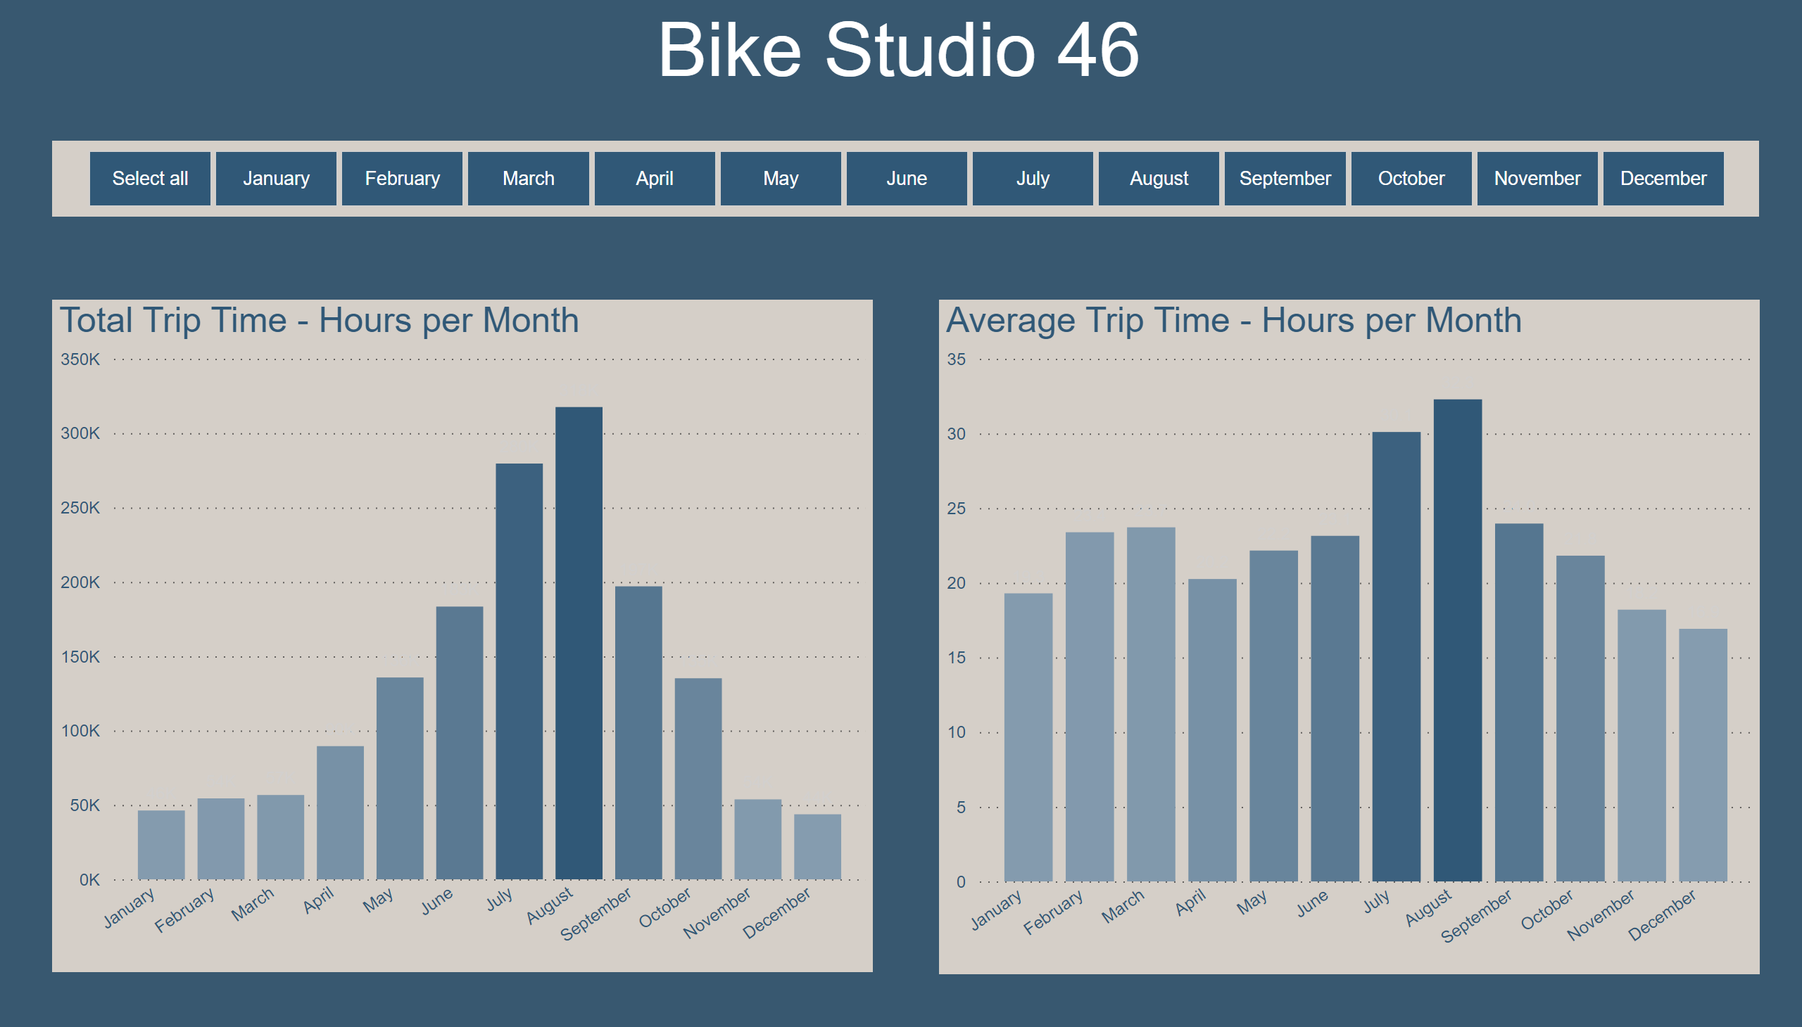
Bar Chart - Total & Average Trip Time
Notes:
Total Trip Time - Hours per Month
No alt text provided
Average Trip Time - Hours per Month
No alt text provided
textbox
No alt text provided
slicer
No alt text provided

Slide 3
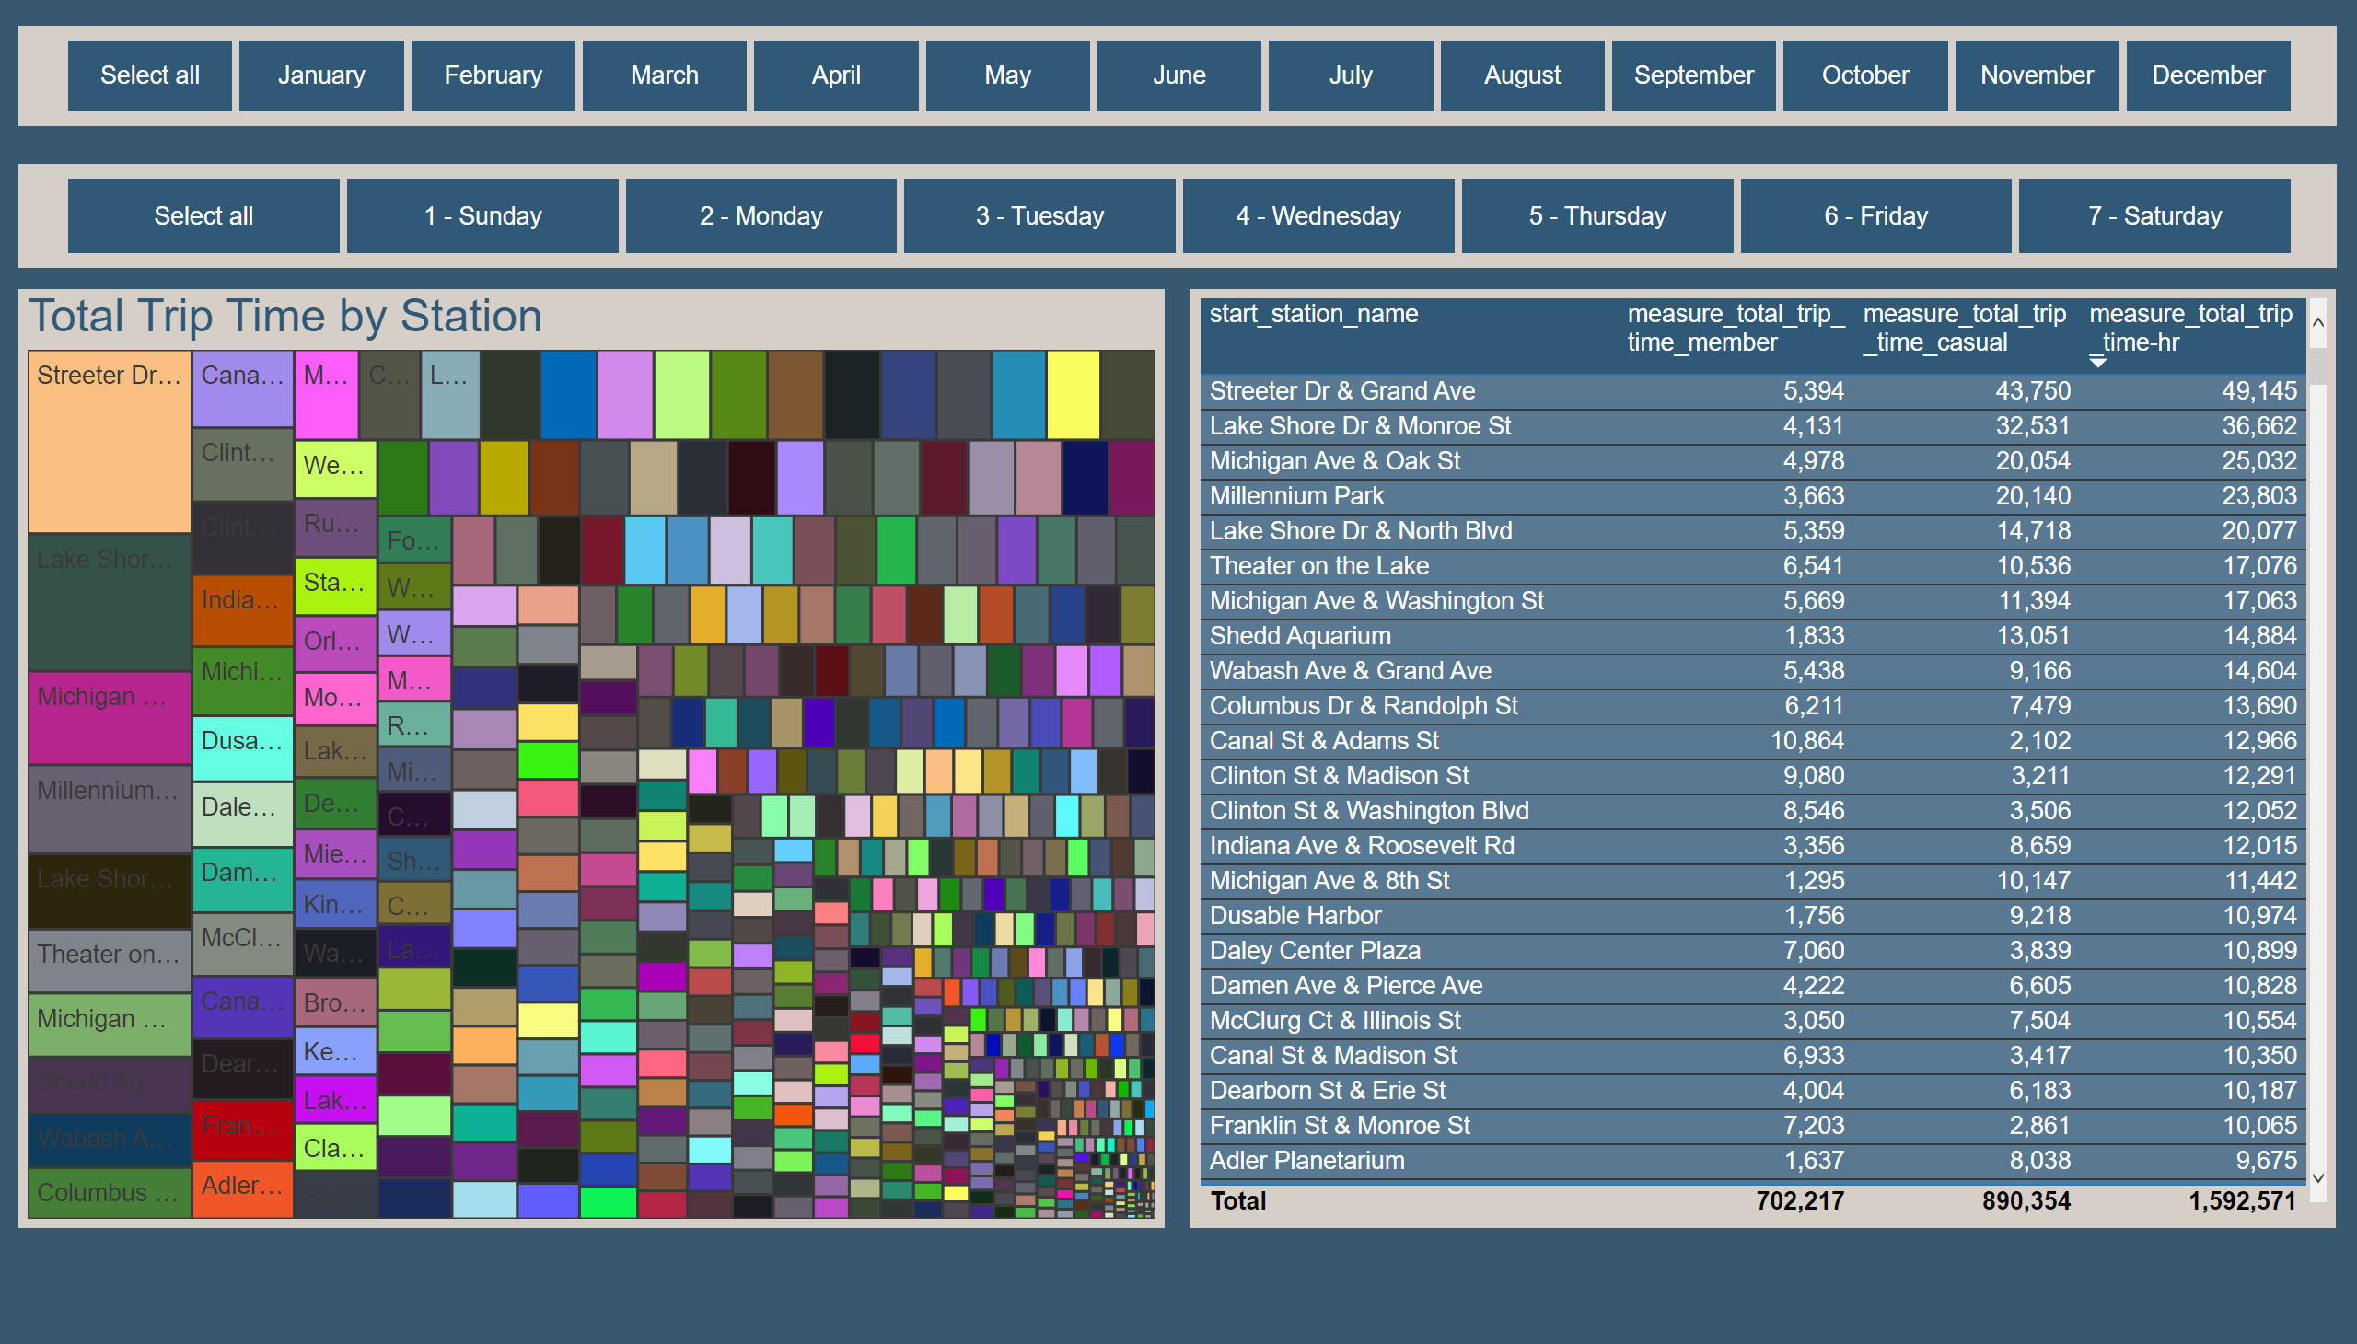
Treemap
Notes:
Total Trip Time by Station
No alt text provided
slicer
No alt text provided
slicer
No alt text provided
tableEx
No alt text provided

Slide 4
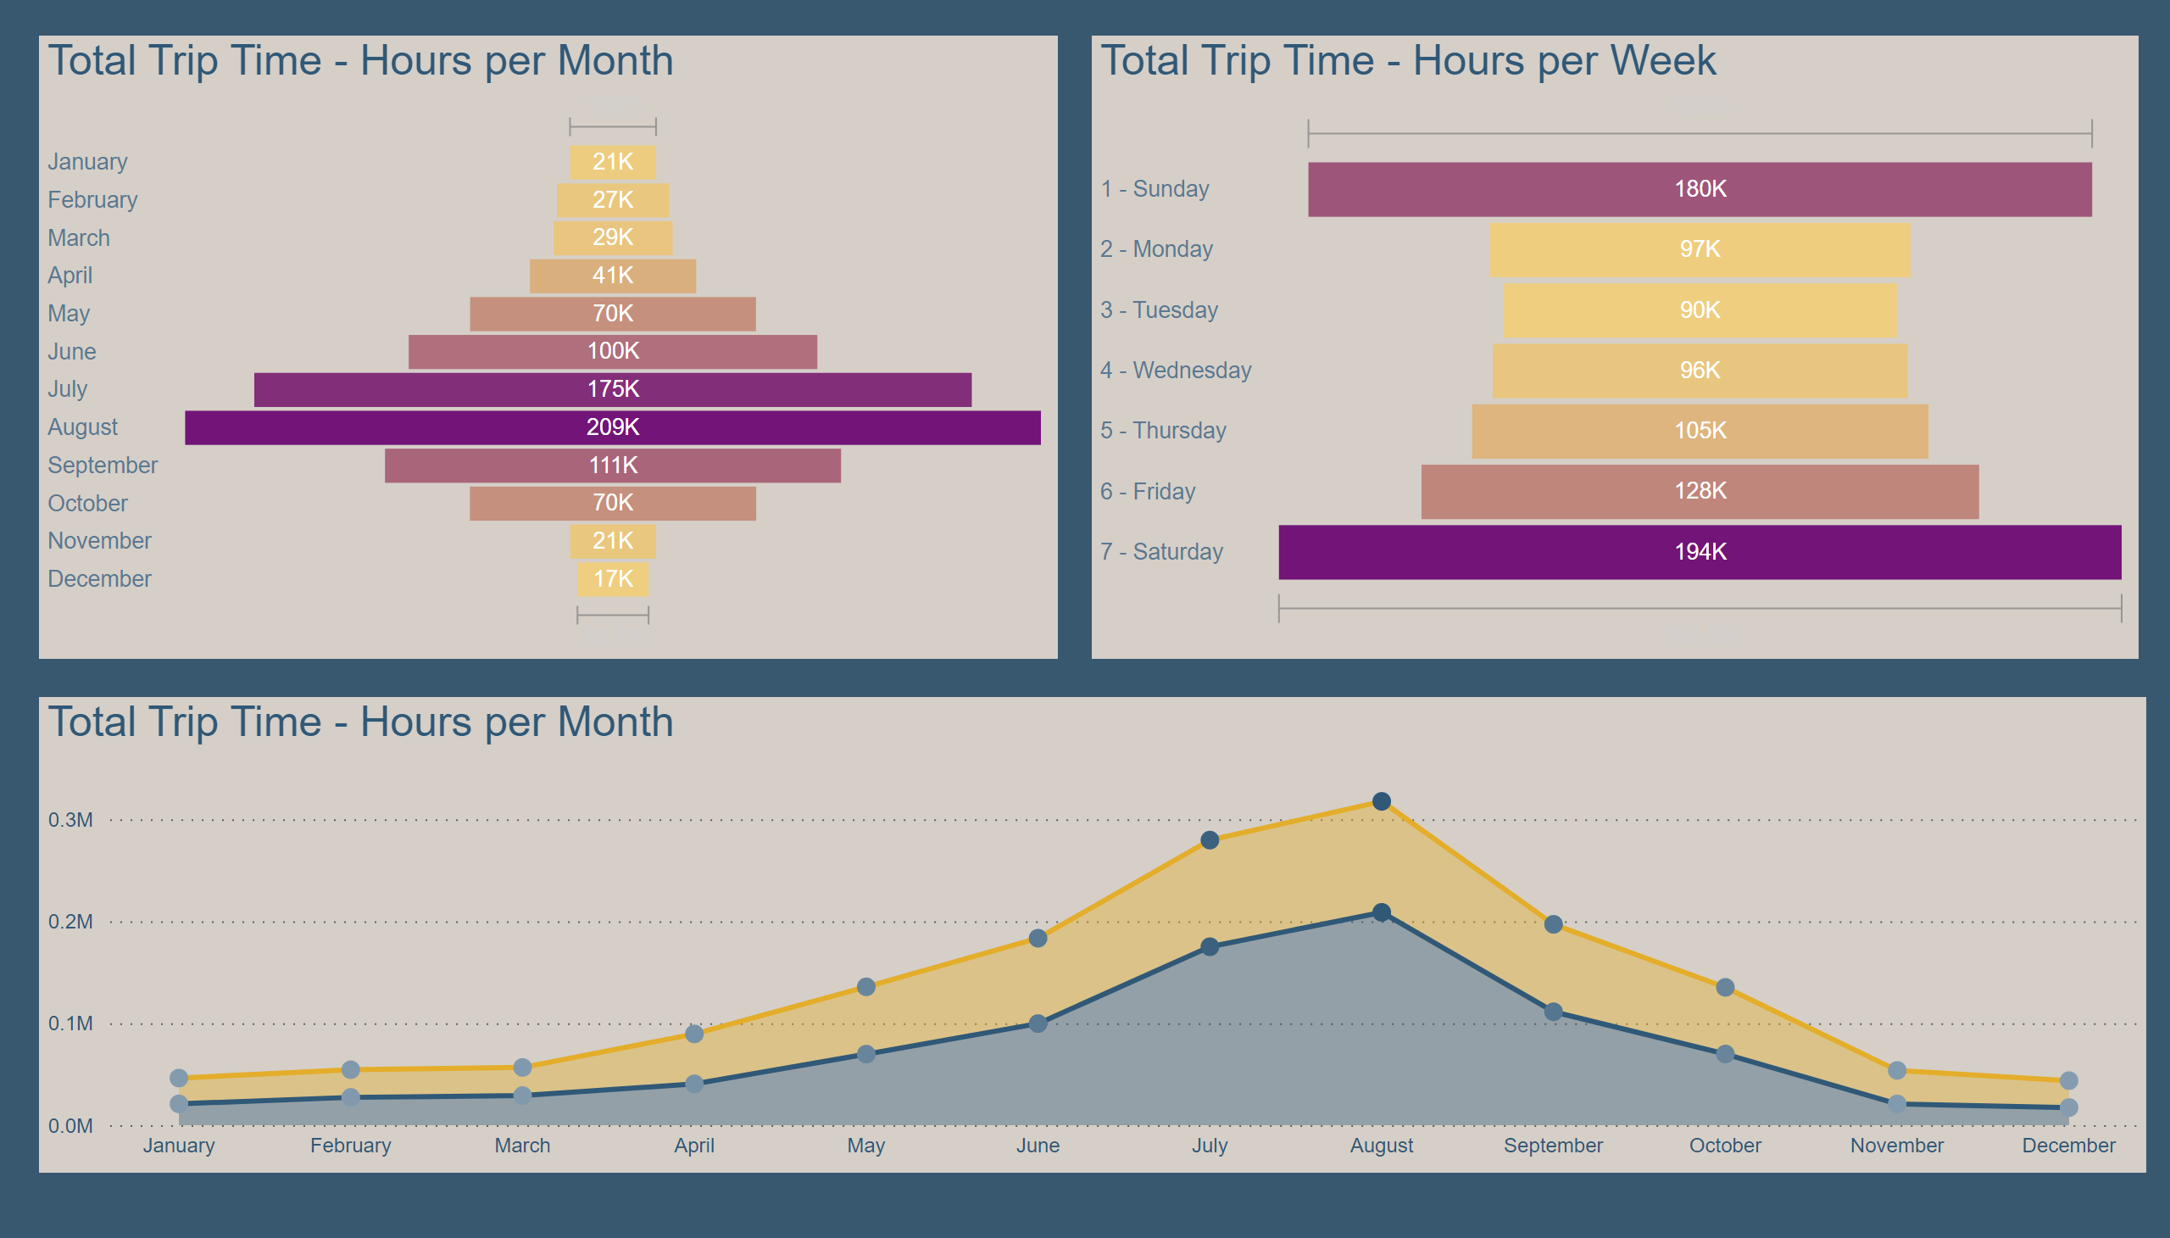
Funnel
Notes:
Total Trip Time - Hours per Month
No alt text provided
Total Trip Time - Hours per Month
No alt text provided
Total Trip Time - Hours per Week
No alt text provided

Slide 5
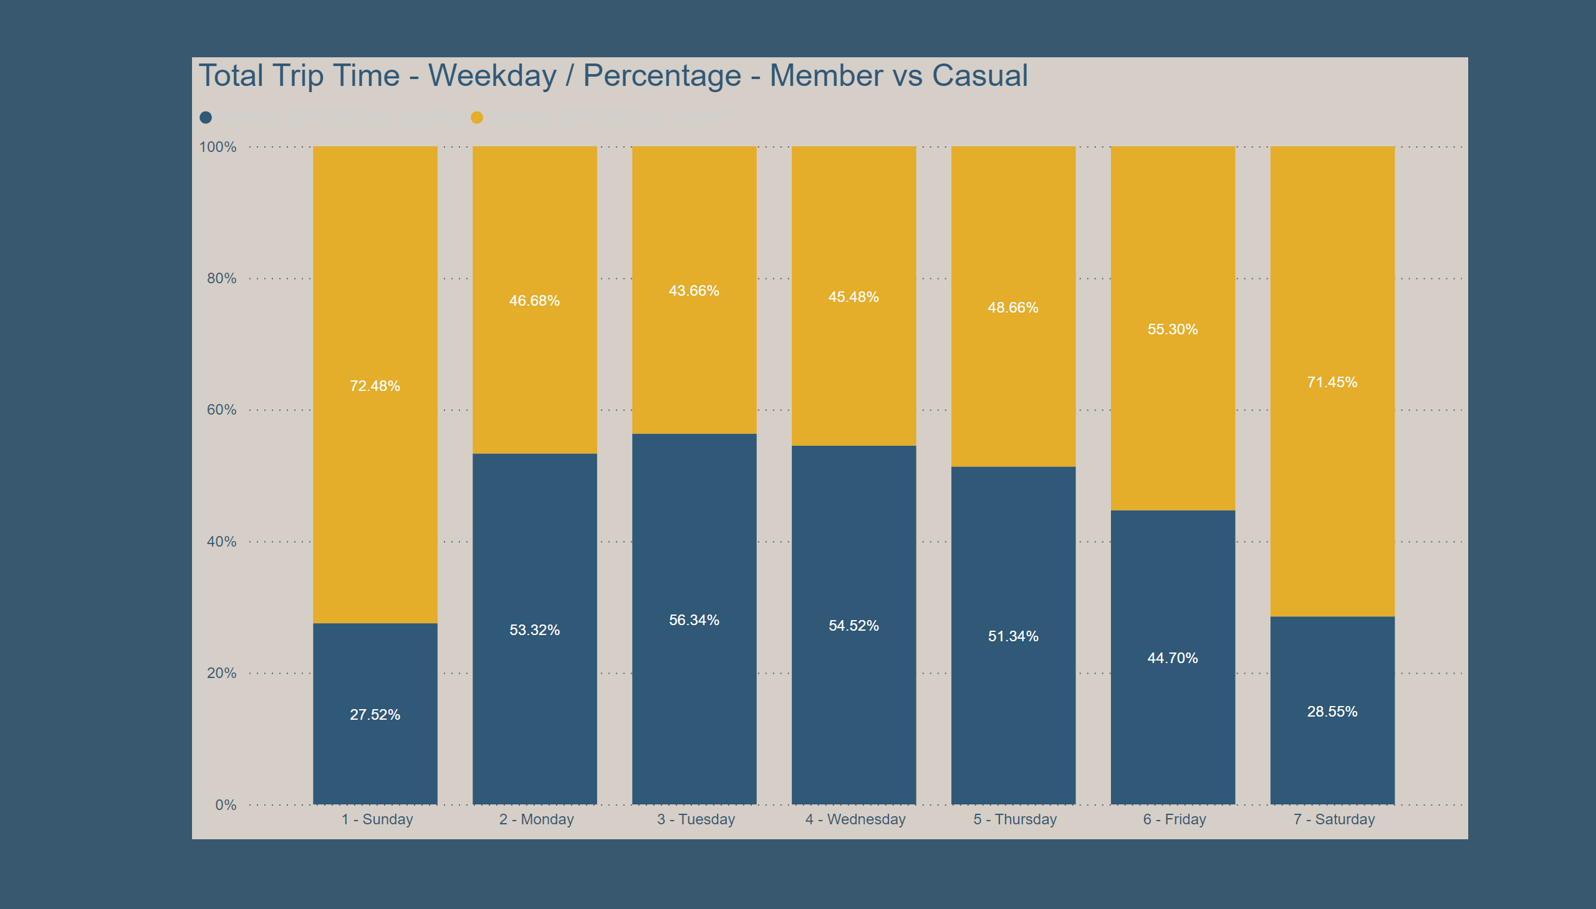
Stacked - Percentage Weekday
Notes:
Total Trip Time - Weekday / Percentage - Member vs Casual
No alt text provided

Slide 6
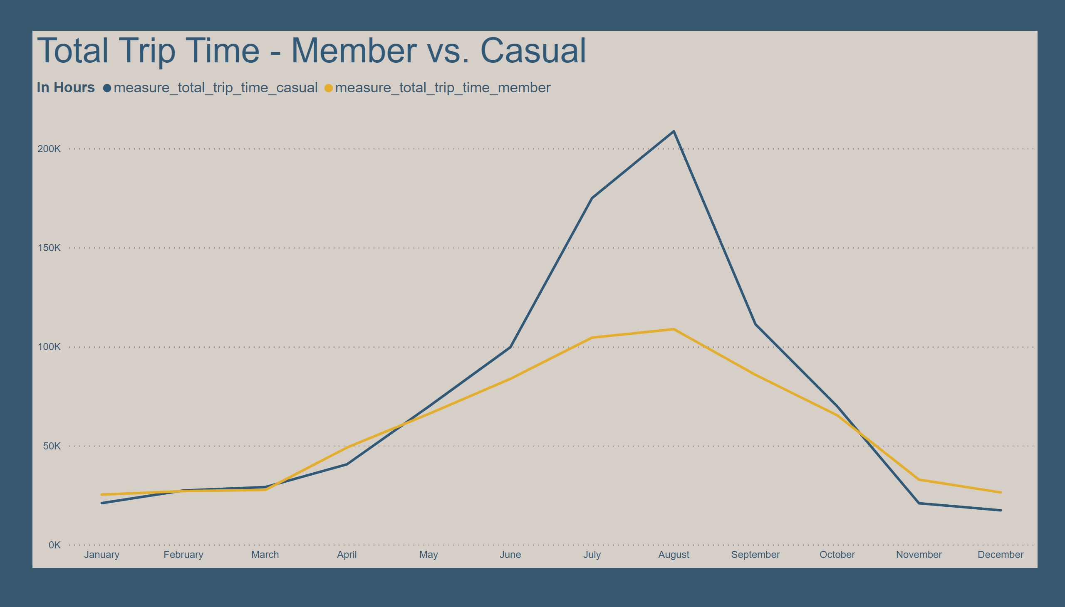
Line - Member vs Casual
Notes:
Total Trip Time - Member vs. Casual
No alt text provided

Slide 7
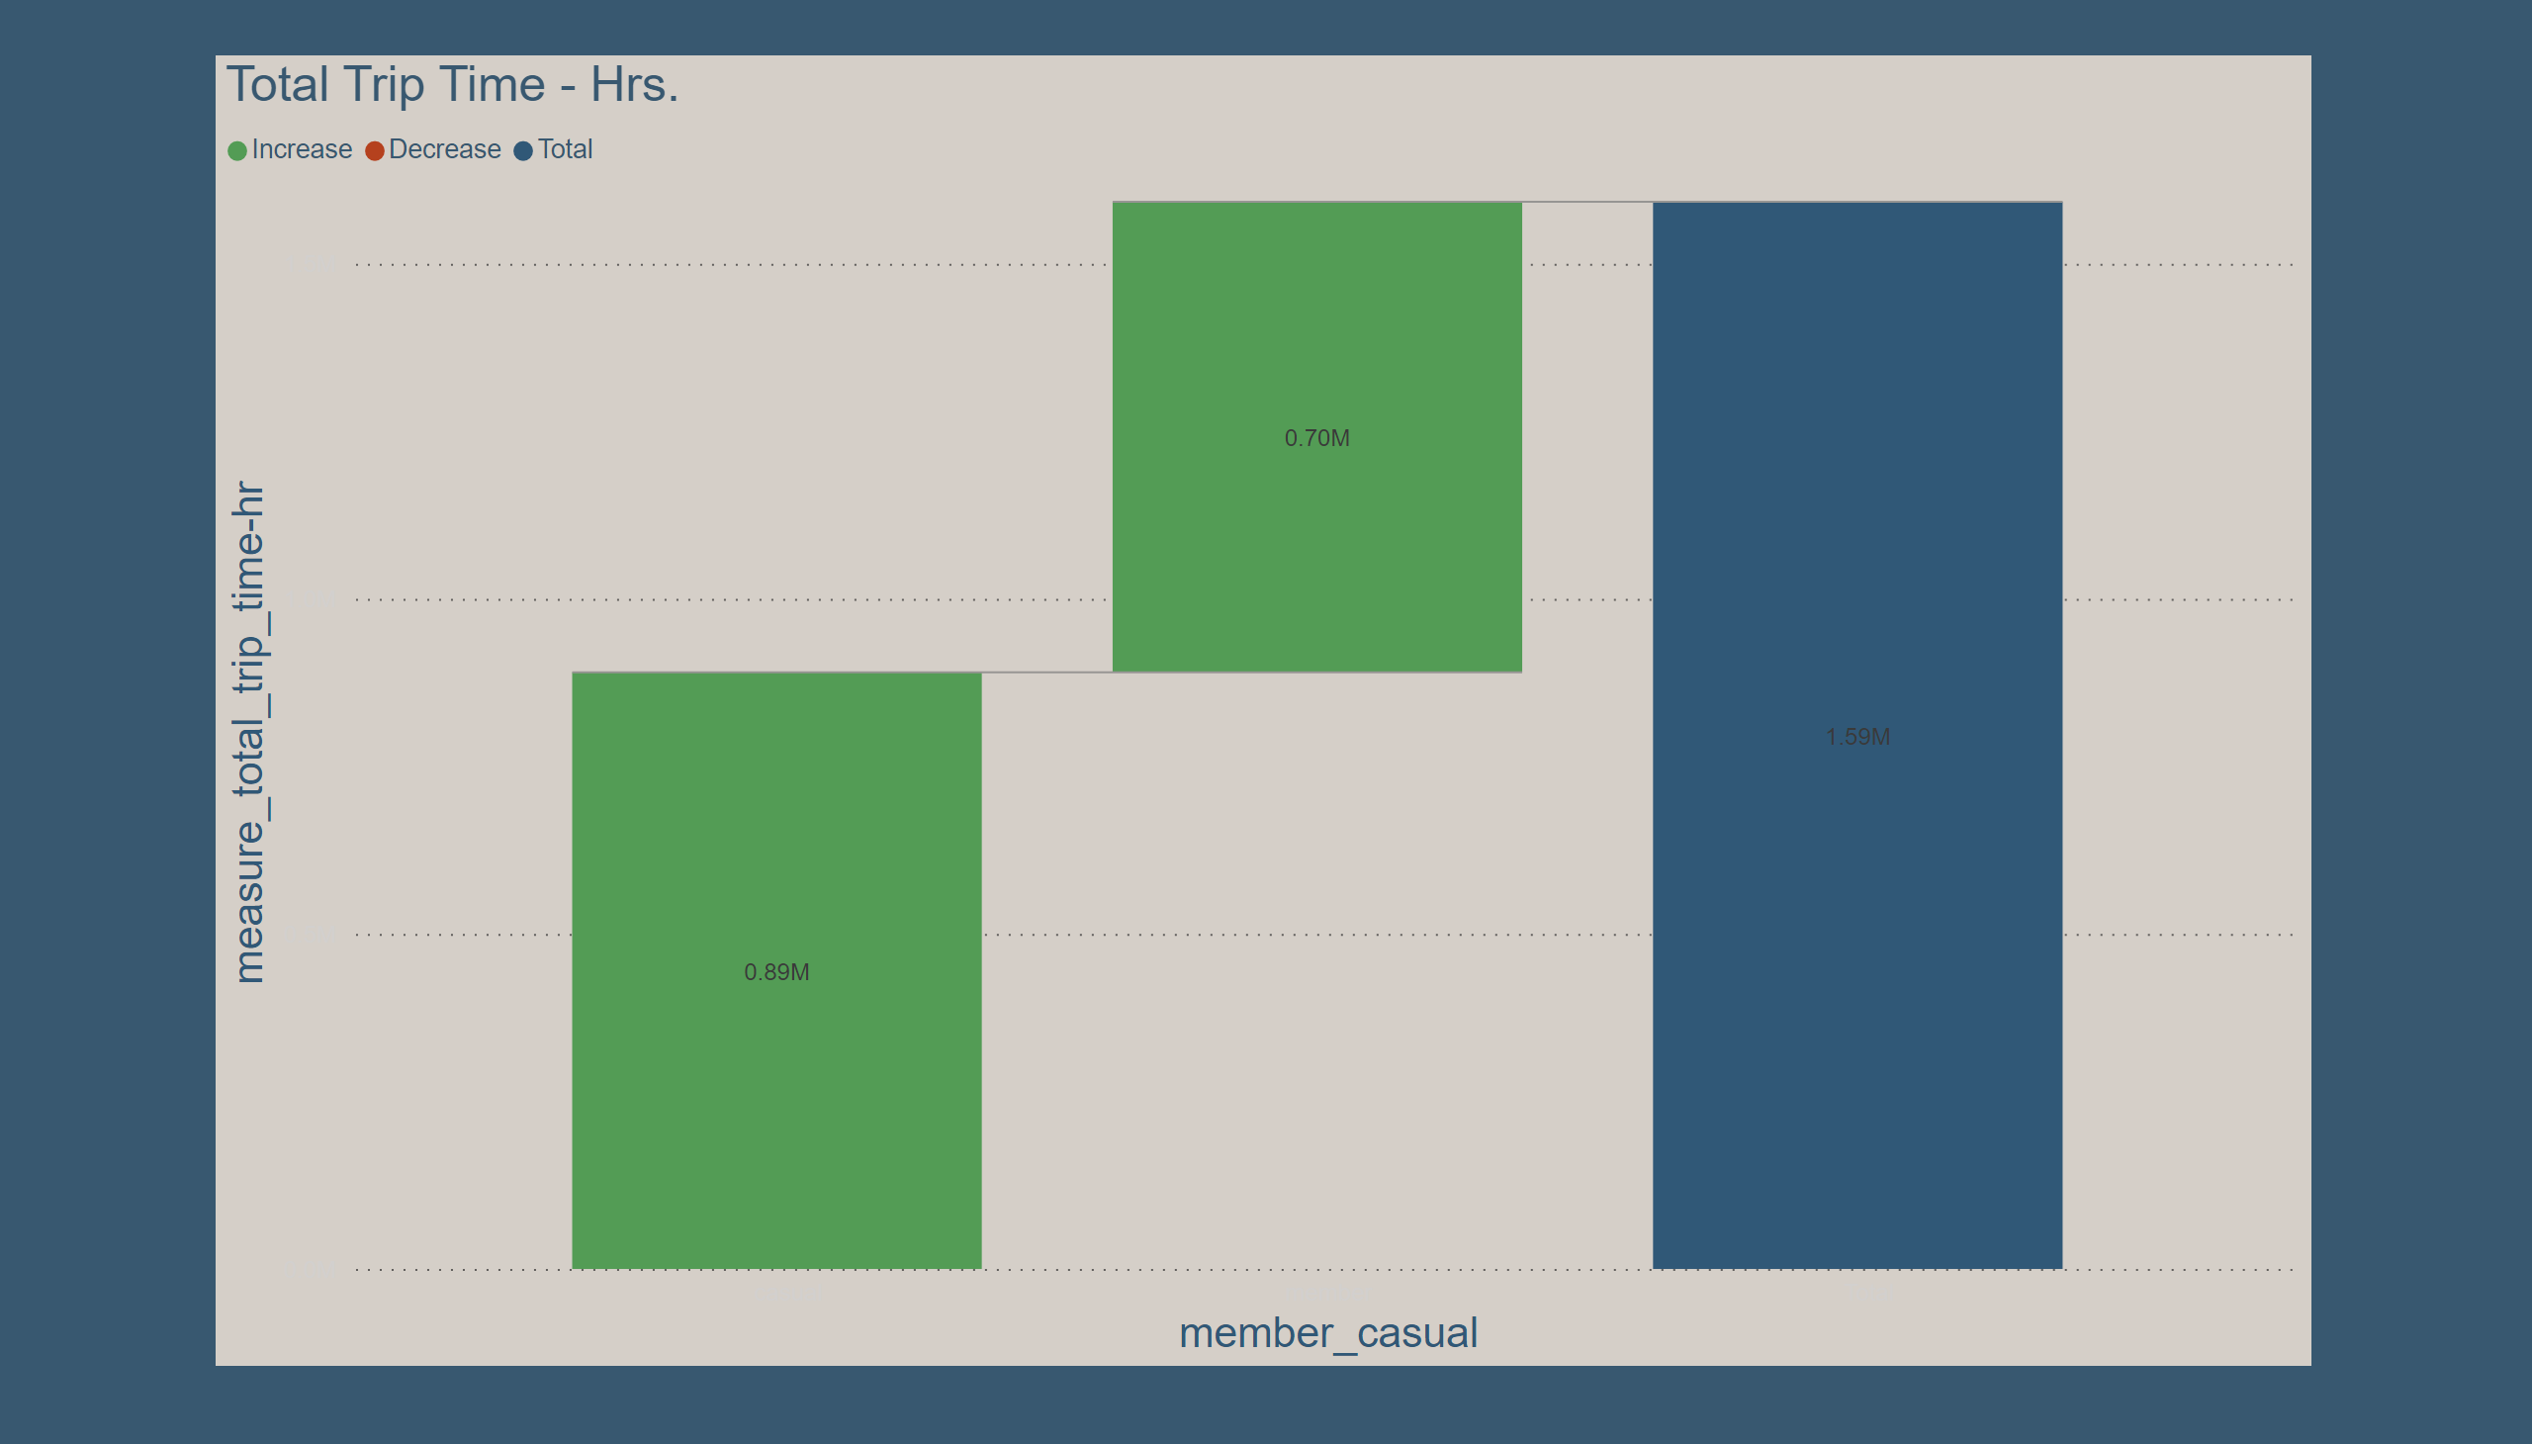
Waterfall
Notes:
Total Trip Time - Hrs.
No alt text provided

Slide 8
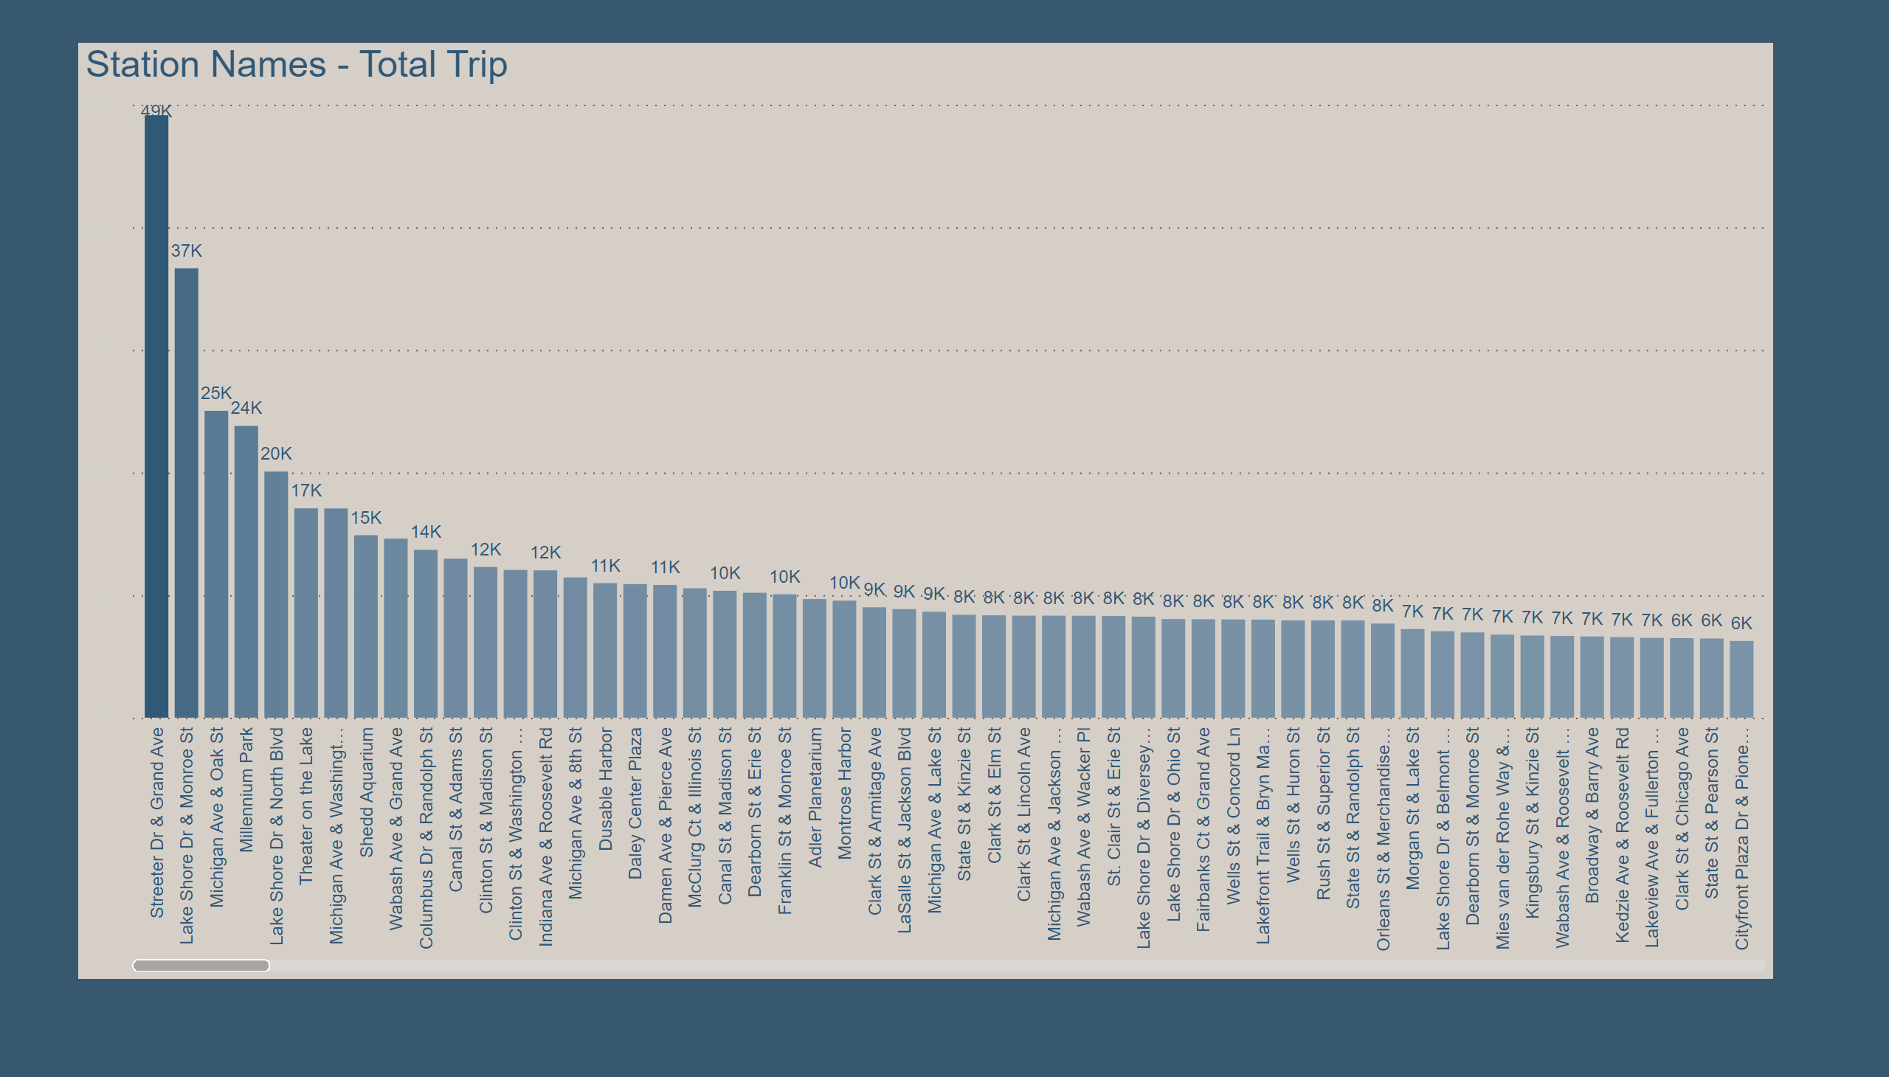
Top Stations
Notes:
Station Names - Total Trip
No alt text provided

