Slide 1



Netflix Movies & TV Shows
View in Power BI
Last data refresh:
8/21/2022 1:49:24 PM UTC
Downloaded at:
8/21/2022 1:50:36 PM UTC

Slide 2
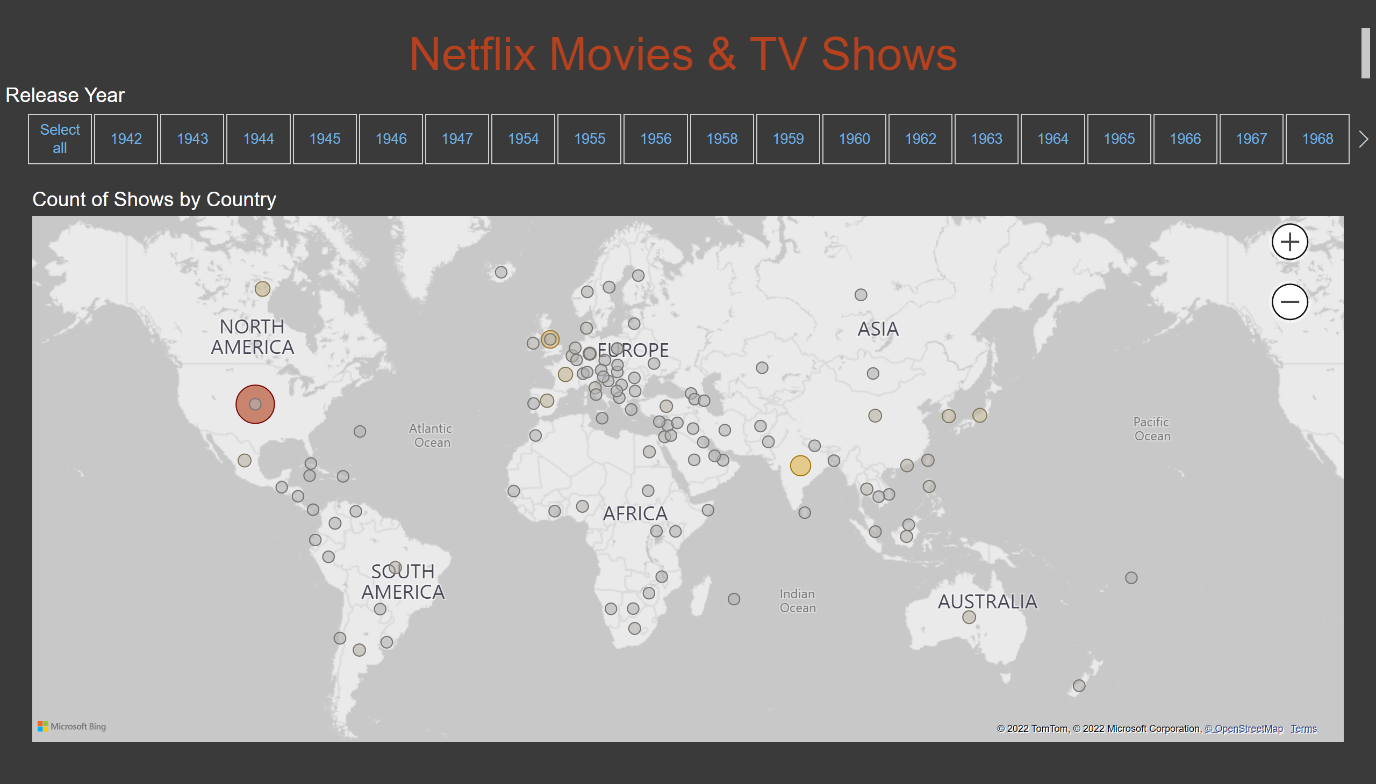
count_by_country
Notes:
Count of Shows by Country
No alt text provided
Release Year
No alt text provided
textbox
No alt text provided

Slide 3
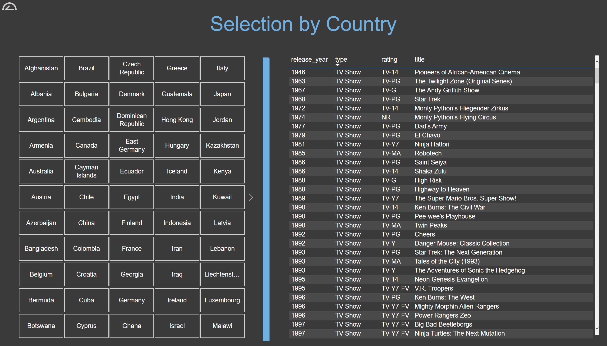
select_by_country
Notes:
tableEx
No alt text provided
actionButton
No alt text provided
shape
No alt text provided
slicer
No alt text provided
textbox
No alt text provided

Slide 4
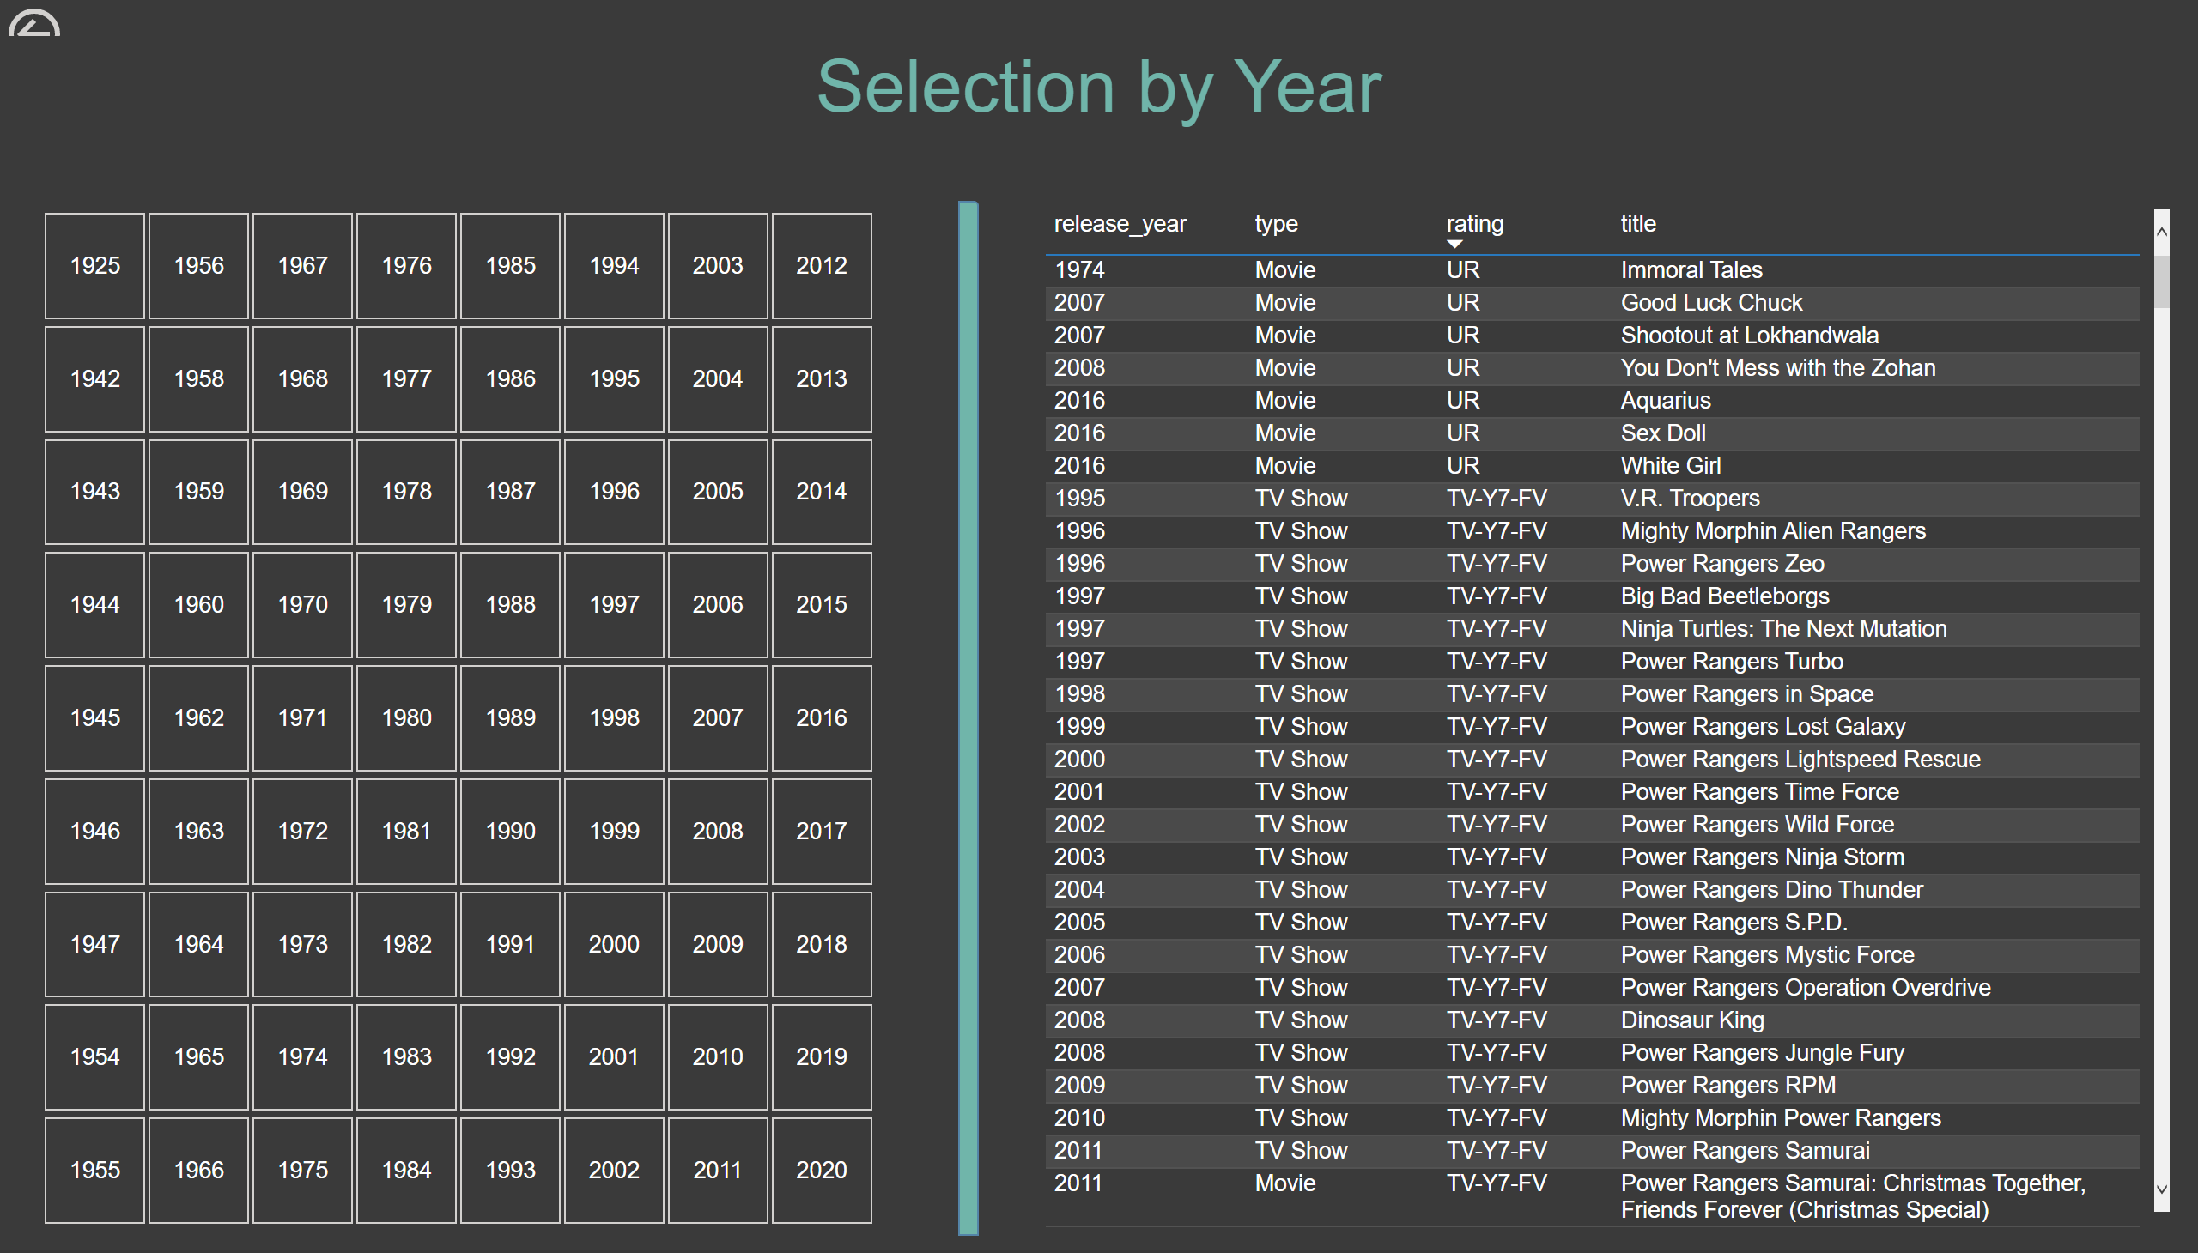
select_by_year_list
Notes:
tableEx
No alt text provided
actionButton
No alt text provided
slicer
No alt text provided
shape
No alt text provided
textbox
No alt text provided

Slide 5
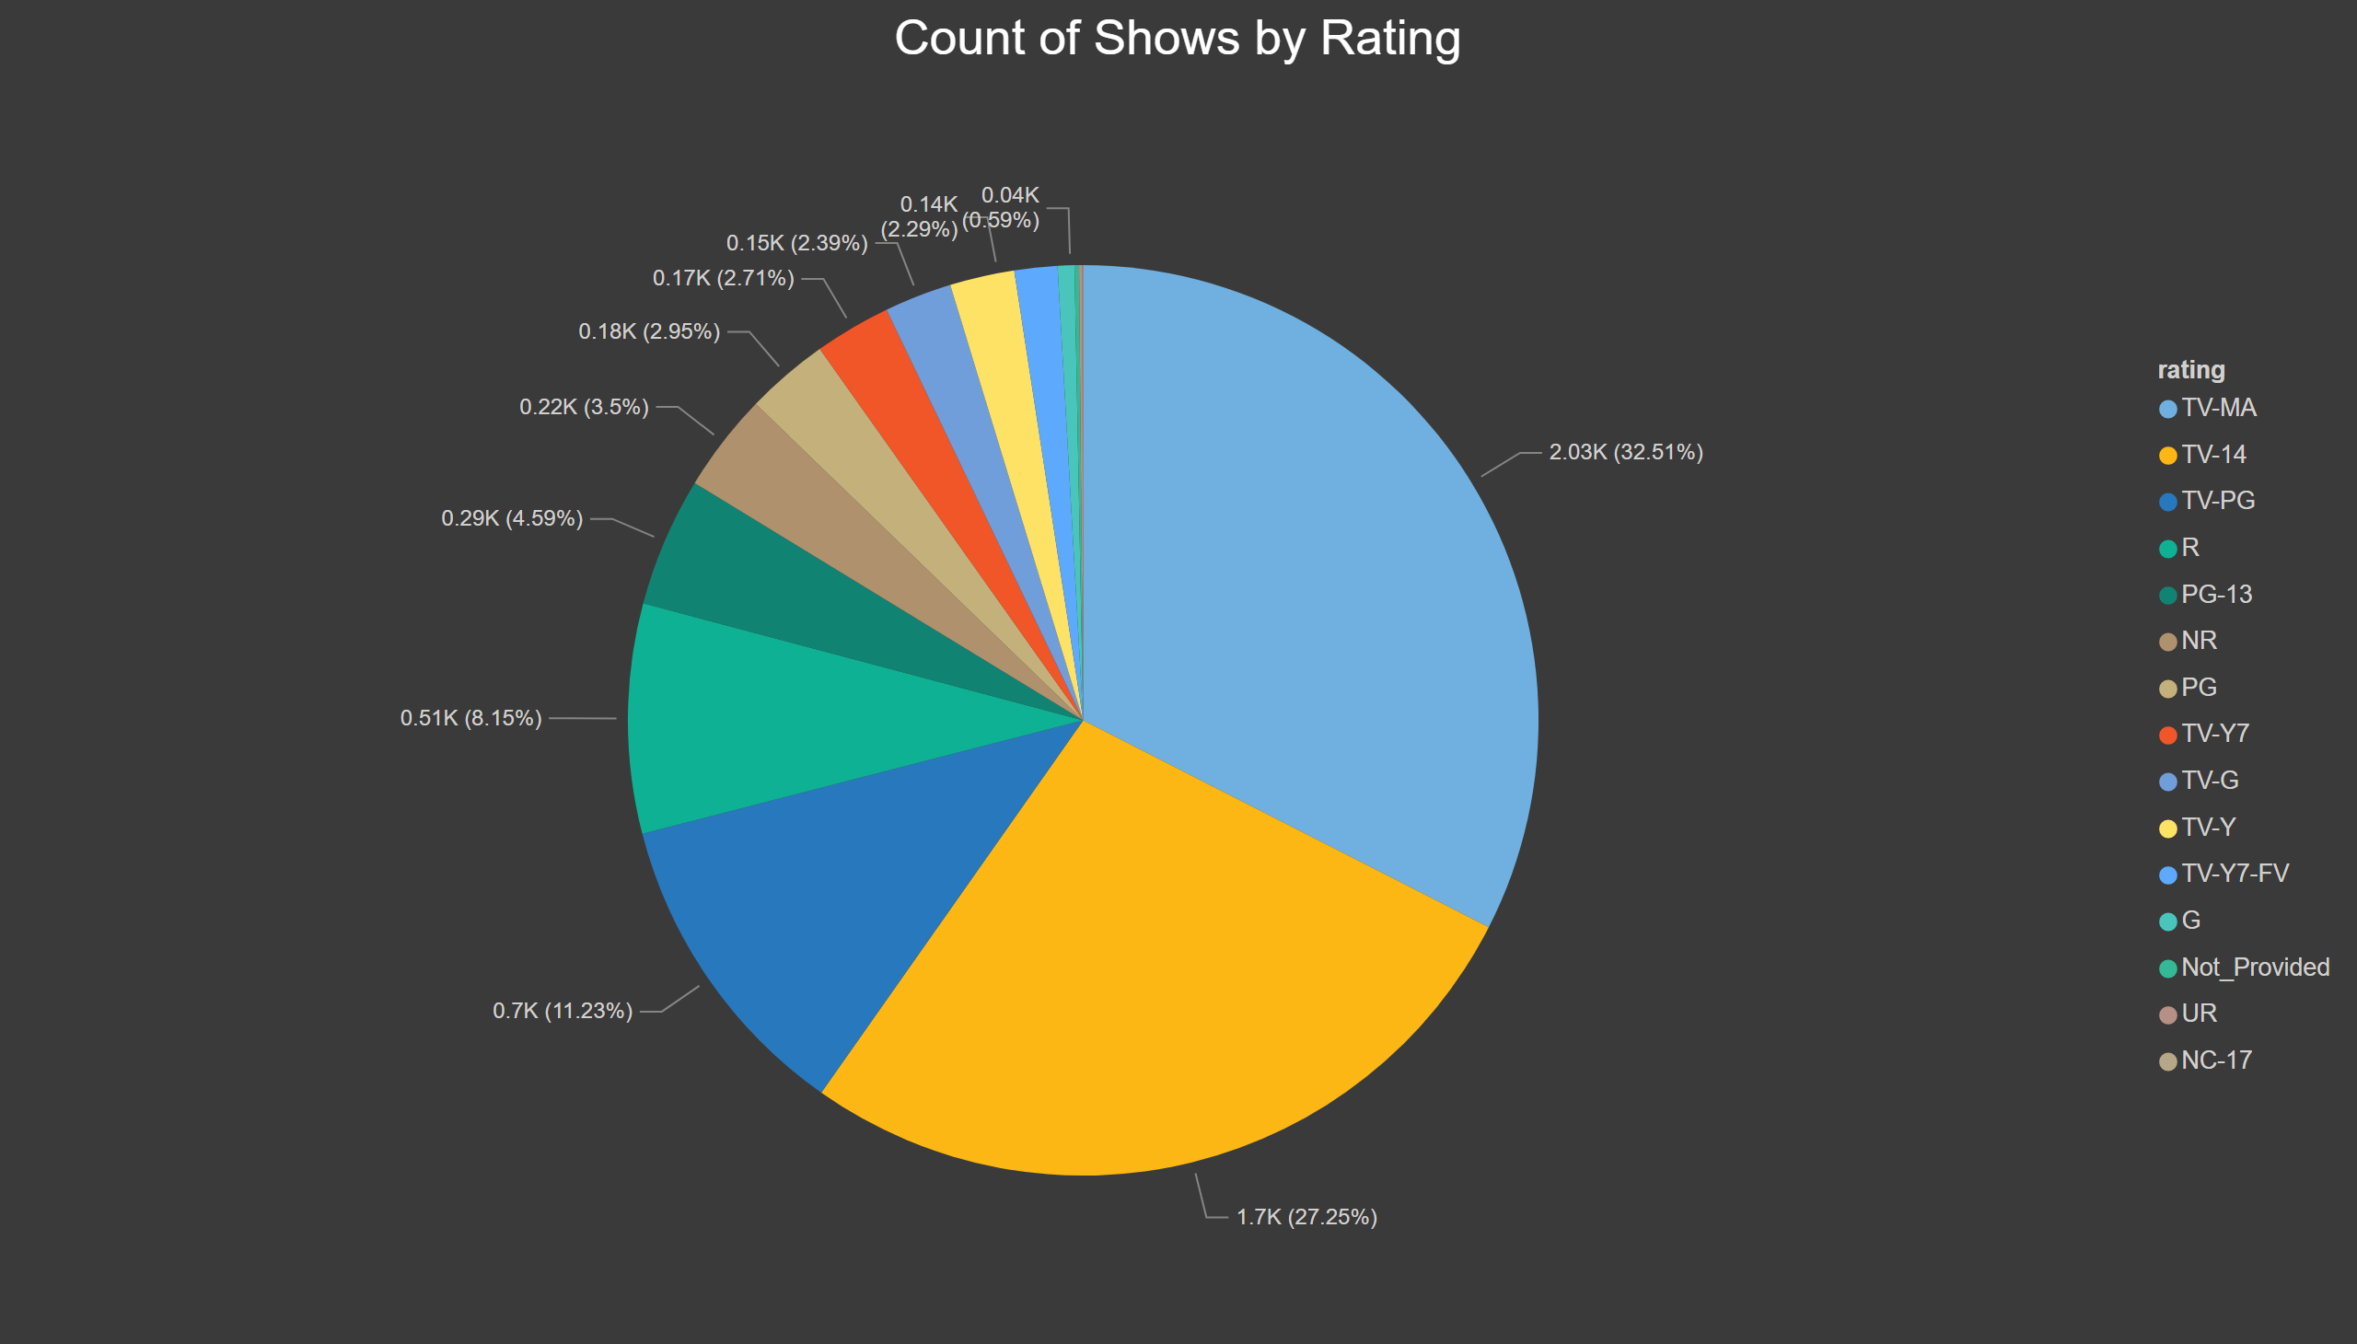
select_by_year_rating
Notes:
actionButton
No alt text provided
pieChart
No alt text provided
textbox
No alt text provided

Slide 6
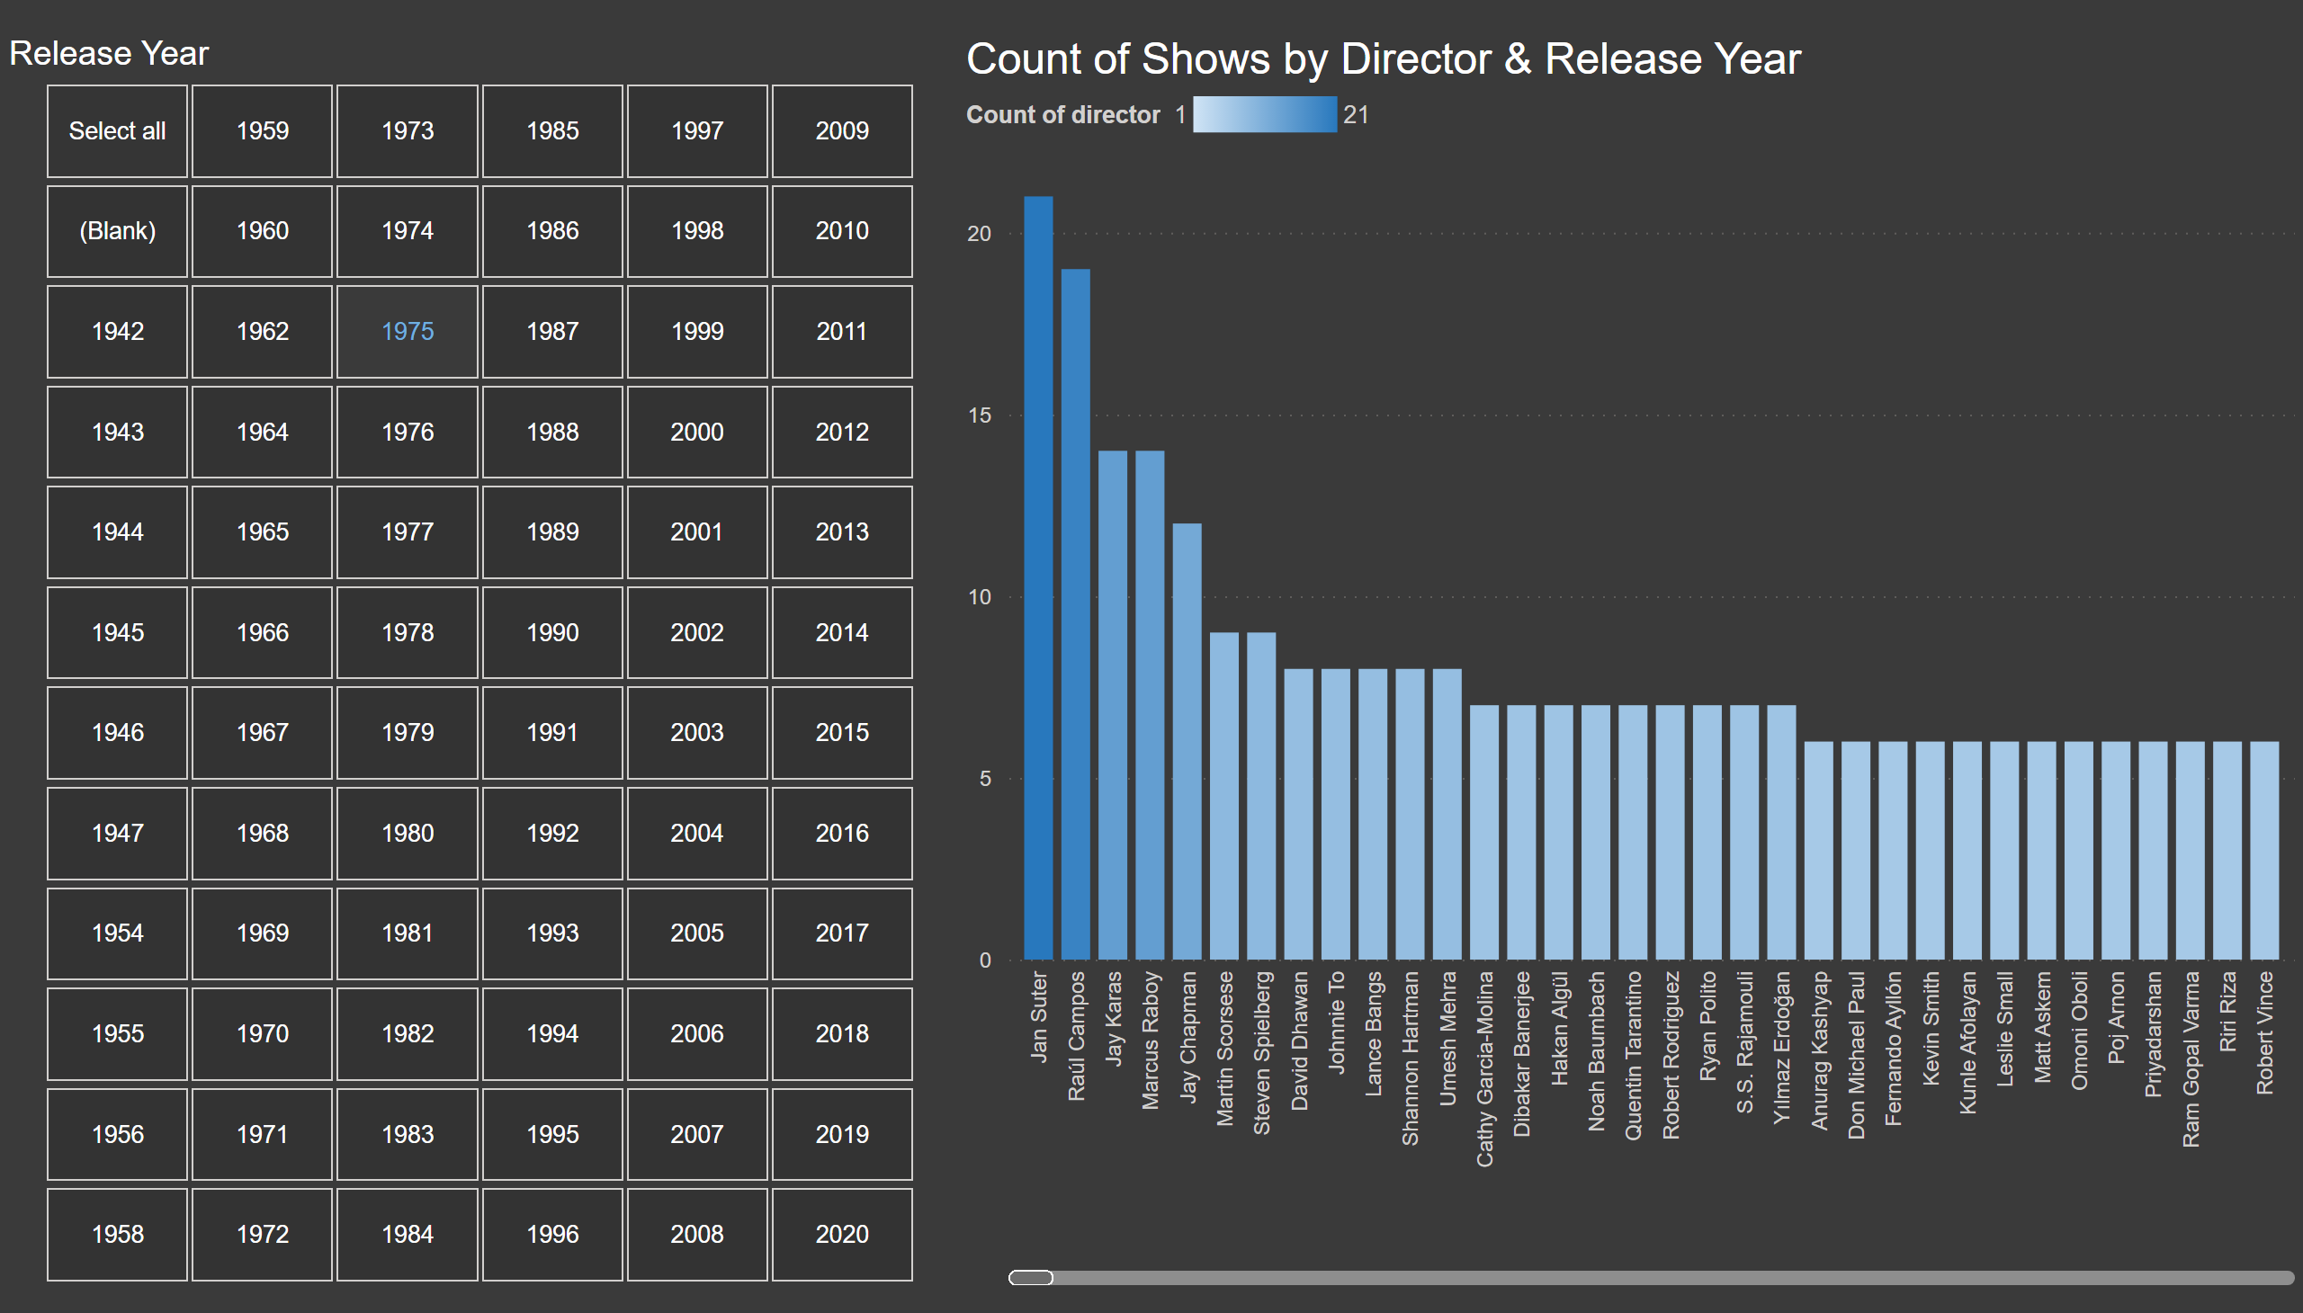
count_by_director
Notes:
Count of Shows by Director & Release Year
No alt text provided
Release Year
No alt text provided

Slide 7
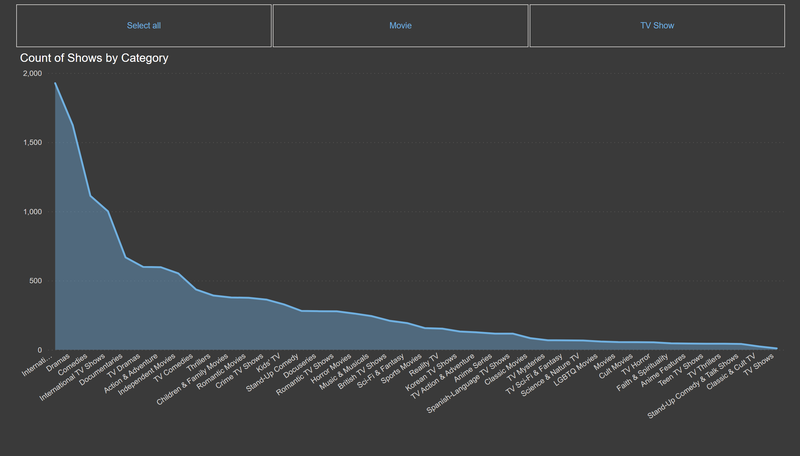
count_by_category
Notes:
Count of Shows by Category
No alt text provided
slicer
No alt text provided

Slide 8
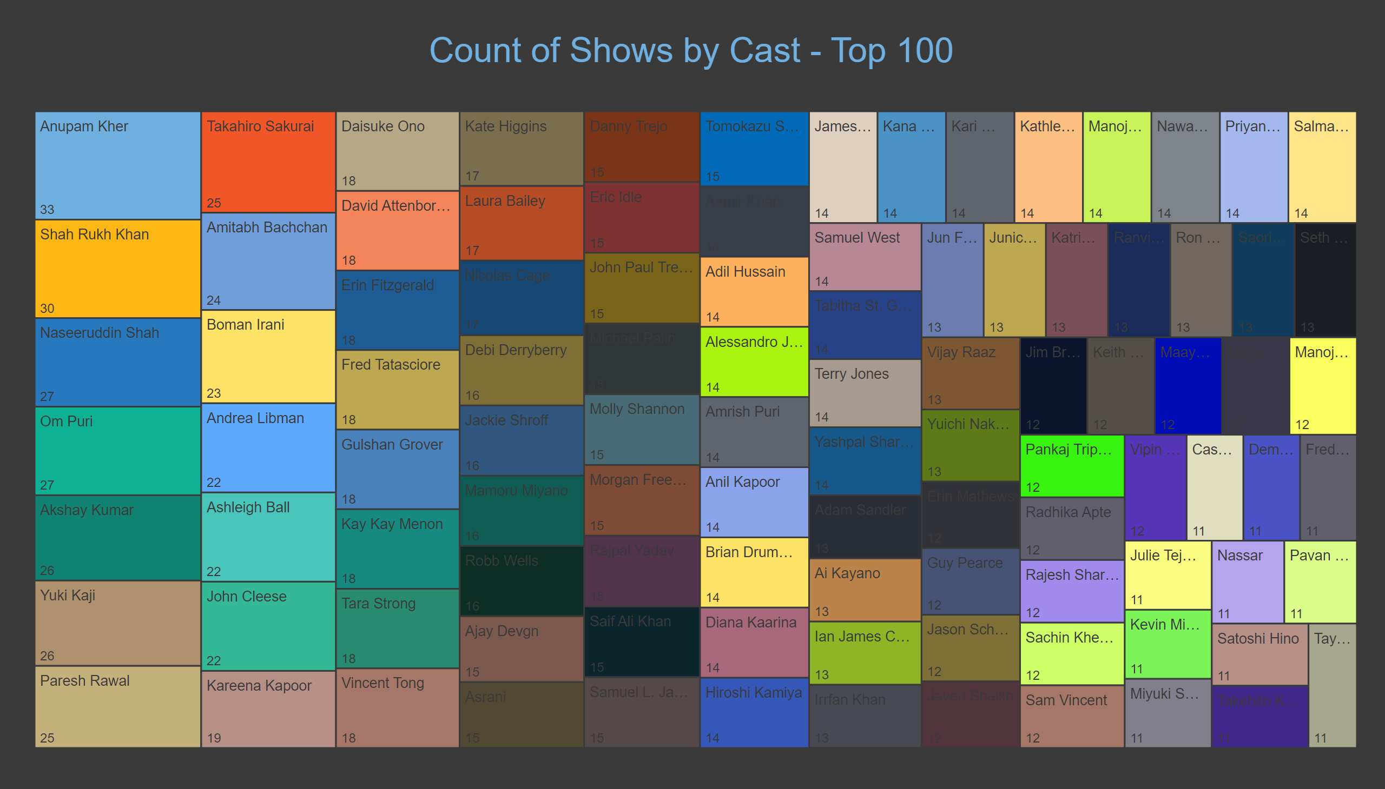
count_by_cast
Notes:
treemap
No alt text provided
textbox
No alt text provided

