Slide 1



world_population_project
View in Power BI
Last data refresh:
8/19/2022 11:59:39 AM UTC
Downloaded at:
8/19/2022 12:21:03 PM UTC

Slide 2
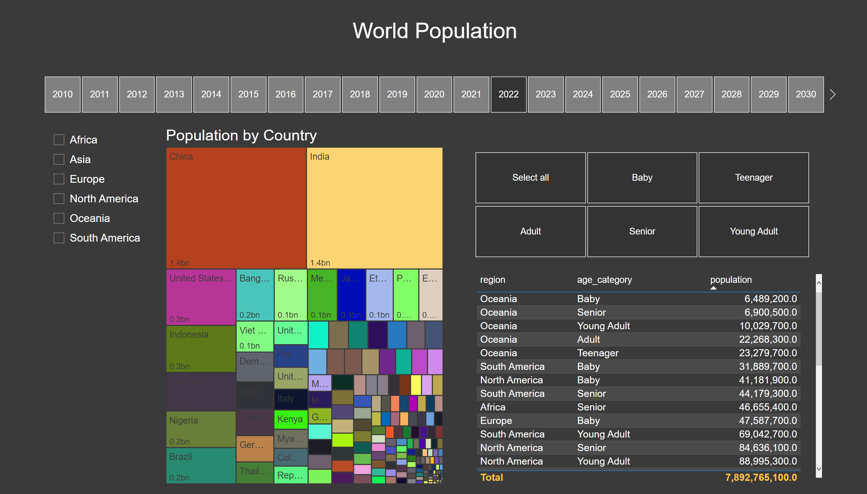
Treemaps & Tables
Notes:
slicer
No alt text provided
slicer
No alt text provided
Population by Country
No alt text provided
slicer
No alt text provided
tableEx
No alt text provided
textbox
No alt text provided

Slide 3
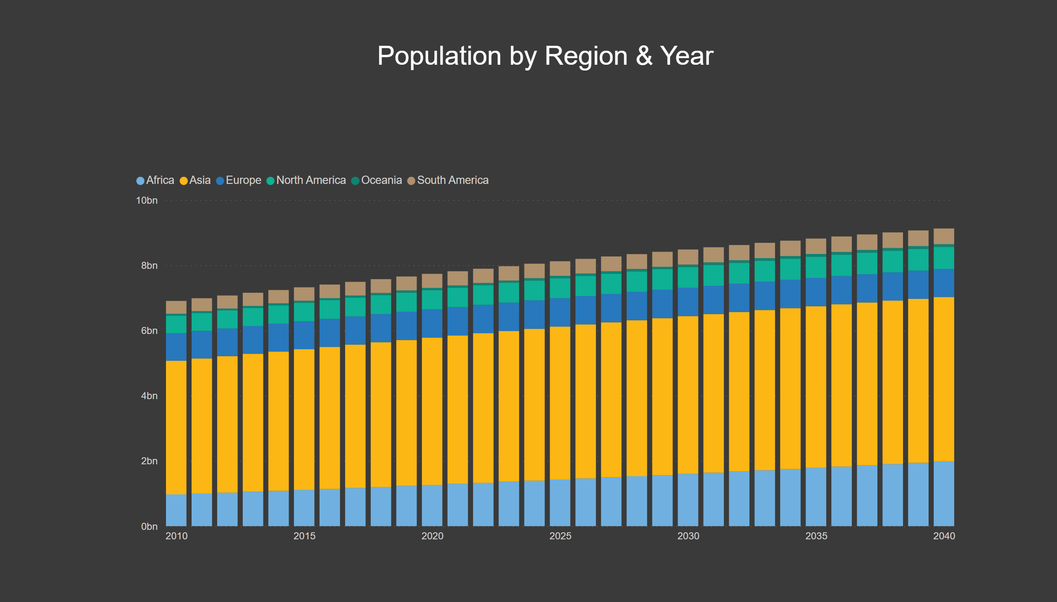
Population by Region & Year
Notes:
columnChart
No alt text provided
textbox
No alt text provided

Slide 4
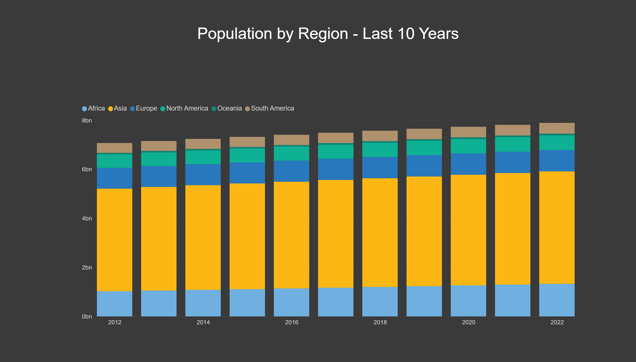
Pop by Region - Last 10 Yrs
Notes:
columnChart
No alt text provided
textbox
No alt text provided

Slide 5
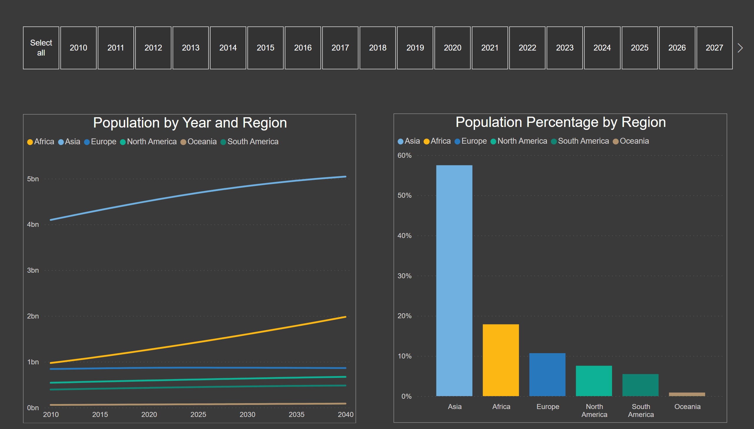
Line and Column Charts
Notes:
Population by Year and Region
No alt text provided
slicer
No alt text provided
Population Percentage by Region
No alt text provided

Slide 6
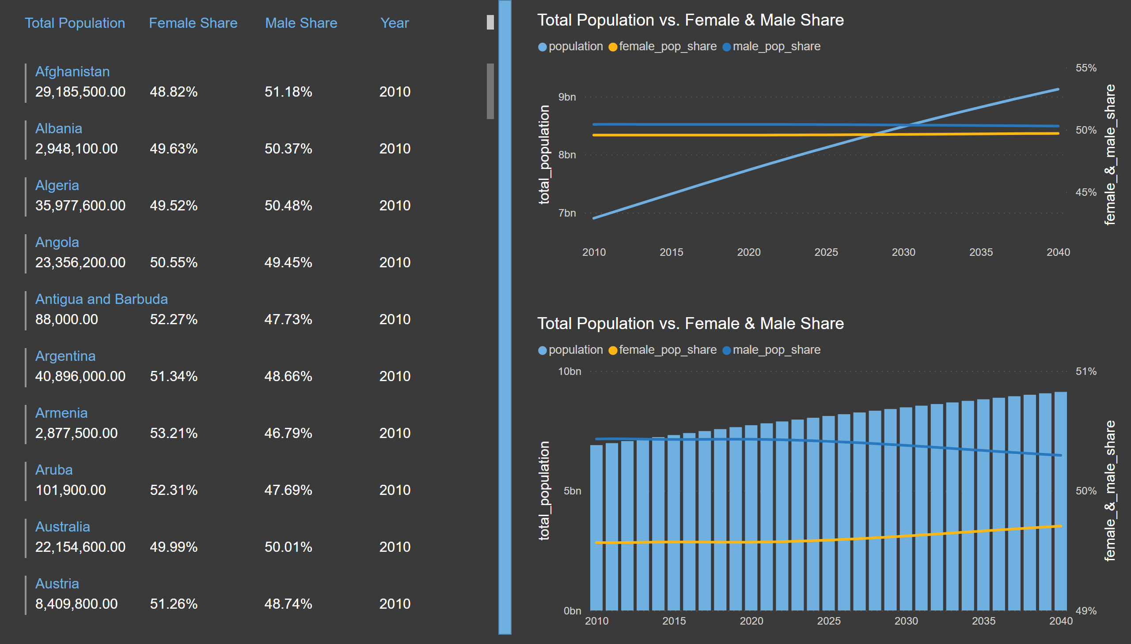
Cards and More
Notes:
multiRowCard
No alt text provided
shape
No alt text provided
Total Population vs. Female & Male Share
No alt text provided
Total Population vs. Female & Male Share
No alt text provided
textbox
No alt text provided

Slide 7
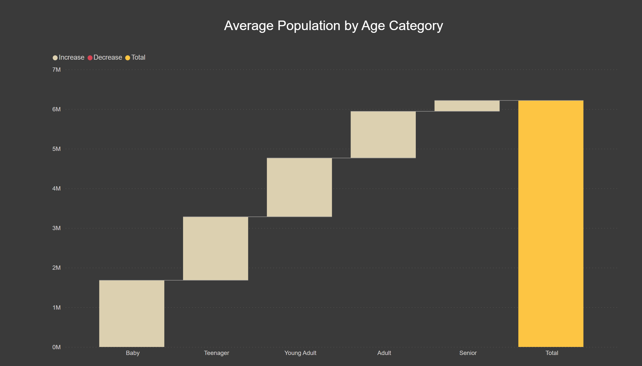
Waterfall
Notes:
Population by Age Category
No alt text provided
textbox
No alt text provided

Slide 8
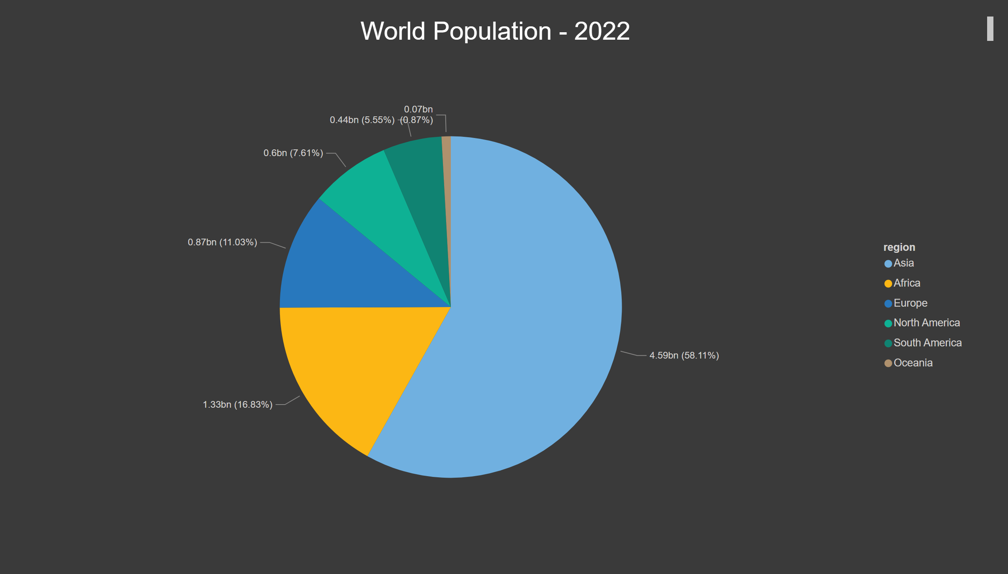
Pie Chart
Notes:
pieChart
No alt text provided
textbox
No alt text provided

Slide 9
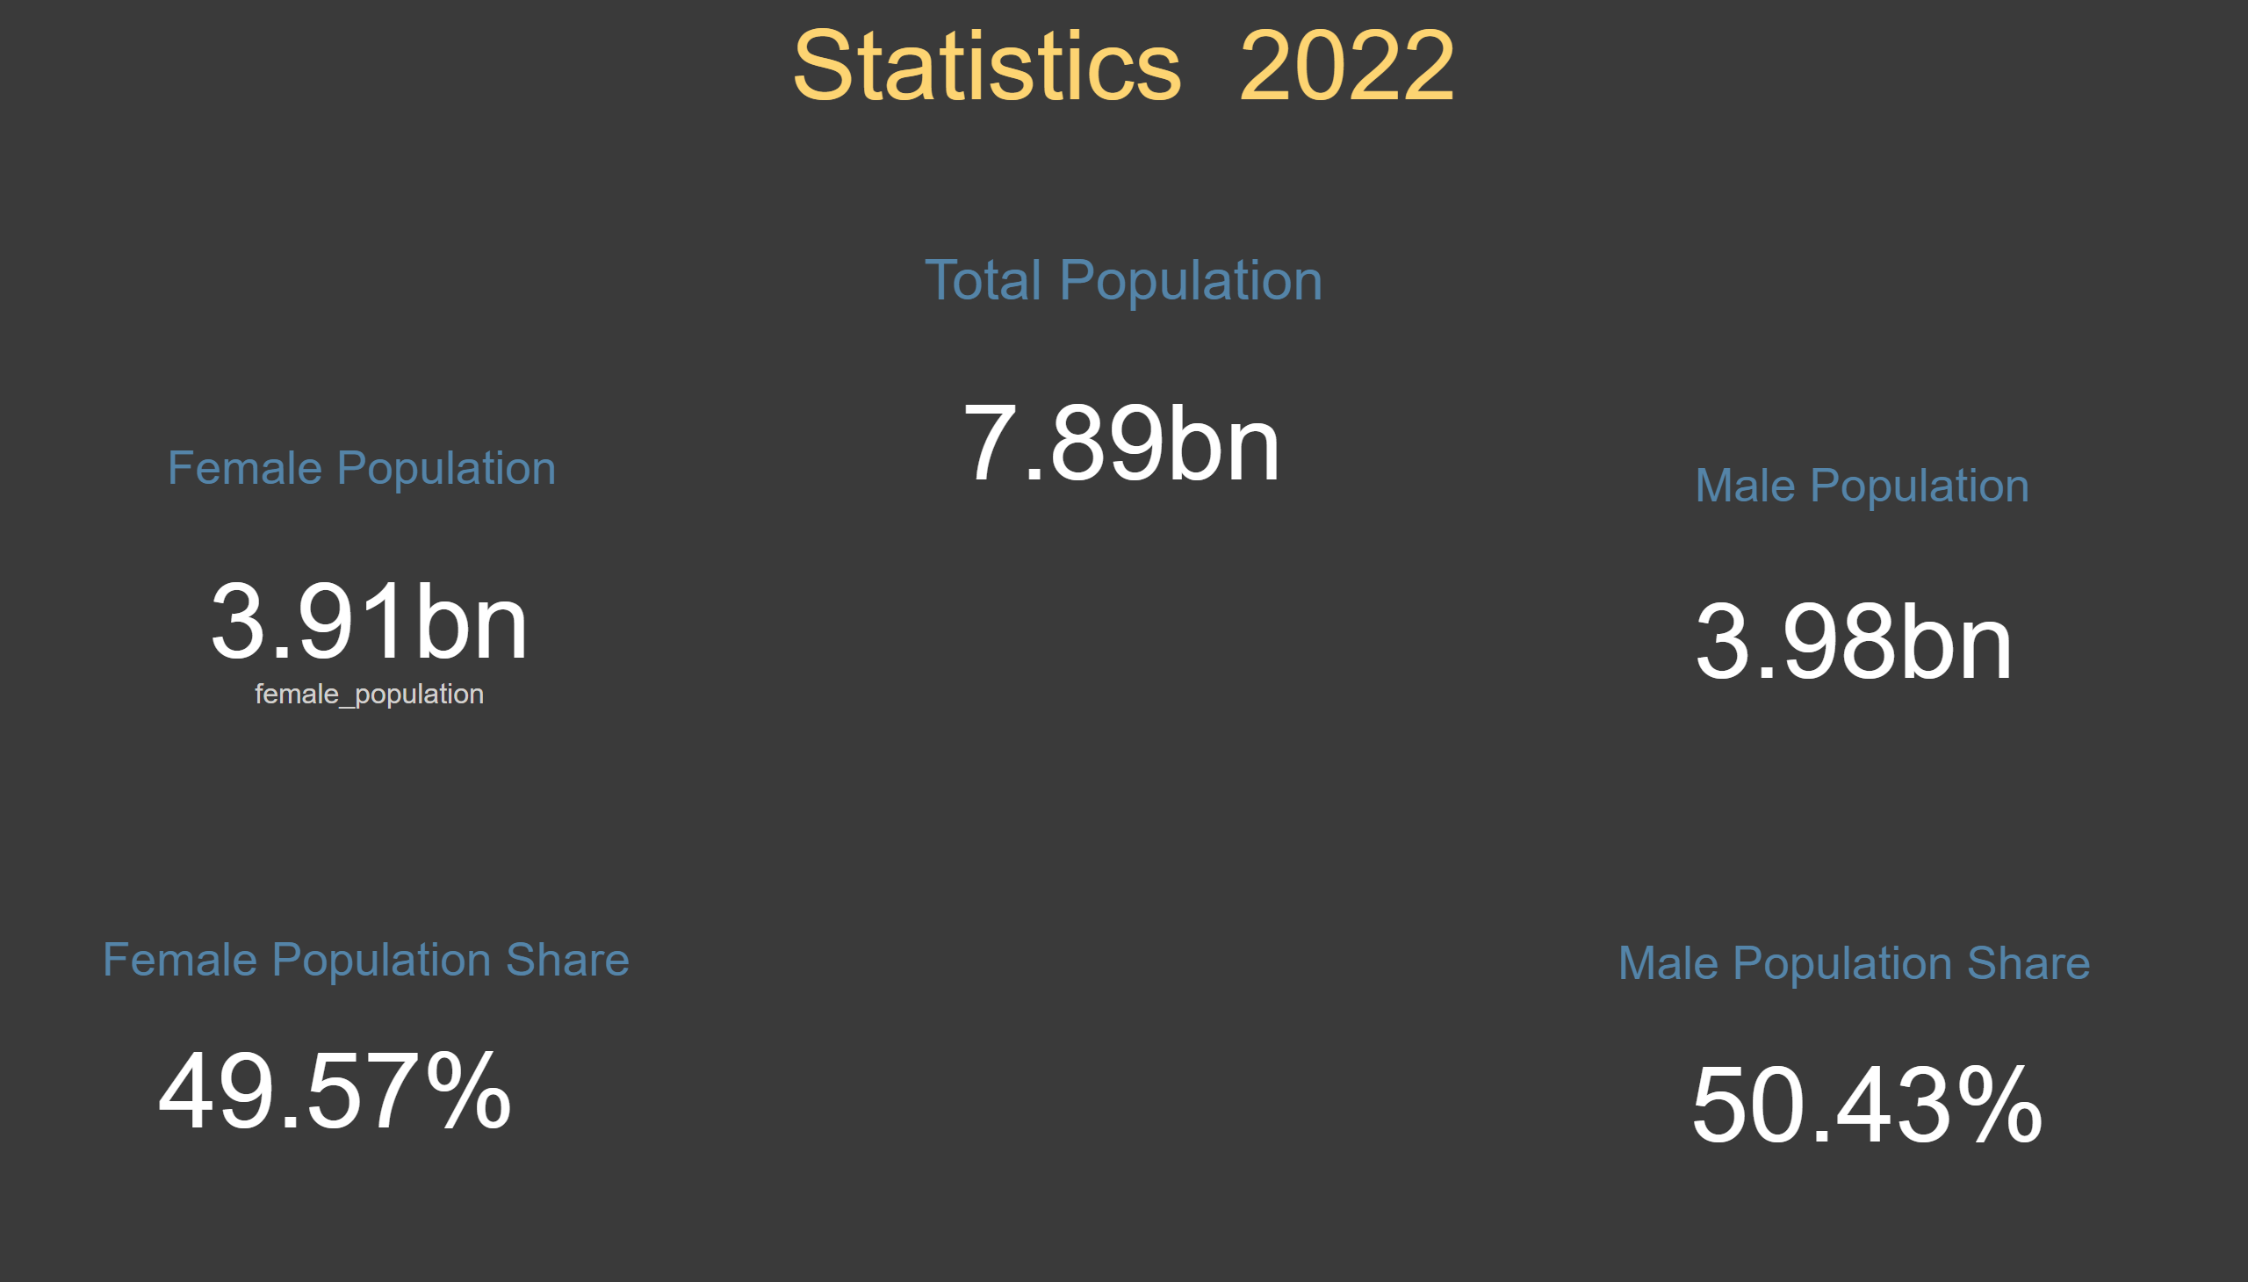
Statistics
Notes:
card
No alt text provided
card
No alt text provided
card
No alt text provided
card
No alt text provided
card
No alt text provided
textbox
No alt text provided
textbox
No alt text provided
textbox
No alt text provided
textbox
No alt text provided
textbox
No alt text provided
textbox
No alt text provided

