Slide 1

Chapter 10:
Characters, C-Strings, and
More About the string Class

Slide 2
10.1
Character Testing

Slide 3
Character Testing
Requires cctype header file
FUNCTION | MEANING
isalpha | true if arg. is a letter, false otherwise
isalnum | true if arg. is a letter or digit, false otherwise
isdigit | true if arg. is a digit 0-9, false otherwise
islower | true if arg. is lowercase letter, false otherwise
isprint | true if arg. is a printable character, false otherwise
ispunct | true if arg. is a punctuation character, false otherwise
isupper | true if arg. is an uppercase letter, false otherwise
isspace | true if arg. is a whitespace character, false otherwise

Slide 4
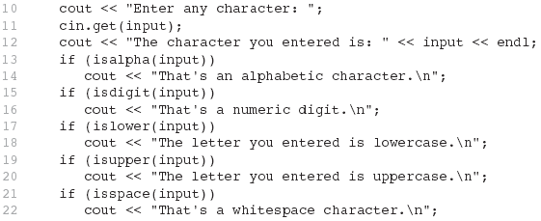
From Program 10-1

Slide 5
10.2
Character Case Conversion

Slide 6

Character Case Conversion
Require cctype header file
Functions:
  toupper: if char argument is lowercase letter, return uppercase equivalent; otherwise, return input unchanged
  char ch1 = 'H';
  char ch2 = 'e';
  char ch3 = '!';
  cout << toupper(ch1); // displays 'H'
  cout << toupper(ch2); // displays 'E'
  cout << toupper(ch3); // displays '!'

Slide 7
Character Case Conversion
Functions:
  tolower: if char argument is uppercase letter, return lowercase equivalent; otherwise, return input unchanged
  char ch1 = 'H';
  char ch2 = 'e';
  char ch3 = '!';
  cout << tolower(ch1); // displays 'h'
  cout << tolower(ch2); // displays 'e'
  cout << tolower(ch3); // displays '!'

Slide 8
10.3
C-Strings

Slide 9
C-Strings
C-string: sequence of characters stored in adjacent memory locations and terminated by NULL character
String literal (string constant): sequence of characters enclosed in double quotes " " : "Hi there!"
H
i
t
h
e
r
e
!
\0

Slide 10
C-Strings
Array of chars can be used to define storage for string:
const int SIZE = 20;
char city[SIZE];
Leave room for NULL at end
Can enter a value using cin or >>
  Input is whitespace-terminated
  No check to see if enough space
For input containing whitespace, and to control amount of input, use cin.getline()

Slide 11
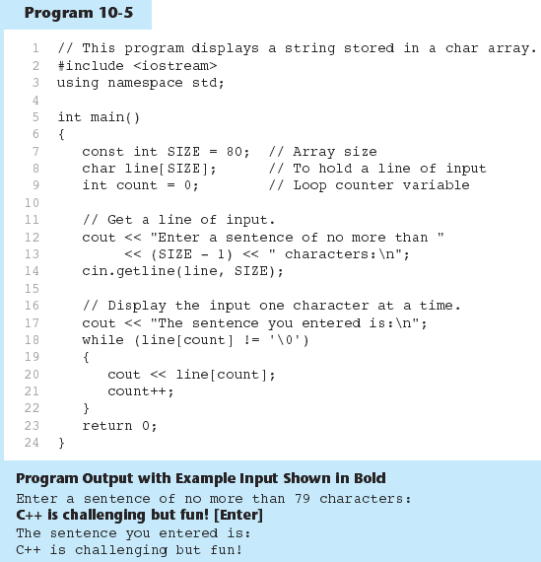
Using C-Strings in Program 10-5

Slide 12
10.4
Library Functions for Working with C-Strings

Slide 13
Library Functions for Working with C-Strings
Require the cstring header file
Functions take one or more C-strings as arguments. Can use:
  C-string name
  pointer to C-string
  literal string

Slide 14
Library Functions for
Working with C-Strings
Functions:
  strlen(str): returns length of C-string str
    char city[SIZE] = "Missoula";
    cout << strlen(city); // prints 8
  strcat(str1, str2): appends str2 to the end of str1
    char location[SIZE] = "Missoula, ";
    char state[3] = "MT";
    strcat(location, state);
    // location now has "Missoula, MT"

Slide 15
Library Functions for
Working with C-Strings
Functions:
  strcpy(str1, str2): copies str2 to str1
  const int SIZE = 20;
  char fname[SIZE] = "Maureen", name[SIZE];
  strcpy(name, fname);
  Note: strcat and strcpy perform no bounds checking to determine if there is enough space in receiving character array to hold the string it is being assigned.

Slide 16
C-string Inside a C-string
Function:
  strstr(str1, str2): finds the first occurrence of str2 in str1. Returns a pointer to match, or NULL if no match.
    char river[] = "Wabash";
    char word[] = "aba";
    cout << strstr(state, word);
    // displays "abash"

Slide 17
10.5
C-String/Numeric Conversion Functions

Slide 18
C-String/Numeric Conversion Functions
Requires <cstdlib> header file
FUNCTION | PARAMETER | ACTION
atoi | C-string | converts C-string to an int value, returns the value
atol | C-string | converts C-string to a long value, returns the value
atof | C-string | converts C-string to a double value, returns the value
itoa | int,C-string, int | converts 1st int parameter to a C-string, stores it in 2nd parameter. 3rd parameter is base of converted value

Slide 19
C-String/Numeric Conversion Functions
int iNum;
long lNum;
double dNum;
char intChar[10];
iNum = atoi("1234"); // puts 1234 in iNum
lNum = atol("5678"); // puts 5678 in lNum
dNum = atof("35.7"); // puts 35.7 in dNum
itoa(iNum, intChar, 8); // puts the string
// "2322" (base 8 for 1234₁₀) in intChar

Slide 20
C-String/Numeric Conversion Functions - Notes
if C-string contains non-digits, results are undefined
  function may return result up to non-digit
  function may return 0
itoa does no bounds checking – make sure there is enough space to store the result

Slide 21
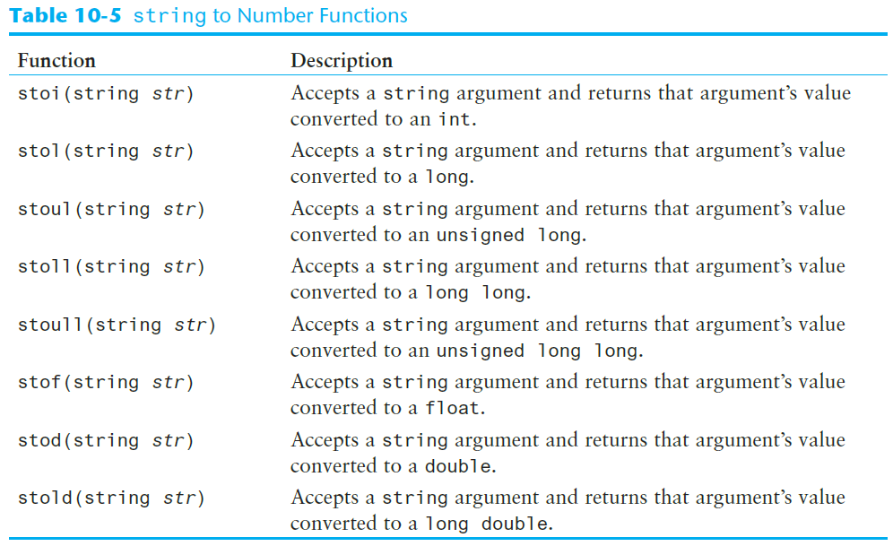
string to Number Conversion

Slide 22
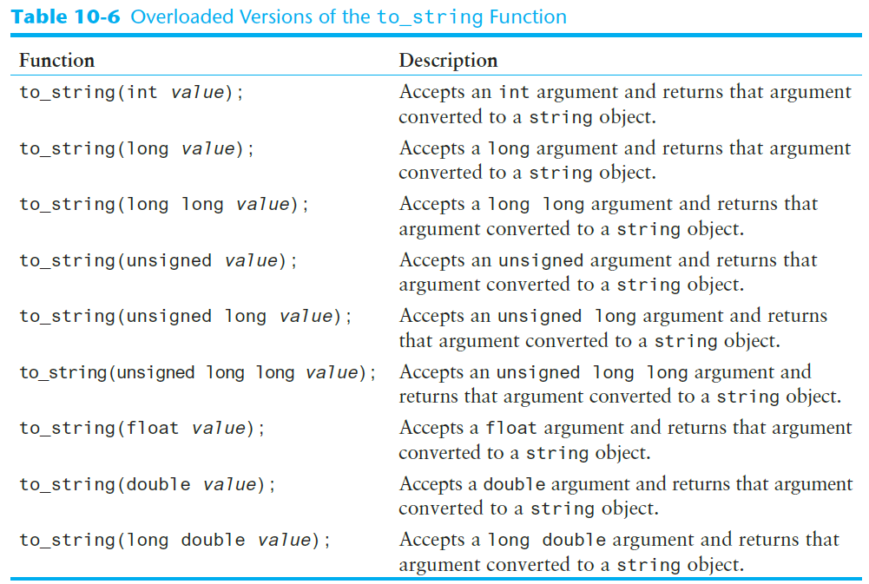
The to_string Function

Slide 23
10.6
Writing Your Own C-String Handling Functions

Slide 24
Writing Your Own C-String Handling Functions
Designing C-String Handling Functions
  can pass arrays or pointers to char arrays
  Can perform bounds checking to ensure enough space for results
  Can anticipate unexpected user input

Slide 25
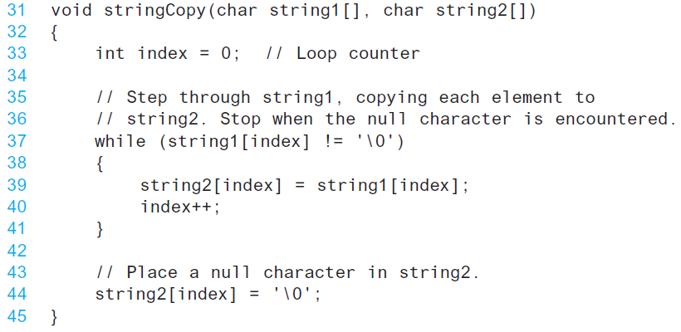
From Program 10-12

Slide 26
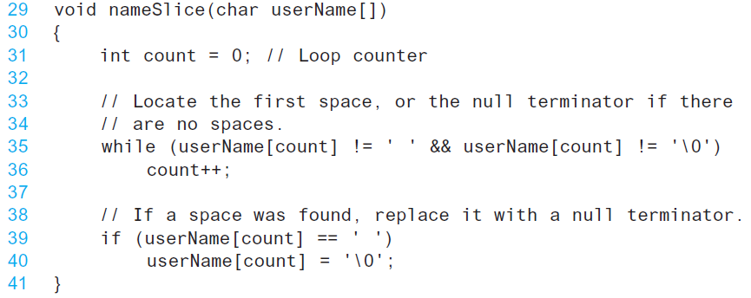
From Program 10-13

Slide 27
10.7
More About the C++ string Class

Slide 28
The C++ string Class
Special data type supports working with strings
#include <string>
Can define string variables in programs:
  string firstName, lastName;
Can receive values with assignment operator:
  firstName = "George";
  lastName = "Washington";
Can be displayed via cout
  cout << firstName << " " << lastName;

Slide 29
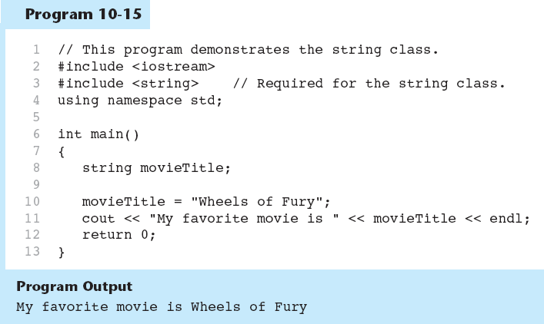
Using the string class in Program 10-15

Slide 30
Input into a string Object
Use cin >> to read an item into a string:
  string firstName;
  cout << "Enter your first name: ";
  cin >> firstName;

Slide 31
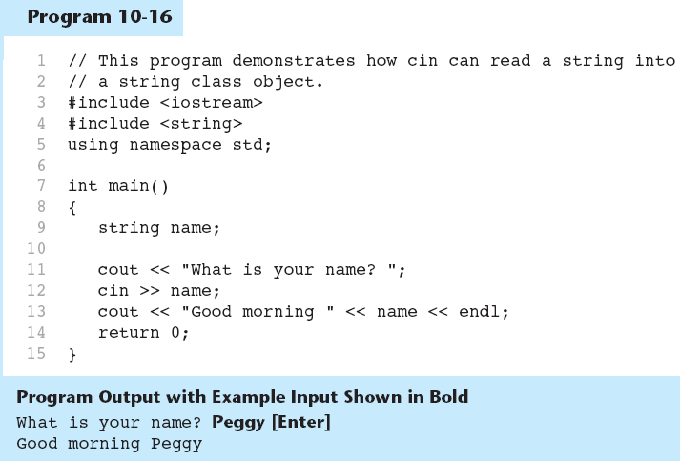
Using cin and string objects in program 10-16

Slide 32
Input into a string Object
Use getline function to put a line of input, possibly including spaces, into a string:
  string address;
  cout << "Enter your address: ";
  getline(cin,address);

Slide 33
string Comparison
Can use relational operators directly to compare string objects:
  string str1 = "George",
  str2 = "Georgia";
  if (str1 < str2)
  cout << str1 << " is less than "
  << str2;
Comparison is performed similar to strcmp function. Result is true or false

Slide 34
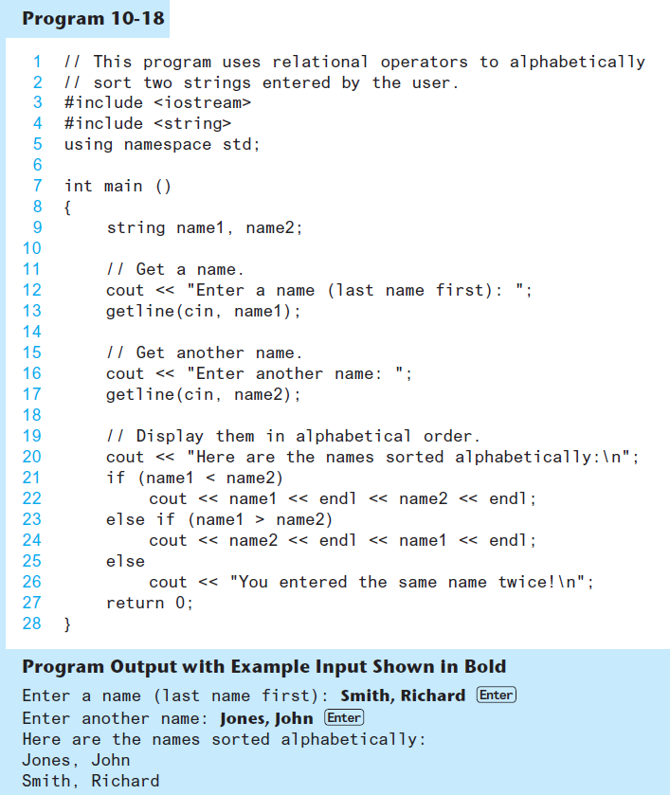

Slide 35
Other Definitions of C++ strings
Definition | Meaning
string name; | defines an empty string object
string myname("Chris"); | defines a string and initializes it
string yourname(myname); | defines a string and initializes it
string aname(myname, 3); | defines a string and initializes it with first 3 characters of myname
string verb(myname,3,2); | defines a string and initializes it with 2 characters from myname starting at position 3
string noname('A', 5); | defines string and initializes it to 5 'A's

Slide 36
string Operators
OPERATOR | MEANING
>> | extracts characters from stream up to whitespace, insert into string
<< | inserts string into stream
= | assigns string on right to string object on left
+= | appends string on right to end of contents on left
+ | concatenates two strings
[] | references character in string using array notation
>, >=, <, <=, ==, != | relational operators for string comparison. Return true or false

Slide 37
string Operators
string word1, phrase;
string word2 = " Dog";
cin >> word1; // user enters "Hot Tamale"
// word1 has "Hot"
phrase = word1 + word2; // phrase has
// "Hot Dog"
phrase += " on a bun";
for (int i = 0; i < 16; i++)
cout << phrase[i]; // displays
// "Hot Dog on a bun"

Slide 38
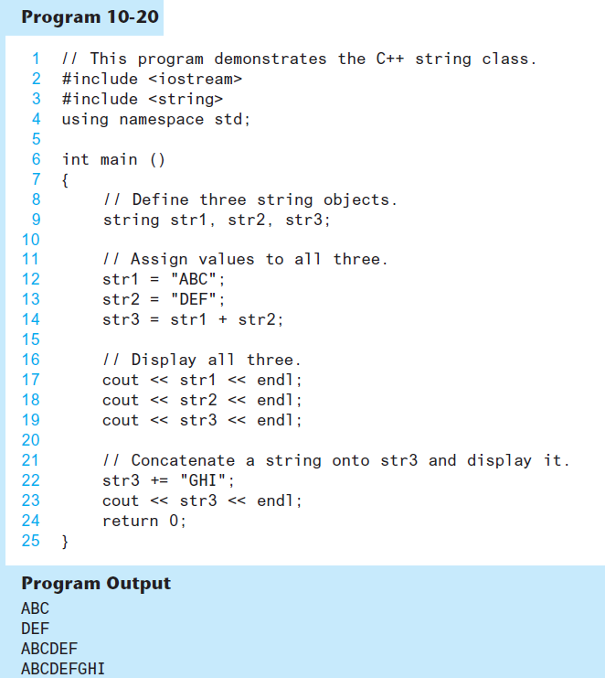

Slide 39
string Member Functions
Are behind many overloaded operators
Categories:
  assignment: assign, copy, data
  modification: append, clear, erase, insert, replace, swap
  space management: capacity, empty, length, resize, size
  substrings: find, front, back, at, substr
  comparison: compare
See Table 10-8 for a list of functions.

Slide 40
string Member Functions
string word1, word2, phrase;
cin >> word1; // word1 is "Hot"
word2.assign(" Dog");
phrase.append(word1);
phrase.append(word2); // phrase has "Hot Dog"
phrase.append(" with mustard relish", 13);
// phrase has "Hot Dog with mustard"
phrase.insert(8, "on a bun ");
cout << phrase << endl; // displays
// "Hot Dog on a bun with mustard"

Slide 41
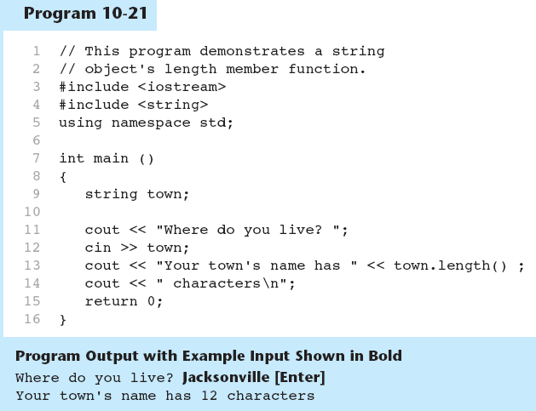
string Member Functions in Program 10-21

