Slide 1
Sensitivity Analysis
Murphy Dome Deciduous Forest (cmt 3)

Slide 2
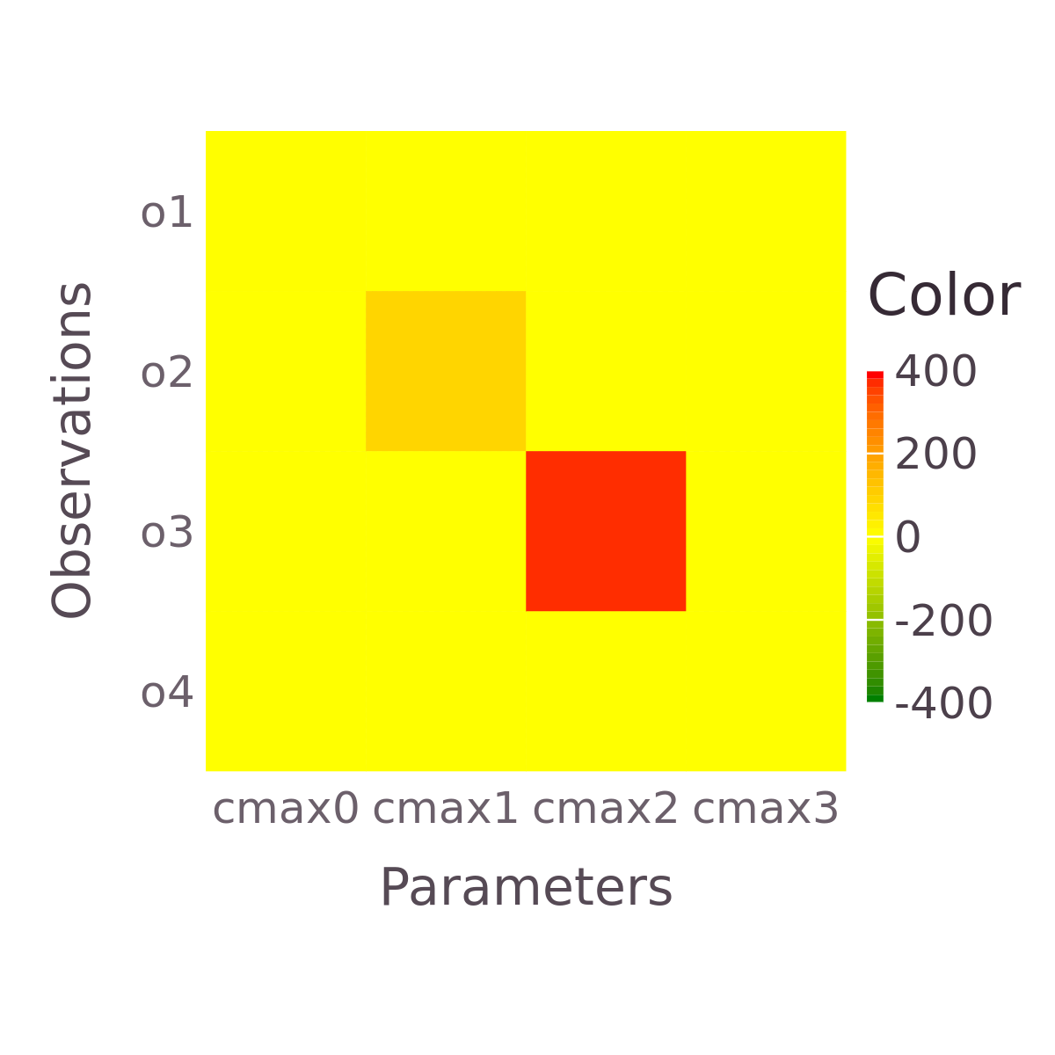
STEP 1
Notes:
3rd cmax most important Make cmax range smaller +/- 10 or 20 from optimal set

Slide 3
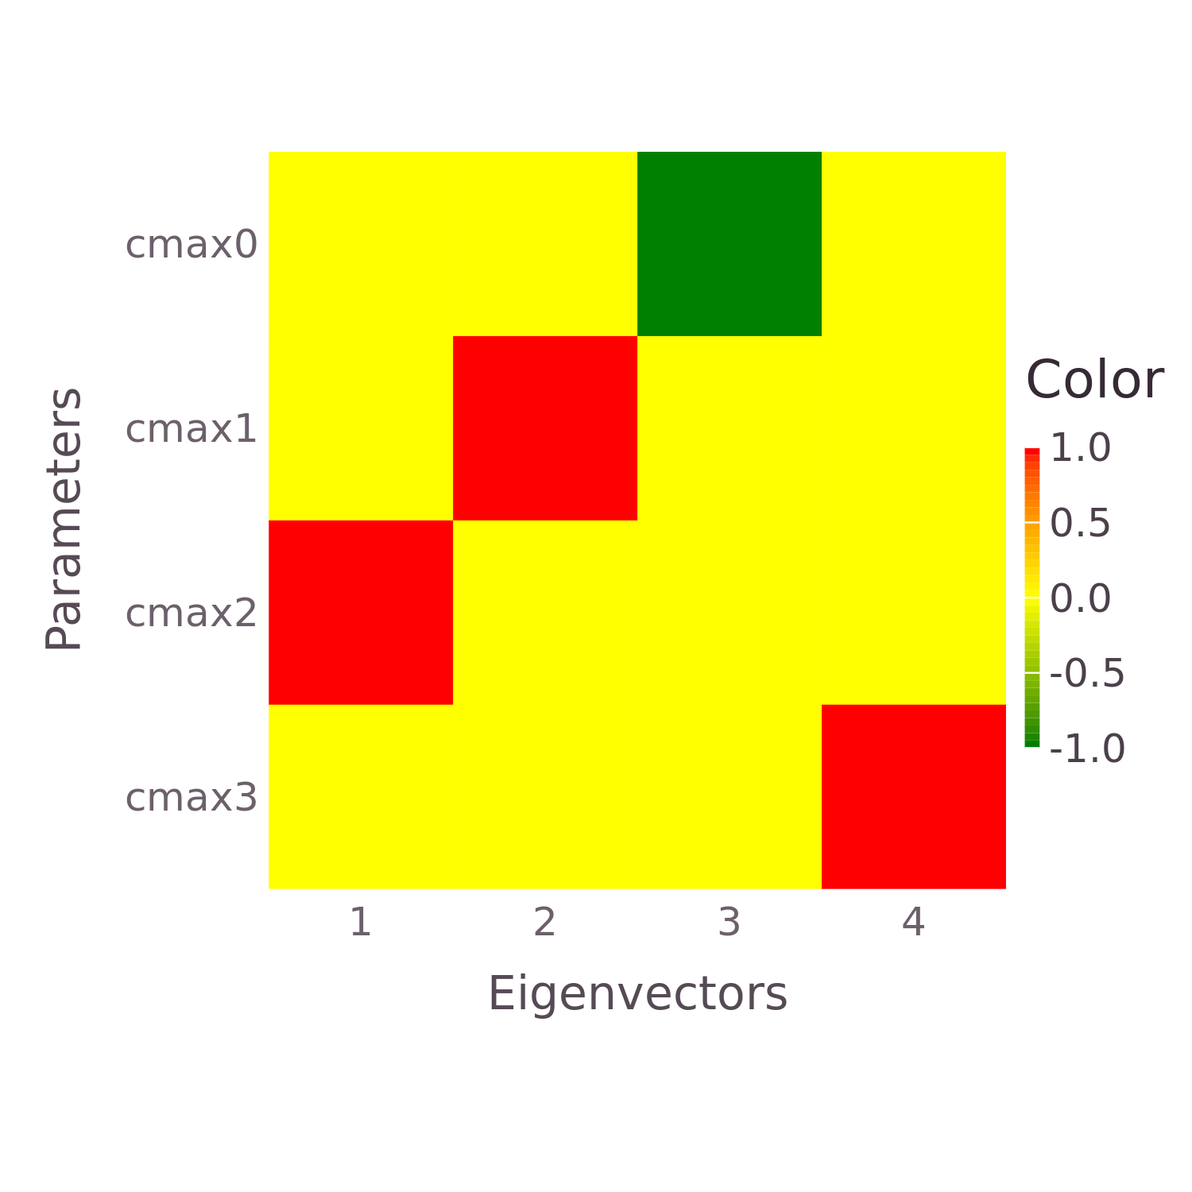
Notes:
Eigenvec 1 and 2 most important,

Slide 4
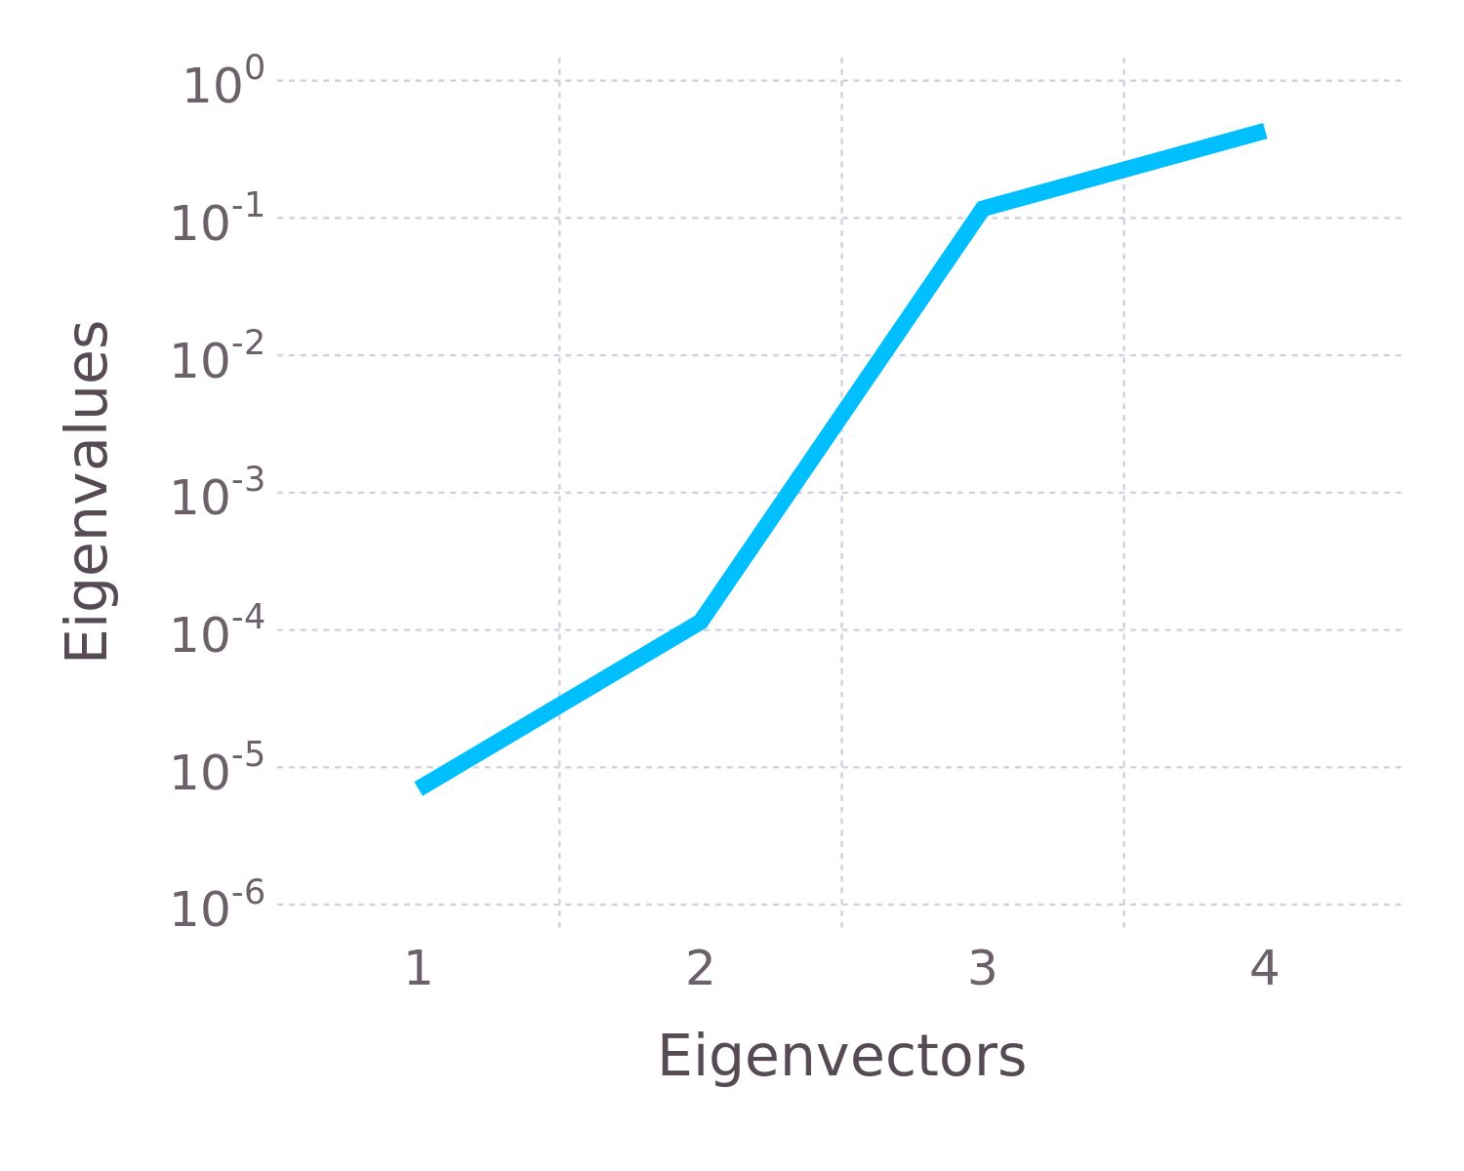
Notes:
If all eigenvec are important, we’d see a more linear relationship - high jump means that eigenvec is less imp

Slide 5
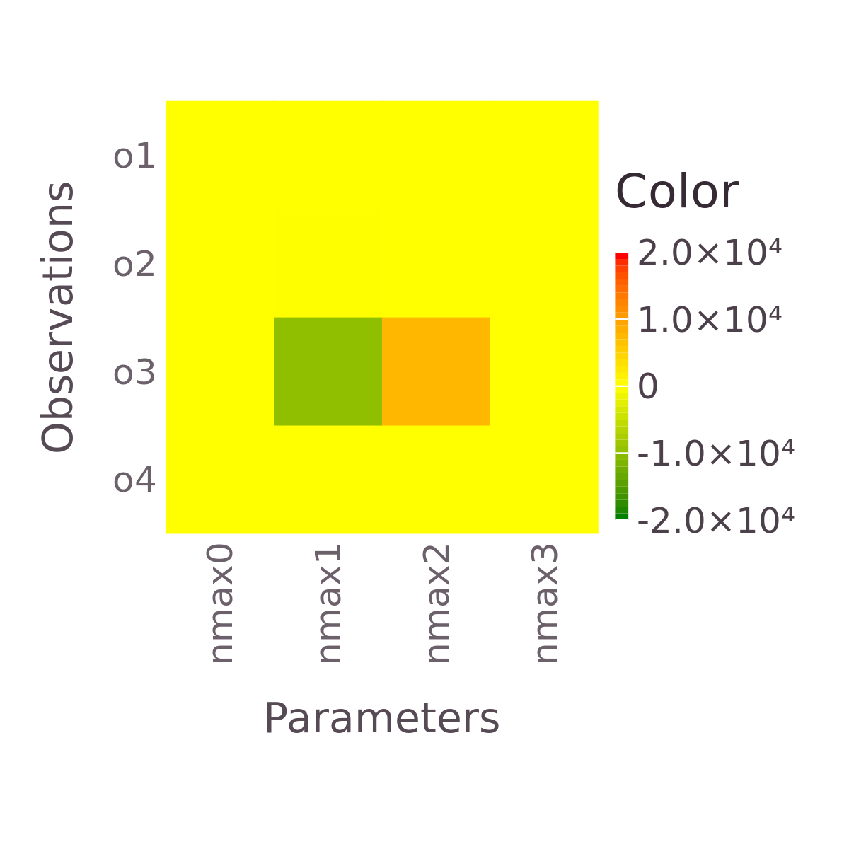
STEP 2
Notes:
Nmax 1 and 2 impacting o2 and o3, nmax 1 and 2 corr

Slide 6
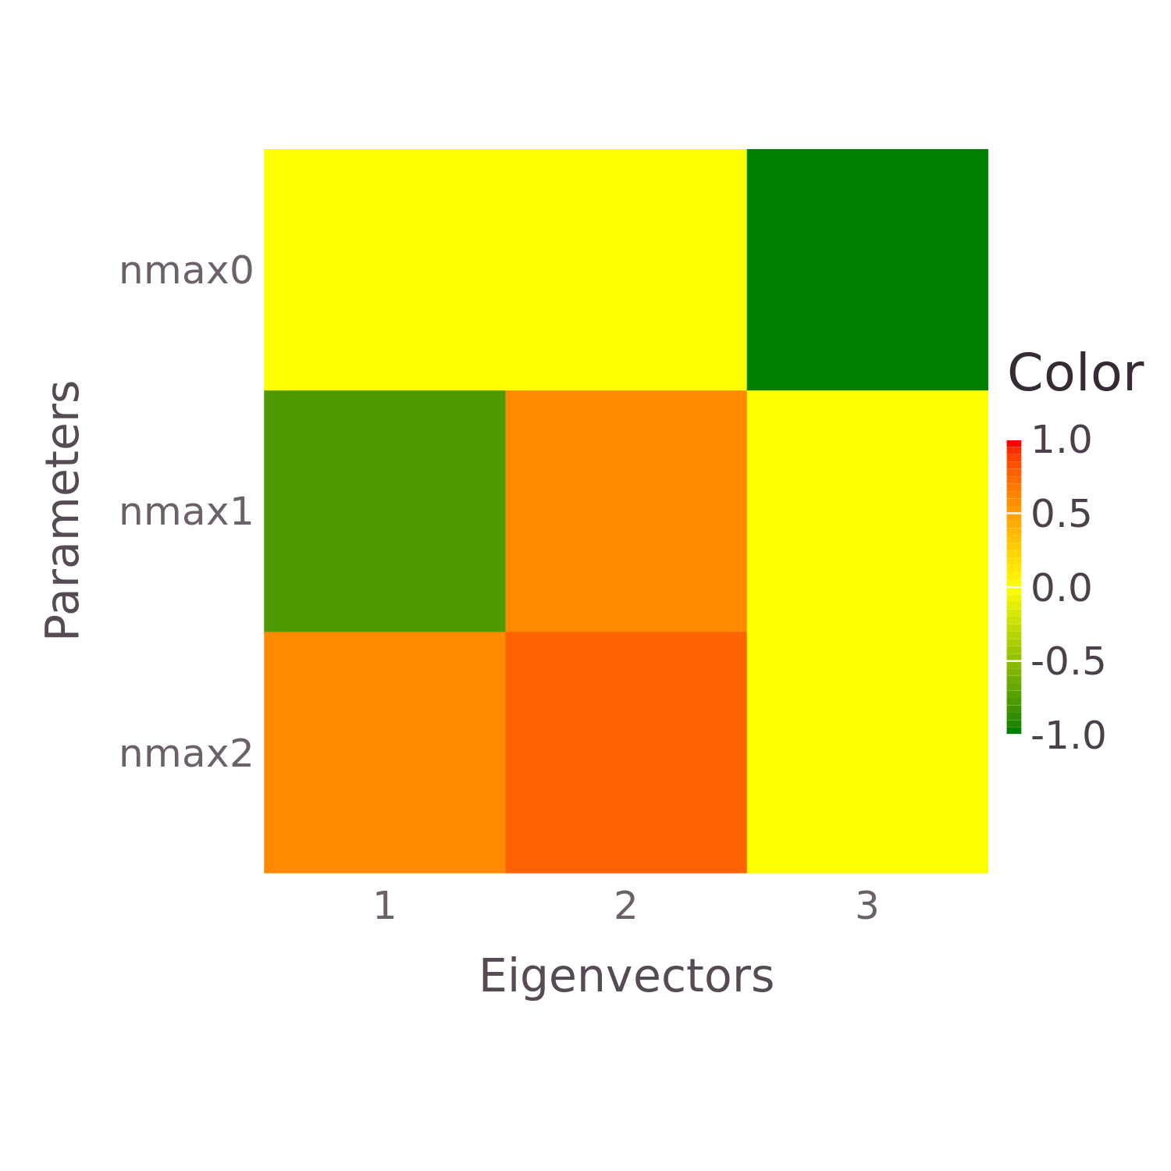

Slide 7
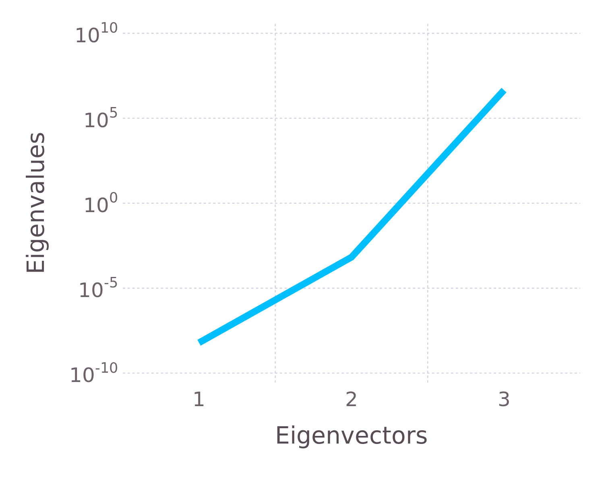

Slide 8
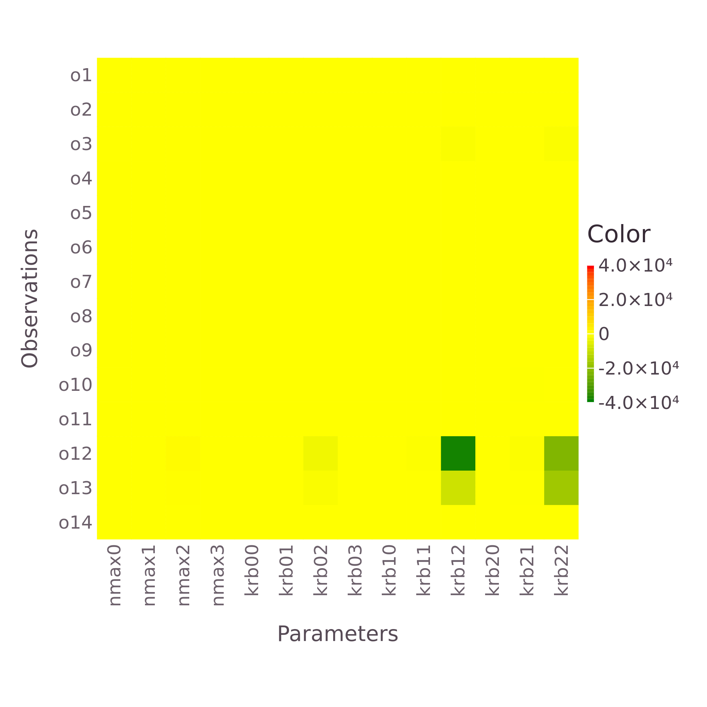
STEP 3

Slide 9
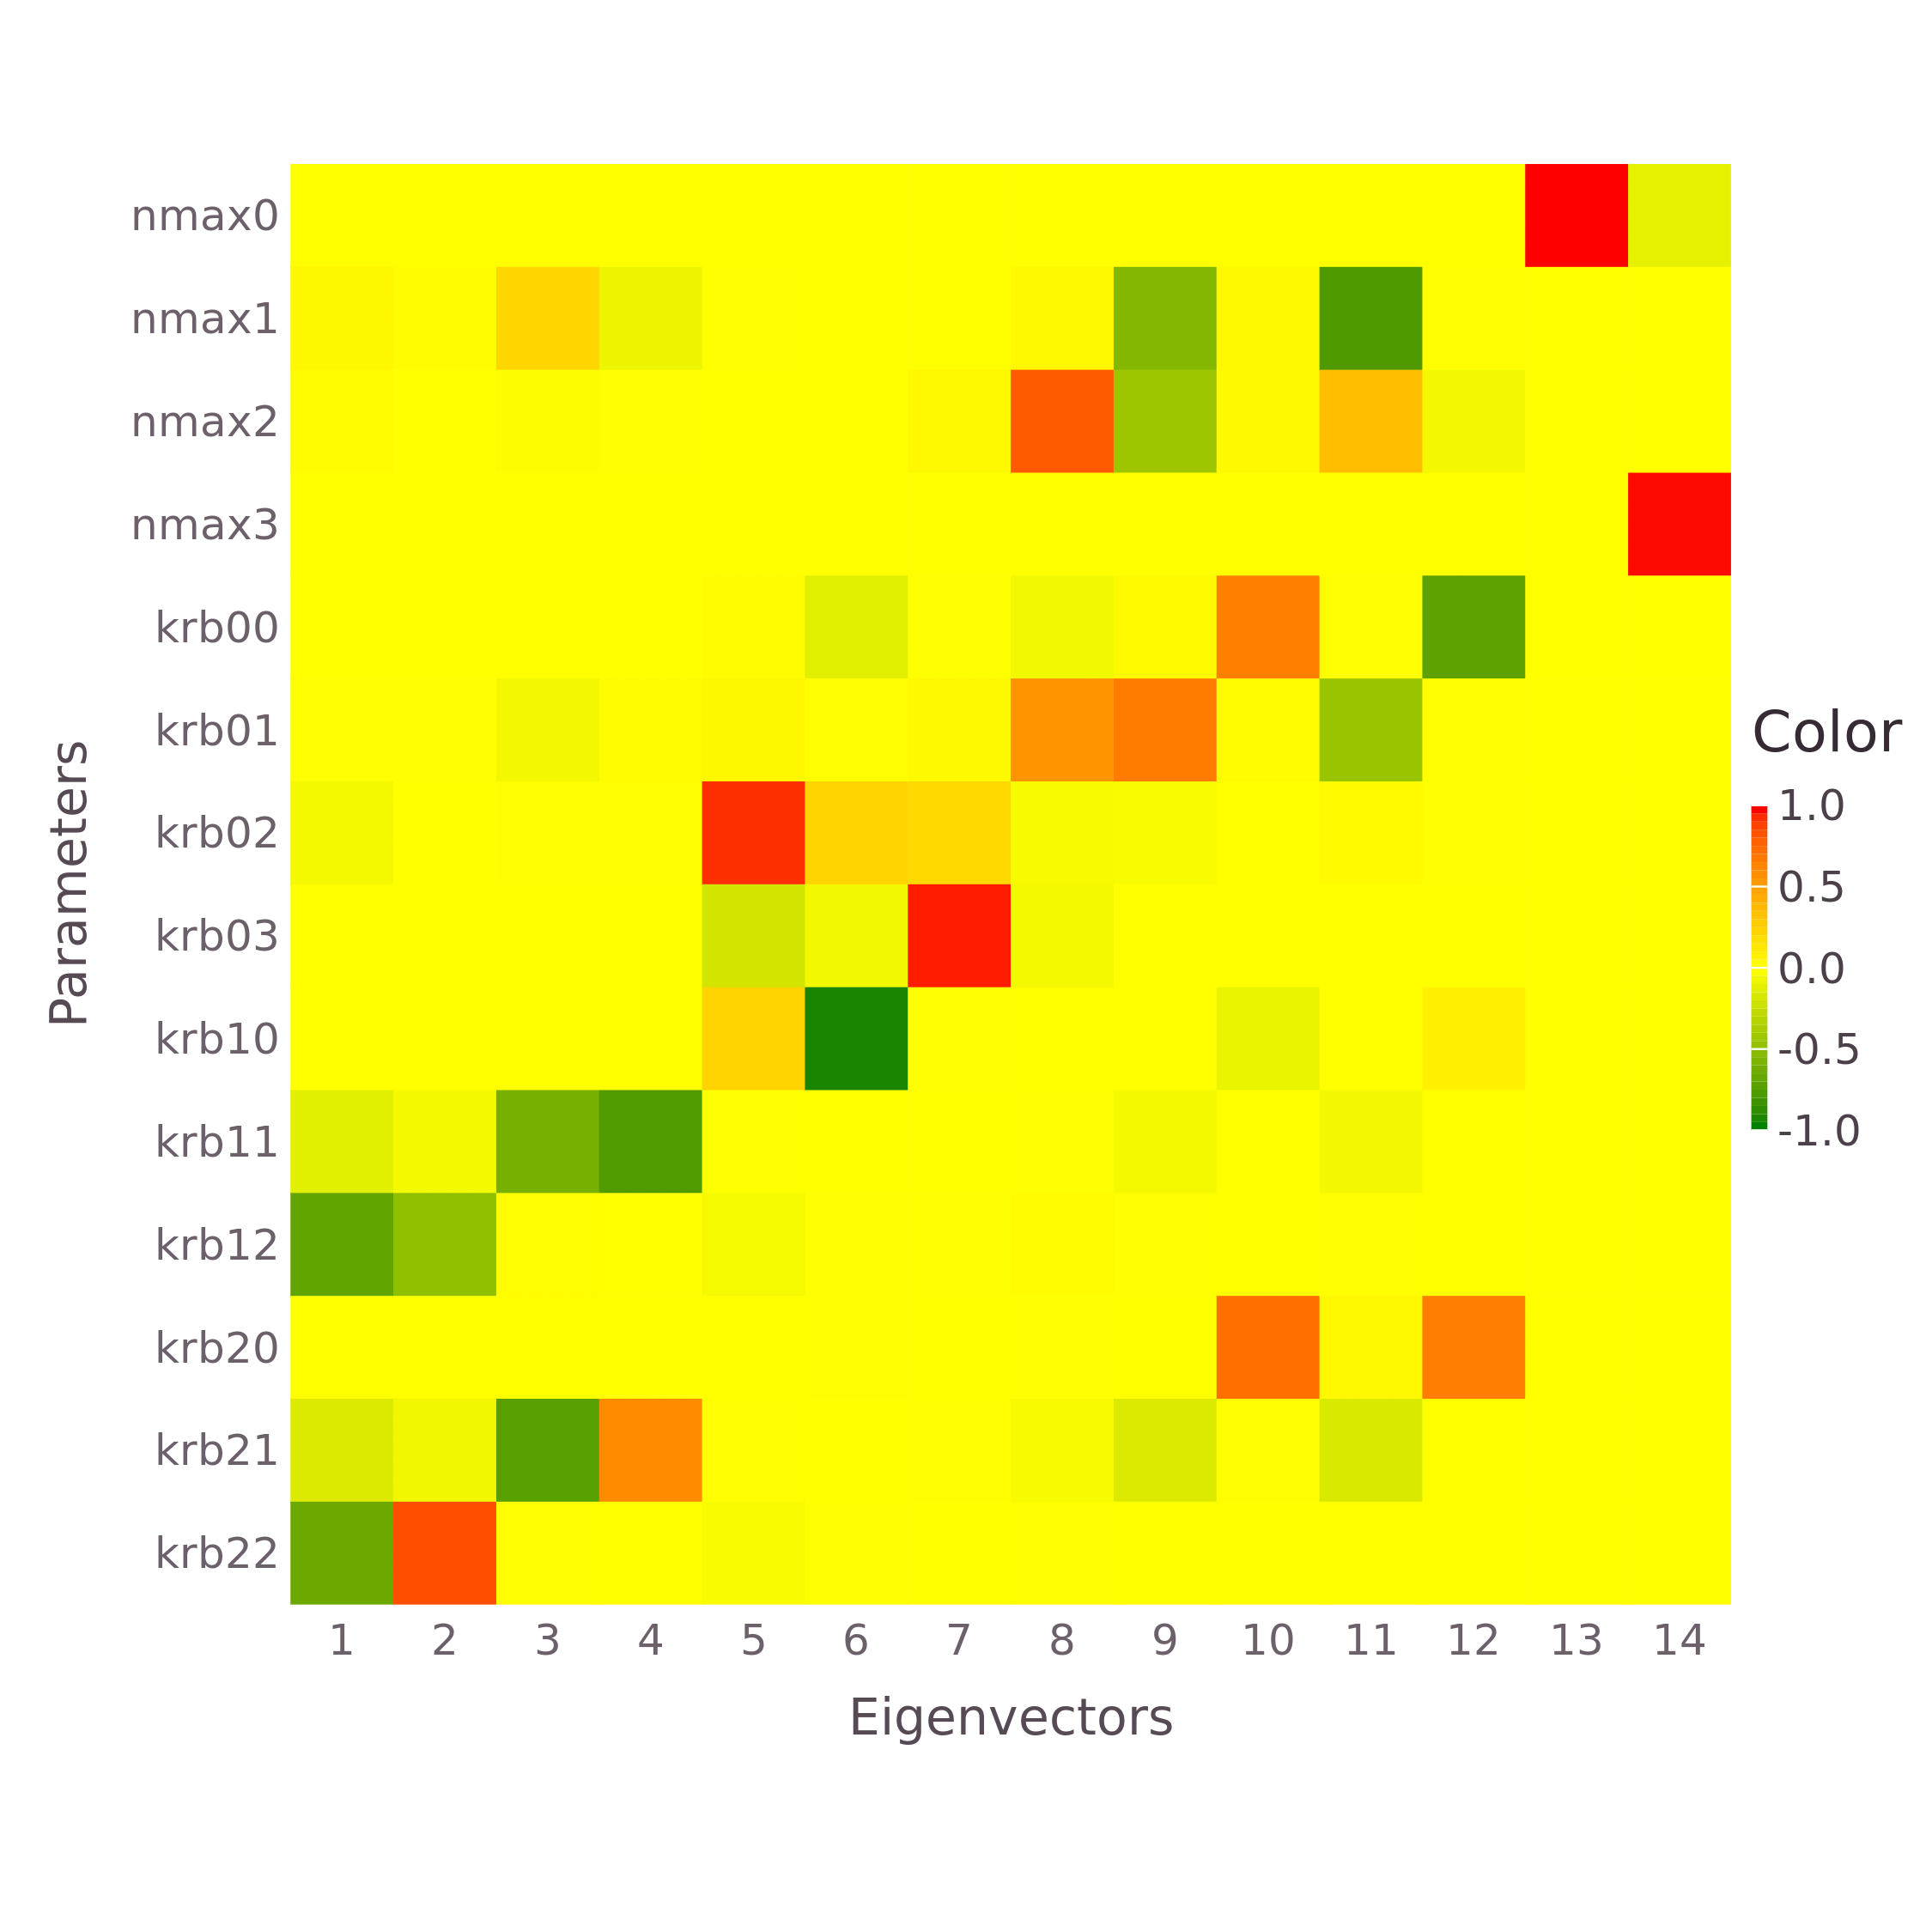

Slide 10
