Slide 1
Spring Cloud Config
Settings Module

Slide 2
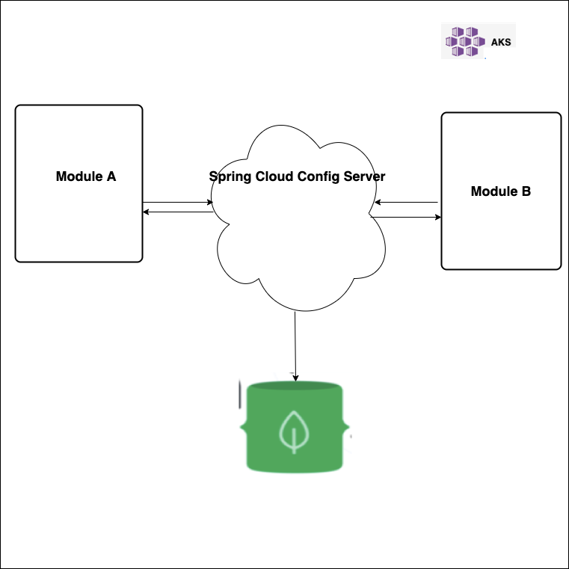
Demo

Slide 3
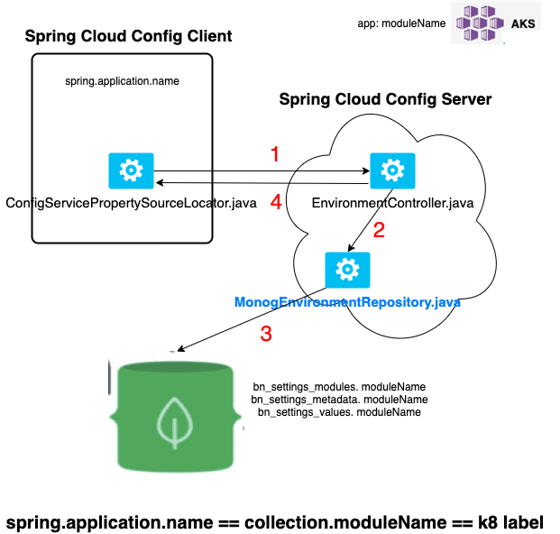
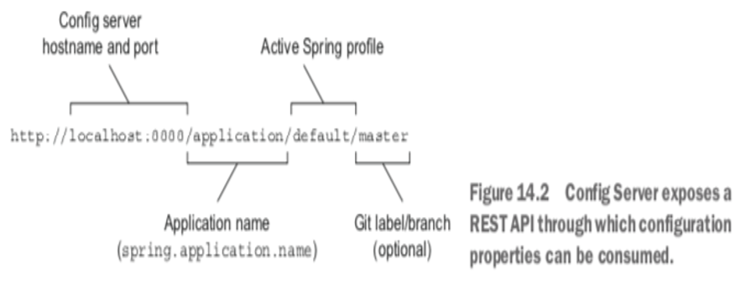
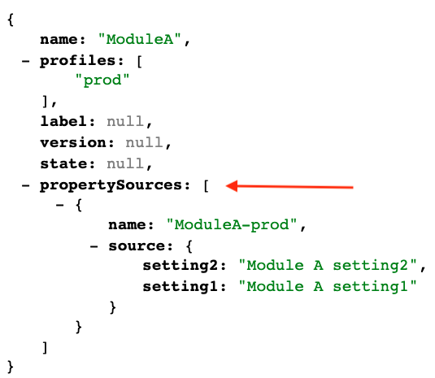
Client Startup
Server URI Format
Server Response

Slide 4
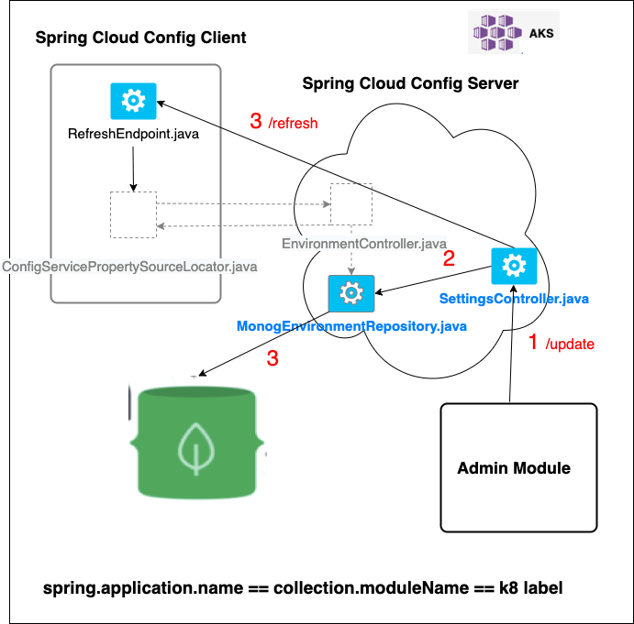
Settings Update

Slide 5
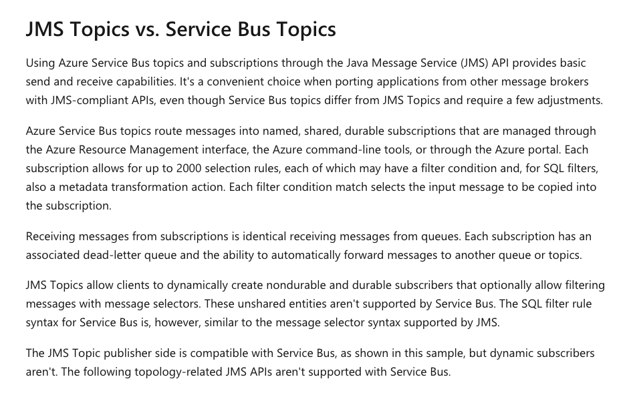
Why We Can’t Use Service Bus Topics ☹
When you create a subscription to a topic it has a specific subscription name.
Any consumer that then starts requesting messages for that subscription name will compete for messages on that subscription.
If you want independent applications to each receive a copy of the message sent to a topic they will each have to create their own subscription to the topic.
You can almost view each subscription as a queue unto itself being fed by the topic.
https://stackoverflow.com/questions/21199333/azure-service-bus-subscribers-can-independently-subscribe-to-a-subscription-an
https://docs.microsoft.com/en-us/azure/service-bus-messaging/service-bus-java-how-to-use-jms-api-amqp#unsupported-features-and-restrictions

