Slide 1
Laurels and Crowns: Ancient Roman Coins Classification Using Computer Vision
Valérie Blanch
2614867B@student.gla.ac.uk
September 2022

Slide 2
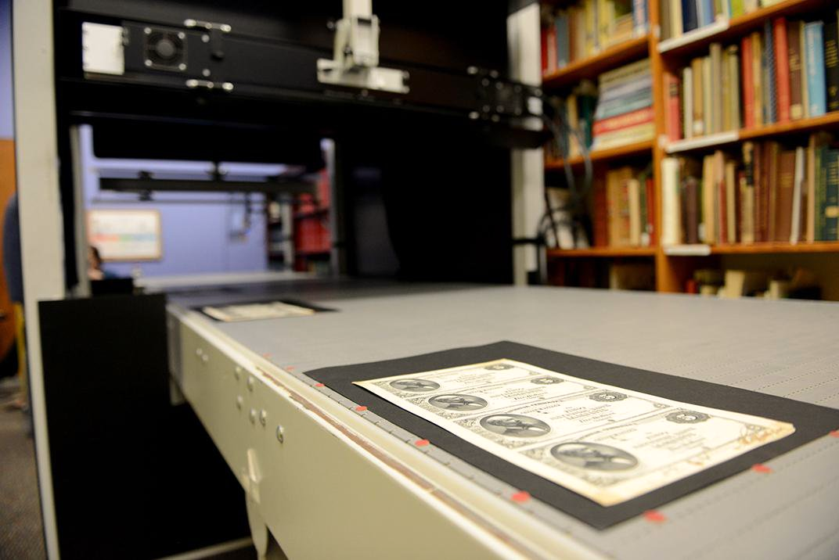
CONTEXT:
The massive digitization of numismatic items

Slide 3
584,274 coins
9,836,043 lots
500,000 coins
In the digital collection of the ANS
Currently on sale on acsearch.info
Traded each year in North America

Slide 4
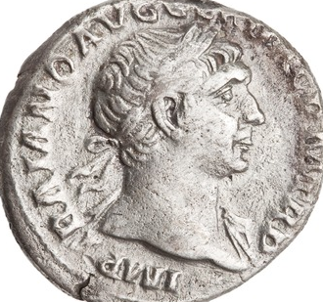
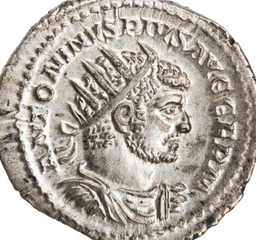
TWO TYPES OF DENOMINATIONS
Denarius :
Bareheaded, laurel wreath, helmet etc.
Antoninianus :
Radiate crown

Slide 5
OBJECTIVE
Building a CNN to classify Roman imperial coins by denomination.

Slide 6
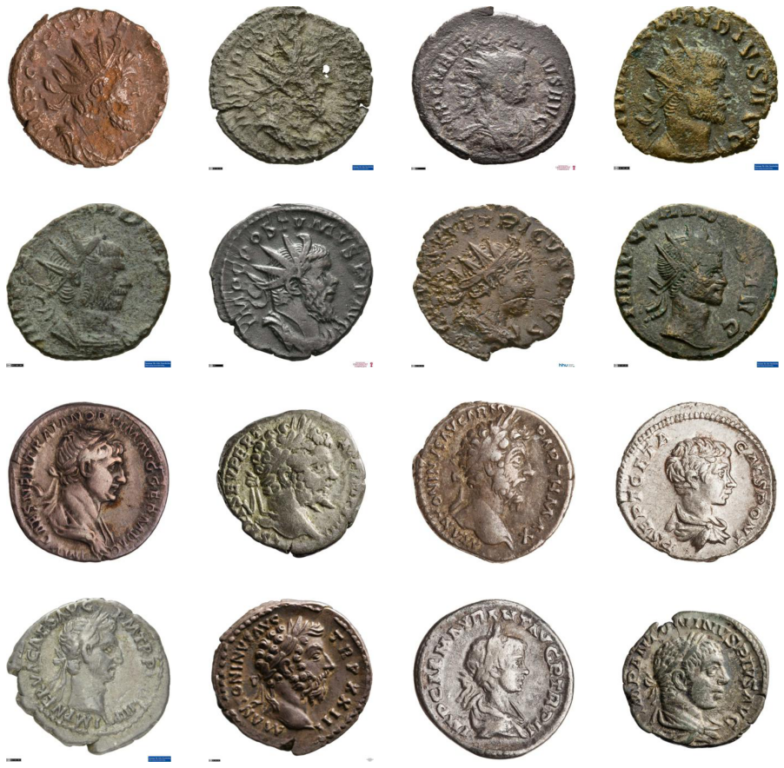
IMAGE DATASET

Slide 7
MODELLING PROCESS
Grayscale images
3 convolutional layers
2 max-pooling layers
RGB images
5 convolutional layers
4 max-pooling layers
InceptionV3 up to “mixed7”
1 dense layer 1024 units
Dropout layer 0.2
MODEL 1
MODEL 2
MODEL 3
MODEL 4
MODEL 5
MODEL 6
Grayscale images
4 convolutional layers
4 max-pooling layers
Dropout layer 0.5
RGB images
5 convolutional layers
5 max-pooling layers
Dropout layer 0.5
InceptionV3 up to “mixed4”
1 convolutional layer
1 max-pooling layer
Dropout layer 0.5

Slide 8
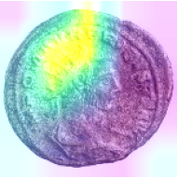
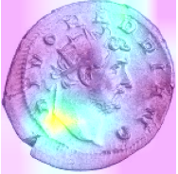
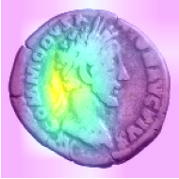
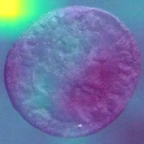
GRAD-CAM HEATMAPS
ANTONINIANUS
Correctly labelled
(Model 4)
ANTONINIANUS
Mislabelled
(Model 6)
(Model 6)
Correctly labelled
DENARIUS
(Model 4)
Mislabelled
DENARIUS

Slide 9
FINAL RESULTS
 | VAL_ACC | VAL_LOSS | ACC_TEST_1 | LOSS_TEST_1 | ACC_TEST_2 | LOSS_TEST_2
Baseline grayscale (1) | 0.9741 | 0.1015 | 0.9625 | 0.1454 | 0.9622 | 0.1421
Updated grayscale (2) | 0.9887 | 0.0392 | 0.9830 | 0.0504 | 0.9868 | 0.0391
Baseline RGB (3) | 0.9823 | 0.0573 | 0.9745 | 0.0720 | 0.9835 | 0.0705
Updated RGB (4) | 0.9897 | 0.0379 | 0.9860 | 0.0473 | 0.9946 | 0.0205
Baseline InceptionV3 (5) | 0.9766 | 0.0731 | 0.9730 | 0.0879 | 0.9507 | 0.1779
Updated InceptionV3 (6) | 0.9903 | 0.0322 | 0.9890 | 0.0376 | 0.9826 | 0.0611

Slide 10
CONCLUSION
Context: massive digitization of numismatic items.
Purpose: classifying ancient coins denominations using a CNN.
Challenge: damaged coins and varied depictions.
Methods: training 6 models to recognise radiate crowns.
Results: an average test accuracy of 98% for the 3 main models.
Limitations: detection of logos and backgrounds, legends, etc.
only male portraits, only coins in good condition.

Slide 11
THANK YOU!

Slide 12
REFERENCES
Picture of the conveyor belt of the Smithsonian Museum : https://www.smithsonianmag.com/smithsonian-institution/museums-are-now-able-digitize-thousands-artifacts-just-hours-180953867/?no-ist photographer : Brendan McCabe
Website of the American Numismatic Society (ANS): https://numismatics.org/
Link of the auction website acsearch: https://www.acsearch.info/
Number of coins traded in the US : Huber-Mörk R. et al. (2011) “Identification of ancient coins based on fusion of shape and local features”, in March. Vis. Appl. 22, p. 983.

