Slide 1

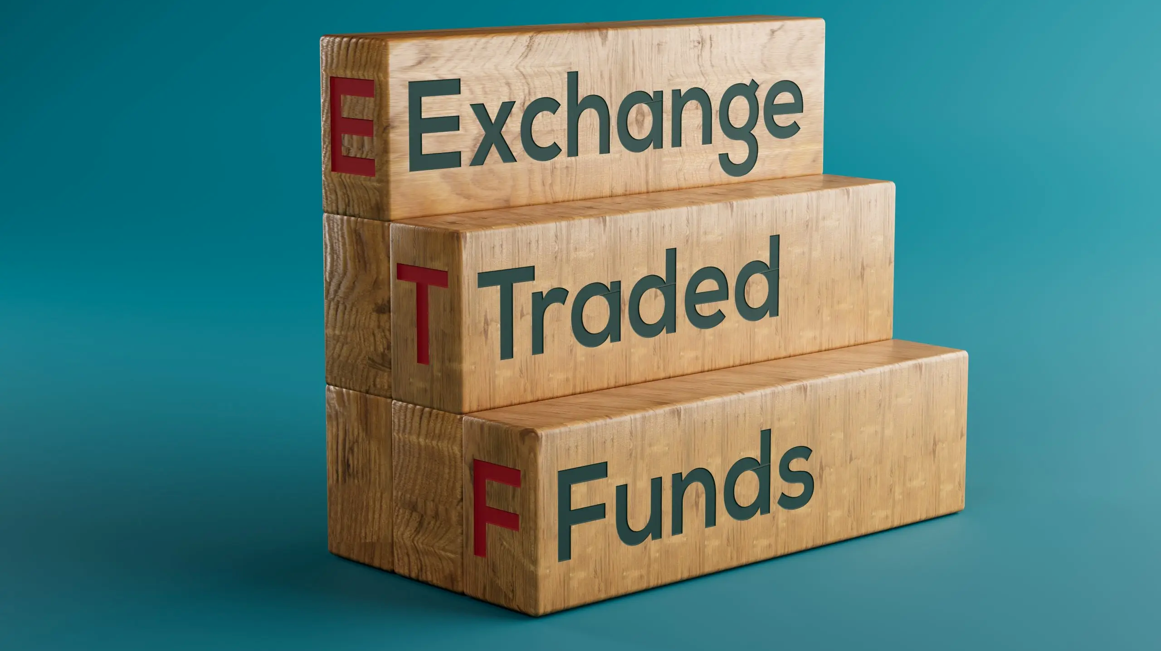
Exchange-Traded
Funds (ETFs)
Presentation by: Student’s Name
FIN 1100 |Personal Finance Final Project

Slide 2
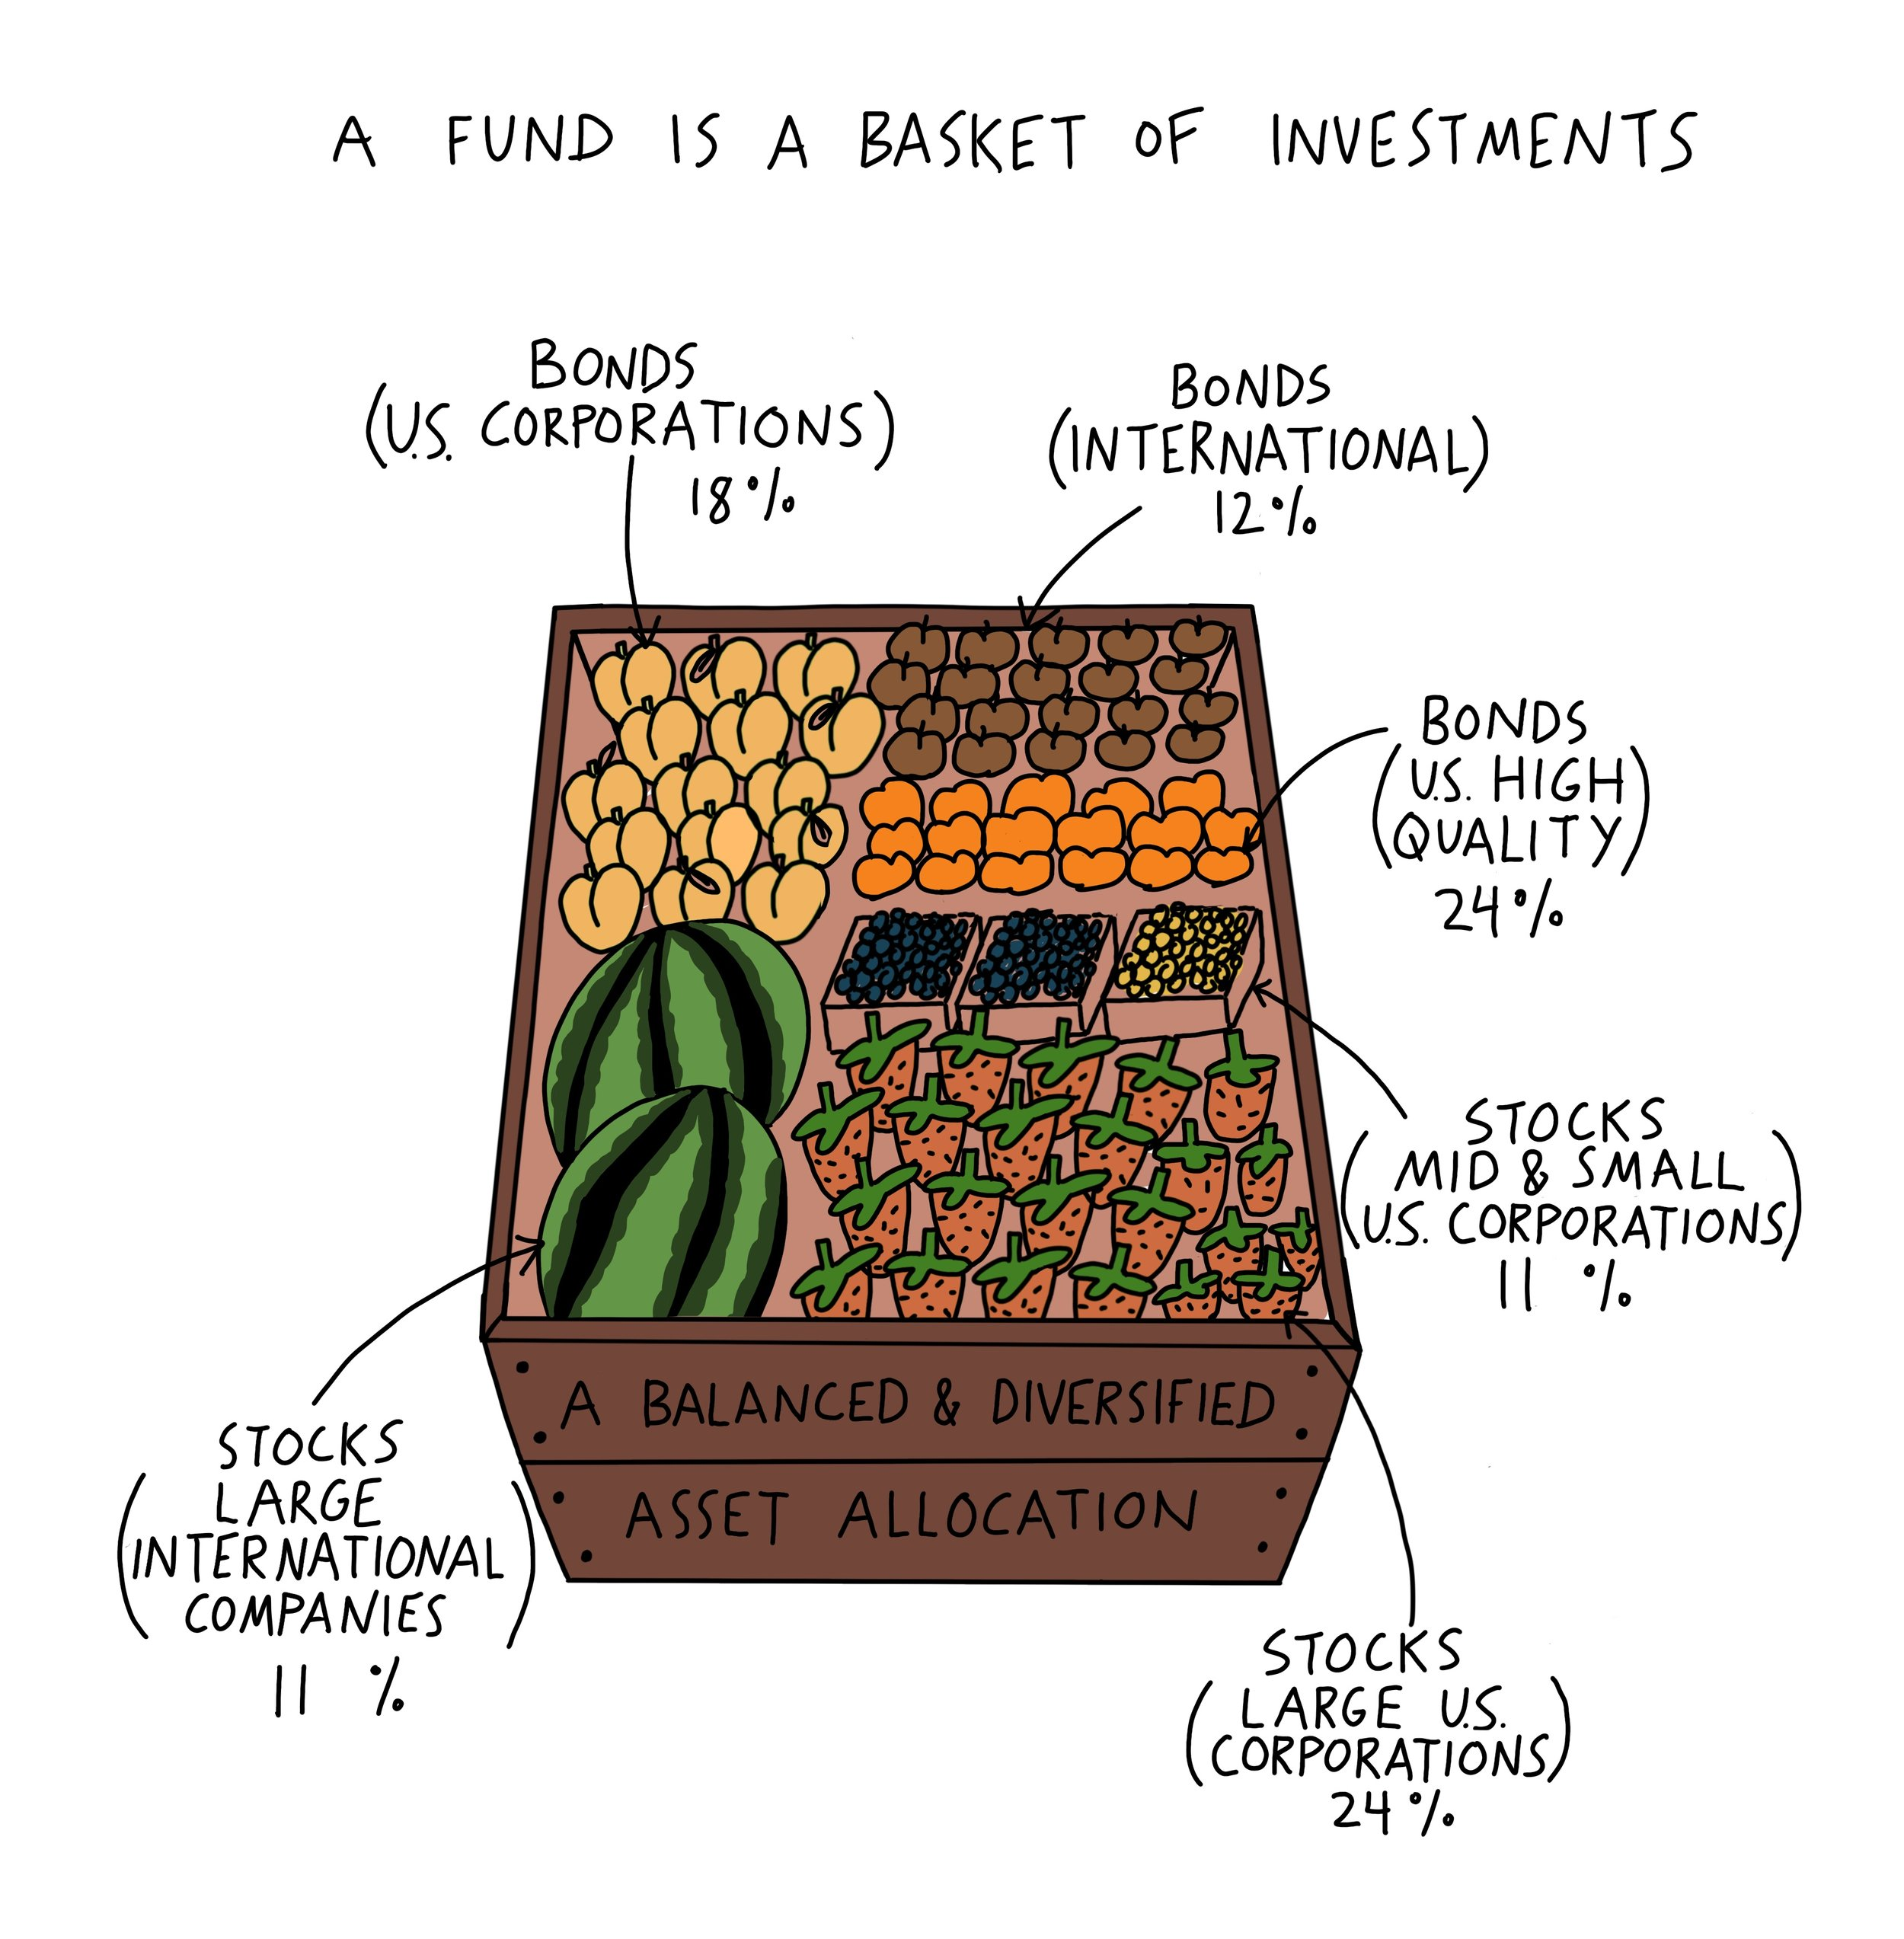
What is an ETF?
An ETF is a type of investment fund that brings together many investments, such as stocks, bonds, or other assets, in one “basket” (Chen, 2026).
Investors can buy and sell shares of an ETF on a stock exchange, so people buy and sell them through a brokerage account.
Key Facts
One ETF can contain dozens or even hundreds of various investments.
ETF prices may fluctuate throughout the trading day.
Many ETFs are designed to copy the performance of a market index, such as the S&P 500.
ETFs enable investors to diversify their portfolios.
They often have lower fees than buying many individual investments.
An ETF can hold a group of investments, such as stocks and bonds, in one fund.

Slide 3
Types of ETFs
Common ETFs
  Passive ETFs: Follow an index, such as the S&P 500.
  Actively Managed ETFs: A fund manager decides which investments to buy and sell.
  Bond ETFs: Invest in government, company, or municipal bonds and may provide income.
  Sector ETFs: Invest in a specific sector, like technology, healthcare, or energy.
  Commodity ETFs: Invest in commodities like gold, silver, or oil.
  International ETFs: Purchase shares of companies or markets outside the United States.
Higher-Risk ETFs
  Crypto ETFs: Track the performance of cryptocurrencies like Bitcoin or Ethereum.
  Currency ETFs: Track changes in foreign currency values.
  Inverse ETFs: Aim to make money when an index or market falls.
  Leveraged ETFs: Try to multiply daily gains, but they can also multiply losses.

Slide 4

Why I chose ETFs
When I first learned about investing, I thought that I would invest all my savings in one successful company.
Then I discovered that even the best companies can lose value due to bad decisions, competition or changes in the economy.
If you invest all your money into one popular firm, such as Tesla or Apple, it can perform exceptionally well, but one bad event could make the stock drop fast.
With an ETF, my money is spread across many companies.
I chose ETFs because they feel like a safer way to start investing.
They are also easy to purchase, have low fees, and fit my objective of building wealth over a long period.

Slide 5
How to Invest in ETFs
First, open a brokerage account or use a retirement account, such as an IRA.
Add money to the account and search for ETFs on the investing platform.
Compare choices by looking at the expense ratio, past performance, trading volume, and the companies or bonds inside the fund.
Choose an ETF that matches your goals and risk level, then enter how many shares you want to buy.
NOTE: A lower expense ratio means less of your money is used to pay the fund’s operating costs.
Open a brokerage account
1
Deposit Money
2
Research ETFs
3
Choose an ETF
4
Buy Shares
5
Monitor Your Investment
6

Slide 6

Benefits and risks
Possible benefits:
  Spreads money across many investments.
  Typically has lower fees than actively managed mutual funds (Segal, 2026).
  Easy to buy and sell.
  Great for first-time investors.
  Some ETFs may create fewer taxable capital gains than mutual funds (Moussawi et al., 2025).
Possible risks:
  If the market or index falls, the ETF can lose value too.
  There are ETFs that invest only in one sector.
  Profit is not guaranteed.
  The constant fluctuation can encourage investors to buy or sell based on emotions (Ben-David et al., 2018).
  Leveraged ETFs can lose money quickly.

Slide 7
Good websites to research ETFs
1. Investor.gov
Explains what ETFs are and how they work.
2. FINRA Fund Analyzer
Allows investors to search for and compare ETFs.
3. Morningstar
Provides ETF ratings, performance history, fees, risk levels, and holdings.
4. ETF.com
5. Investopedia
Provides information about the ETFs, including an ETF screener and educational articles.
Gives simple definitions and basic investing tips.
Its screener helps investors in reducing the number of ETFs they have to choose from.
Shows the impact of fees and expenses on an investment over time.
Gives information about ETF risks, fees, and benefits.
Investors can use filters to compare various ETF options.
NOTE: Click a title to open the website.

Slide 8

Reflection
I did not realize there were so many different types of ETFs before doing this project. I discovered that different ETFs serve different purposes and to make wise investments, it is important to know what they invest in before buying.
ETFs can be a valuable resource since they can make diversification easier.
Some options, such as leveraged or inverse ETFs, are much riskier than others and are not suitable for beginners.
This research helped me to learn that I should take my time to compare my options and select investments that will help me to achieve my goals.
I would use ETFs as part of a long-term plan.
I would like to invest in simple, low-cost ETFs that allocate my funds to various investments.
I will also make sure that I understand the fees and risks involved before making any investment decision.
My financial philosophy is to save first, avoid bad debt, invest little by little, and keep learning.

Slide 9
References
Ben‐David, I., Franzoni, F., & Moussawi, R. (2018). Do ETFs increase volatility?. The journal of finance, 73(6), 2471-2535.
Chen, J. (2026, May 6). Exchange-traded fund (ETF): What it is and how to invest. Investopedia. https://www.investopedia.com/terms/e/etf.asp
Moussawi, R., Shen, K., & Velthuis, R. (2025). The role of taxes in the rise of etfs. The Review of Financial Studies, 38(10), 2988-3039.
Segal, T. (2026, March 26). A complete guide to understanding ETF benefits and risks. Investopedia. https://www.investopedia.com/articles/exchangetradedfunds/11/advantages-disadvantages-etfs.asp
U.S. Securities and Exchange Commission. (n.d.). Exchange-traded funds (ETFs). Investor.gov. https://www.investor.gov/introduction-investing/investing-basics/investment-products/mutual-funds-and-exchange-traded-2

