Slide 1

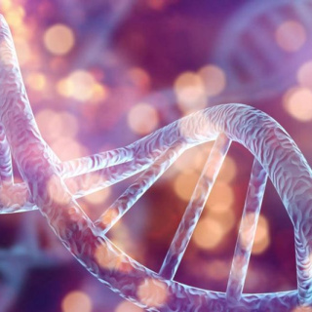
The Process of Meiosis
How Cells Create Unique Life

Slide 2
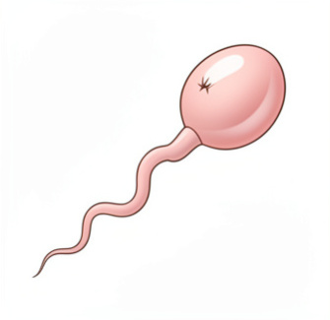
Why Do We Need Meiosis?
The Purpose of Sexual Reproduction
If sperm and egg cells were normal body cells, a baby would have twice the necessary chromosomes!
The Solution: Reduction Division
Meiosis ensures gametes have exactly half the chromosomes. When they combine during fertilization, the correct number is restored.
Humans: 46 → 23 → 46
Result: Genetic diversity and species survival.

Slide 3
Mitosis vs. Meiosis: A Quick Recap
Mitosis (Growth & Repair)
Goal: Make identical copies
Divisions: 1
Daughter Cells: 2
Chromosome Number: Remains Diploid (2n)
Genetics: Clones of parent
Meiosis (Reproduction)
Goal: Make gametes
Divisions: 2
Daughter Cells: 4
Chromosome Number: Halved to Haploid (n)
Genetics: Genetically unique

Slide 4
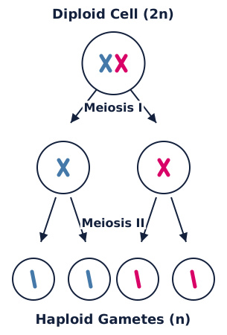
The Big Picture: Two Rounds
Meiosis isn't just one long division; it's a double feature!
Meiosis I: Separation of Homologues
Homologous chromosomes (matching pairs from mom and dad) separate. This is where the chromosome number is cut in half.
Meiosis II: Separation of Sister Chromatids
Sister chromatids split apart. This looks just like mitosis, but it starts with haploid cells.

Slide 5

True or False ✅​ ❌​
Mitosis produces four genetically unique cells, while meiosis produces two identical cells.
👍​
👎​
TRUE
FALSE
Answers on the next slide...

Slide 6
True or False ✅​ ❌​
✅​
Mitosis produces four genetically unique cells, while meiosis produces two identical cells.
👎​
FALSE
Actually, it's the reverse! Mitosis produces two identical cells for growth. Meiosis produces four unique cells for reproduction.

Slide 7
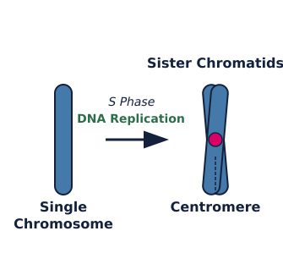
Before We Begin: Interphase
Just like mitosis, the cell must prepare before dividing.
S Phase (Synthesis)
The cell replicates its DNA. Each chromosome now consists of two identical sister chromatids joined at the centromere.
Important Note
After this, the cell is still diploid (2n), but it has double the amount of DNA. It is ready for Meiosis I.

Slide 8
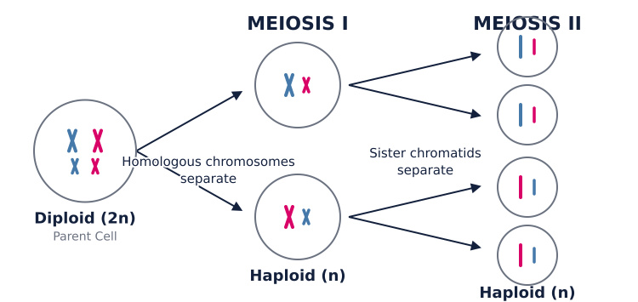
Overview of the Two Divisions

Slide 9
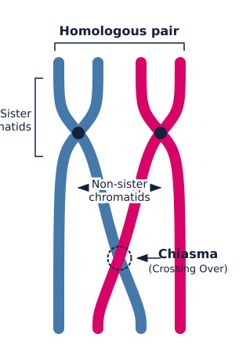
Meiosis I: Prophase I
This is the longest and most complex phase.
Synapsis & Crossing Over
Homologous chromosomes pair up (synapsis). They physically exchange sections of DNA (crossing over).
Why this matters: This is the primary source of genetic variation! You are a mix of your parents' DNA because of this step.

Slide 10
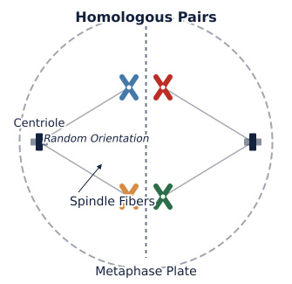
Meiosis I: Metaphase I
Alignment at the Equator
Homologous pairs line up side-by-side along the metaphase plate.
Independent Assortment
The orientation of each pair is random. Which chromosome faces the "left" or "right" is determined by chance.
Result: This random shuffling creates countless possible combinations in the gametes.

Slide 11
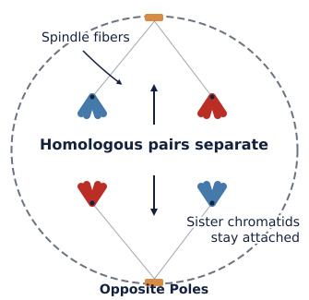
Meiosis I: Anaphase I
The Separation
The homologous chromosomes separate and move toward opposite poles of the cell.
Crucial Detail
Sister chromatids stay attached. Unlike mitosis, the centromeres do not split yet. The cell is reducing its chromosome count now.

Slide 12
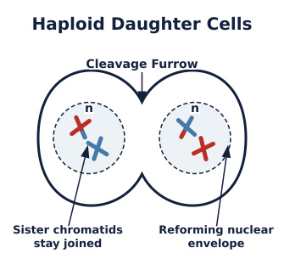
Meiosis I: Telophase I & Cytokinesis
Two New Cells
The chromosomes arrive at the poles. The nuclear membrane reforms, and the cell divides (cytokinesis).
The Result
We now have two haploid cells.
Even though they are haploid (n), each chromosome still consists of two sister chromatids.

Slide 13
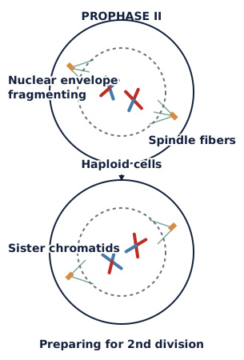
Meiosis II: The Second Round
No DNA replication occurs between Meiosis I and II!
The Mechanics
Meiosis II is essentially mitosis happening in two haploid cells.
The Goal
To separate the sister chromatids. This ensures each gamete gets only one copy of each chromosome.

Slide 14
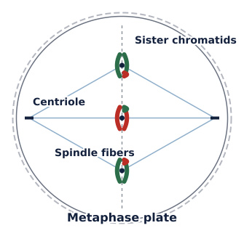
Meiosis II: Prophase II & Metaphase II
Prophase II
Chromosomes condense again, and spindle fibers reform in both cells.
Metaphase II
Chromosomes line up individually along the metaphase plate in a single line.
Note: This looks similar to Metaphase in mitosis.

Slide 15
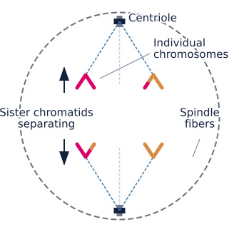
Meiosis II: Anaphase II
Finally, the Split
The centromeres split. The sister chromatids separate and move to opposite poles.
Now they are considered individual chromosomes.
This step ensures that every resulting gamete has the correct genetic payload.

Slide 16
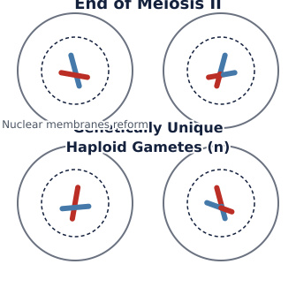
Meiosis II: Telophase II & Cytokinesis
The Grand Finale
Nuclear membranes form around the four sets of chromosomes.
The Final Product
Cytokinesis divides the cytoplasm.
Result: Four genetically unique haploid gametes.

Slide 17
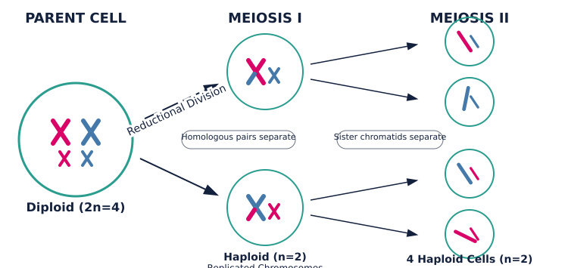
Visualizing the Complete Process

Slide 18
Sources of Genetic Variation
1. Crossing Over
Occurs in Prophase I.
Homologous chromosomes swap DNA segments.
Creates new combinations of genes on a single chromosome.
Think of it as shuffling two decks of cards together.
2. Independent Assortment
Occurs in Metaphase I.
Pairs align randomly.
The 23 pairs can align in over 8 million different combinations!
Ensures siblings look different (unless they are identical twins).

Slide 19
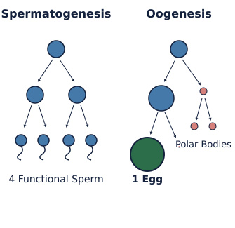
Spermatogenesis vs. Oogenesis
Meiosis looks slightly different in males and females.
Spermatogenesis (Males)
Occurs continuously after puberty.
Result: 4 equal-sized, functional sperm cells.
Oogenesis (Females)
Begins before birth, pauses, and finishes at ovulation.
Result: 1 large egg + 3 small polar bodies (which disintegrate). The egg gets most of the cytoplasm.

Slide 20

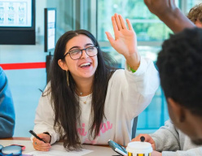
Discuss! 🤷‍♀️​ 💁‍♂️​ 💬​
Critical Thinking
If meiosis produced diploid gametes instead of haploid ones, what would happen to the chromosome count in a species over just three generations?

Slide 21
Discuss! 🤷‍♀️​ 💁‍♂️​ 💬​
✅​
You might have said...
Chromosome count doubles each generation (46->92->184->368),
which cannot sustain life .

Slide 22
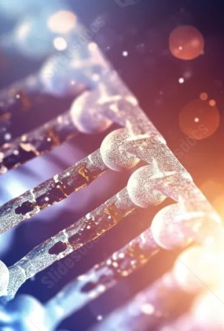
Summary: The Beauty of Meiosis
Key Takeaways
Reduction: Meiosis I reduces chromosome number by half (2n → n).
Division: Meiosis II separates sister chromatids.
Outcome: Four genetically unique haploid cells.
Significance: Essential for sexual reproduction and maintaining stable chromosome numbers across generations.
You are unique because of this process!

