Slide 1
Beyond the Bedside
Evaluating Hospital Quality of Care amidst Workforce Shortages in the Southeast

Slide 2
How does the shortage of healthcare professionals in different regions of the U.S. impact the quality of care provided in acute care hospitals?
Research Topic

Slide 3
1) Which states are facing the most severe shortages of primary care practitioners?
Research Questions
2) How do the states with the most pronounced shortages perform in terms of CMS Overall Hospital Quality scores?
3) Are there differences in CMS Hospital Quality subdomain scores between hospitals in shortage areas versus those in non-shortage areas?

Slide 4
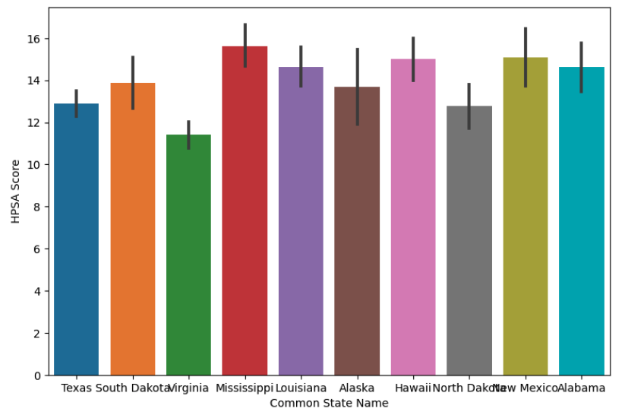
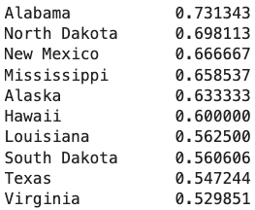
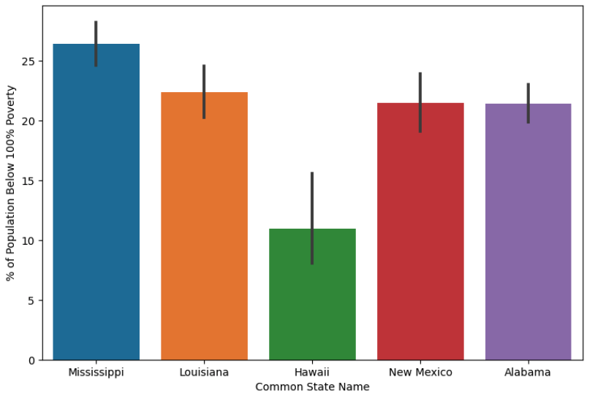
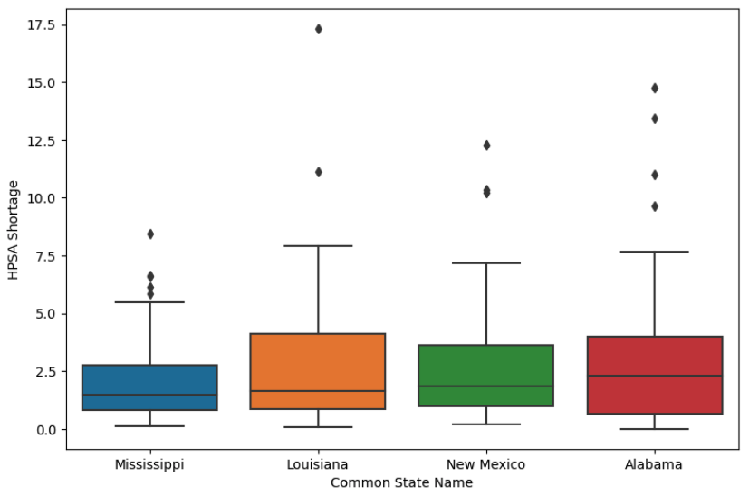
1) Which states are facing the most severe shortages of primary care practitioners?

Slide 5
2) How do the states with the most pronounced shortages perform in terms of CMS Overall Hospital Quality scores?

Slide 6
3) Are there differences in CMS Hospital Quality subdomain scores between hospitals in shortage areas versus those in non-shortage areas?

Slide 7
Story Outline
I am a data analyst working for a hospital in Mississippi that is in a healthcare shortage area.
My stakeholders (hospital executives) have asked me to identify which CMS Hospital Quality subdomains require improvement, and which subdomains we are performing well in.
Why? (What is the business objective?)
We want to improve our hospital’s quality of care performance, because we receive higher payments from the CMS when we score more highly on the Hospital Quality measures.
(2) We’ve applied to CMS-funded residency slots, which are awarded to hospitals serving underserved communities. We want to use this analysis to pinpoint the areas where we excel, so we can highlight our strengths in the marketing materials used to attract residents to our hospital.

