Slide 1


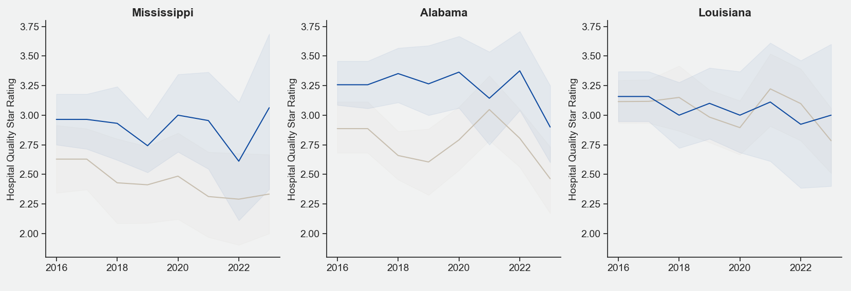

Shortage area hospitals in Mississippi & Alabama have higher average star ratings than non-shortage areas.
Mississippi
Alabama
Louisiana
Hospital Quality Star Rating
Non-Shortage Area
Shortage Area

Slide 2
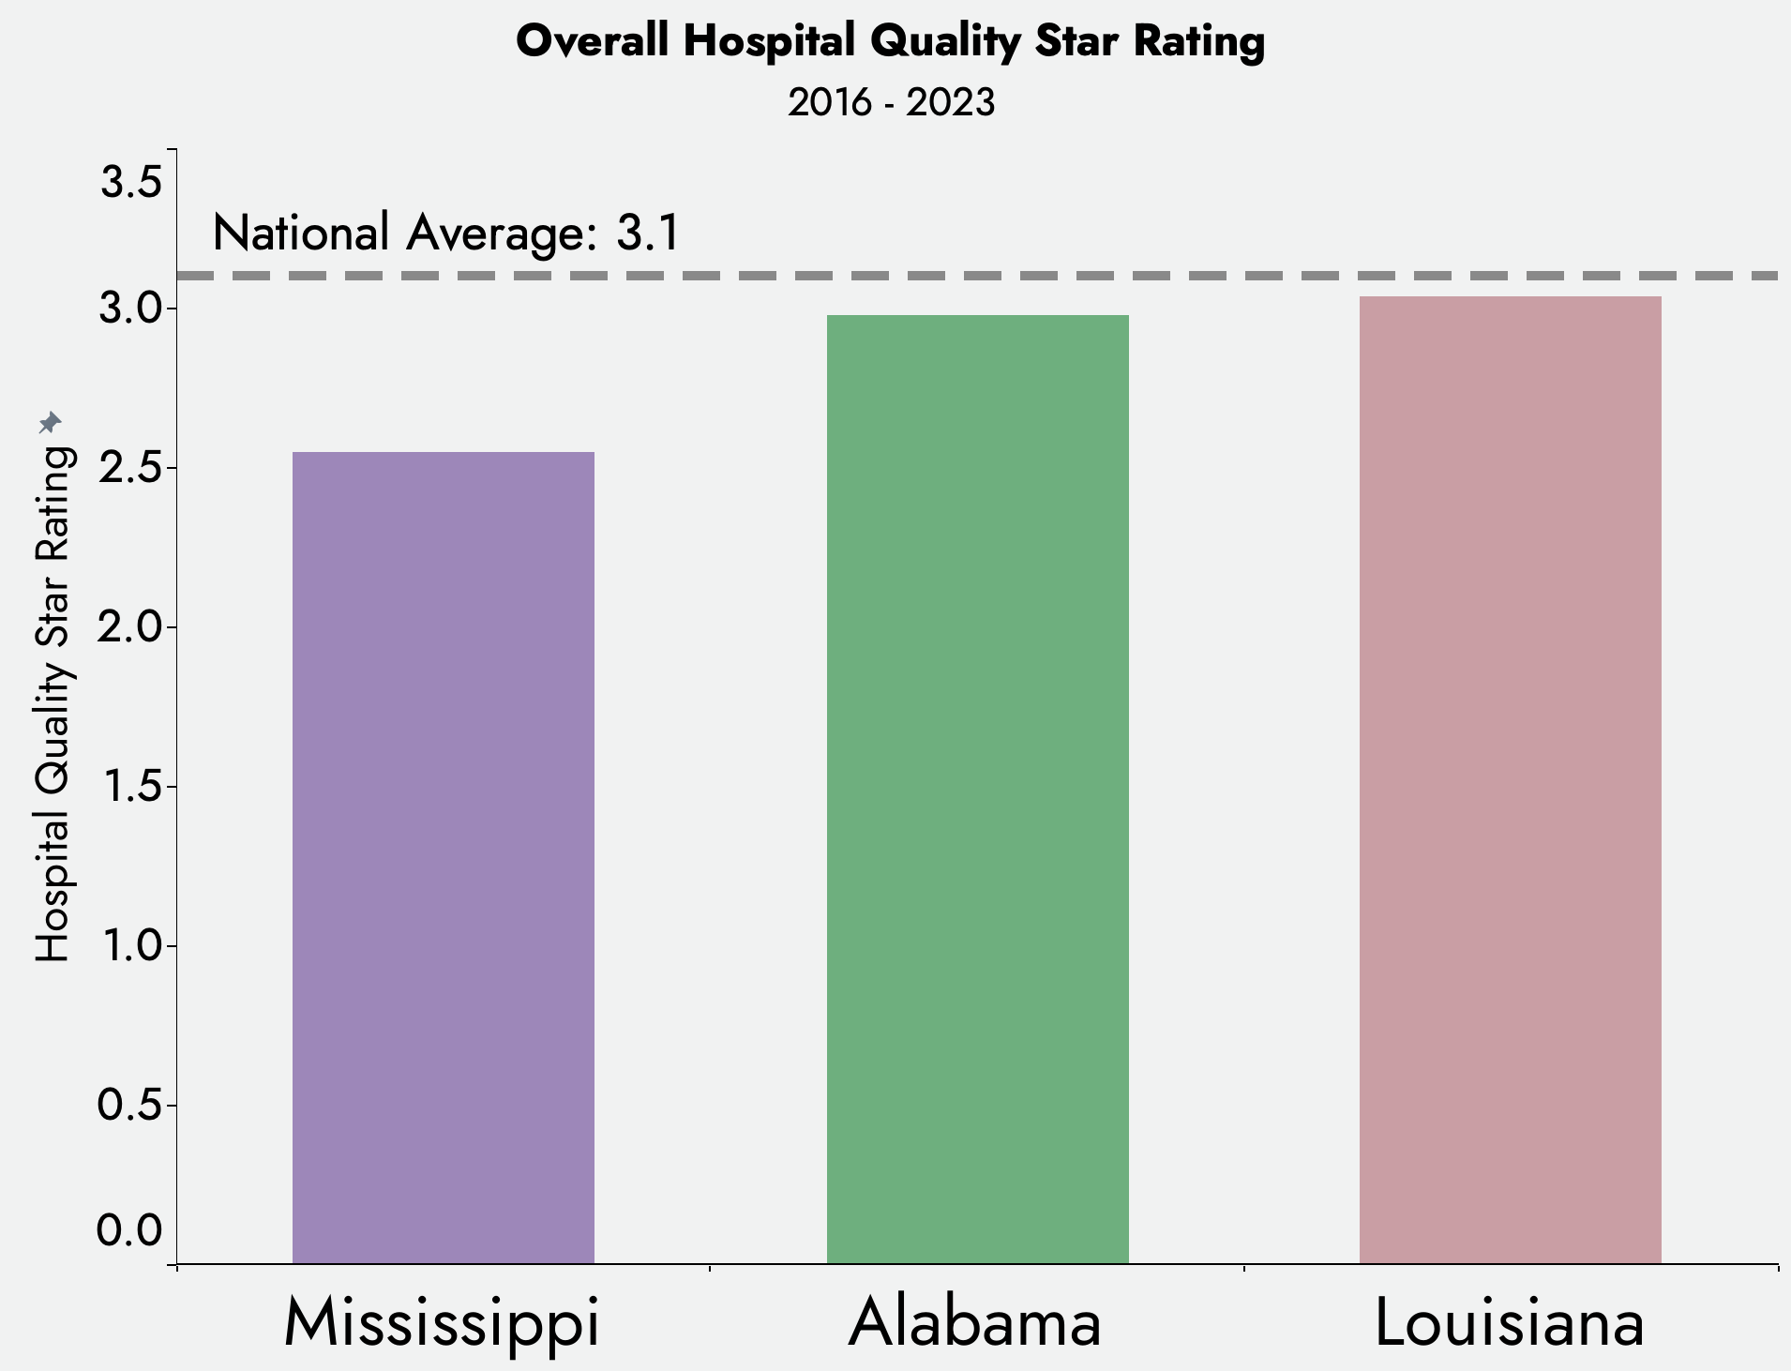

Hospitals in Mississippi have lower Hospital Quality
Star Ratings compared to Alabama & Louisiana.
n = 54
n = 83
n = 79
Notes:
Again, I wanted to start at a high level, looking at all the hospitals in Mississippi, Alabama, & Louisiana. I’ve put the number of hospitals that go into each bar here.
This bar graph shows the average star rating for all hospitals in a given state. We can compare this average star rating to the national average, which is shown by this dotted line.
It’s apparent that hospitals in Mississippi have a lower average star rating compared to Alabama & Louisiana.

Slide 3
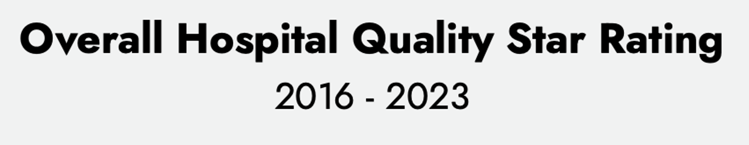
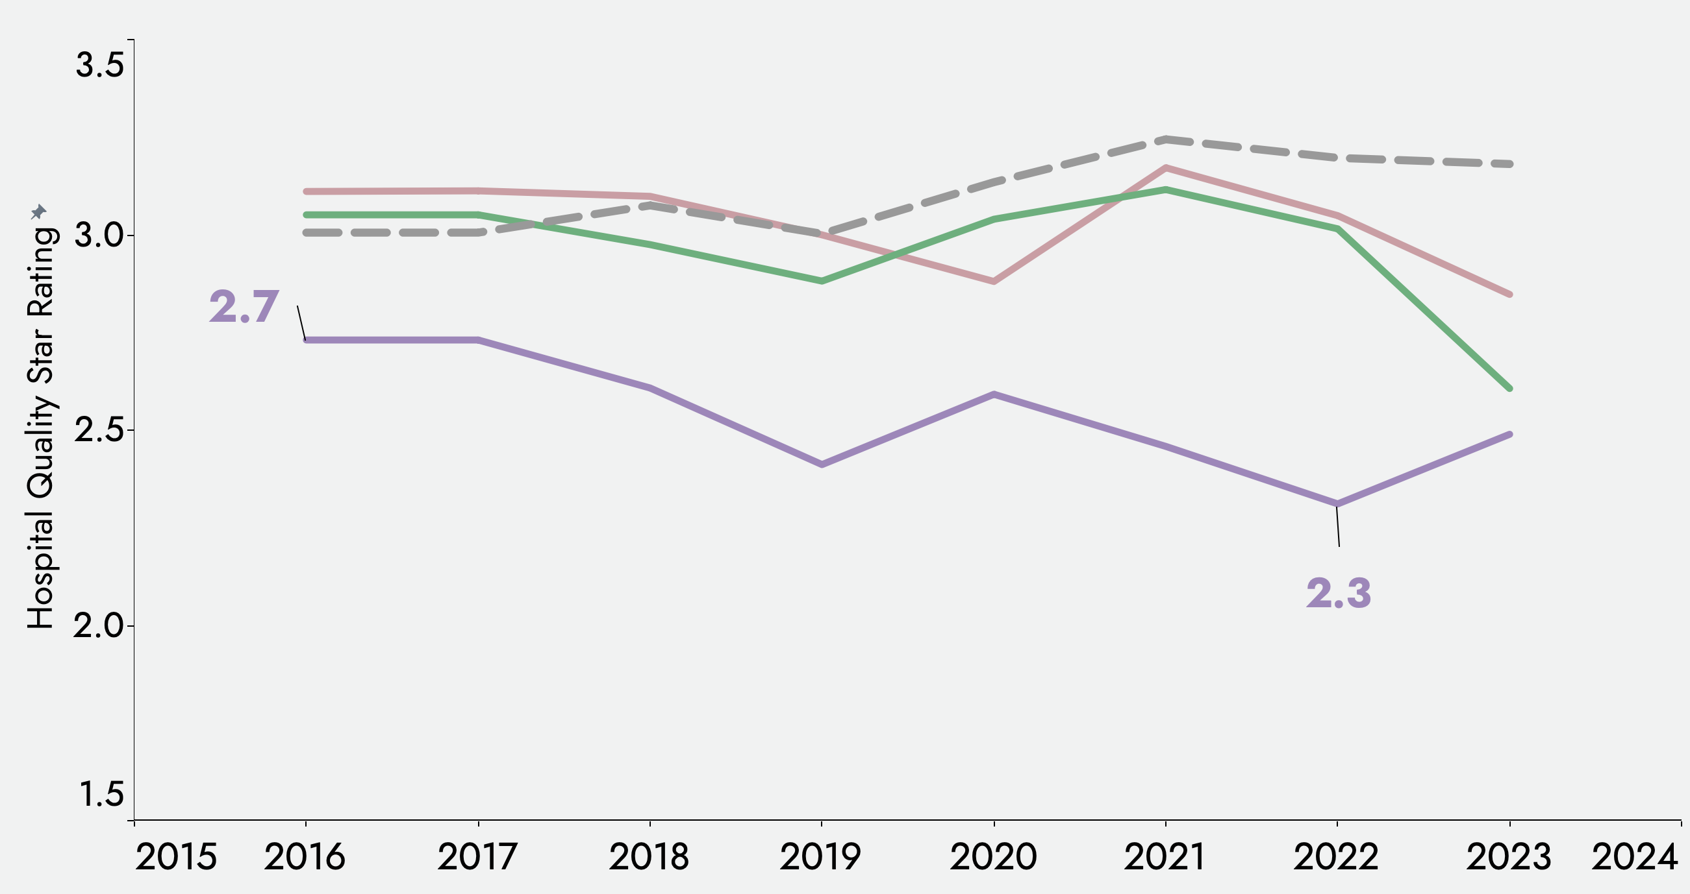

Hospitals in Mississippi have lower Hospital Quality
Star Ratings compared to Alabama & Louisiana.
Alabama
Louisiana
Mississippi
n = 54
n = 83
n = 79
Notes:
We can see the star rating for Mississippi hospitals getting lower over time, reaching an average of 2.3 stars in 2022.
This comparison was for all the hospitals in a given state, but I wanted to know how the star ratings compared between shortage area hospitals and non-shortage area hospitals WITHIN each of these states.

