Slide 1
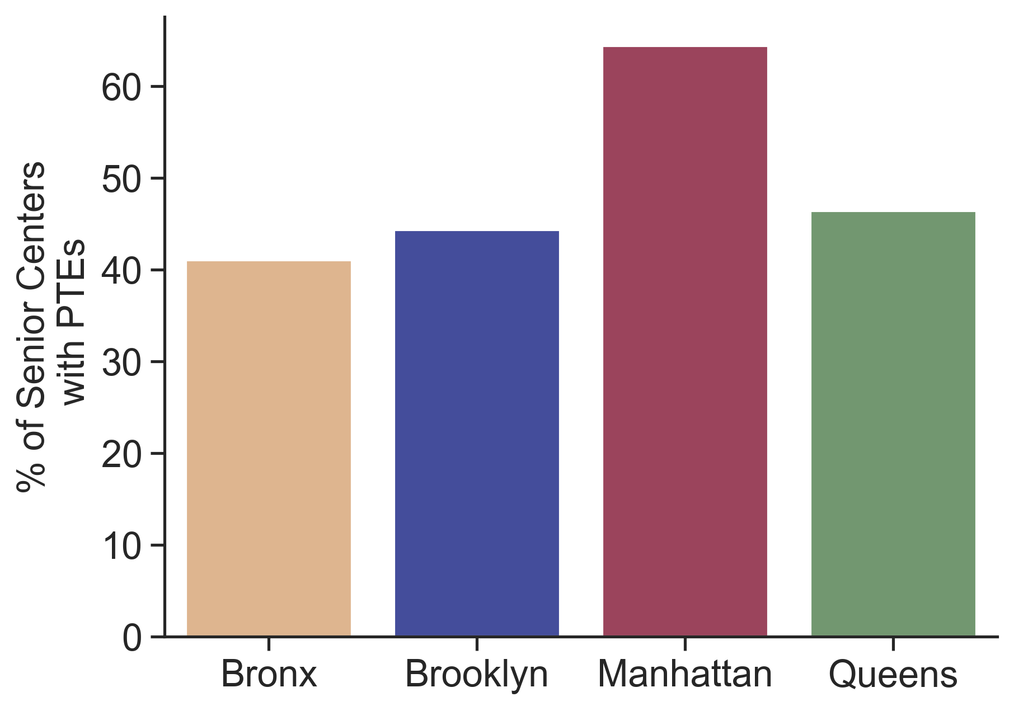
Employees
64% of senior centers in Manhattan have part-time employees on staff.

