Slide 1
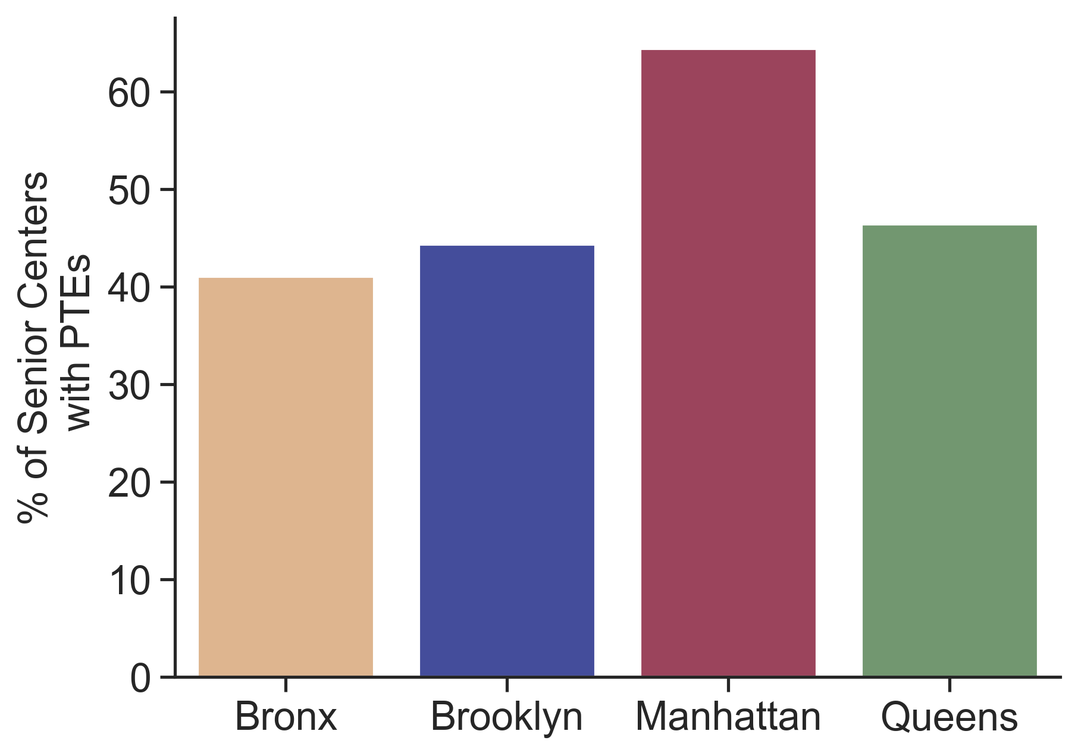
Employees
64% of senior centers in Manhattan have part-time employees on staff.

Slide 2
Employees
Employees
Budget Allocation
Meals
Meals
59%
63%
Brooklyn
Manhattan
46%
43%
Medians are reported

Slide 3
Employees
Employees
Budget Utilization
Meals
Meals
not reported
not reported
Brooklyn
Manhattan
24%
25%
Medians are reported

Slide 4
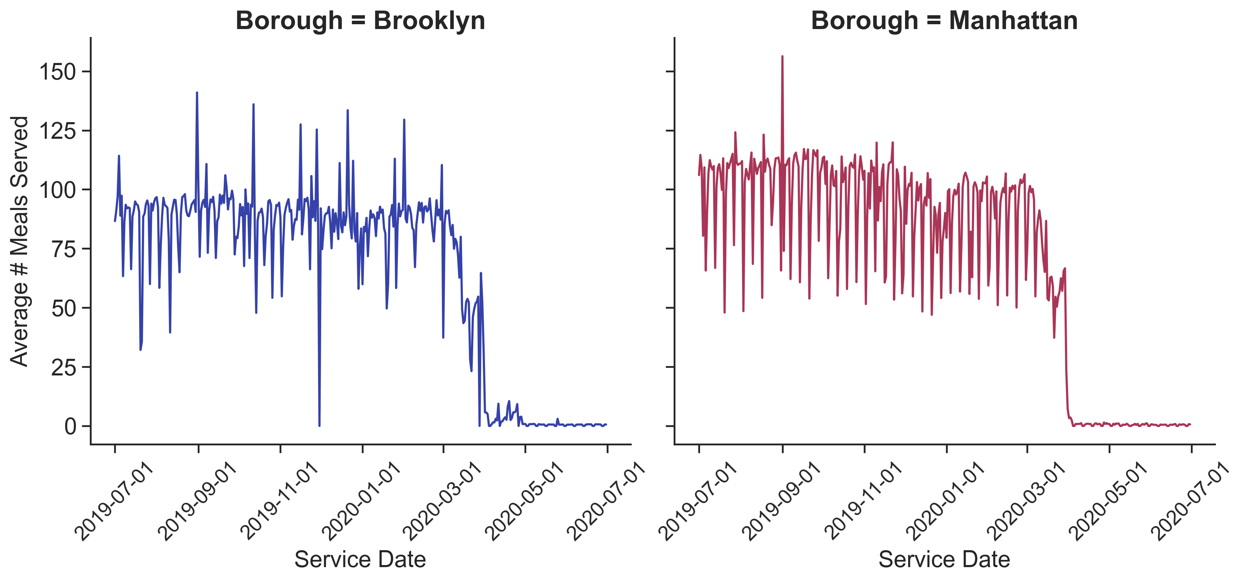

Manhattan senior centers have a higher average number of meals served per year than Brooklyn.
Meals Served

Slide 5
Next Steps
Services
Aside from meals, how often are the other service categories used?
People
Understand part-time employee involvement.
...And Beyond!
Explore other boroughs!
Budget
Investigate senior centers at the lower end of the total annual budget distribution.

