Slide 1
Northwind TraderS
Customer Growth, Revenue, & Price Optimization:
Trends from company inception to present
Valerie Magalong

Slide 2
Our Customers
Delicatessens & bistros
Restaurants
Grocery stores
Specialty food markets
butcher shops
wine boutiques
cheese shops
 | Total Number of Customers
Europe | 54
North America | 21
South America | 16

Slide 3
CUSTOMERGROWTH
~67% increase in total number of customers
Notes:
- There has been a ~67% increase in the total number of customers between our first quarter of sales and our most recent quarter.

Slide 4
Lifetime Revenue: $1,265,793
 | Total Revenue
Europe | $ 774,575
North America | $ 319,363
South America | $ 171,856

Slide 5
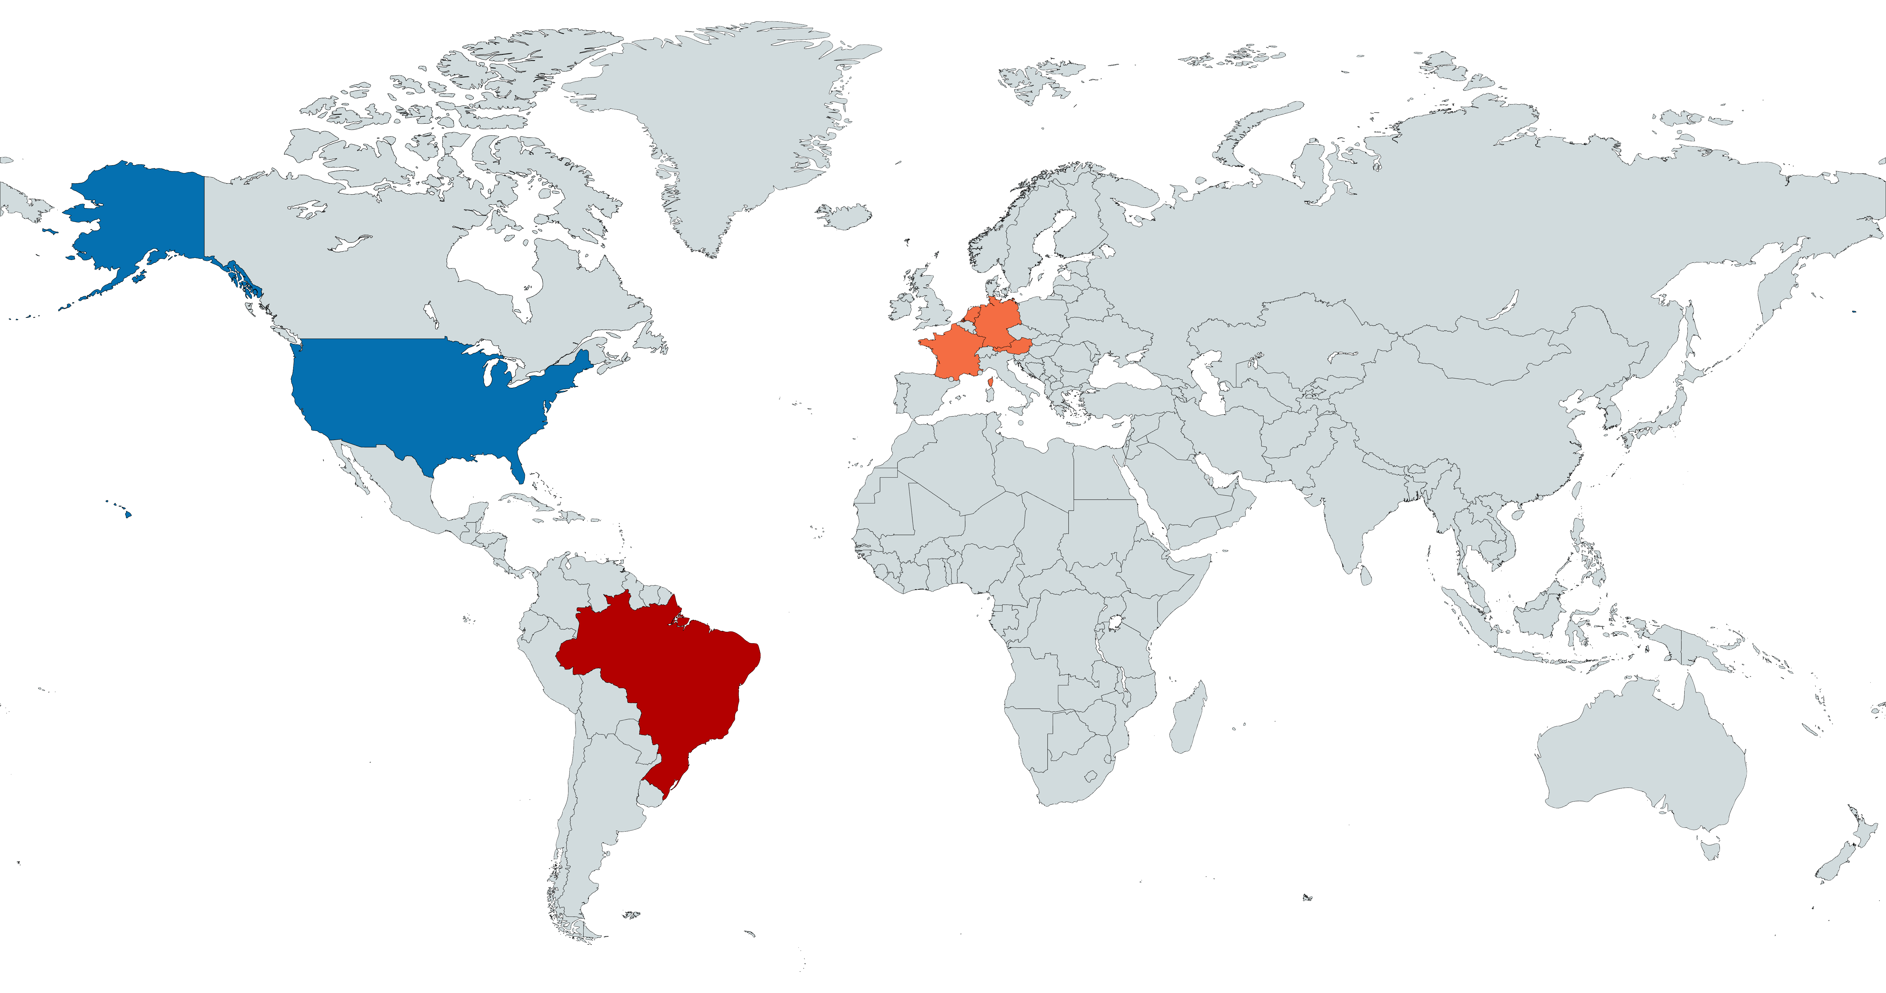
France
Germany
Austria
USA
$81 k
$230 k
$128 k
$246 k
TOP 5 COUNTRIES With HIGHEST LIFETIME REVENUE
Brazil
$107 k

Slide 6
Top GROSSING Product categories
Beverages
21% of Lifetime Revenue

Slide 7
Côte de Blaye
A hot product for our customers
…but why?
Beverage Name | Lifetime Revenue
Côte de Blaye | $ 141,397
Ipoh Coffee | $ 23,527
Chang | $ 16,356
Lakkalikööri | $ 15,760
Steeleye Stout | $ 13,644
Chai | $ 12,788
Chartreuse verte | $ 12,295
Outback Lager | $ 10,673
Rhönbräu Klosterbier | $ 8,177
Sasquatch Ale | $ 6,350
Guaraná Fantástica | $ 4,504
Laughing Lumberjack Lager | $ 2,397
Europe | North America | South America
$ 62,897 | $ 53,572 | $ 24,927
$ 16,887 | $ 2,886 | $ 3,754
$ 9,777 | $ 4,550 | $ 2,028
$ 10,783 | $ 3,357 | $ 1,620
$ 7,605 | $ 3,145 | $ 2,893
$ 6,344 | $ 4,320 | $ 2,124
$ 8,898 | $ 963 | $ 2,434
$ 7,109 | $ 979 | $ 2,585
$ 3,865 | $ 2,581 | $ 1,732
$ 3,618 | $ 2,117 | $ 616
$ 2,974 | $ 760 | $ 771
$ 1,557 | $ 560 | $ 280

Slide 8
Côte de Blaye
A hot product for our customers
…but why?

Slide 9
LiFETIME INSIGHTS
91
21
CUSTOMERS
COUNTRIES
$1.27 mil.
830
REVENUE
Orders placed
!!!
!!!
CATEGORY
CATEGORY
July 1996 – May 1998

Slide 12
Add text here

Slide 13
TITLE HERE
Add text here

Slide 15
PEOPLE PROCESS TOOLS EXPERIENCE
ELEMENT ONE
Your description here.
ELEMENT TWO
Your description here.
ELEMENT THREE
Your description here.
ELEMENT FOUR
Your description here.
ELEMENT FIVE
Your description here.
ELEMENT SIX
Your description here.

Slide 16





COMPANY PILLARS
MONEY
PEOPLE
RISK
TIME
EFFORT
Add text here.
Add text here.
Add text here.
Add text here.
Add text here.

Slide 17
CONSUMER DATA
TITLE 1
TITLE 2
Add text.
Add text.
TITLE 7
TITLE 3
COLLECTION
Add text.
Add text.
Consumer data refers to the information collected about individuals and their behavior, preferences, and characteristics as they interact with businesses and brands.
This data is a valuable resource for companies to gain insights into their target audience and improve their marketing and sales strategies.
It's important for businesses to handle consumer data with care and respect their privacy rights, as mishandling of this information can have consequences for company and consumer.
TITLE 6
TITLE 4
Add text.
Add text.
TITLE 5
Add text.

Slide 18
LiFETIME INSIGHTS
1
2
CATEGORY
CATEGORY
Add text here.
Add text here.
3
4
CATEGORY
CATEGORY
Add text here.
Add text here.
5
6
CATEGORY
CATEGORY
Add text here.
Add text here.

Slide 19
EVENT TIMELINE
EVENT NUMBER 1
EVENT NUMBER 2
EVENT NUMBER 3
EVENT NUMBER 4
Add text here.
Add text here.
Add text here.
Add text here.
EVENT NUMBER 5
EVENT NUMBER 6
EVENT NUMBER 7
EVENT NUMBER 8
Add text here.
Add text here.
Add text here.
Add text here.

Slide 20
COMPANY GROWTH
LEVEL 4
Add text here.
SUCCESS STRATEGY
Business growth is essential for any company that wants to remain competitive and successful in the long term.
By expanding reach, increasing revenue streams, and developing new products or services, businesses can achieve sustainable growth that creates new opportunities for success.
With the right strategy, resources, and team in place, businesses can achieve the growth they need to reach their full potential and thrive in today's competitive marketplace.
LEVEL 3
Add text here.
LEVEL 2
Add text here.
LEVEL 1
Add text here.

