Slide 1
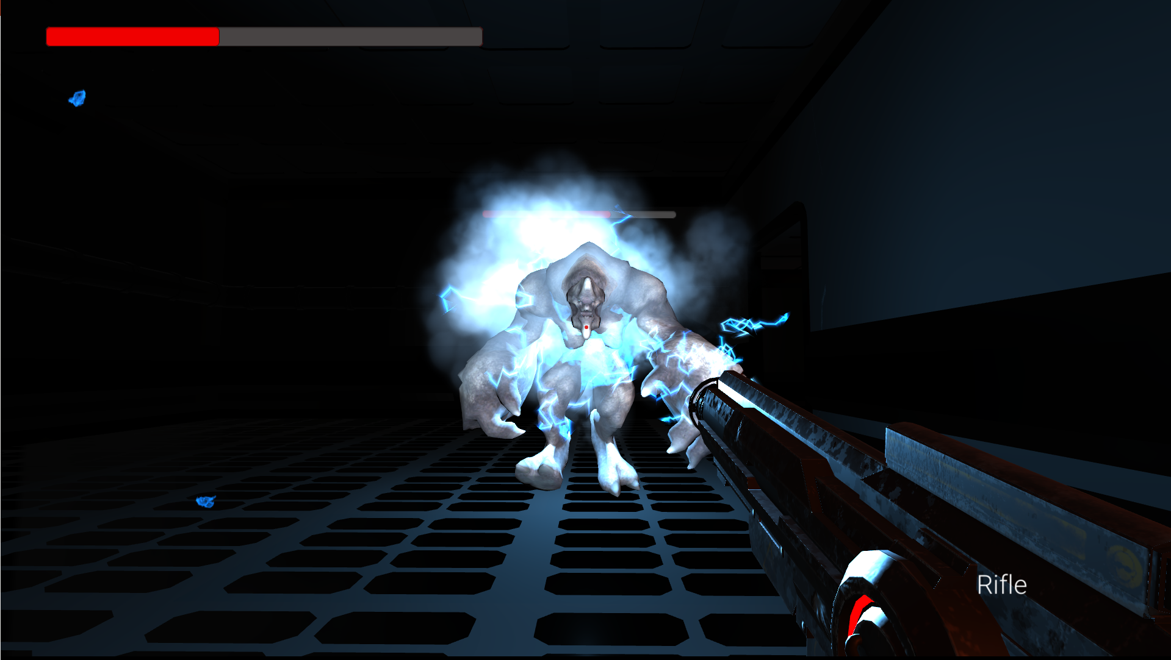
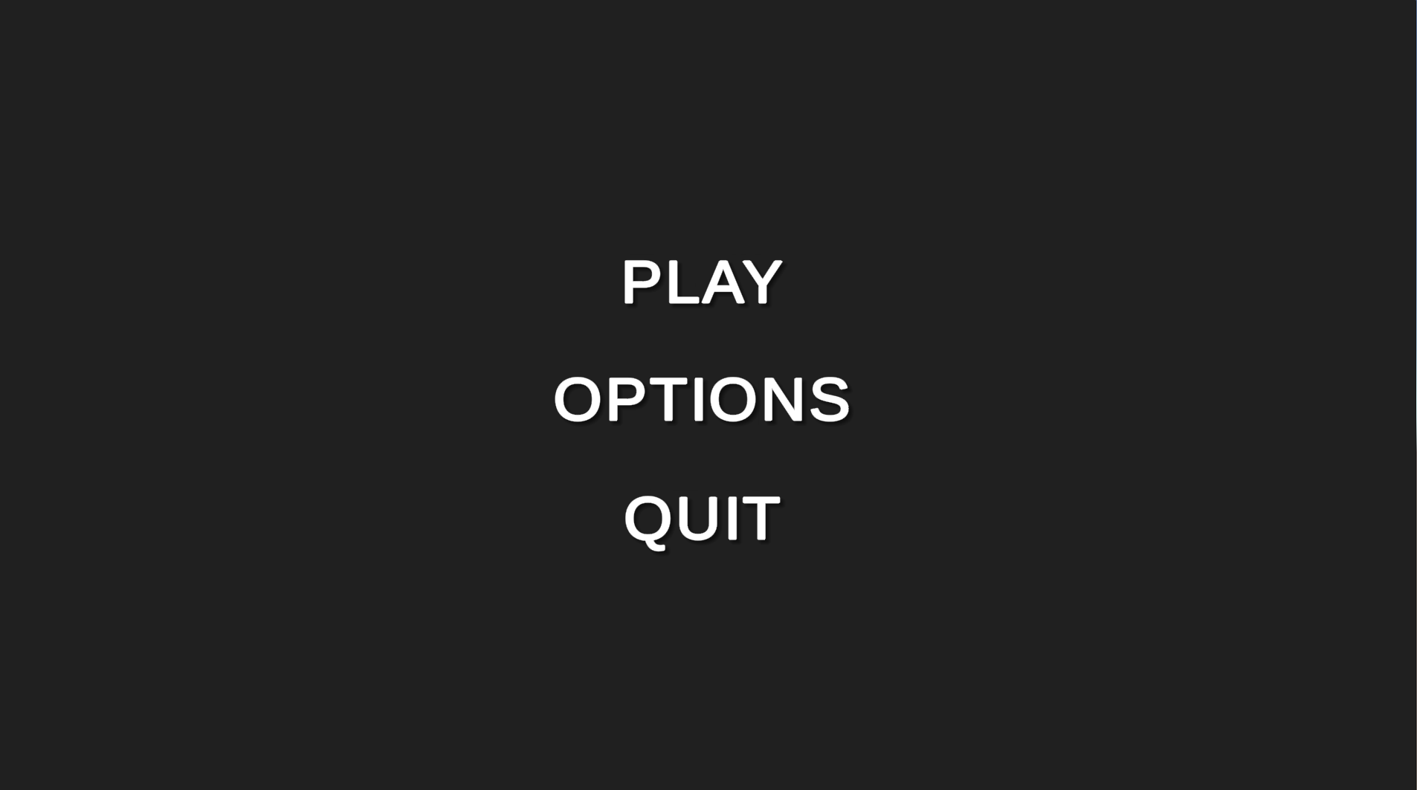
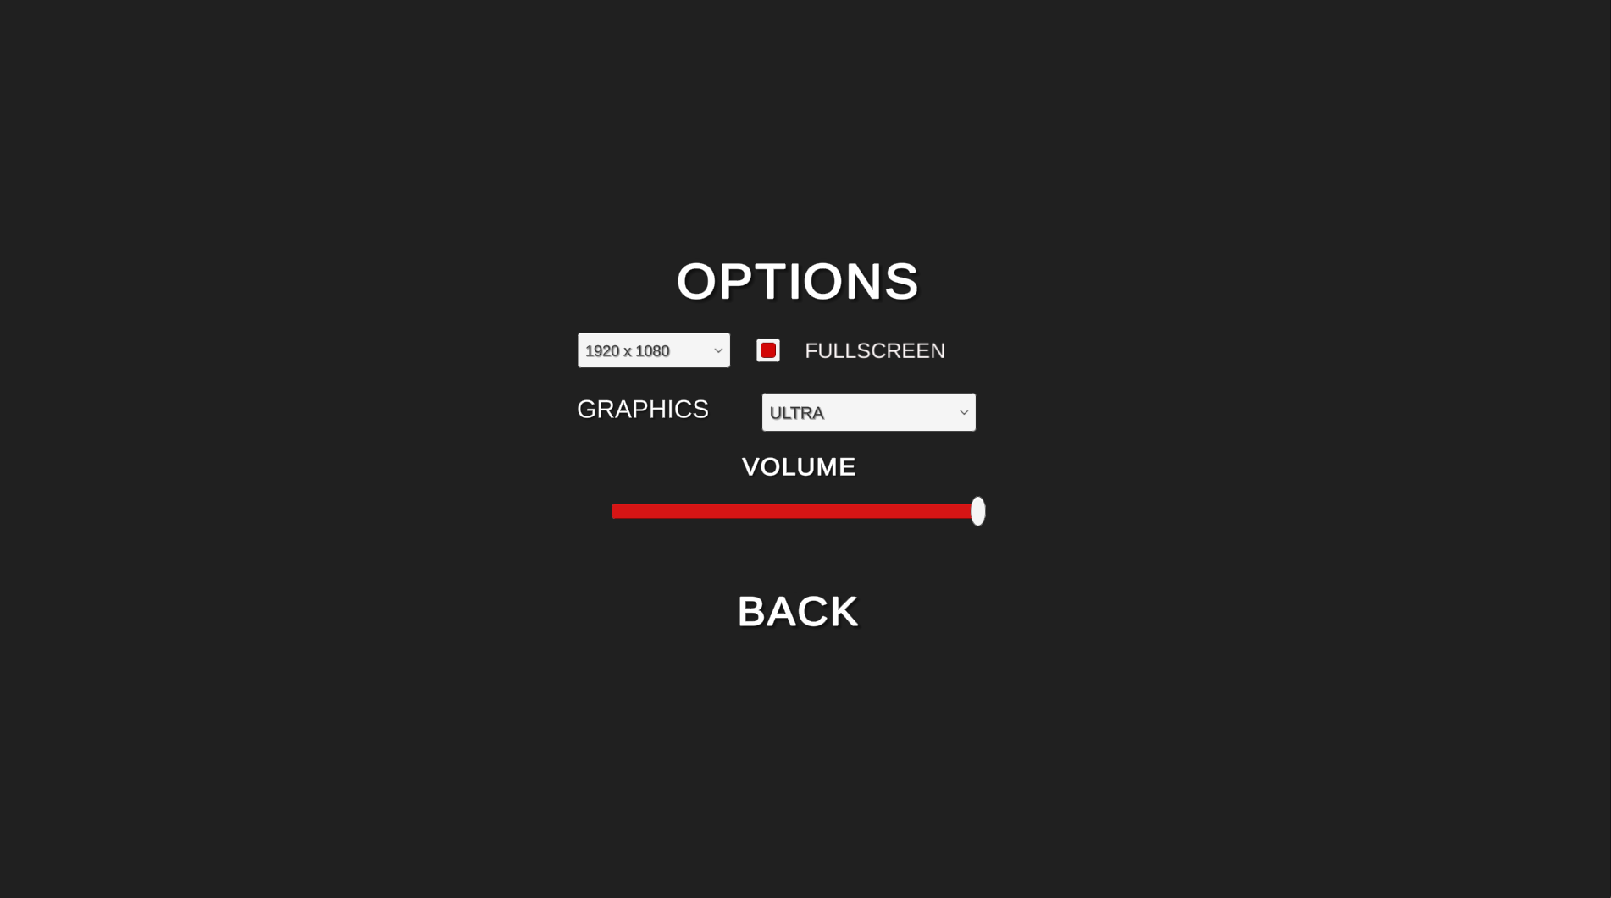
Quarter Life
Valeri Haataja, Matti Heinonen, Samuli Rönkkö, TVT17SPO
Information Technology, Product Design and Implementation
Introduction
The aim of this project was to make a 3D game with Unity. We decided to make a sci-fi first person shooter where player needs to survive as a last survivor from research station where alien creatures has escaped.
Objectives
Objectives included that game has three playable scenes in addition to main menu, settings and end credits scenes. Game should save progress and in main menu player can choose to load or start new game. (See Figure 1 below.) In settings menu player should be able to change resolution, quality and volume. Game should also have different kind of enemies that patrol the gamemap and some puzzle mechanics.
FIGURE 1. Main menu
Methods
Project was made using Unity game engine and Unity Asset Store was used to get assets to the game. For level building we used Snaps prototyping assets and Unity ProBuilder.
Results
In the end of project we had working game from start to finish. It had three playable levels with two different enemies which patrolled gamemap and attacked if they saw or heard player. Player also had to solve some puzzles to get different doors open. Game has settings for resolution, quality, volume and full screen toggle which player can modify. (See Figure 2 below.) Game also saves progress when player moves from one scene to another.
FIGURE 2. Settings menu
Although the end product is working game, there is lot things we could have polished but we didn’t have enough time.
FIGURE 3. Final boss
Conclusions
The project was success. Game is playable from start to finish and most of planned features were succesfully added to the game. Possible improvements could have been made but time was limited for this project.
References
1. Unity game engine:
https://unity.com/
2. Snaps assets:
https://unity.com/snaps
3. ProBuilder:
https://unity3d.com/unity/features/worldbuilding/probuilder
Unity Game Project
ECTS credits: 15
Date of publication: 2019, Autumn
Instructor: Pertti Heikkilä

