Slide 1
Software Engineering 2: myTaxiService
Casati Fabrizio, Castelli Valerio

Slide 2
Context
Aim: build a taxi management system for a medium-large city
The city area is divided in taxi zones, there must be a taxi queue for each zone
Taxis are matched with requests depending on the zone they come from
Interaction with the system happens through smartphones, tablets and web browser
Support both immediate requests and reservations (for registered users only)
The existing taxi management service of the city is fully migrated and decommissioned
24/7 service (ideally)

Slide 3
Domain Assumptions (I)
Taxis are uniquely associated to drivers and viceversa
Passengers don’t need to choose a particular taxi driver among those available for their ride
Taxi drivers are provided with a mobile phone with an active data plan by the city council
Passengers are not allowed to place reservations more than 15 days in advance or cancel reservations after a taxi has already been scheduled for them
Rides can be requested by all passengers, while reservations can only be placed by registered passengers
The only taxis eligible for fulfilling a reservation are the ones present in the queue of the zone associated with the reservation source address 10 minutes before the scheduled meeting time

Slide 4
Domain Assumptions (II)
In order to receive ride requests, a taxi driver must explicitly mark himself as available
A taxi driver will not be able to receive ride requests while he’s unavailable
Taxis that are considered to be out-of-city will not be able to receive calls
A taxi driver who is currently on a ride will not be able to receive calls
A taxi driver must always notify the system when he terminates a ride
After a taxi driver has been associated to a call, he must confirm or refuse the request within two minutes. After that period of time, the call is considered refused
If no taxis are available to fulfill a reservation 10 minutes before the scheduled meeting time, attempts of rescheduling are to be made at intervals of 2 minutes for at most 20 times

Slide 5
Functional Requirements
The city administration must have the possibility to enter and update taxi driver data and the taxi zone division
Taxi drivers must be able to
communicate their availability status
receive, accept, refuse and drop ride requests
communicate they have terminated a ride
Passengers must be able to request rides and, if logged in, also place and manage their reservations
The system must support third party expansion through plugins and remote services
It must be possible to verify the identity of a passenger before taking him onboard

Slide 6
Stakeholders and actors
Stakeholders
ACTORS
Passengers
Taxi drivers
City council
Taxi drivers’ union
Mobile phone producers
Wireless carriers
Third party developers
Guest passenger
Guest taxi driver
Logged in passenger
Logged in taxi driver
Administrative personnel
Mapping service
Remote services

Slide 7
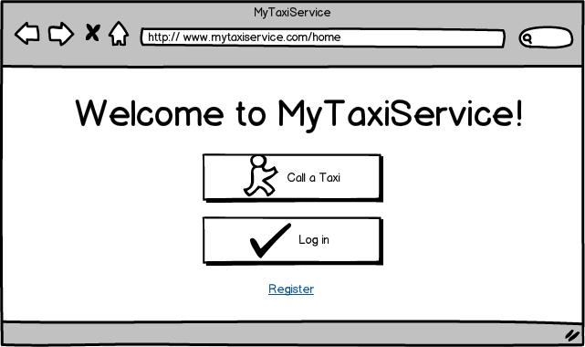
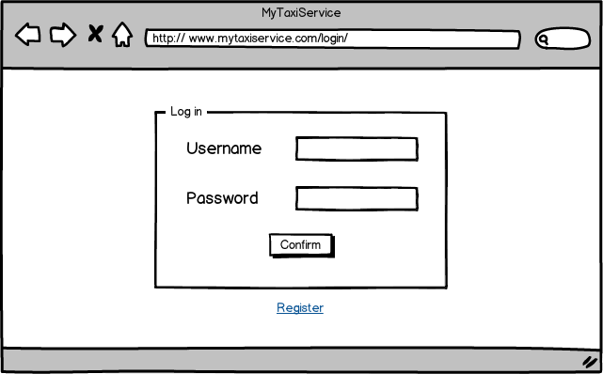
UI Mockup (I)
HOMEPAGE
USER LOGIN

Slide 8
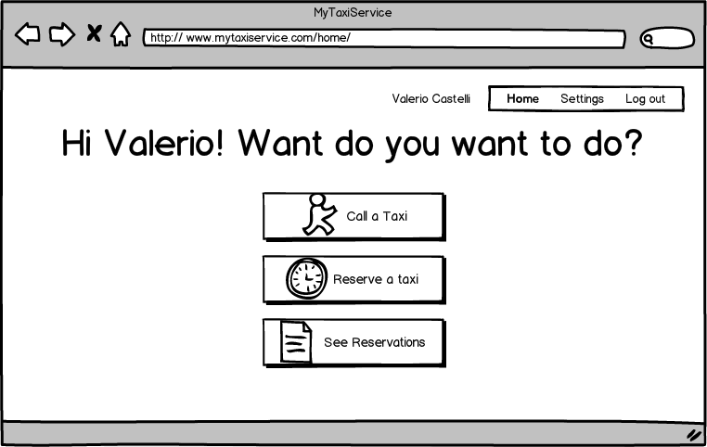
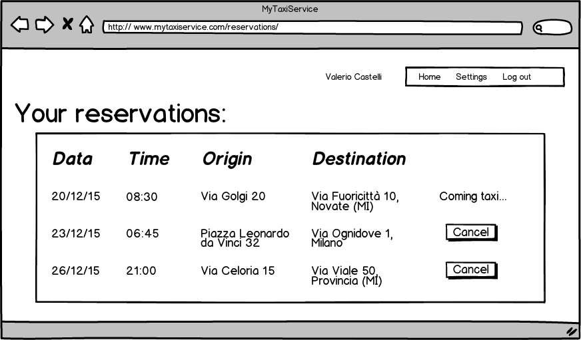
UI Mockup (II)
PASSENGER HOMEPAGE
PASSENGER RESERVATIONS

Slide 9
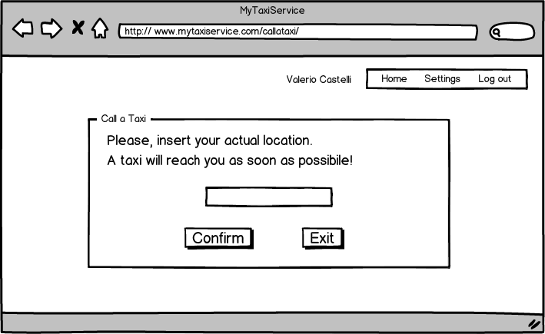
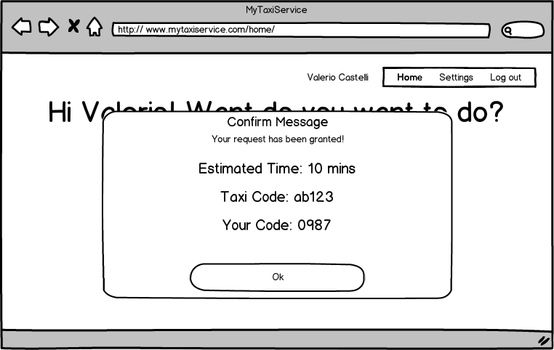
UI Mockup (III)
PASSENGER REQUEST
REQUEST CONFIRMATION

Slide 10
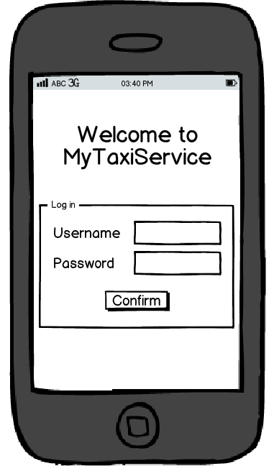
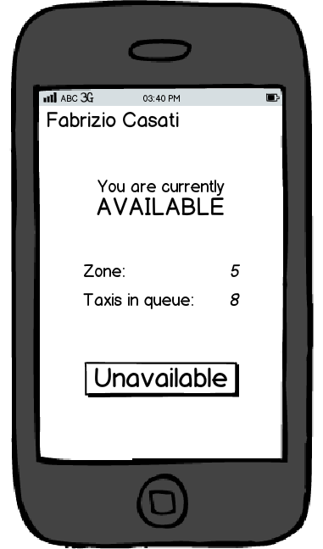
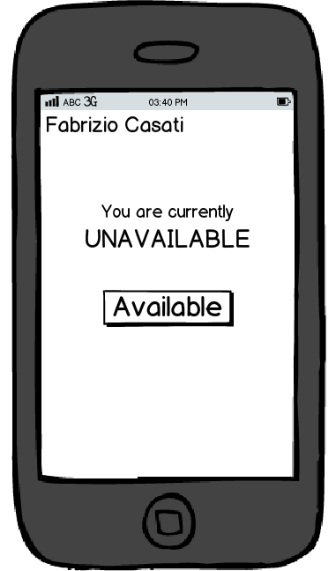
UI Mockup (IV)
MOBILE LOGIN
Taxi available
Taxi unavailable

Slide 11
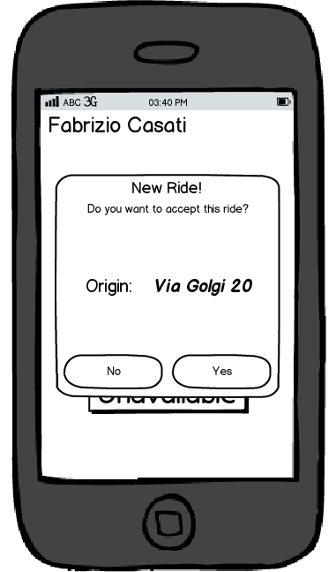
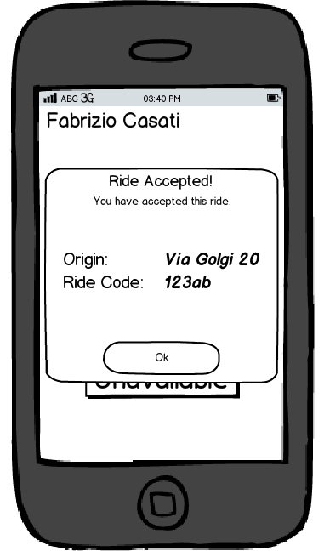
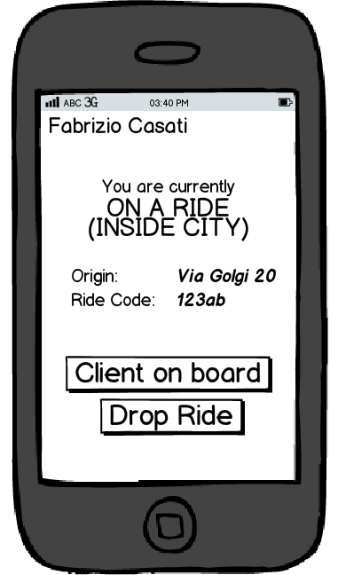
UI Mockup (V)
ride request
accepted ride
currently riding

Slide 12
Architectural Design
Multi-layer and multi-tier architecture
Access to DBMS is mediated by an intermediate abstraction (Data Layer) for flexibility
Business Layer implements core functionalities, exposed through an Application Façade
A subset of functionalities is made available for remote calls via a Service Layer (SOAP and JAX-WS)
Communication between remote clients and central system happens through a message broker and notification system
Implementation based on Java EE

Slide 13
Architecture: high level components
Account Management
Passenger registration and login procedure
Settings management and password retrieval
Taxi Management System
Maintains the availability status of each taxi updated
Manages the taxi queue associated with each zone in the city
Accepts and handles taxi reservations
Fulfills taxi requests by selecting the first available taxi in the corresponding taxi zone
Mapping Service
Reverse geocoding, maps and ETA
System Administration
Insert, update, delete taxis and zones
API permission management
Statistical queries and service monitoring
Remote Services Interface
Exposes APIs to third party services
Notification System
Sends notification to users
Data Access Utilities
Mediates access to DBMS
Database Management System (DBMS)

Slide 14
High level components
Taxi Management System:
Reservation Management
Request Management
Location Management
Taxi Management
Account Management:
Passenger Registration
Login
Password Retrieval
Settings Management
System Administration:
API Permission Management
Zone Division Management
Taxi Driver Management
Service Statistics
Plugin Management

Slide 15
Deployment view

Slide 16
Remote API
Methods exposed by the core system via a web service interface
Service Oriented Architecture (SOA)
XML-based requests (SOAP)
Managed by the JAX-WS API of Java EE
Each session bean exposes a subset of the available methods
Plugins are allowed to extend the offered API
Remote third party services can invoke the exposed methods
Different levels of privileges are supported
Details discussed in the DD (Component Interfaces section)

Slide 17
Architectural Styles
Service Oriented Architecture (SOA)
Used to expose the APIs of the core system
Allows easily expansion of the offered functionalities
Layered Architecture
Separation of concerns
Great clarity and flexibility
Different services run on different machines
Client/Server Architecture
Business Logic implemented in servers
Clients used only for presentation purposes
4-tier Architecture
Better security and resilience
Critical services are isolated and protected from external attacks
Cloud Architecture
Great scalability of hardware resources
Cost-effective
No necessity of maintaining a server farm
Publisher/Subscriver Architecture
Used to implement the notification system
Flexible with respect to further expansions

Slide 18
Other design decisions
CORE SYSTEM IMPLEMENTATION: JAVA EE
APPS: NATIVE FRAMEWORKS AND HTML5
Supports multi-tiered applications
Highly reliable
Interoperable (JAX-WS)
Automatically manages reliable DB transactions, resource allocation and secure network communicatons
Supports load balancing
Mature, well known, supported technology
Native look & feal on each platform
Supports platform-specific advancements
Very small codebase
Only implements presentation
WebApps implemented in HTML5
Available both on desktop and mobile
Tailored to the specific form-factor

Slide 19
Integration Testing
ENTRY CRITERIA
INTEGRATION STRATEGY
RASD and DD fully written and reviewed
Data Access Utilities: 100% complete
Taxi Management System: 90% complete
Account Management: 70% complete
System Administration: 70% complete
Client Apps: 50% complete
Components are integrated when they reach 90% completion
Bottom up approach
Reflects the development process
Discover errors earlier
In case of ties: critical-module-first approach
Subsystems are fairly independent from one another
Gives precedence to most critical functionalities

Slide 20
Integration of components
TAXI MANAGEMENT SYSTEM
SYSTEM ADMINISTRATION
ACCOUNT MANAGEMENT

Slide 21
Integration of subsystems
Bottom-up: start with components that haven’t got unfinished depencencies
To break ties: critical-module-first
Start with Taxi Management System
Then System Administration
Finally Account Management
When business logic is integrated, add the Remote Services and the Notification System
Last step: integrate the client apps

Slide 22
Test Equipment and Tools
Test equipment
tools
Mobile devices
All supported platforms (Android, iOS, Windows)
All supported screens (3”-6” phone, 7”-12” tablet)
Subject to revision depending on actual market share of the devices
Desktop and notebook: no particular req.
Cloud infrastructure
Possibly already the final one
JUnit
Both unit testing and integration testing
In conjunction with Mockito
Arquillian
Test how the containers interact with the beans
Preliminary performance testing
Analysis tools for each mobile platform
Apache JMeter to test loads on both web layer and business layer

Slide 23
Stubs, drivers and test data
Bottom-up approach: a driver for each component and subsystem
Stubs to replace clients when developing the core system
Allow us to test the notification system without having the clients
Simply write the calls on a log
Test data: stress the possible sources of anomalies
Taxi drivers: invalid taxi license, invalid driving license, already existing id…
Passengers: invalid email, address, phone number, already existing id…
Zones: overlapping zones, location vertices not producing a convex area, invalid or null locations..
Requests: location outside city
Reservations: source location outside city, meeting time outside the validity range
In general: null objects and/or fields

Slide 24
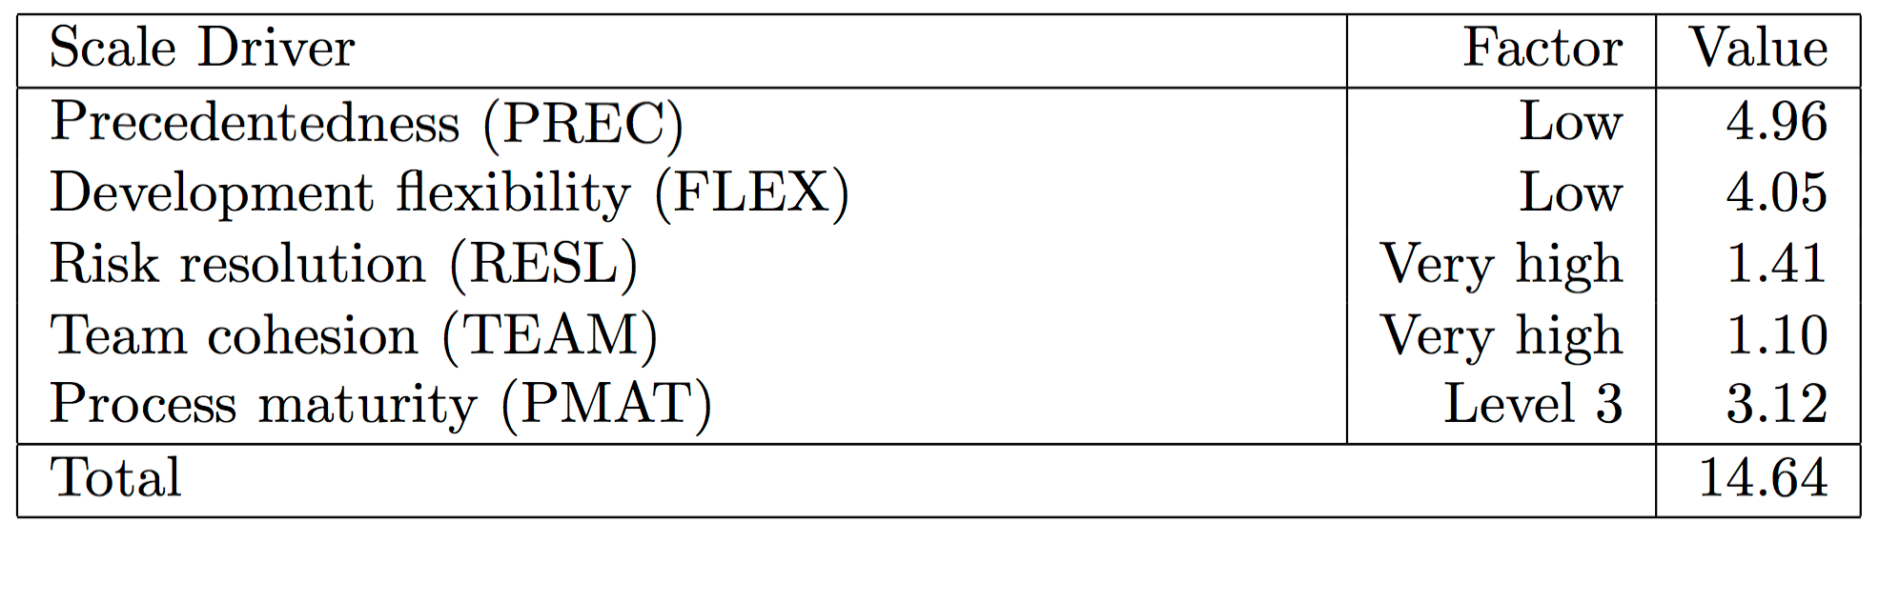
Function Points and COCOMO II
COCOMO II Scale Drivers:
Precedentedness: low
We have some experience in designing software, but not at this scale and not in J2EE
Development flexibility: low
Strict functional requirements
Risk resolution: very high
Quite extensive analysis of the possible risks
Team cohesion: very high
We’ve been working together for 3+ years
Process maturity: level 3 CMM
First project of this kind, but we know well the tools and the environment

Slide 25
Effort and duration estimation
OPTIMISTIC SCENARIO
PESSIMISTIC SCENARIO
Assuming a conversion rate of 46 LOC x FP
SLOC = 238 * 46 = 10948
“Average” suggested value
Effort = A * EAF * KSLOCE = 57 person-months
EAF = product of cost drivers = 1.54613
E = B+ 0.01 * scale_drivers = 1.0564
Duration = 3.67 * Effort^{F} = 12.81 months
F = 0.28 + 0.2 ∗ (E − B) = 0.30928
Actual duration: 57 person-months / 2 = 28.5 m
Assuming a conversion rate of 67 LOC x FP
SLOC = 238 * 67 = 15946
“High” suggested value
Effort = A * EAF * KSLOCE = 85 person-months
EAF = product of cost drivers = 1.54613
E = B+ 0.01 * scale_drivers = 1.0564
Duration = 3.67 * Effort^{F} = 14.49 months
F = 0.28 + 0.2 ∗ (E − B) = 0.30928
Actual duration: 85 person-months / 2 = 42.5 m

Slide 26
Risk Analysis
POLITICAL ISSUES
TECHNICAL ISSUES
HUMAN ISSUES
Issues with the city administration
Change of the city government
Budget crisis (spending review?)
Shift in local government priorities
Issues with taxi drivers’ union
Changes in national legislation
Countermeasures: let stakeholders have an active role in the project (meetings, reviews, demos…)
Changes in the map service API
Isolate the calls to the mapping service and make them portable
Overestimate technical abilities
Try to hire good people
Loss of source code
Use backups
Changes in cloud pricing plans
Keep the system portable
Key members of the team leave the company or get ill
Make sure no single person is the sole responsible of a task
Users refuse the app
Plan acceptance tests and marketing strategies, incentives
Schedule slippage
Allocate extra time at the end of each phase

Slide 27
Extra: Code Inspection of GlassFish
Class: com.sun.enterprise.connectors.jms.system.ActiveJmsResourceAdapter
Methods: createManagedConnectionFactory(…), createManagedConnectionFactories(…)
Issues:
Constant violation of information hiding
Exceptions are not properly handled in many cases (empty catch blocks, pure logging operations, never checks objects to be not-null)
There are several points in which the comments explicitly say the code is a patch, a hack or a certain function isn’t fully implemented yet (TODOs)
Poor documentation (incomplete Javadoc, comments mostly missing, unexplained acronyms)
Not thread safe
Inconsistent formatting and poor choice of names (same name for constant and variable, one-letter variables and even plainly misleading names)

