Slide 1
Software Engineering 2: myTaxiService
Casati Fabrizio, Castelli Valerio

Slide 2
Context
Aim: build a taxi management system for a medium-large city
The city area is divided in taxi zones, there must be a taxi queue for each zone
Taxis are matched with requests depending on the zone they come from
Interaction with the system happens through smartphones, tablets and web browser
Support both immediate requests and reservations (for registered users only)
The existing taxi management service of the city is fully migrated and decommissioned
24/7 service (ideally)

Slide 3
Domain Assumptions (I)
Taxis are uniquely associated to drivers and viceversa
Passengers don’t need to choose a particular taxi driver among those available for their ride.
Taxi drivers are provided with a mobile phone with an active data plan by the city council.
Passengers are not allowed to place reservations more than 15 days in advance or cancel reservations after a taxi has already been scheduled for them
Rides can be requested by all passengers, while reservations can only be placed by registered passengers.
The only taxis eligible for fulfilling a reservation are the ones present in the queue of the zone associated with the reservation source address 10 minutes before the scheduled meeting time.

Slide 4
Domain Assumptions (II)
In order to receive ride requests, a taxi driver must explicitly mark himself as available.
A taxi driver will not be able to receive ride requests while he’s unavailable.
Taxis that are considered to be out-of-city will not be able to receive calls.
A taxi driver who is currently on a ride will not be able to receive calls.
A taxi driver must always notify the system when he terminates a ride.
After a taxi driver has been associated to a call, he must confirm or refuse the request within two minutes. After that period of time, the call is considered refused.
If no taxis are available to fulfill a reservation 10 minutes before the scheduled meeting time, attempts of rescheduling are to be made at intervals of 2 minutes for at most 20 times.

Slide 5
Functional Requirements
The city administration must have the possibility to enter and update taxi driver data and the taxi zone division
Taxi drivers must be able to
communicate their availability status
receive, accept, refuse and drop ride requests
communicate they have terminated a ride
Passengers must be able to request rides and, if logged in, also place and manage their reservations
The system must support third party expansion through plugins and remote services
It must be possible to verify the identity of a passenger before taking him onboard

Slide 6
Stakeholders and actors
Stakeholders
ACTORS
Passengers
Taxi drivers
City council
Taxi drivers’ union
Mobile phone producers
Wireless carriers
Third party developers
Guest passenger
Guest taxi driver
Logged in passenger
Logged in taxi driver
Administrative personnel
Mapping service
Remote services

Slide 7
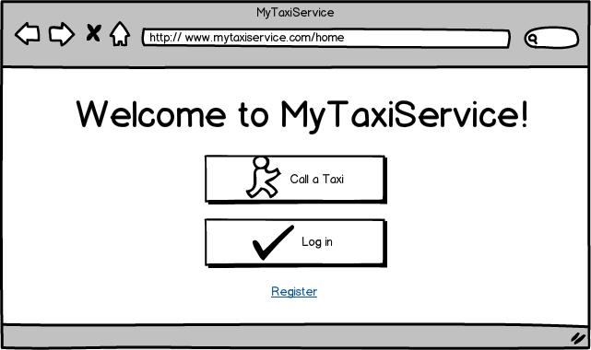
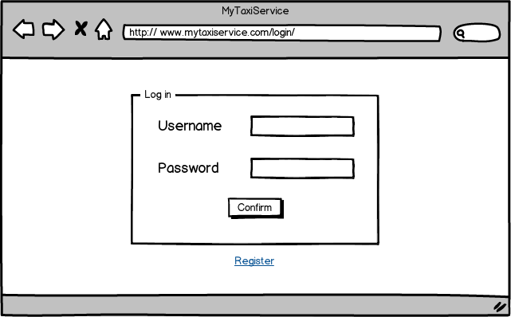
UI Mockup (I)
HOMEPAGE
USER LOGIN

Slide 8
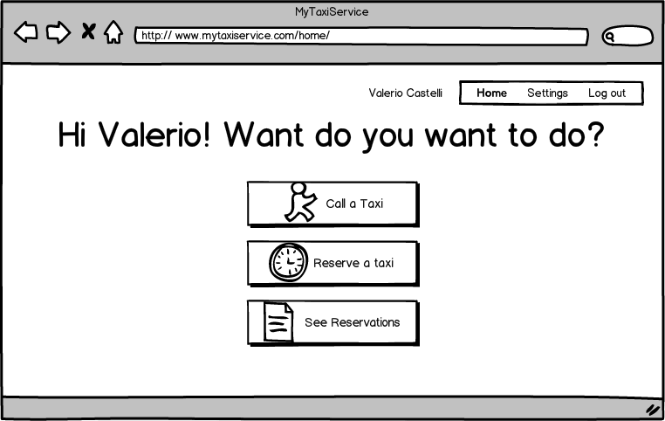
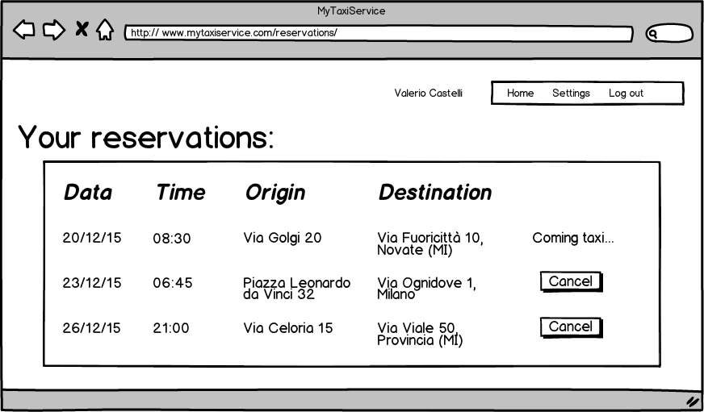
UI Mockup (II)
PASSENGER HOMEPAGE
PASSENGER RESERVATIONS

Slide 9
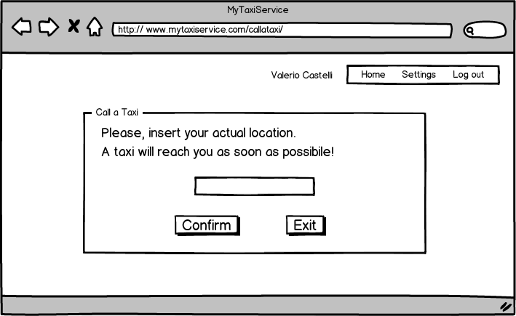
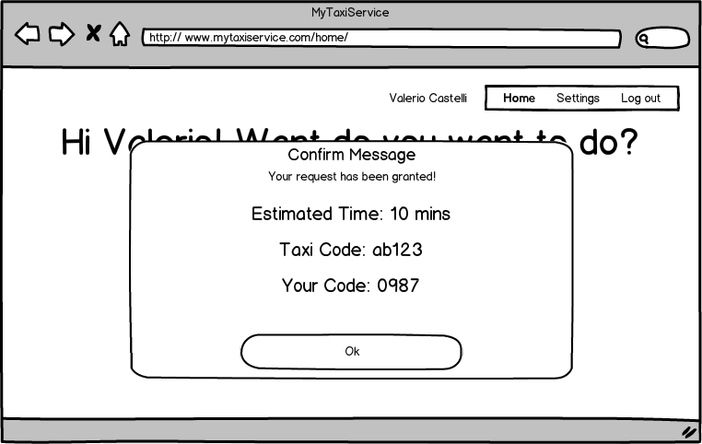
UI Mockup (III)
PASSENGER HOMEPAGE
PASSENGER RESERVATIONS

Slide 10
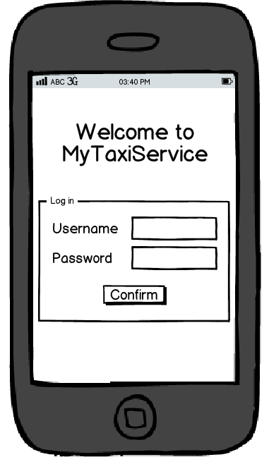
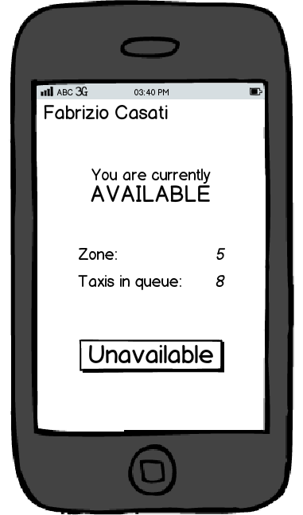
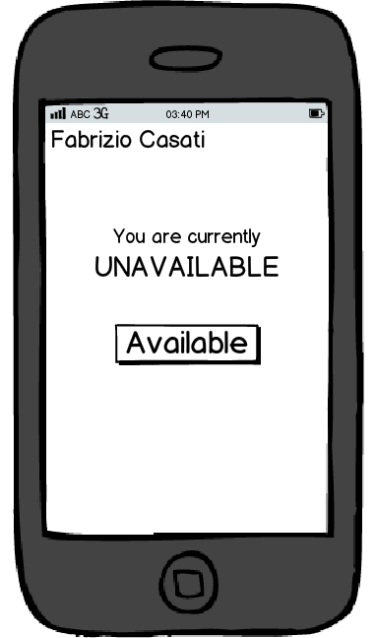
UI Mockup (IV)
MOBILE LOGIN
Taxi available
Taxi unavailable

Slide 11
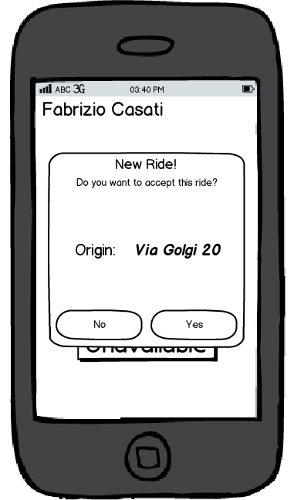
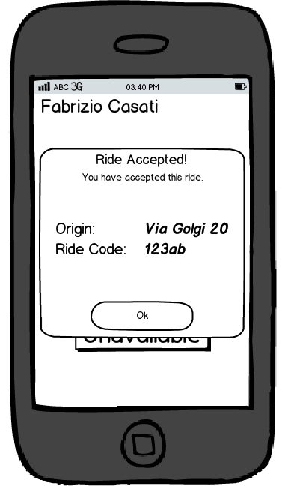
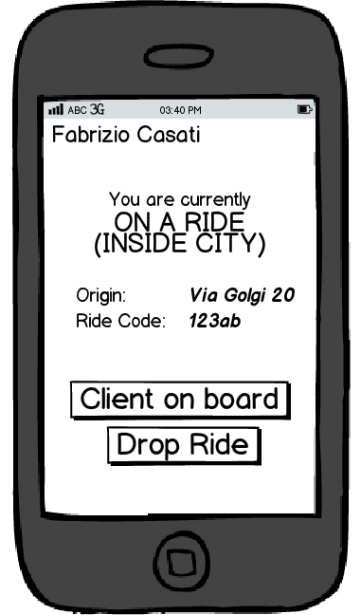
UI Mockup (V)
ride request
accepted ride
currently riding

