Slide 1

Tor – The Onion Router
Valerio Tanferna, Alessandro Martinelli

Slide 2
Roadmap
Introduction
Tor protocol
Hidden services
Connecting to the Tor network

Slide 3





Traffic analysis
Packet’s header travel in clear on the Internet
A malicious user may perform data analysis based on the information he can infer from the packet header.
book.com
User
game.com
Lucypher

Slide 4
What is the problem?
Aside from the obvious privacy concern, traffic analysis is problematic also for other reasons, e.g:
ISP may block traffic to set destinations
Journalists can’t safely communicate with whistleblowers and dissidents
If you're travelling abroad and you connect to your employer's computers to check or send mail, you can inadvertently reveal your national origin and professional affiliation to anyone observing the network

Slide 5
Roadmap
Introduction
Tor protocol
Hidden services
Connecting to the Tor network

Slide 6
The Onion Router
The Onion Router (Tor) is an open-source software program that allows users to protect their privacy and security against a common form of Internet surveillance known as traffic analysis [technopedia.com]
Tor is based on OR, a project developed in the 1990 by the U.S. Navy in an effort to protect government communications
Tor is born in 2002 by Dingledine and Mathewson, member of the original OR project, who founded The Tor Project in 2006. The Tor Project is supported by the Electronic Frontier Foundation.

Slide 7
Improvements of TOR over OR
The more interesting improvements added in TOR with respect to OR are the following:
Perfect Forward Secrecy
Directory servers
Variable exit policies
Rendezvous points and hidden services
Other improvements:
No mixing, padding, or traffic shaping (yet)
Many TCP streams can share one circuit
Leaky-pipe circuit topology
End-to-end integrity checking

Slide 8
The Onion Router: a first look
The Idea is to have packets go through several preset node, before reaching the actual destination
The more nodes partecipate to the protocol, the more difficult associating a node to his intended destinations is
B
E
D
book.com
U
A
G
game.com
C
F
antiGov.com

Slide 9




Onion Routing
Relay
Exit-Relay
A
B
C
U
D
OR C
OR A
OR B
MSG
Session key

Slide 10
All the keys that TOR use
Tor uses a variety of different keys, with three goals in mind:
Encryption, to ensure privacy of data within the Tor network
Authentication, so clients know they're talking to the relays they meant to talk to
Signatures, to make sure all clients know the same set of relays

Slide 11


How build a circuit
UA
UB
UA
UB
U
TLS
A
TLS
B
S
c1
c1
c2
c2
Create c1, (g^{X})K⁺_{A}
many circuits can
be multiplexed
over the single
TLS connection
K⁺ public key (RSA)
K_{XY} simmetric key (AES)
Created c1, g^{Y},H(K)
Relay c1, {extend,g^{X2}}K_{UA}
Create c2, (g^{X2})K⁺_{B}
Relay c1, {extend,g^{Y2},H(K²)}K_{UA}
Created c2, g^{Y2},H(K_{UB})
Relay c1, {{data,get}K_{UB}}K_{UA}
Relay c2, {data,get}K_{UB}
get
Relay c1, {{hello}K_{UB}}K_{UA}
Relay c2, {hello}K_{UB}
hello

Slide 12

Circuit Identifier
Based on their command, cells are either
control cells, which are always interpreted by the node that receives them. Main commands
Create & Created
Destroy
relay cells, which carry end-to-end data. Main commands:
Relay Data
Relay Extend
Relay Truncate

Slide 13
Some further details: Tor Proxy
Who is actually in charge of establishing the connections, exchanging the symmetric key etc?
The Tor Proxy Software
An attacker will try to have the user browser bypass the Tor Proxy, so the IP address is revealed. This can be done e.g. by having it running a script.
A possibile protection is to use the NoScript extension
Computer running Tor
OS
Browser
Tor Proxy
A
B
C
D
Network card
U
E
F
G
game.com
H
I
J
K
antiGov.com

Slide 14



TOR browser running on PC
U
OR1
OR2
OR3
93.34.75.148 (Italy)
97.34.136.48 (France)
102.34.207.45 (Germany)
137.93.194.09 (Switzerland)
192.168.1.5
U
192.168.1.5
93.34.75.148 (Italy)

Slide 15

Router configured with TOR
U
OR1
OR2
OR3
93.34.75.148 (Italy)
97.34.136.48 (France)
102.34.207.45 (Germany)
137.93.194.09 (Switzerland)
192.168.1.5
U
OR1
OR2
OR3
93.34.75.148 (Italy)
97.34.136.48 (France)
102.34.207.45 (Germany)
137.93.194.09 (Switzerland)
192.168.1.5

Slide 16

Some further details: Directory Servers
Who tell a node which the nodes running Tor are?
The Directory Server (there are 9 of them)
They agree on a consensus directory
A Tor node trust a consensus directory only if is signed by more than half of the DSs.
An attacker must control more than half of the DSs
Node B, PK_{B} Node F, PK_{F} Node G, PK_{G} Node J, PK_{J}
Directory Server
A
B
B
C
D
U
E
F
game.com
F
G
G
H
I
J
J
K
antiGov.com

Slide 17
Directory Servers vs Censorship in totalitarian regimes
It is not infrequent that, in a totalitarian regime, the government wants to prevent people from using Tor.
This can be achieved obtaining from the directory servers the IP address of all the node partecipating in Tor, and blocking any connection to them.
TOR Bridge Relay:
Alternative entry point to TOR network
No publicy know
Included and preconfigured in Tor Browser
You can add more Brigde Relay
ISP can still block TOR!
Solution: Pluggable transports transform the Tor traffic flow between the client and the bridge
This way, censors, who usually monitor traffic between the client and the bridge, will see innocent-looking transformed traffic instead of the actual Tor traffic.

Slide 18
Some further details: link encryption
Are all the connections along the path encrypted?
No, the last step is outside the Tor network, so it’s up to the website whether to implement a secure connection or not
The HTTPS everywhere extension may solve this
If something bad happens, the one who get in trouble is the exit-relay
An exit-relay may use an exit-policies, who specify which type of traffic he will forward
Node B, PK_{B} Node F, PK_{F} Node G, PK_{G} Node J, PK_{J}
B F,, HTTPS only G J, no SMTP
A
B
C
D
U
E
F
G
game.com
H
I
J
K
antiGov.com

Slide 19
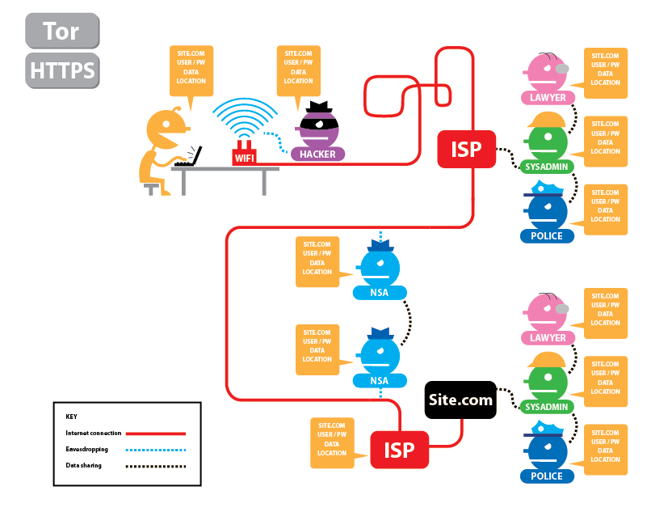

Slide 20
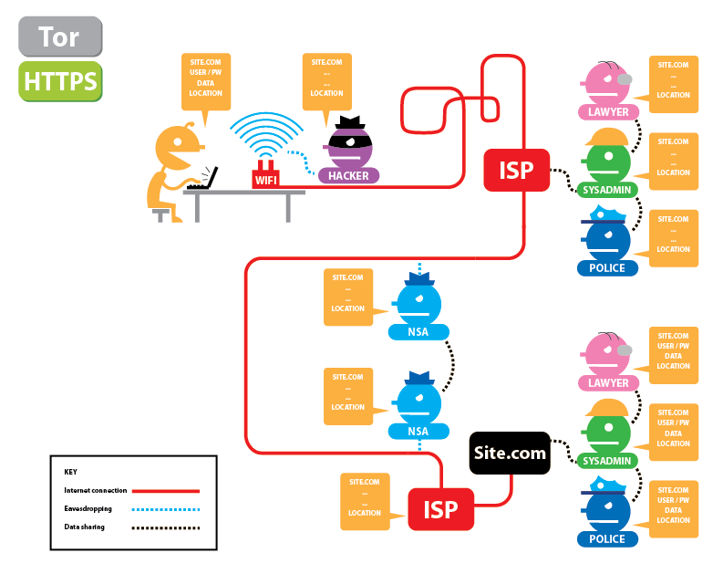

Slide 21
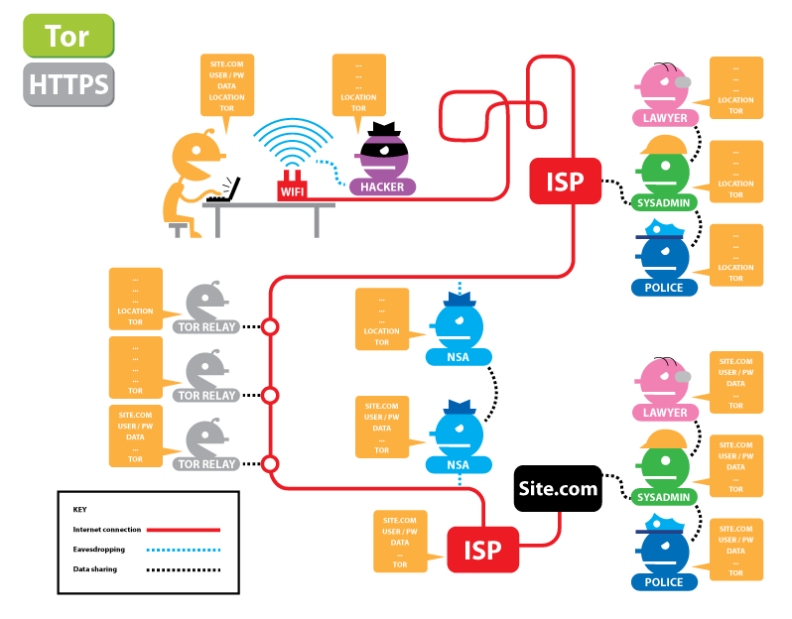

Slide 22
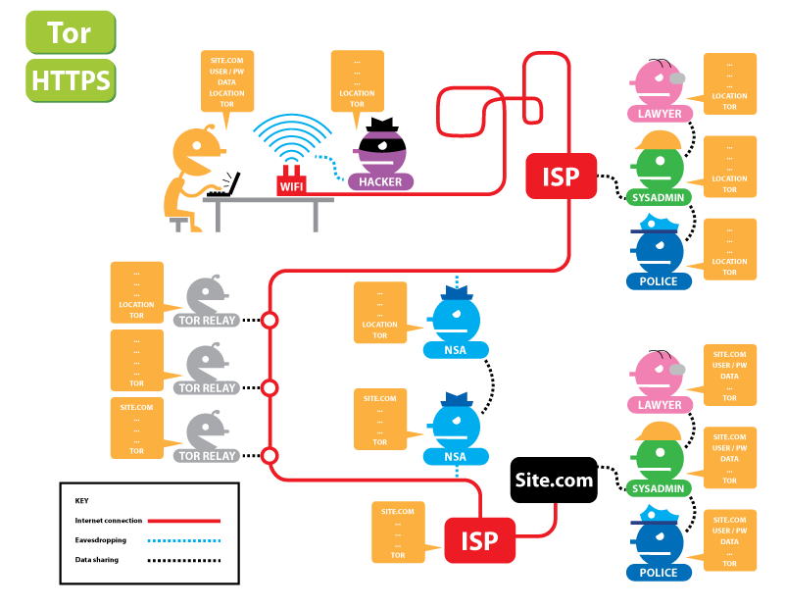

Slide 23
Roadmap
Introduction
Tor protocol
Hidden services
Connecting to the Tor network

Slide 24
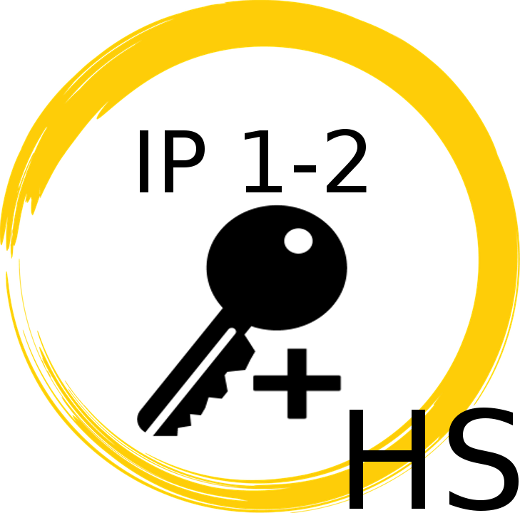

Hidden Services
DirectoryServer
a6gyk9.onion
IP1
U
HS
IP2
IP Introduction Point HS Hidden Service
Session key
Digital
Signature
Public key
Private key

Slide 25

Hidden Services
DirectoryServer
a6gyk9.onion
IP1
USR
RP
HS
IP2
IP Introduction Point HS Hidden Service
Session key
Digital
Signature
Public key
Private key

Slide 26
Hidden Services
DirectoryServer
a6gyk9.onion
IP1
USR
RP
HS
IP2
IP Introduction Point HS Hidden Service
Session key
Digital
Signature
Public key
Private key

Slide 27
Hidden Services
DirectoryServer
IP1
USR
RP
HS
IP2
IP Introduction Point HS Hidden Service
Session key
Digital
Signature
Public key
Private key

Slide 28
Roadmap
Introduction
Tor protocol
Hidden services
Connecting to the Tor network

Slide 29
How can I connect to Tor network?
Tor browser Use a standard browser (e.g firefox or chrome) over the Tor network
Use Tor Browser, a browser developed by the Tor Project

Slide 30
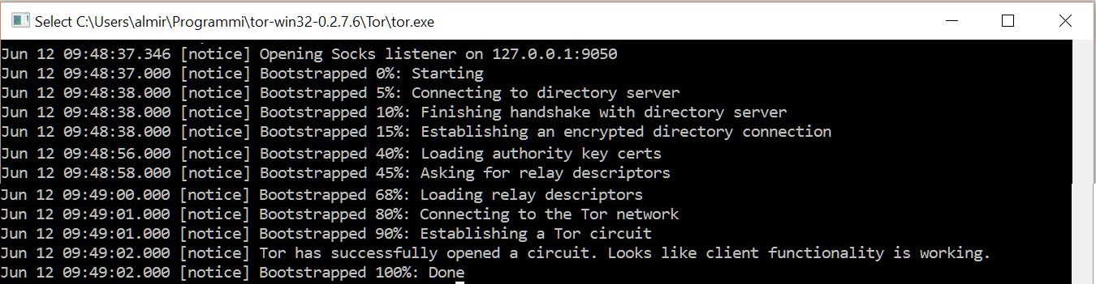
Standard browser over Tor (1)
Download the Expert Bundle from torproject.org
Once launched, this software will
open a socket listener
contact a directory server, asking the necessary information for building a circuit
eventually connect to the Tor network and establish a Tor circuit

Slide 31
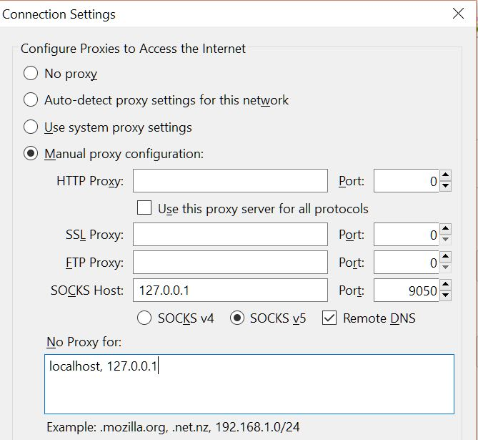
Standard browser over Tor (2)
We have to configure the browser to use a proxy,
Address: the loopback address
Port: the port where Tor is listening

Slide 32
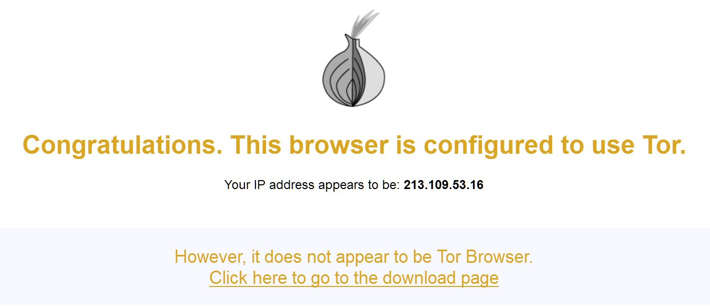
Standard browser over Tor (3)
Check https://check.torproject.org to know whether you are using Tor or not

Slide 33
Standard browser over Tor (4)
However, just being connected to the Tor network doesn’t guarantees anonimity on the Internet
Infomation leaks are still possibile, e.g running third-party script, or using HTTP between the exit-relay and the server
A kind of private browsing mode is required
Firefox Private Browsing and Chrome Incognito mode are still lacking some important features (they mainly address local attack only)
Althrough a lot of work has been done by a collaboration between Torproject and Google, the Chrome Incognito mode still not provides good defenses against fingerprinting and a network adversary

Slide 34
The Tor Browser (1)
Based on Mozilla Extended Support Release (ESR) Firefox branch
The developing is driven by the following requirements, aiming to defend against both network and local forensic adversaries:
Proxy Obedience
State Separation
Disk Avoidance
Application Data Isolation
Fingerprinting Unlinkability

Slide 35
The Tor Browser (2)
For satisfying this requirements, it brings a lot of modification w.r.t firefox, such as
More than 100 about:config entry have been modified
Over 60 patches to Firefox have been applied
Uses some extensions, like HTTPS everywhere, NoScrpit and Torbutton

Slide 36
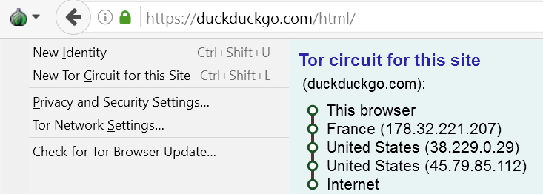
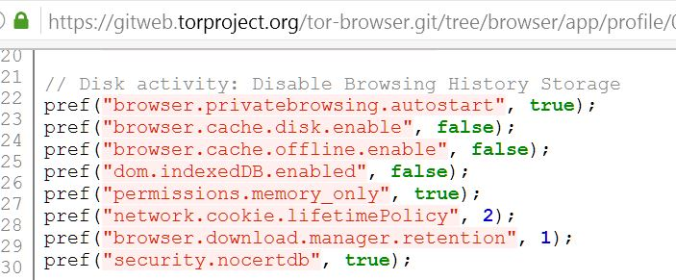
The Tor Browser (2)
Torbutton example
About:config modification example

Slide 37
Reference
https://svn.torproject.org/svn/projects/design-paper/tor-design.pdf
https://www.torproject.org/projects/obfsproxy.html.en
http://crypto.stanford.edu/~dabo/pubs/papers/privatebrowsing.pdf
https://www.torproject.org/projects/torbrowser/design/
https://gitweb.torproject.org/torspec.git/tree/tor-spec.txt
http://tor-talk.torproject.narkive.com/KZ6qfXwp/tbb-tor-project-s-amendments-to-firefox-about-config
https://gitweb.torproject.org/tor-browser.git/tree/browser/app/profile/000-tor-browser.js?h=tor-browser-31.6.0esr-4.5-1
https://gitweb.torproject.org/builders/tor-browser-bundle.git/tree/Bundle-Data/linux/Data/Browser/profile.default/preferences/extension-overrides.js
https://www.torproject.org/docs/faq

