Slide 1
Biology meets code
Programming session
Valeriu Ohan May 2022

Slide 2

The FASTA file format
Simple non-compressed text file for representing nucleotide or peptide sequences
Contains pairs of lines
First line is a sequence descriptor starting with a grater-than symbol (>) and containing a label
Second line is the raw sequence
>Sequence_1
AGTCGTAGCTAGCTAGACCCATTTAGATCGGATACATA

Slide 3
Transcribing DNA into RNA
An RNA string is a string formed from the alphabet containing 'A', 'C', 'G', and 'U’.
Given: A DNA string t of length at most 1000 bp.
Return: The transcribed RNA string of s.
Test file
© https://rosalind.info

Slide 4
Complementing a Strand of DNA
In DNA strings, symbols 'A' and 'T' are complements of each other, as are 'C' and 'G’. The reverse complement of a DNA string s is the string c formed by reversing the symbols of s, then taking the complement of each symbol (e.g., the reverse complement of "GTCA" is "TGAC").
Given: A DNA string s of length at most 1000 bp.
Return: The reverse complement c of s.
Test file
© https://rosalind.info

Slide 5
Computing GC Content
The GC-content of a DNA string is given by the percentage of symbols in the string that are 'C' or 'G'. For example, the GC-content of "AGCTATAG" is 37.5%. Note that the reverse complement of any DNA string has the same GC-content.
Given: At most 10 DNA strings in FASTA format (of length at most 1 kbp each).
Return: The ID of the string having the highest GC-content, followed by the GC-content of that string.
Test file
© https://rosalind.info

Slide 6
Counting Point Mutations
Given two strings s and t of equal length, the Hamming distance between s and t, denoted dH(s,t), is the number of corresponding symbols that differ in s and t.
Given: Two DNA strings s and t of equal length (not exceeding 1 kbp).
Return: The Hamming distance dH(s,t).
Test file
© https://rosalind.info

Slide 7
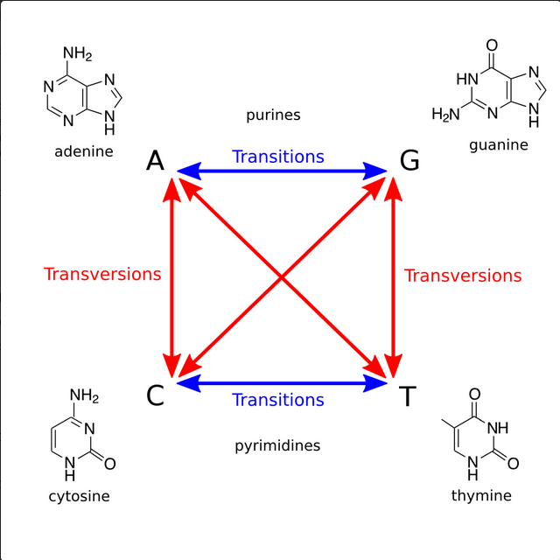
Transitions and Transversions
For DNA strings s1 and s2 having the same length, their transition/transversion ratio R(s1,s2) is the ratio of the total number of transitions to the total number of transversions, where symbol substitutions are inferred from mismatched corresponding symbols as when calculating Hamming distance.
Given: Two DNA strings s1 and s2 of equal length (at most 1 kbp).
Return: The transition/transversion ratio R(s1,s2).
Test file
© https://rosalind.info

Slide 8
Translating RNA into Protein
The 20 commonly occurring amino acids are abbreviated by using 20 letters from the English alphabet (all letters except for B, J, O, U, X, and Z). Protein strings are constructed from these 20 symbols. Henceforth, the term genetic string will incorporate protein strings along with DNA strings and RNA strings. Given: Two DNA strings s and t of equal length (not exceeding 1 kbp).
The RNA codon table dictates the details regarding the encoding of specific codons into the amino acid alphabet.
Given: An RNA string s corresponding to a strand of mRNA (of length at most 10 kbp).
Return: The protein string encoded by s.
Test file
© https://rosalind.info

Slide 9
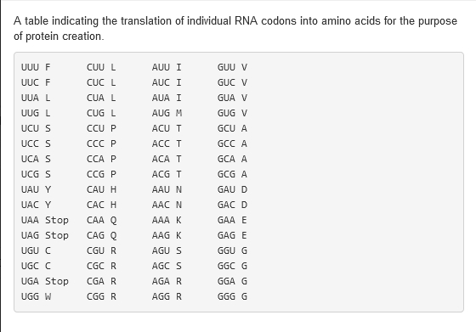
RNA codon table
{ 'UUU':'F', 'CUU':'L', 'AUU':'I', 'GUU':'V', 'UUC':'F', 'CUC':'L', 'AUC':'I', 'GUC':'V', 'UUA':'L', 'CUA':'L', 'AUA':'I', 'GUA':'V', 'UUG':'L', 'CUG':'L', 'AUG':'M', 'GUG':'V', 'UCU':'S', 'CCU':'P', 'ACU':'T', 'GCU':'A', 'UCC':'S', 'CCC':'P', 'ACC':'T', 'GCC':'A', 'UCA':'S', 'CCA':'P', 'ACA':'T', 'GCA':'A', 'UCG':'S', 'CCG':'P', 'ACG':'T', 'GCG':'A', 'UAU':'Y', 'CAU':'H', 'AAU':'N', 'GAU':'D', 'UAC':'Y', 'CAC':'H', 'AAC':'N', 'GAC':'D', 'UAA':'Stop', 'CAA':'Q', 'AAA':'K', 'GAA':'E', 'UAG':'Stop', 'CAG':'Q', 'AAG':'K', 'GAG':'E', 'UGU':'C', 'CGU':'R', 'AGU':'S', 'GGU':'G', 'UGC':'C', 'CGC':'R', 'AGC':'S', 'GGC':'G', 'UGA':'Stop', 'CGA':'R', 'AGA':'R', 'GGA':'G', 'UGG':'W', 'CGG':'R', 'AGG':'R', 'GGG':'G' }
© https://rosalind.info

Slide 10
RNA Splicing
After identifying the exons and introns of an RNA string, we only need to delete the introns and concatenate the exons to form a new string ready for translation.
Given: A DNA string s (of length at most 1 kbp) and a collection of substrings of s acting as introns. All strings are given in FASTA format.
Return: A protein string resulting from transcribing and translating the exons of s.
Test file
© https://rosalind.info

Slide 11
Open Reading Frames
Either strand of a DNA double helix can serve as the coding strand for RNA transcription. Hence, a given DNA string implies six total reading frames, or ways in which the same region of DNA can be translated into amino acids: three reading frames result from reading the string itself, whereas three more result from reading its reverse complement.
An open reading frame (ORF) is one which starts from the start codon (M) and ends by stop codon, without any other stop codons in between. Thus, a candidate protein string is derived by translating an open reading frame into amino acids until a stop codon is reached.
Given: A DNA string s of length at most 1 kbp in FASTA format.
Return: Every distinct candidate protein string that can be translated from ORFs of s. Strings can be returned in any order.
Test file
© https://rosalind.info

Slide 12
Open Reading Frames
Example input:
>Rosalind_99
AGCCATGTAGCTAACTCAGGTTACATGGGGATGACCCCGCGACTTGGATTAGAGTCTCTTTTGGAATAAGCCTGAATGATCCGAGTAGCATCTCAG
Example output:
MLLGSFRLIPKETLIQVAGSSPCNLS
M
MGMTPRLGLESLLE
MTPRLGLESLLE
© https://rosalind.info

Slide 13
Inferring mRNA from Protein
When researchers discover a new protein, they would like to infer the strand of mRNA from which this protein could have been translated, thus allowing them to locate genes associated with this protein on the genome.
Unfortunately, although any RNA string can be translated into a unique protein string, reversing the process yields a huge number of possible RNA strings from a single protein string because most amino acids correspond to multiple RNA codons (see the RNA Codon Table).
Given: A protein string of length at most 1000 aa.
Return: The total number of different RNA strings from which the protein could have been translated, modulo 1,000,000.
Test file
© https://rosalind.info

Slide 14
Genome Assembly as Shortest Superstring
For a collection of strings, a larger string containing every one of the smaller strings as a substring is called a superstring (or contig). By the assumption of parsimony, a shortest possible superstring over a collection of reads serves as a candidate chromosome.
Given: At most 50 DNA strings of approximately equal length, not exceeding 1 kbp, in FASTA format (which represent reads deriving from the same strand of a single linear chromosome). The dataset is guaranteed to satisfy the following condition: there exists a unique way to reconstruct the entire chromosome from these reads by gluing together pairs of reads that overlap by more than half their length.
Return: A shortest superstring containing all the given strings (thus corresponding to a reconstructed chromosome).
Test file
© https://rosalind.info

