Slide 1

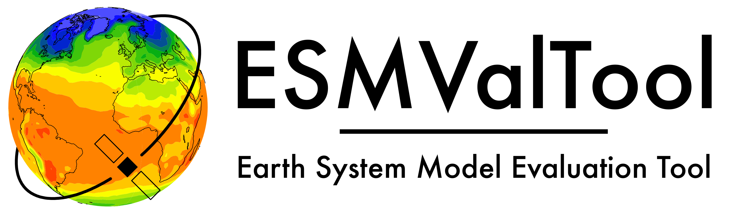
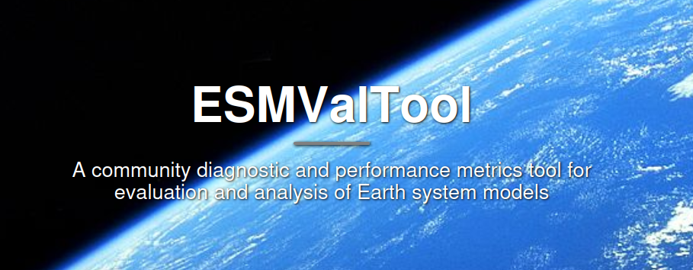


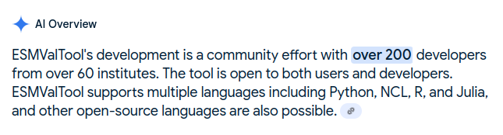
ESMValTool
Best Climate Model Evaluation Tool – FAIR and square
Valeriu Predoi* and Bouwe Andela**
for the ESMValTool developers***
* NCAS-CMS, University of Reading, United Kingdom
** Netherlands eScience Centre (NleSC), Netherlands
*** 200+ good folk from 60+ institutions, even AI knows this:

Slide 2




Findable Accessible Interoperable Reusable

Slide 3
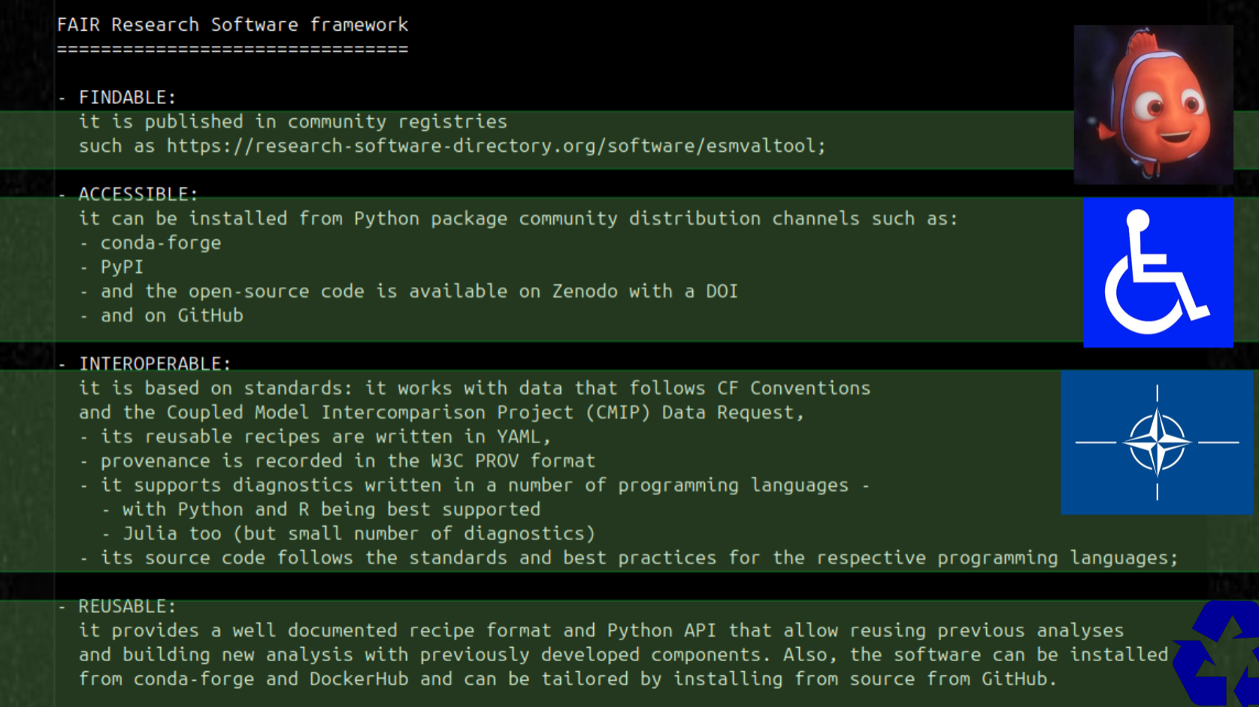

Slide 4
- Research Software Directory: https://research-software-directory.org/software/esmvaltool
- GitHub: https://github.com/ESMValGroup/ESMValTool
- Zenodo: https://zenodo.org/records/14974718
- conda-forge: https://anaconda.org/conda-forge/esmvaltool
- PyPI: https://pypi.org/project/ESMValTool/
- our own website: www.esmvaltool.org
- multiple institutional references: https://help.jasmin.ac.uk/docs/software-on-jasmin/community-software-esmvaltool/
Findable

Slide 5
- Research Software Directory: https://research-software-directory.org/software/esmvaltool
- GitHub: https://github.com/ESMValGroup/ESMValTool
- Zenodo: https://zenodo.org/records/14974718
- conda-forge: https://anaconda.org/conda-forge/esmvaltool
- PyPI: https://pypi.org/project/ESMValTool/
- our own website: www.esmvaltool.org
- multiple institutional references: https://help.jasmin.ac.uk/docs/software-on-jasmin/community-software-esmvaltool/
Accessible
- open source
- available as Python package, for download, or simple install
- deployed on a number of HPCs
- forked and developed at many sites (as module)
- superb support & community
- tested thoroughly

Slide 6
(my favourite thing: engineering, baby!)
STANDARDS!
- Input Data Standards: CF/CMOR netCDF4 (CMIP5/6/7, obs4MIPs, OBS/OBS6, ana4MIPs, GRIB, CORDEX etc); allows for data CMORization
- Output Data Standards: CMOR netCDF4 and W3C-PROV
- Programming Language Standards: compute core in Python+DASK, diagnostics in Python, R, NCL, Julia
- Infrastructure Standards: recipes and configuration in YAML, modern packaging, standard Sphinx documentation
- Code quality standards: Ruff+pre-commit, integrated in CI testing
- Testing Standards: 95% test coverage, multiple testing platforms, multiple OSs and Python versions; testing with bleeding edge dependencies
- Versioning Standards: semantic versioning, regular releases
- Deployment Standards: packaged and deployed on multiple Python package indices; containers via DockerHub; deployed on HPCs
Interoperable

Slide 7
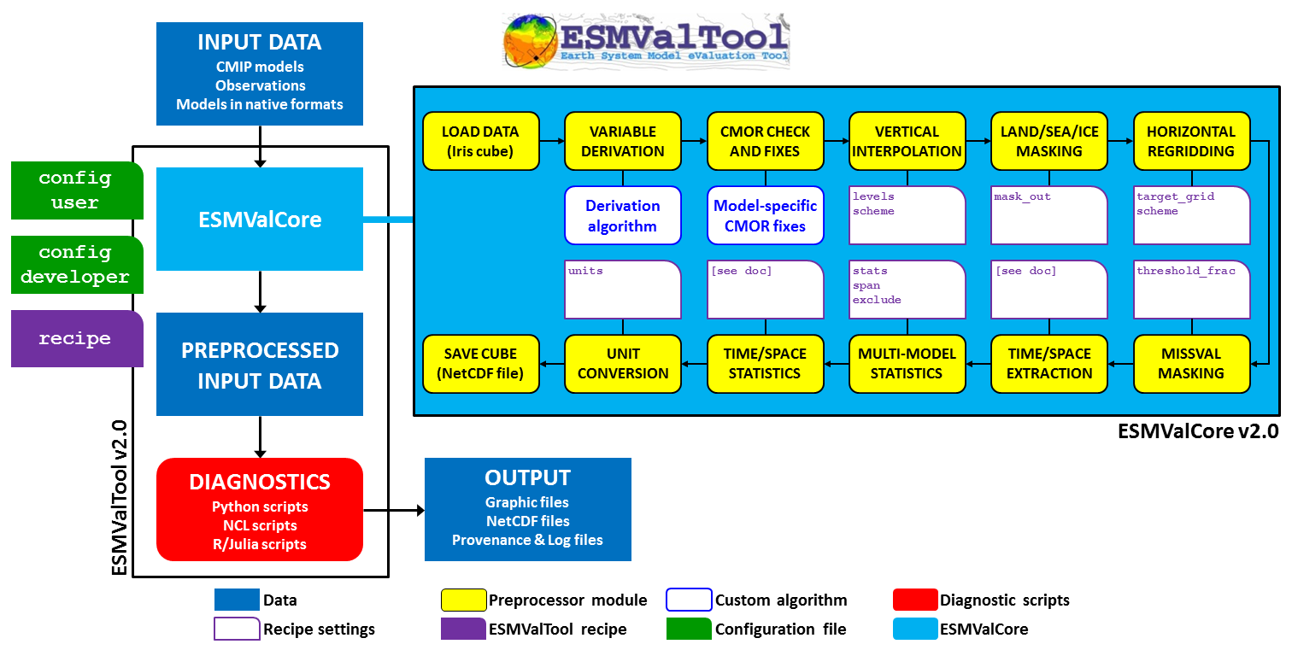
Use OTB - Reuse/repurpose functionality – Adapt with minimal effort
Reusable
- fully exposed Python API
- highly modular
- well-structured recipe format
- simple operational workflow
All these well documented and traceable!

Slide 8

ESMValTool
Best Climate Model Evaluation Tool – FAIR and square
Valeriu Predoi* and Bouwe Andela**
for the ESMValTool developers
* NCAS-CMS, University of Reading, United Kingdom
** Netherlands eScience Centre (NleSC), Netherlands

