Slide 1
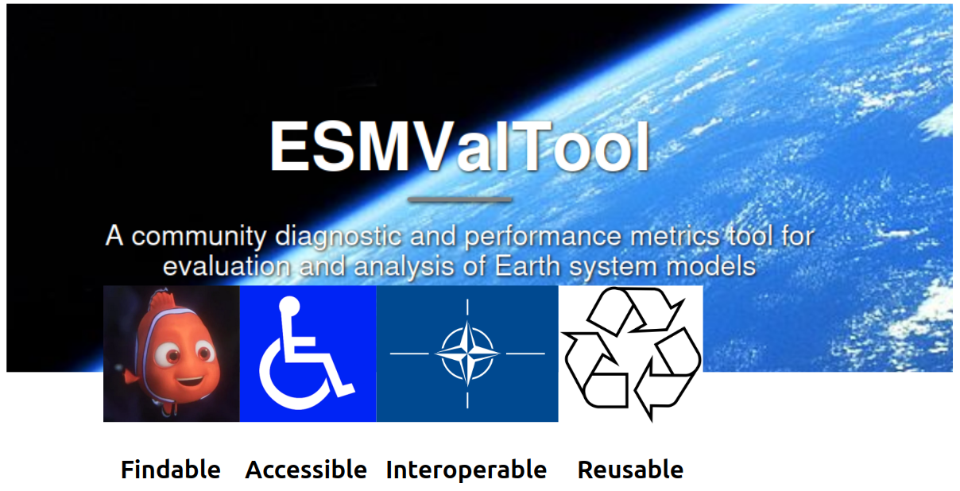




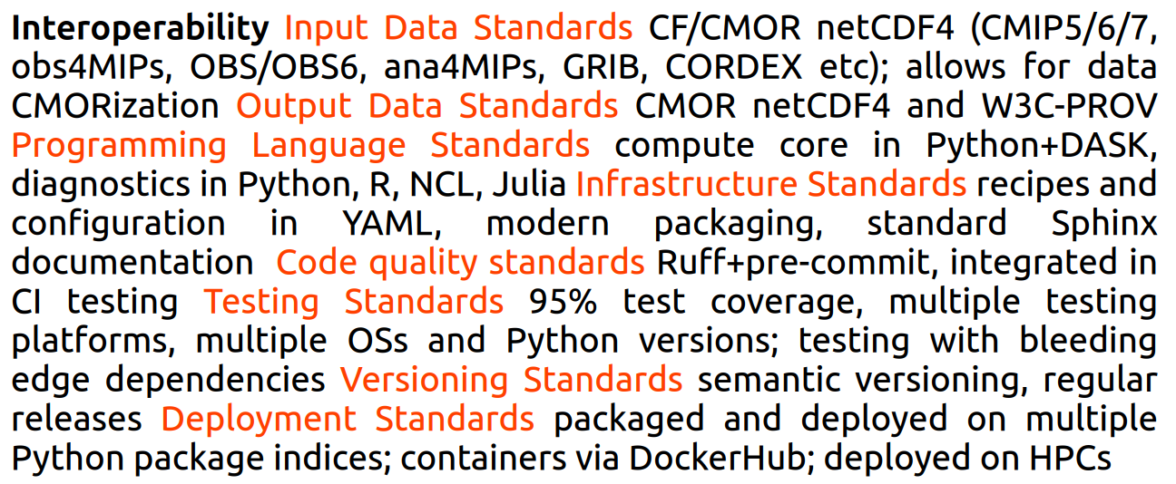
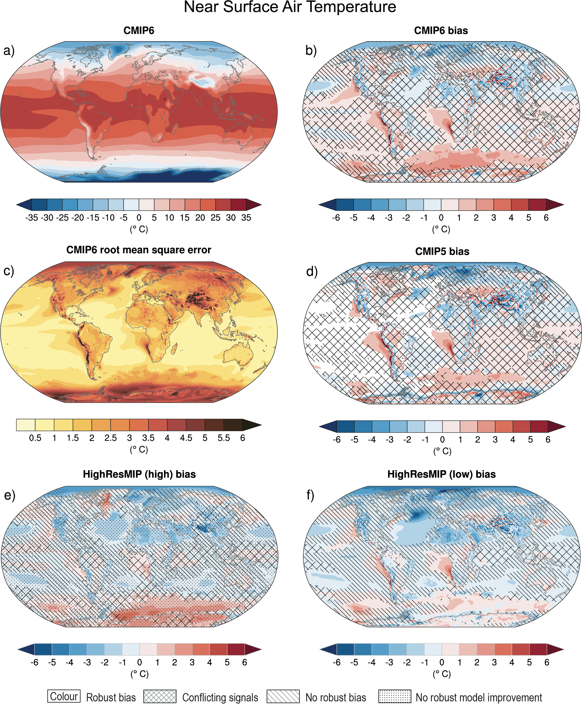
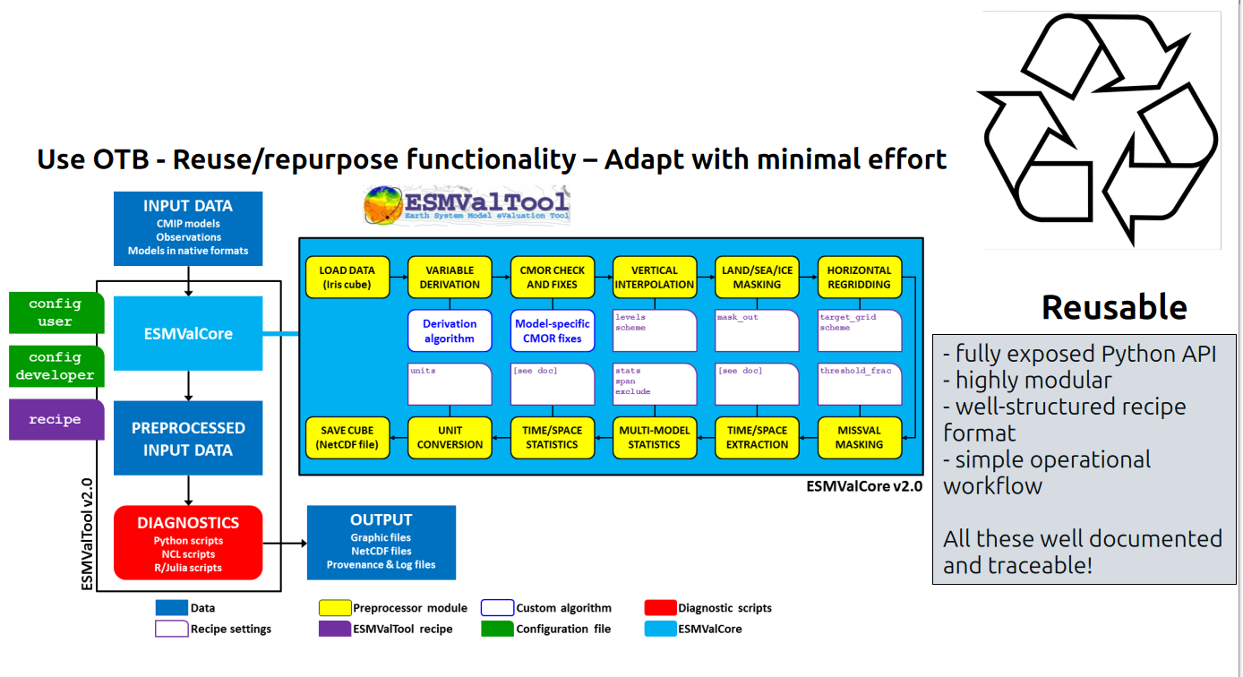
https://doi.org/
ESMValTool
A community diagnostic and performance metrics tool for evaluation and analysis of Earth system models
Valeriu Predoi ¹, for the ESMValTool Developers Team
¹ NCAS-CMS & Department of Meteorology, University of Reading, UK
Earth System Model Evaluation Tool (ESMValTool) is an open-source community-developed diagnostics and performance metrics tool for the evaluation and analysis of Earth System Models (ESMs). ESMValTool allows for a comparison of single or multiple models against predecessor versions and observations. The aim of ESMValTool is to take model evaluation to the next level by facilitating analysis of many different ESM components, providing well-documented source code and scientific background of implemented diagnostics. Traceability and reproducibility of the results are ensured by providing detailed provenance records for all output. While originally designed to facilitate a more comprehensive and rapid evaluation of models participating in the Coupled Model Intercomparison Project (CMIP), the tool can also be used to analyze output from regional models, a large variety of gridded observational data and reanalysis datasets. The development of ESMValTool is supported by several national and international projects. ESMValTool has been used in several chapters of the Working Group I contribution to the Intergovernmental Panel on Climate Change’s Sixth Assessment Report (IPCC AR6). ESMValTool has been selected by the CMIP7 Model Benchmarking Task Team as one of the featured model benchmarking and evaluation tools. In 2024, the ESMValTool team received the first annual Helmholtz incubator software award for sustainability.
Annual mean near-surface (2 m) air temperature (°C) for the period 1995–2014.

