Slide 1
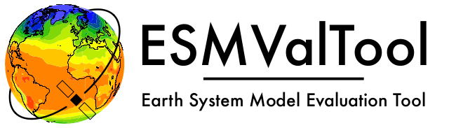
Reliable and reproducible Earth System Model data analysis with ESMValTool
Valeriu Predoi (NCAS-CMS University of Reading, UK) and Bouwe Andela (eScience Centre, The Netherlands) for the ESMValTool Technical Lead Team

Slide 3


Software ecosystem: ESMValCore and ESMValTool
ESMValCore: highly optimized, pure-Python package, responsible for computationally-heavy pre-processing of data (climate statistics, regridding, multi-model statistics etc) → COMPUTING and DATA REDUCTION are the outputs, SMALL TECHNICAL TEAM (strong technical skills) the developers
ESMValTool: main scientific analysis and diagnostics library (written in Python, NCL, R, and Julia) – responsible for development of diagnostics and metrics (stored in recipes), with scientific output (plots, files etc) → SCIENCE is the main output, LARGE and DIVERSE (coding skills, technical knowledge) COLLABORATIVE group the developers

Slide 4
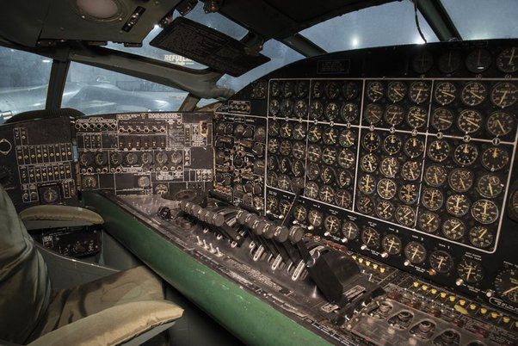
Software ecosystem: ESMValCore and ESMValTool
Common to both: - lots of code (~200k lines, minimal code rot)
- complex dependency environments (100 direct dependencies, 500-1000 dependencies in any given environment)
- need for wide supported platforms (operating systems, Python versions etc)
- need for ease of installation, and maintenance
- complex configurations, but made as simple as possible for users
Testing is absolutely necessary to ensure correct functionality and portability, over long development cycles, with widely varied developers’ skills and interests

Slide 5
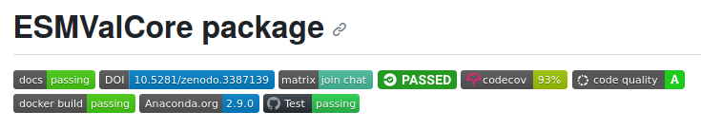
Overall testing strategy - ESMValCore
Highly optimized, pure-Python package, responsible for computationally-heavy pre-processing of data (climate statistics, regridding, multi-model statistics etc) → COMPUTING and DATA REDUCTION are the outputs, SMALL TECHNICAL TEAM the developers ->
Testing needs to be technically diverse and comprehensive
Testing done for all supported operating systems and Python (as main language) versions
Both strict and in-depth testing

Slide 6
Overall testing strategy - ESMValCore
Both strict and in-depth testing: Core system tests: - software environment fitness (building the environment, and installing the package in it, regularily) - backup environment recipe build and installation tests (conda-lock) - Python package build tests - Docker container(s) build and deploy tests General purpose tests: - unit/integration/regression (with sample data) tests - coding standards tests (pylint and flake8) - test coverage tests (when adding new code) Documentation:
- documentaton build and deploy tests

Slide 7
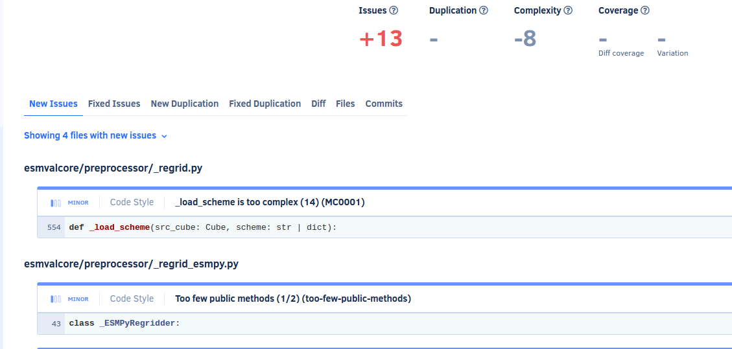
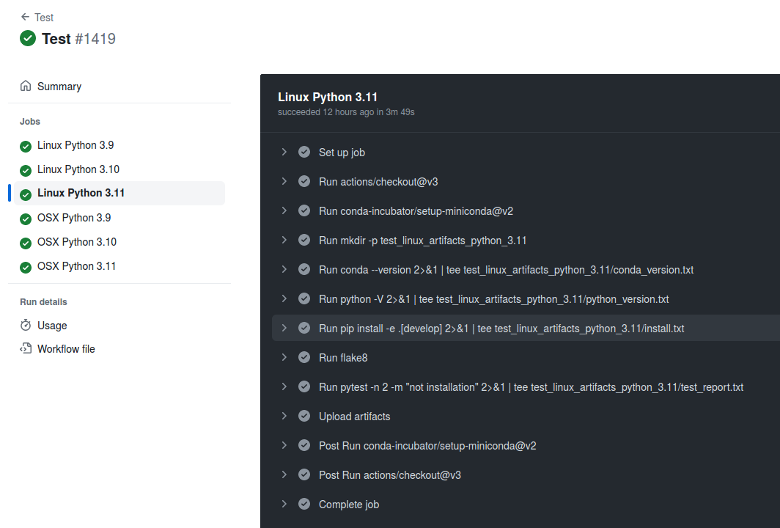
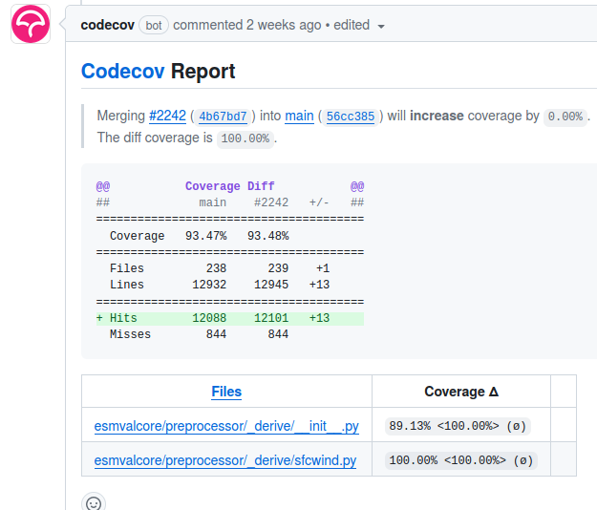
Overall testing strategy (for separate packages)

Slide 8

Overall testing strategy - ESMValTool
ESMValTool
Main scientific analysis and diagnostics library – responsible for development of diagnostics and metrics (in recipes), with scientific output (plots, files etc) → SCIENCE is the main output, LARGE and DIVERSE COLLABORATIVE group the developers
Testing needs to ensure scientific correctness and allow for variability of developers’ skills (ie not too restrictive, definitely not too lax, or “not great, not terrible”)
Testing done for all supported OS and Python versions
Scientific output-oriented tests
Still include some technical testing (like for ESMValCore, but less strict)

Slide 9
Overall testing strategy - ESMValTool
ESMValTool
Scientific output-oriented tests include: - numerical and graphical output comparisons (with previous versions, and current version when changes occur; both manual and automated triggers) via a dedicated tool for recipe output comparison which is smart enough to handle small differences in numerical results in NetCDF files and small differences in plots through image hashing - EXIF and Mark I Eyeball testing (visualization of output) - input data specifications consistency tests - output provenance tests
Still with some technical testing like for ESMValCore, but less strict: - FEWER unit/integration/regression (with sample data) tests - FEWER coding standards tests (pylint and flake8) - NO test coverage tests (when adding new code)

Slide 10
Provenance output and testing
all our software is stored on Zenodo for every release with a DOI
we have docker containers that offer pretty good software environment reproducibility, we record the filenames and global NetCDF attributes of all input files.

