Slide 1
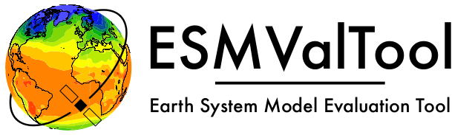
Reliable and reproducible Earth System Model data analysis with ESMValTool
Valeriu Predoi (NCAS-CMS University of Reading, UK)
and Bouwe Andela (Netherlands eScience Centre, The Netherlands)
for the ESMValTool Technical Lead Team

Slide 2
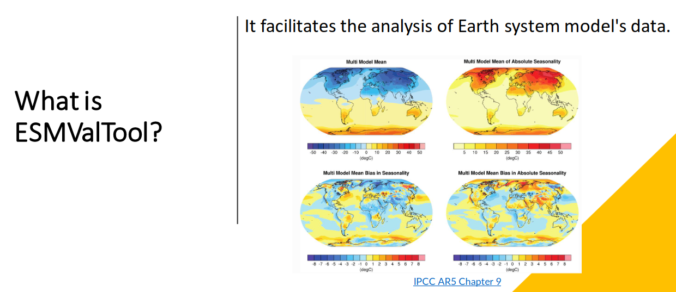
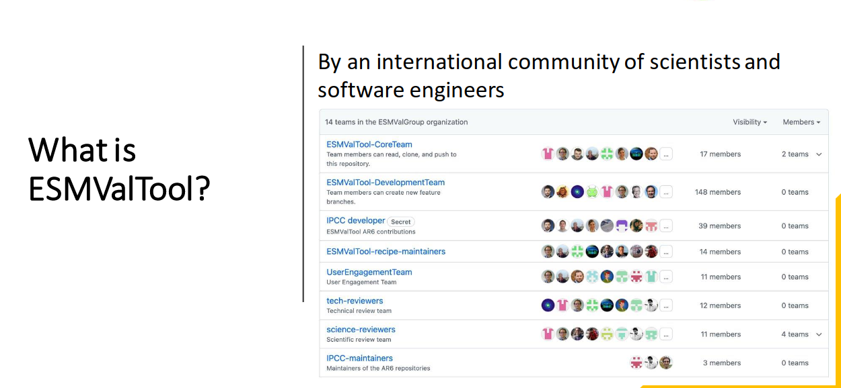
Documentation https://docs.esmvaltool.org/en/latest/
GitHub https://github.com/ESMValGroup
Website https://esmvaltool.org/
Video https://www.youtube.com/watch?v=sidM4EB6Sbo

Slide 3
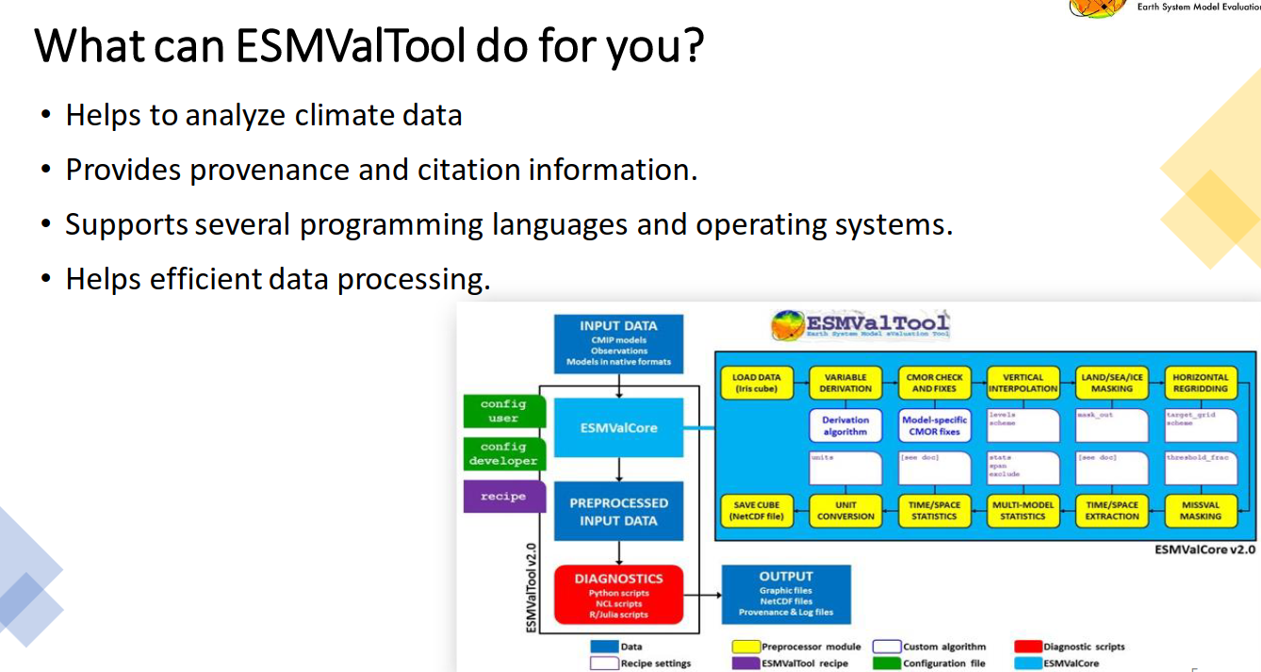
Documentation https://docs.esmvaltool.org/en/latest/
GitHub https://github.com/ESMValGroup
Website https://esmvaltool.org/
Video https://www.youtube.com/watch?v=sidM4EB6Sbo

Slide 4


Software ecosystem: ESMValTool and ESMValCore
ESMValTool: scientific analysis and diagnostics library (written in Python, NCL, R, and Julia) – contains reproducible recipes with scientific output (plots, data files etc) → SCIENCE is the main output, LARGE and DIVERSE (coding skills, technical knowledge) COLLABORATIVE group the developers
ESMValCore: Python package for working with CMIP(-like) data, responsible for running ESMValTool recipes. It finds and optionally downloads the input data, applies preprocessor functions (climate statistics, regridding, multi-model statistics etc) and passes the resulting NetCDF files on to the scientific analysis codes→ COMPUTING and DATA REDUCTION are the outputs, SMALLER TECHNICAL TEAM (strong technical skills) the developers

Slide 5
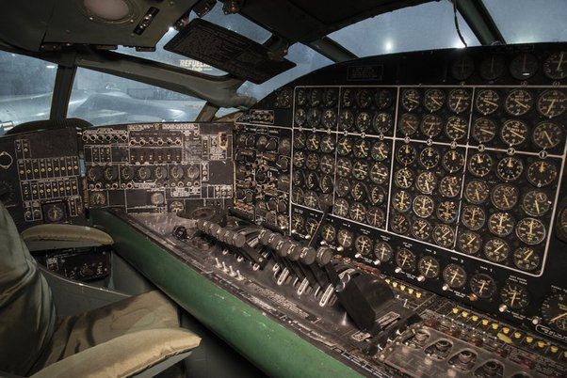
Software ecosystem: ESMValCore and ESMValTool
ESMValTool
- lots of code (~200k lines)
- many dependencies (~100 direct dependencies, ~600 indirect dependencies), but should be easy to install
- provides ~100 recipes and diagnostics, which are fairly independent of each other
ESMValCore
- relatively compact codebase
- only a few dependencies
- reliability is key because it is used by every recipe
Testing is absolutely necessary to ensure correct functionality and portability, over long development cycles, with widely varied developers’ skills and interests

Slide 6
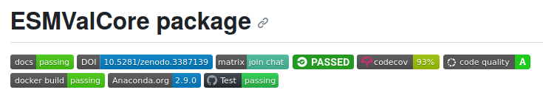
Overall testing strategy - ESMValCore
Reliable Python package, responsible for computationally-heavy pre-processing of climate data (climate statistics, regridding, multi-model statistics etc) → COMPUTING and DATA REDUCTION are the outputs, SMALL TECHNICAL TEAM the developers
Testing needs to be technically diverse and comprehensive
Testing done for Linux and OSX and all recent Python versions
Both strict and in-depth testing

Slide 7
Overall testing strategy - ESMValCore
Both strict and in-depth testing:
Core system tests:
- software environment fitness (building the environment, and installing the package in it, regularily)
- backup environment recipe build and installation tests (conda-lock)
- Python package build tests
- Docker container(s) build and deploy tests
General purpose tests:
- unit/integration/regression (with sample data) tests
- coding standards tests (mypy, pylint, and flake8)
- code coverage check by Codecov, 100% coverage required for changes
Documentation:
- documentaton build and deploy tests

Slide 8
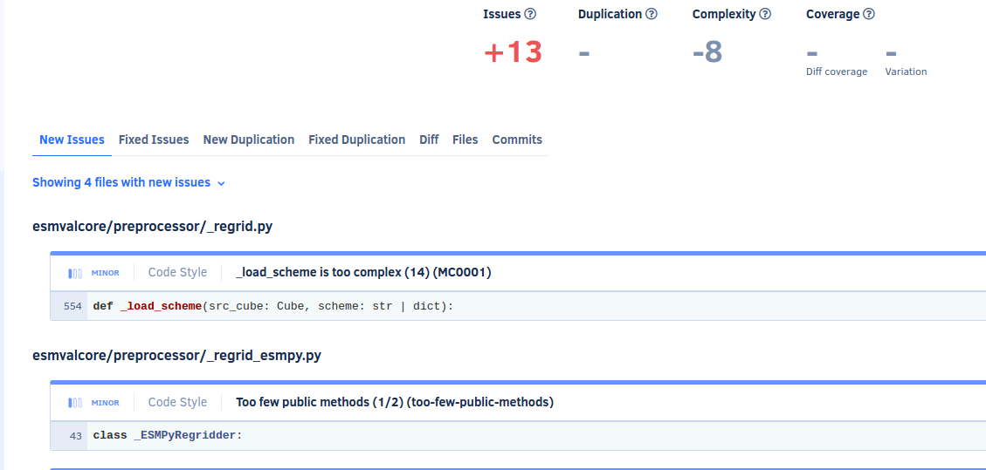
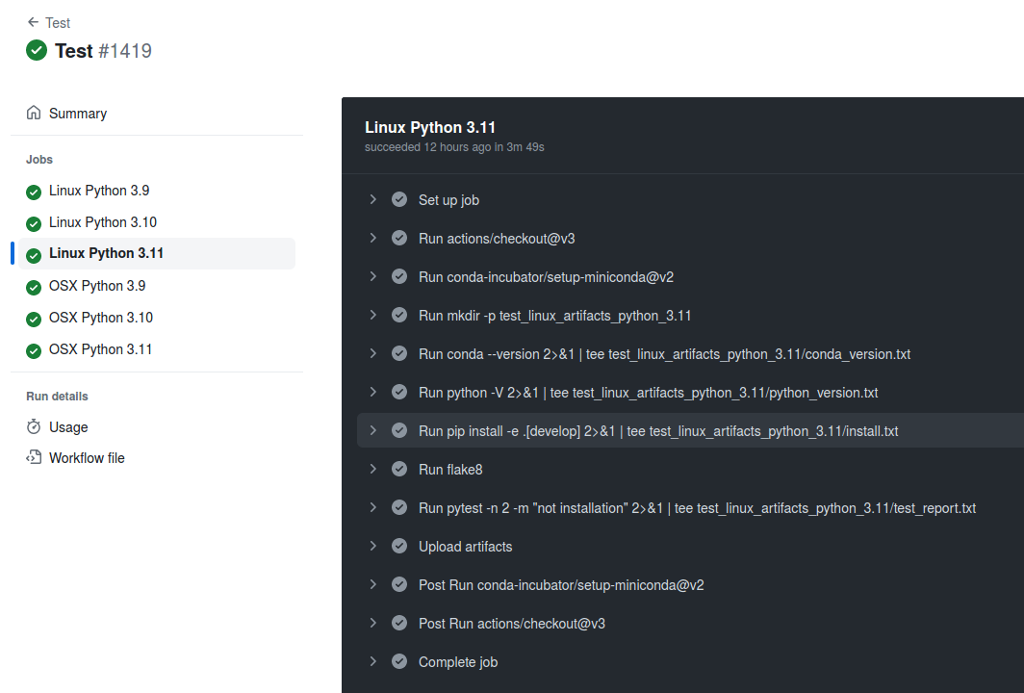
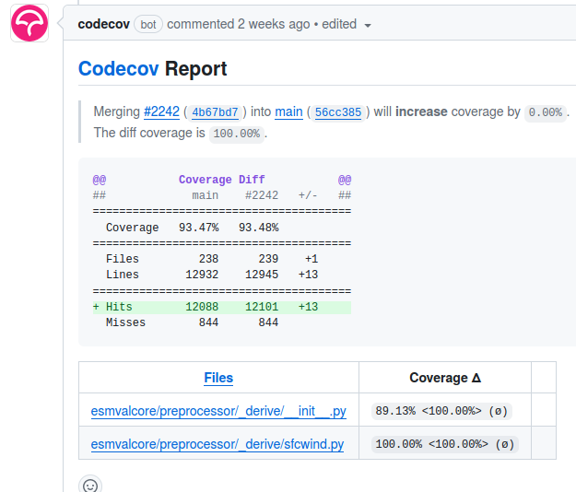
Overall testing strategy (for separate packages)

Slide 9

Overall testing strategy - ESMValTool
ESMValTool
ESMValTool: scientific analysis and diagnostics library (written in Python, NCL, R, and Julia) – contains reproducible recipes with scientific output (plots, data files etc) → SCIENCE is the main output, LARGE and DIVERSE (coding skills, technical knowledge) COLLABORATIVE group the developers
Testing needs to ensure scientific correctness and allow for variability of developers’ skills (ie not too restrictive, definitely not too lax, or “not great, not terrible”)
Basic testing done for all supported OS and Python versions
Scientific output-oriented tests
Still include some technical testing (like for ESMValCore, but less strict)

Slide 10
Overall testing strategy - ESMValTool
ESMValTool
Scientific output-oriented tests include:
Numerical and graphical output comparisons with previous, scientifically approved versions
Dedicated tool for recipe output comparison which is smart enough to handle small differences in numerical results in NetCDF files and small differences in plots through image hashing
Testing workflow is at the moment manual for every release, working on automation by setting up a “recipe test workflow”
Mark I Eyeball testing (visualization of output) – comparison with figures in papers
Input data specifications consistency tests
Still with some technical testing like for ESMValCore, but less strict:
Limited unit/integration tests, only for a few shared components
More relaxed on coding standards (pylint and flake8)
No code coverage checks

Slide 11
FAIR research software
- Software releases are stored on Zenodo with a DOI
- Docker containers for reproducible software environments for every release
- A recipe with fixed input data versions is recorded for each recipe run
- ESMValCore records provenance, which includes the filenames and global NetCDF attributes of all input files used to create a figure.
For more information on FAIR research software, see:
Barker, M., Chue Hong, N.P., Katz, D.S. et al. Introducing the FAIR Principles for research software. Sci Data 9, 622 (2022). https://doi.org/10.1038/s41597-022-01710-x

Slide 12
ESMValTool: take home message
The tools have a modular design in which community members of varying skill level are able to contribute without compromising reliability and user experience for others
Test and code quality requirements are adjusted to how many users and developers will be affected if a component breaks
FAIR research software for doing open science

