Slide 1
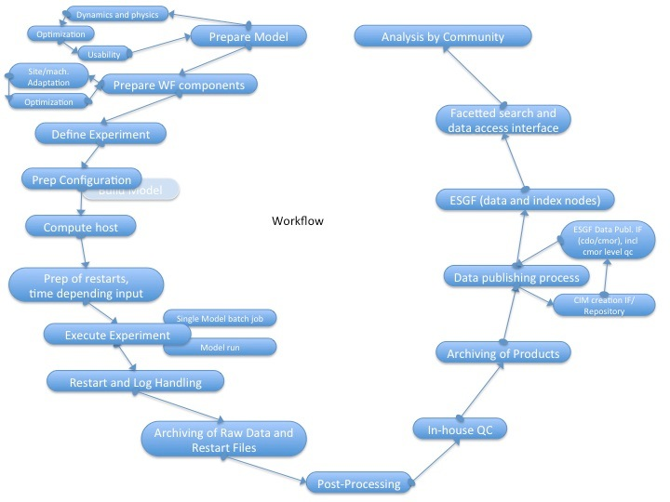
The Modeling Circle
Courtesy M. Lautenschlager, DKRZ

Slide 2
Motivation for WP4 of ISENES2
„ The objective of this work package is to provide networking activities to increase the pace of climate science employing modelling by sharing best practice in software environments for Earth System Models and encouraging more sharing of selected codes within the climate community.“
task 1: workflow and post processing
task 2: configuration management
task 3: meta-data capture
task 4: coupling

Slide 3
Tools Required
Workflow and post processing tools
  Increasing complexity
  S2D
  Data volumes
  Downstream users
Configuration management tools
  Efficient Mgt of
    Scientific models
    Technical codes
    Experiment definitions
Meta-data capture tools
  Description of
    Experiments
    Simulations
    Data
Coupling tools
  For scientific codes to be coupled in new combinations for ESMs

Slide 4
ISENES2 Workshops
Workflows 1 + 2; MPI-M / MO
  A first workshop will identify issues and opportunities to be explored in more depth. June 3-5 2014
  The second workshop will also include discussion on available post processing solutions in use in the community and how they are integrated into workflows.
Configuration Management 1 + 2; MO / MPI-M
  A first WS to start community evaluation of FCM by experienced (IPSL) and novice (MPI-M) users. Sep 2013
  A second WS for the evaluation and dissemination of the findings
MD-Generation 1 + 2; DKRZ
  The aim will be to encourage investment in software and working processes that will allow more comprehensive meta-data to be collected more efficiently. Further, the development of workflow and diagnostic solutions will be influenced by the meta-data requirements. Jan 21/22 2014
  To support the second workshop, the Met Office and DKRZ will develop documents that identify key interfaces between the meta-data and the experiment definition and modelling processes, and explore design solutions.

Slide 5
Why are you here?
Discuss MD generation „on the fly“
  Some centers don’t/can’t(?) do that
  Those that can do it, do it differently
  Should learn from each other!

Slide 6
Motivation from DoW
Networking will lower the following barriers for the use of common software solutions for workflow and post processing (task 1), configuration management (task 2), meta-data capture (task 3) and coupling (task 4):
Technical and human resources in most institutions are stretched and often applied to extend existing legacy solutions rather than to take the more risky approach of trying new solutions. Also, developments are targeted at local problems. Even when they have the potential to find more generic application, they are not advertised as such and are not used more widely. This work package will provide opportunity for advertising solutions to a wider community by sharing experience in software that deals with the modelling environments.
The lack of understanding of longer-term benefits of available solutions. If some participants are able to quantify the benefits of apparently risky or large changes, other participants are more likely to invest thus spreading best practice. There are large overheads of software evaluation in this field. Any software needs to be adapted to meet specific, complex local needs. This work package supports evaluations of software for all the ESM environment tools listed above.

Slide 7
Motivation cont’d
For all tasks 1 to 3, the objective of this work package is to facilitate best practices and software sharing by supporting software evaluations that will lead to well prepared, in depth workshops allowing partners to understand the opportunities for shared software solutions. It will fund teams to evaluate software and effort to support the evaluators. This bottom-up approach will be complemented by the management engagement proposed in NA1*.
* Governance and strategy activities will be developed in strong link with other work packages such as NA2 on future HPC technologies and model developments, NA3 on possible common developments on software and development of governance methods, and NA4 on data archive governance.

Slide 8
Task Description from DoW IS-ENES2
Significant experience has been gained in CMIP5 and related exercises in providing meta-data to describe ESM experiment sets. A number of sites are recognising the need to build meta-data capture into the heart of the ESM experiment process and to drive data provision exercises; this needs to be supported by both software and processes.
This networking activity will promote the sharing of experiences and designs in this emerging area through two workshops organised by DKRZ. The aim will be to encourage investment in software and working processes that will allow more comprehensive meta-data to be collected more efficiently. Further, the development of workflow and diagnostic solutions will be influenced by the meta-data requirements. To support the workshop, the Met Office and DKRZ will develop documents that identify key interfaces between the meta-data and the experiment definition and modelling processes, and explore design solutions.

Slide 9
Deliverable/Milestones from DoW
Deliverable:
  Meta-data capture final workshop report (DKRZ)
Milestones:
  MS42: Initial workshop on meta-data generation during experiments, mth 9
  MS46: Final workshop on meta-data generation during experiments, mth 37

Slide 10
Minutes etc.
Issues
  Compare schemas of WFs/FWs
  (IPSL, CYLC@DKRZ, MOHC, GFDL)
  Reasons to collect Provenance Data:
    Robustness (restart possibility)
    Good scientific practice
    Visibility of provenance data collection process needs discussion
    The numerical logbook
    Usage and development of CVs
    Usage and development of PIDs
Time line
  Next MD-WS needs to be planned for m37(ISENES2) = May 2016
  Meta-data capture final workshop report for m40(ISENES2) = Aug 2016
Next Steps
  Produce Minutes of this meeting
  Idea: Accompany CMIP6 prep work by a paper

Slide 11
Idea
CMIP6:
  Modeling Infrastructure Panel planned
    tasked with establishing and maintaining standards for model data sharing
    to create a document outlining the technologies necessary for operation of a global data infrastructure, and
    the standards necessary for maintaining these technologies.
  The document will outline a protocol for creating and running a MIP.
Produce a basis for this document
  Possible/probably with the other WS in ISENES
~ “Best practices for MD generation
and workflows in ESM experimentation“

Slide 12
PID
PID to mark CIM documents!
PID make versioning easier
…can be on file or directory level → needs to be decided

Slide 13
Recommendations
There should be a means of informing users and data centres of deviations from the recommendations on formats, headers, etc.
Agreements on formats etc:
- earlier to publish
- better to be communicated (especially verification checks)!
Checks on data should result in warnings, not in errors as right or wrong depends on the usage.

Slide 14
…to be put out clear:
Data centres cannot guarantee to publish data that do not follow the technical requirements

Slide 15
MD capture
One ore more DB aside – filled during the data production process
Aside or not aside: Social problem, „cleaner“ social engeneering (access, responsability, …) when aside → 2 or 3 DB per system
Data into file headers – collected and filled in a DB later

