Slide 1
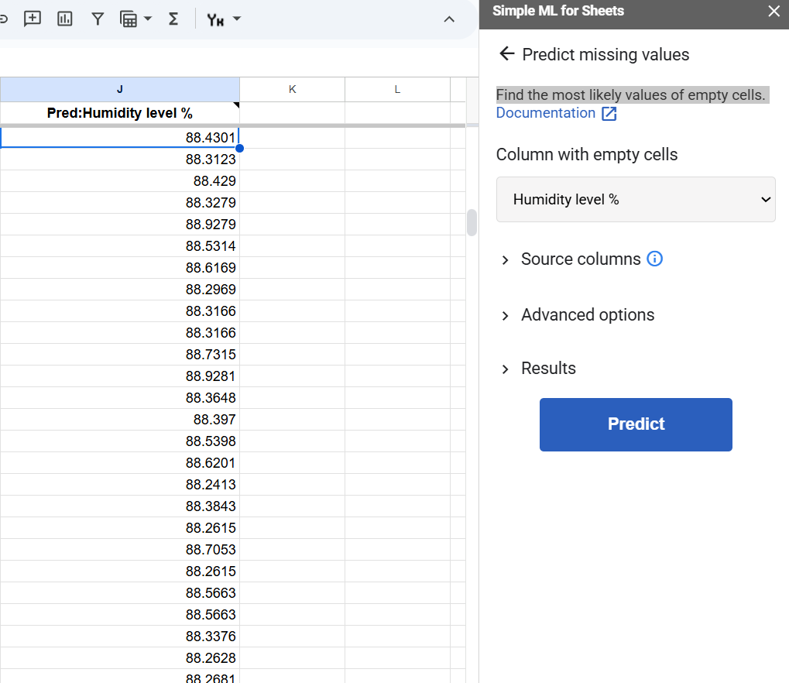
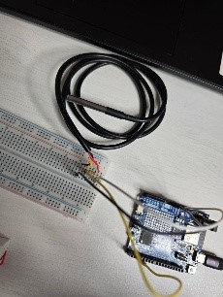
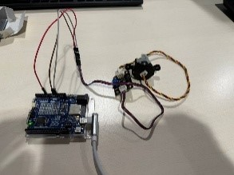
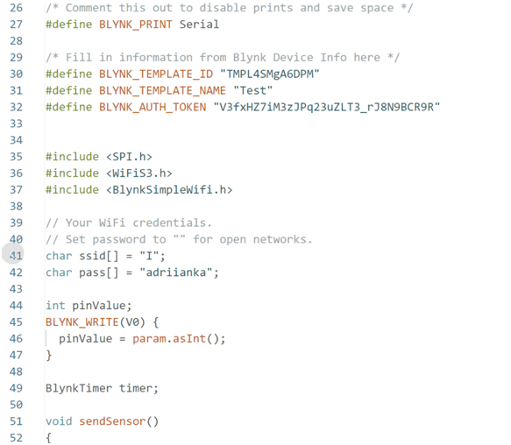
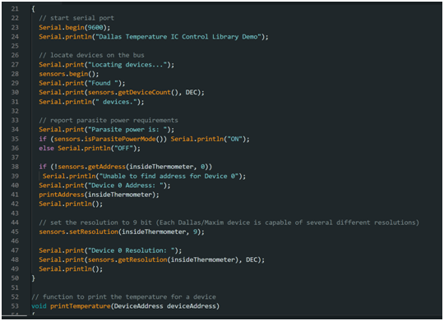
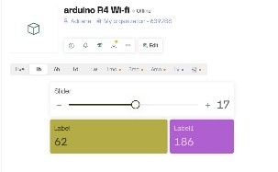
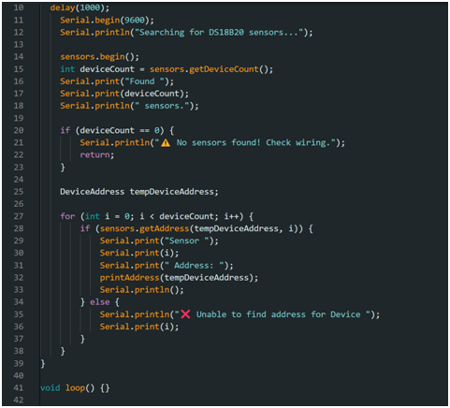
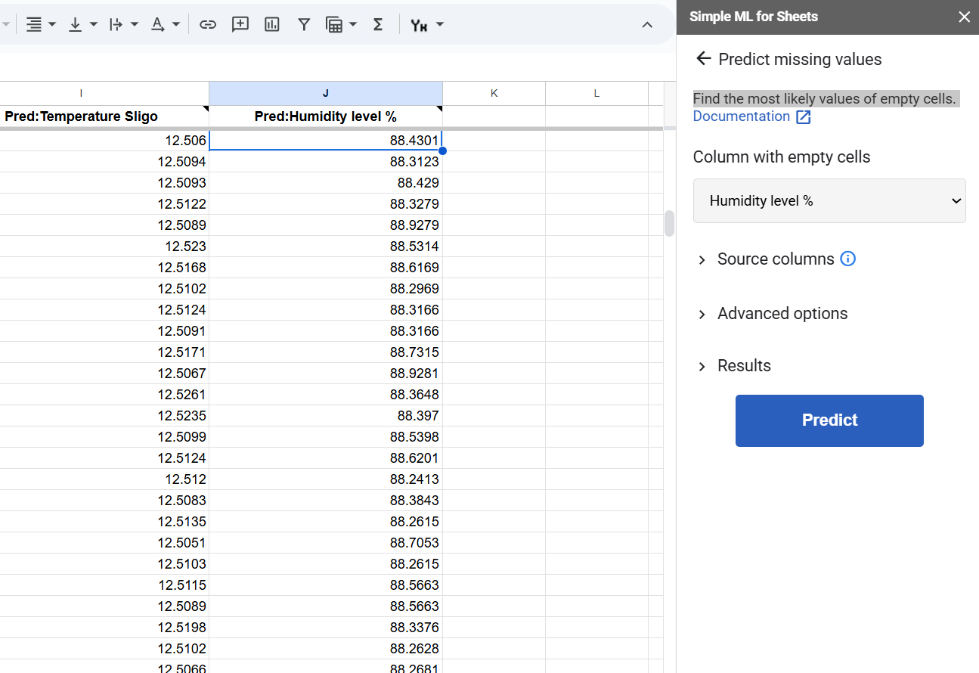
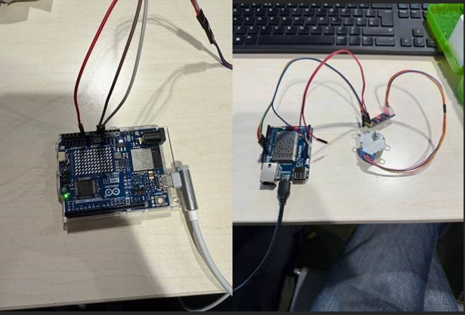
This Scientific Poster Template Is Provided By PosterNerd Water Quality Monitoring Device
By Adriana Prepeshniuk, Roman Ilkevych, Yelyzaveta Kareiveva, Valerii Navalnyi and Darragh Cawley
5
Conclusion
Abstract
Methodology
The Water Quality Monitoring Device is an Arduino-based system designed to provide an affordable and accessible means to assess water quality in real time. This solution aligns with the United Nations’ Sustainability Development Goal 6, which emphasizes water and clean sanitation for all. The device focuses on two primary water quality parameters: turbidity and temperature, By measuring the clarity of water with a turbidity sensor and its temperature using a waterproof DS18B20 digital temperature sensor, the system offers a simple yet effective method for communities to monitor water safety..
1. User Interaction:
The user immerses the sensors into a water sample.
4. Data Transmission:
Processed data is sent to the Blynk.io server, which updates the application interface, providing the user feedback through the following code..
In summary, the Arduino Water Quality Monitoring System represents an effective, low-cost approach to water monitoring. By integrating reliable sensors with Arduino hardware and leveraging the Blynk.io platform for real time data display, the project addresses the critical need for accessible water testing methods..
This project not only meets the immediate goal of providing a portable water quality assessment tool but also lays the groundwork for future scalability and integration in resource limited environments. The design is both practical and adaptable, ensuring that communities can access vital information about their water quality, ultimately contributing to improved public health outcomes.
2. Data Acquisition:
The DS18B20 and SEN0189 sensors measure the temperature and turbidity of the water respectively.
Introduction
Future Steps
Access to clean water is a human right, yet hundreds of millions do not have access to it and over 2 billion drink from contaminated water.
Traditional methods of water testing involves manual sample collection and laboratory analysis, which are time-consuming and not feasible for continuous monitoring. However, advancements in Internet of Things technologies allows for real-time data collection.
We decided to approach SDG 3( (Good Health and Wellbeing) and SDG 6 ( Clean Water and Sanitation) through the implementation of IoT technology..
3.Data Processing:
The Arduino board reads sensor data, calculates the necessary parameters (such as converting analog values to voltage) and determines whether the water is safe to drink based on predefined thresholds.. The following code is an example as to how the Arduino works with the temperature sensor.
To enhance the project’s functionality, we will continue refining data logging and visualization. One potential improvement is implementing the system with Blynk or a similar IoT platform,, allowing for remote monitoring of water quality parameters. This would make our project more practical for real world applications, enabling users to receive real-time updates on water conditions
Furthermore, we aim to expand our project by implementing a pH sensor, providing additional insight into the water quality. Measuring pH levels alongside turbidity and temperature will give a more comprehensive assessment, making our system more valuable for applications such as environmental monitoring and drinking water safety.
We also plan to enhance the physical design of our project to improve stability and portability. Soldering the wires will ensure more stable connections, reducing the chances of loose or unreliable contacts. Additionally, gluing or securing all the components together in a compact structure will make the device easier to handle and transport. These improvements will contribute to a more durable and professional-looking final product.
.
.
.
Materials
Arduino UNO R4 Wi-Fi
Waterproof DS18B20 Digital Temperature Sensor
JOPTO TSW-30
SEN0189 Turbidity Sensor
.Breadboard
Jumper Wires
4.7K Voltage Resistors
5.. Machine Learning Implementation:
Through using “ML Sheets”, missing values in recorded data sent to a google sheet can now be found easily..
Acknowledgements
https://www.sciencedirect.com/science/article/abs/pii/S0167739X13000241?via%3Dihub
https://docs.blynk.io/en/getting-started/activating-devices/manual-device-activation
https://www.sciencedirect.com/science/article/pii/S2666285X2100090X
.

