Slide 1
Git
@ 2025 Valerii Navalnyi
This presentation is licensed under the Creative Commons Attribution 4.0 International License (CC BY 4.0).
The author asserts their moral right to be identified as the author of this work in accordance with Section 107 of the Copyright and Related Rights Act 2000.
Tutorial for Beginners

Slide 2
Prerequisites
VS Code
Git installed
Verify in any terminal with:
git
git --version

Slide 3
Video format: 2 ways for each topic
Again, what is Git?
CLI way (git bash)
Visual Interface way (VS Code)
Git is a popular version control system.
It was created by Linus Torvalds in 2005, and has been maintained by Junio Hamano since then.
It is used for: Tracking code changes, who made changes, collaboration.

Slide 4
Configuration: Git Config
git init — initialize git repository (creates .git folder)
  Repository: A folder where Git tracks your project and its history.
git config user.name ‘Your Name’ — set your name
  What’s the point? You need to tell git who you are (each commit is signed with a name and email) — so it’s possible to track who makes changes.
git config user.email ‘example@email.com’ — set your email
git config --list — to check
Note:
If you enter incorrect value, just write the command again with a new value. The old value is overwritten.
Use git config without --global option to configure locally — in current directory.

Slide 5
Configuration: The same visual way
Can’t do it through VS Code :)
  Need to git config Name and Email manually
Three levels of configuration scope:
git config --system — System (for all users on a device)
git config --global — Global (for current user on a device)
git config --local — Local (current repo. This is default!)

Slide 6
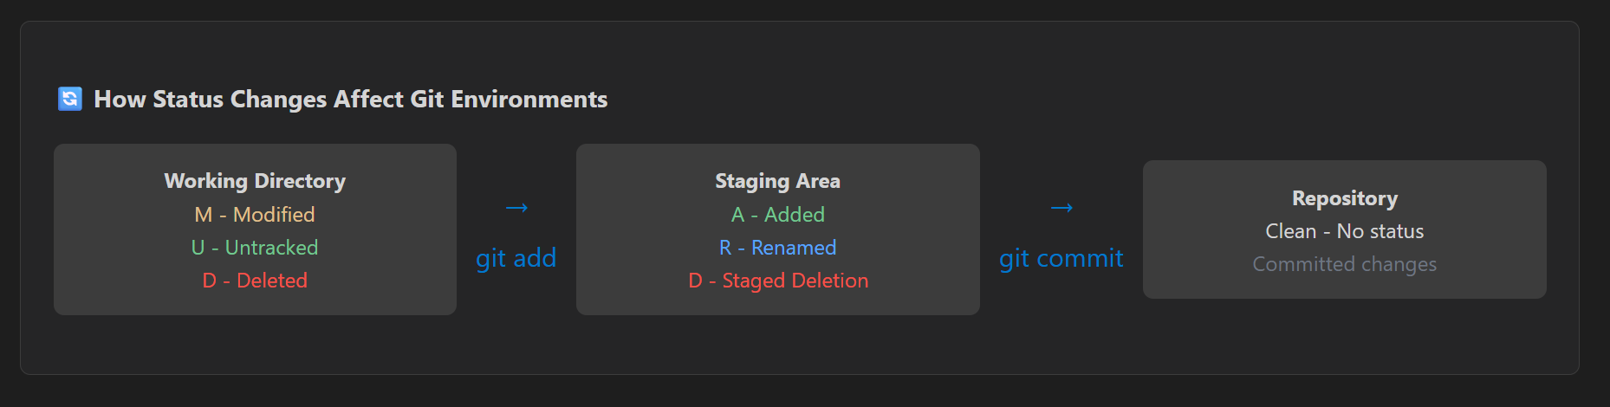
Git Environments: Git Staging, Git Commit
Source of the image
Working Directory (Changed sth) ⬇️ git add .
Staging Area (Saved Changes) ⬇️ git commit -m ‘Message’
Repository (Clean - no changes) ✅

Slide 7
So, what is Git Staging (Index)?
Staging — is like dating.
Before we merry, we date :)
Staging is like a waiting room for your changes.
Git tracks any changes you make to your project by default. But only the chosen (staged) changes are saved. New files are untracked unless committed.
The main point here is that you don’t have to include all of your changes in your next Commit. At this stage you tell Git what exactly you want to include in your next saved state of the project (Commit) — and this is Staging.
=> This gives you control over what goes into your project history.

Slide 8
Git Staging: Key commands
git add <file> — Add a file to Staging environment
git add . — Add all files in current folder to Staging environment
git add --all OR git add -A — Add all files
git restore --staged <file> — Unstage a file
git log
See commit history
git log --oneline
See commit history (Simplified View
git status
See what’s going on
Note: To exit the git outputs,
press Q.

Slide 9
So, what is Git Commit?
Commit — is like marriage.
Now that you’re sure, you can marry and settle down — safely save that state of your project.
It’s a save point / checkpoint / snapshot / saved state of your project.
It records the state of your files at a certain time, with a message describing the changes made.
Remember: Git doesn’t save the file themselves! Only the changes made.
You can always go back to a previous commit if you need to.
The main thing here is like with functions:
1 commit is 1 good change to the project
(Functions do 1 thing
and do it well)

Slide 10
Git Commit: Key commands
git commit -m ‘Message’ — Commit staged changes with a message.
git commit — if you don’t provide -m option, Git opens VS Code’s built-in text-editor. Add you message there, close the editor, and commit will be made.
Note: If you don’t provide a message to your commit — it will be aborted (discarded).
Keep first line short, under 50 characters (VS Code will prompt with red highlight)
git status
See what’s going on (& branch)
git log
See commit history

Slide 11
Git Commit: How to write Commit messages
Rule of thumb
When writing a commit message, ask:
Does this sentence work after “This commit will…”?
Examples:
❌ bad
✅ good
Added user login
Fixes bug in navbar
I refactored auth logic
Add user login
Fix navbar overflow on mobile
Refactor authentication logic

Slide 12
Git Commit: Why imperative?
Consistency with Git’s own output
Git uses imperative mood everywhere:
Merge branch ‘main’
Revert ‘Fix memory leak’
Update README
Your commits blend naturally into Git history when you follow the same style.
2. Clear, action-oriented meaning
Imperative mood answers the question: “What does this commit do?”
Add authentication; Fix navbar; Remove deprecated API etc…

Slide 13
Git Commit: Forgot to add something? Made a typo?
git commit --amend -m "Corrected message" — Fix the last commit message/ add different files/ changes
git reset --soft HEAD~1 \ HEAD^ — undo the last commit and keep your changes staged.
HEAD Pointer — Git maintains a variable for referencing, called HEAD: it points to the latest commit and branch
git status
See what’s going on
git log (--oneline)
See commit history

Slide 14
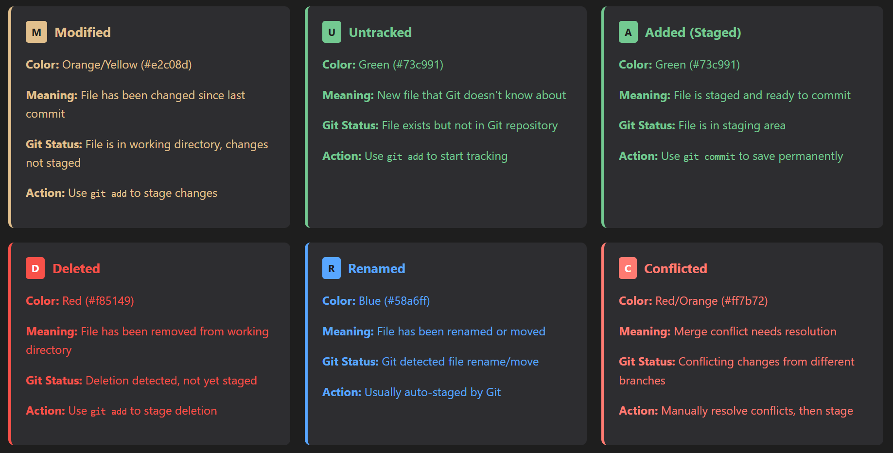
VS Code Git Status Indicators

Slide 15
.gitignore
Sometimes we don’t want git to track certain files. This might include:
vscode
node_modules
personal files like (to-do; notes)
IMPORTANT: Create .gitignore at the start of the project! If files are ignored later, they can still be viewed in older commits.
Syntax:
# — These are comments
* — “Match any character any amount of times”
=> bash wildcards apply!
There are numerous .gitignore templates online.

Slide 16
Git Branches: Different Project “Versions”
These are different versions of the project. Typically, we have:
main/master : Where production lives (e.g., the branch linked to the website hosting).
dev: The branch where all development happens (it moves ahead of Main, and then is merged into main).
We don’t want colonial vibes, so let’s stick with master main. This command will rename you branch name to main:
git branch -m <name>
git branch -m main

Slide 17
Git Branches: Why?
You’re not scared to break anything in production:
  Pushed a commit - and suddenly build fails, the site stopped responding.
Feeling free to experiment
You can keep different version of your projects, for example:
  branch1: One with HTML and CSS.
  branch2: Same but rebuilt with Bootstrap5.
No need to make commits, and git revert them later.

Slide 18
Git Branches: Typical Workflow
The developer creates a repository with a default main branch
The developer creates a dev branch (as a copy of main) to develop new features.
The developer switches to dev/ checks out dev.
The developer creates new commits on dev.
Then the developer switches back to main.
They merge dev into main.
Now main = dev & dev = main, and the feature branch (the dev branch) can be deleted.
git init, config...
git branch 'dev’
git switch ‘dev’ / git checkout ‘dev’
git add, commit...
git switch ‘main’ / git checkout ‘main’
git merge ‘dev’
git branch --delete ‘dev’

Slide 19
Git Branches: Checkout?
When you switch from main to dev, you check out dev.
Example:
git checkout dev
or (modern syntax):
git switch dev
What “checkout” means in plain terms
To check out a branch means:
Make that branch the current branch
Move HEAD to point to that branch
Update your working directory to match the new branch
So after:
git checkout dev
You have:
HEAD → dev → latest commit on dev

Slide 20
Git Branch: Key commands
git branch <name> — Create a new branch with specified name.
git branch -m <name> — Rename the branch you’re currently on to the specified name.
git branch -a <name> — List all branches.
git branch --delete <name> — Delete the branch with the specified name.
git switch <name> / git checkout <name> — Change to the branch with specified name (make that branch the current branch).
git merge <name> — Merge the specified branch into your current branch.
git status
See what’s going on (& branch)
git log (--oneline)
See commit history

Slide 21
Working with Remotes: Git push/pull
Create a repository on GitHub.
Link local repo to remote
Always pull first
Make some changes locally…
Then push your changes to remote
Note: Don't forget to commit before pushing changes. (can’t push without clean working directory).
If you delete a file from the remote repository and then pull changes to VS Code, it will be deleted from your local computer as well.
Pulling: When you (or someone else on the team) change something on the remote Repository, you must pull changes to VS Code to avoid errors.
Pushing: When you make changes locally, you need to push them to Github so they’re reflected on the remote Repository.
Create a repository on GitHub.
git remote add origin <repo url>
git pull
(git add, git commit)
git push -u origin main)
  Here -u means “set upstream”
Set upstream — a tracking relationship:
=> creating a link between a local branch and a remote branch (like one on GitHub), so you can use simple git pull or git push commands without specifying the remote and branch every time.
origin — a default name for your main remote repo. You can rename or have multiple remotes if needed.

Slide 22
Going through merge conflicts: git merge
Merge Conflict State: when project state differs from your local repository and remote
=> needs to be resolved manually
VS Code provides convenient editor for this
Workflow:
Merge with git merge
Accept/Discard Incoming/Outgoing changes
Recommit to finish merge
Git will automatically create message: Merge branch ‘dev’

Slide 23
Git diff: Compare between various commits
git diff HEAD — allows to compare between current staged changes and the last commit you made.
Extensive VS Code and Git Lens support

Slide 24
Reverting changes: git reset
git reset --soft HEAD~1 — undo the last commit and keep your changes staged.
with --soft options you can roll back your branch to a particular commit while maintaining the changes made to the working directory and index.
=> can do this natively in VS Code
Ctrl + Shift + P
Undo Last Commit
Note:
There is no native VS Code interface for git reset. But you can install GitLens extension which has more powerful visual interface.
Alternatively, you can reset to a particular commit, providing its unique ID:
git reset --soft <commit_id>

Slide 25
Sources
W3Schools git materials helped me correctly phrase definitions.
Also, some of my explanations and examples are based upon my knowledge from Ray Villalobos‘s Learning Git and GitHub course.
@ 2025 Valerii Navalnyi
This presentation is licensed under the Creative Commons Attribution 4.0 International License (CC BY 4.0).
The author asserts their moral right to be identified as the author of this work in accordance with Section 107 of the Copyright and Related Rights Act 2000.

