Slide 1
Lecture 2. 2D Regression and Correlation coefficient/ Двумерная регрессия и коэффициент корреляции
2D Regression in approximation perspective
Relative error: DA and ML views
Correlation coefficient, determinacy, properties
Weird and False correlation examples
Three frameworks for correlation coefficient
Naïve
Approximation
Probability: Gaussian distribution
2D Regression in probability perspective
If time permits:
Different function and/or different criteria
Nature-inspired optimization

Slide 2
Iris Scatterplots (Sepal and Petal)
Sepal length-width plot Petal length-width plot
(noticeable correlation)
The views:
Do differ!
Correlate?
MatLab:
>> subplot(1,2,1);plot(iris(:,1),iris(:,2),'b.');
>> subplot(1,2,2);plot(iris(:,3),iris(:,4),'b.');

Slide 3
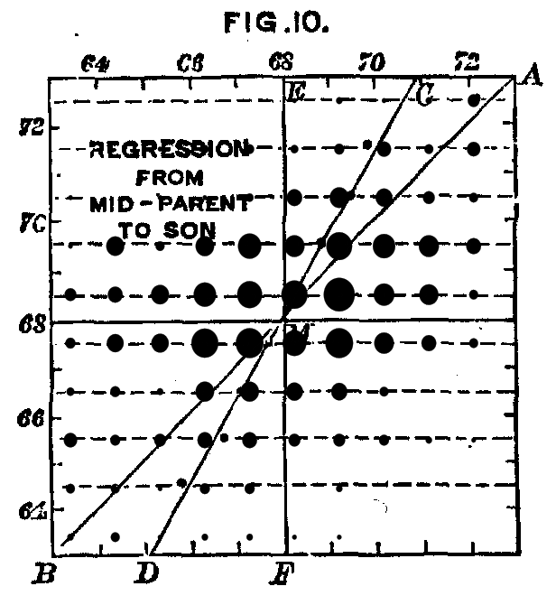
2D Linear regression 1
A bit of History
Francis Galton (1822-1911), another
grandson of Erasmus Darwin,
obsessed with the idea that
talent is inherited, finds that
the height of son
regresses to the mean,
from father’s height (1885) –
This explains the term.

Slide 4
2D Linear regression, 2
Iris Petal Width: how can we express it
through Petal Length linearly
PeWi=a*PeLe+b

Slide 5
2D Linear regression, 3
Iris How can we fit equation
PeWi=a*PeLe+b
Meaning of a:
a = Change in PeWi
at PeLe changed by 1
(slope)
b = expected PeWi at PeLe=0 (This requires some fantasy…)
(intercept)

Slide 6
2D Linear regression, 4
How can we express y=ax+b with minimum error? Maths:
At entity i=1, 2, . . ., N equation
y_{i} = ax_{i} + b + e_{i}
where e_{i} is error (residual)
Idea: Find a and b minimizing errors e_{i}

Slide 7
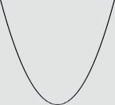
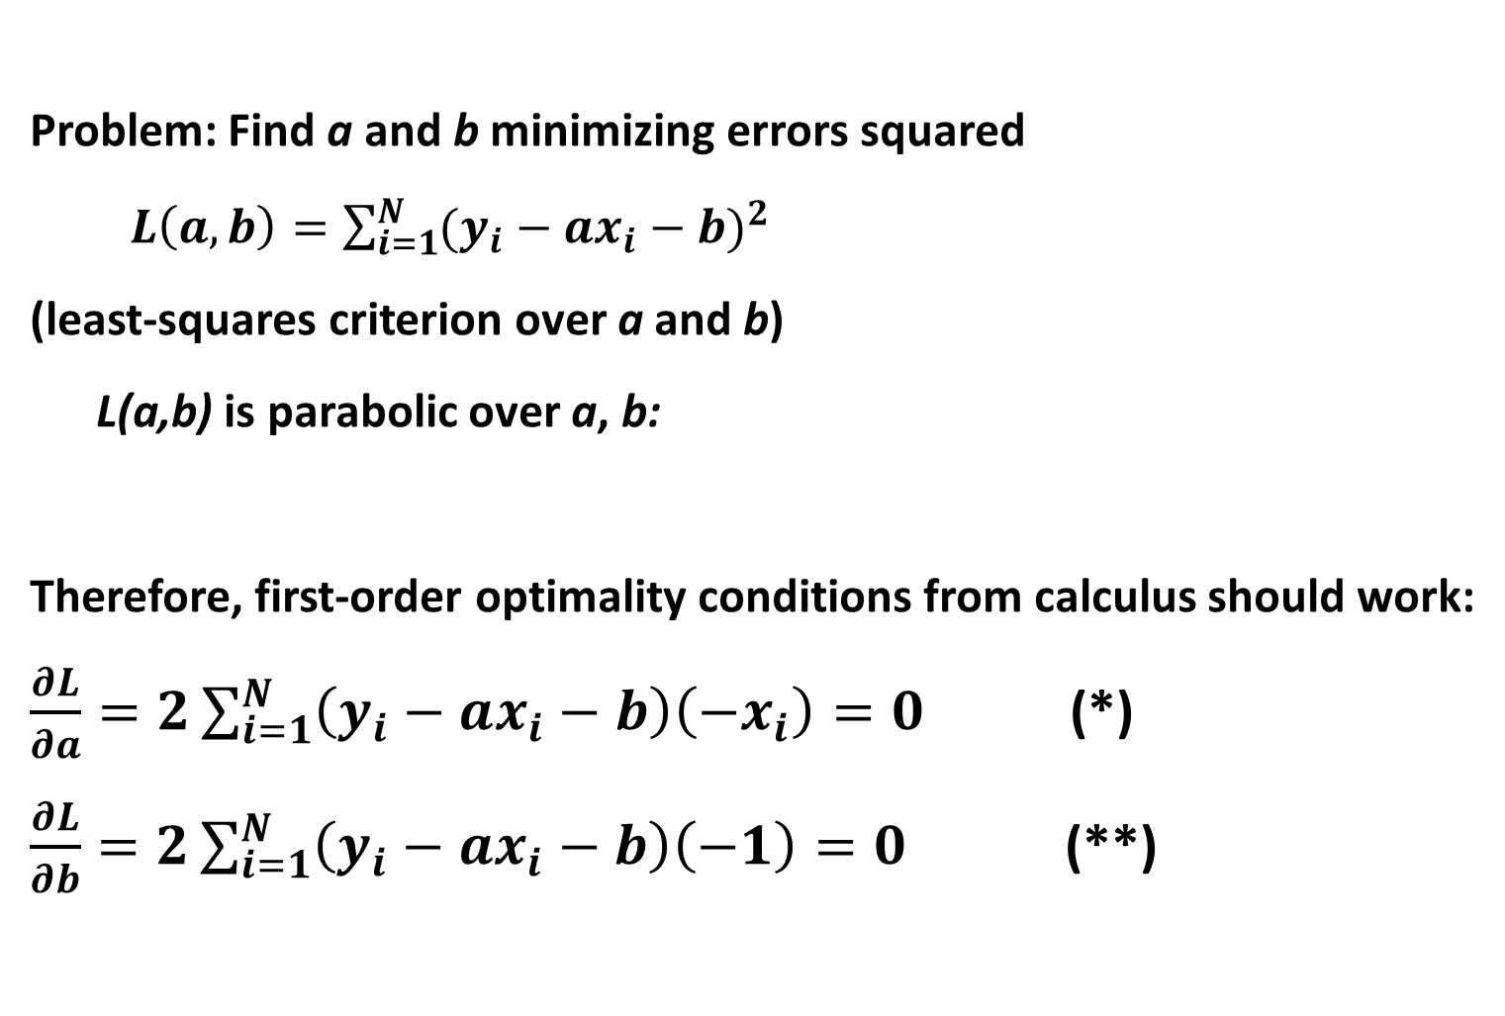
2D Linear regression ,5
Problem: Find a and b minimizing errors squared
$L\left(a,b\right)=\sum_{i=1}^{N}{{(y_{i}−ax_{i}−b)}^{2}}$
(least-squares criterion over a and b)
L(a,b) is parabolic over a, b:
Therefore, first-order optimality conditions from calculus should work:
$\frac{∂L}{∂a}=2\sum_{i=1}^{N}{\left(y_{i}−ax_{i}−b\right)\left(−x_{i}\right)=0}$ (*)
$\frac{∂L}{∂b}=2\sum_{i=1}^{N}{\left(y_{i}−ax_{i}−b\right)\left(−1\right)=0}$ (**)

Slide 8
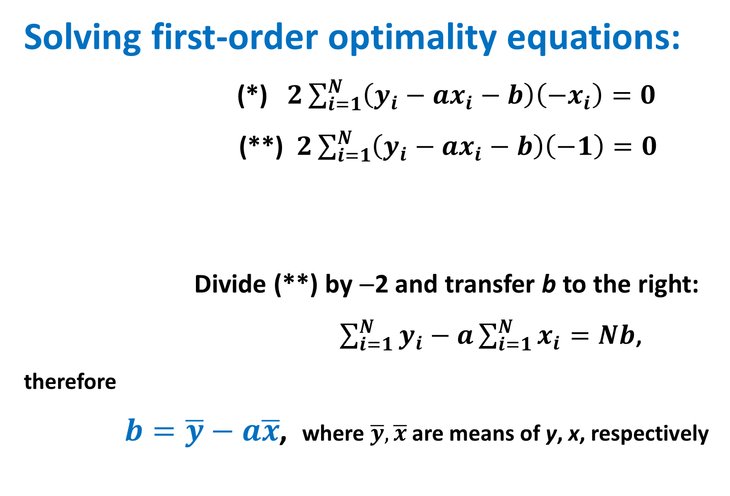
2D Linear regression, 6
Solving first-order optimality equations:
(*) $2\sum_{i=1}^{N}{\left(y_{i}−ax_{i}−b\right)\left(−x_{i}\right)=0}$
(**) $2\sum_{i=1}^{N}{\left(y_{i}−ax_{i}−b\right)\left(−1\right)=0}$
Divide (**) by −2 and transfer b to the right:
$\sum_{i=1}^{N}{y_{i}−a\sum_{i=1}^{N}{x_{i}}=Nb}$,
therefore
$b=\overline{y}−a\overline{x}$, where $\overline{y},\overline{x}$ are means of y, x, respectively

Slide 9
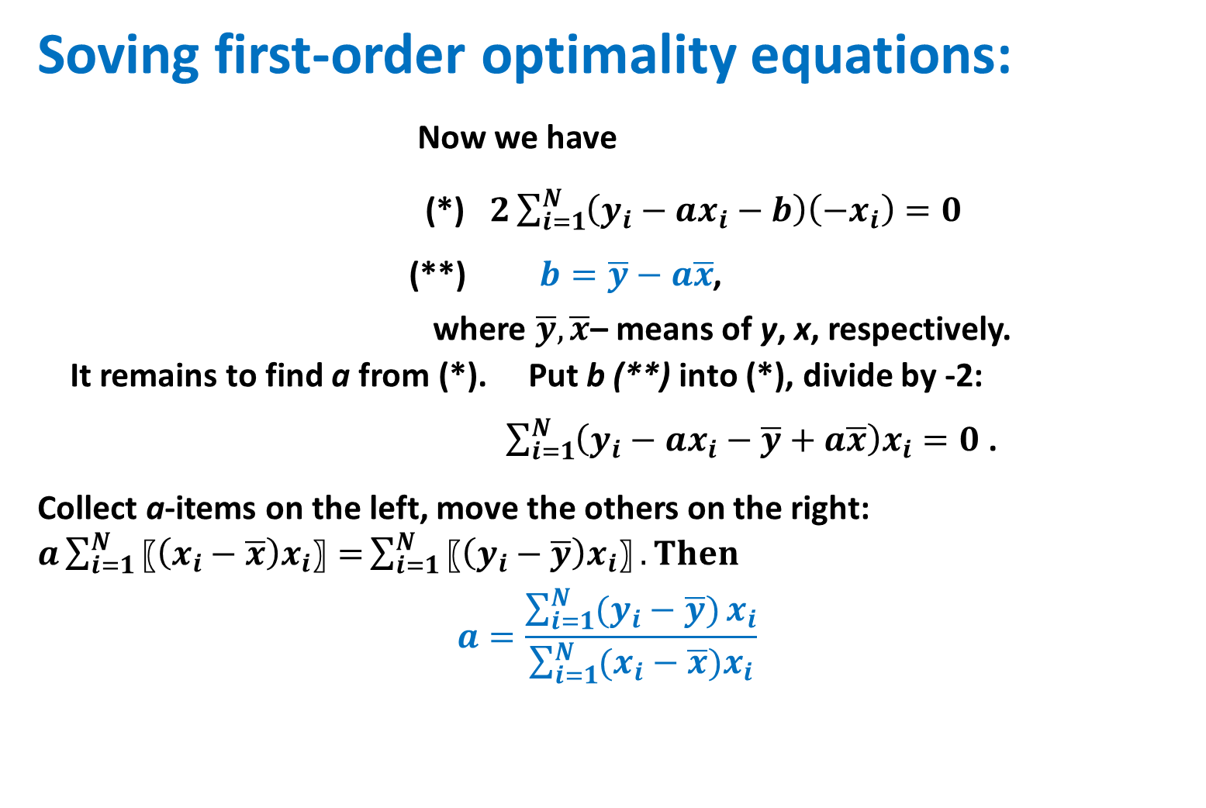
2D Linear regression, 7
Soving first-order optimality equations:
Now we have
(*) $2\sum_{i=1}^{N}{{\left(y_{i}−ax_{i}−b\right)\left(−x_{i}\right)=0}^{}}$
(**) $b=\overline{y}−a\overline{x}$,
where $\overline{y},\overline{x}$– means of y, x, respectively.
It remains to find a from (*). Put b (**) into (*), divide by -2:
$\sum_{i=1}^{N}{\left(y_{i}−ax_{i}−\overline{y}+a\overline{x}\right)x_{i}=0}$ .
Collect a-items on the left, move the others on the right: $a\sum_{i=1}^{N}{〖\left(x_{i}−\overline{x}\right)x_{i}〗=}\sum_{i=1}^{N}{〖\left(y_{i}−\overline{y}\right)x_{i}〗}. Then$
$$a=\frac{\sum_{i=1}^{N}{(y_{i}−\overline{y})}x_{i}}{\sum_{i=1}^{N}{(x_{i}−\overline{x}})x_{i}}$$

Slide 10
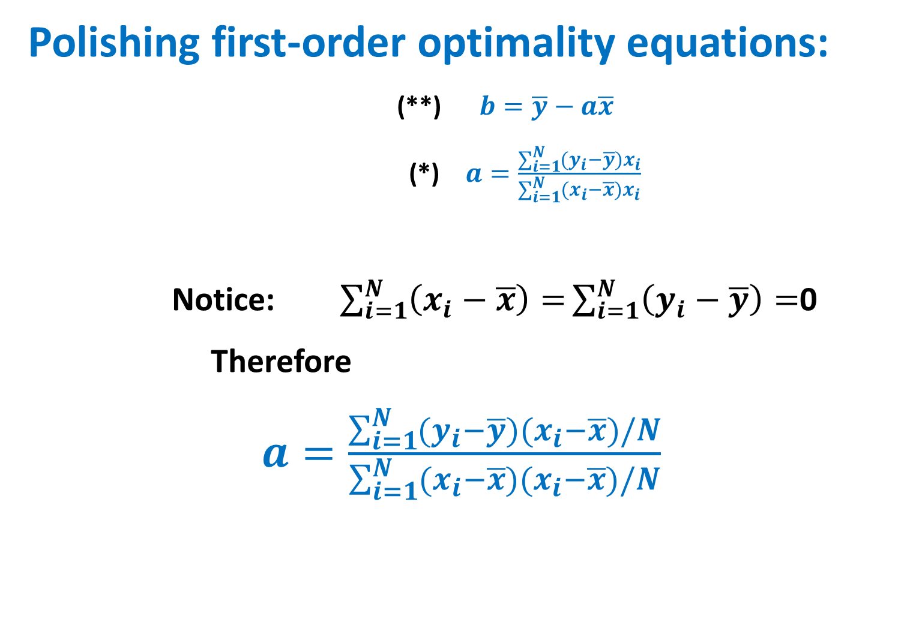
2D Linear regression, 8
Polishing first-order optimality equations:
(**) $b=\overline{y}−a\overline{x}$
(*) $a=\frac{\sum_{i=1}^{N}{(y_{i}−\overline{y})}x_{i}}{\sum_{i=1}^{N}{(x_{i}−\overline{x}})x_{i}}$
Notice: $\sum_{i=1}^{N}{\left(x_{i}−\overline{x}\right)=}\sum_{i=1}^{N}{\left(y_{i}−\overline{y}\right)=}$0
Therefore
$a=\frac{\sum_{i=1}^{N}{(y_{i}−\overline{y})}{(x}_{i}−\overline{x})/N}{\sum_{i=1}^{N}{(x_{i}−\overline{x}}){(x}_{i}−\overline{x})/N}$

Slide 11
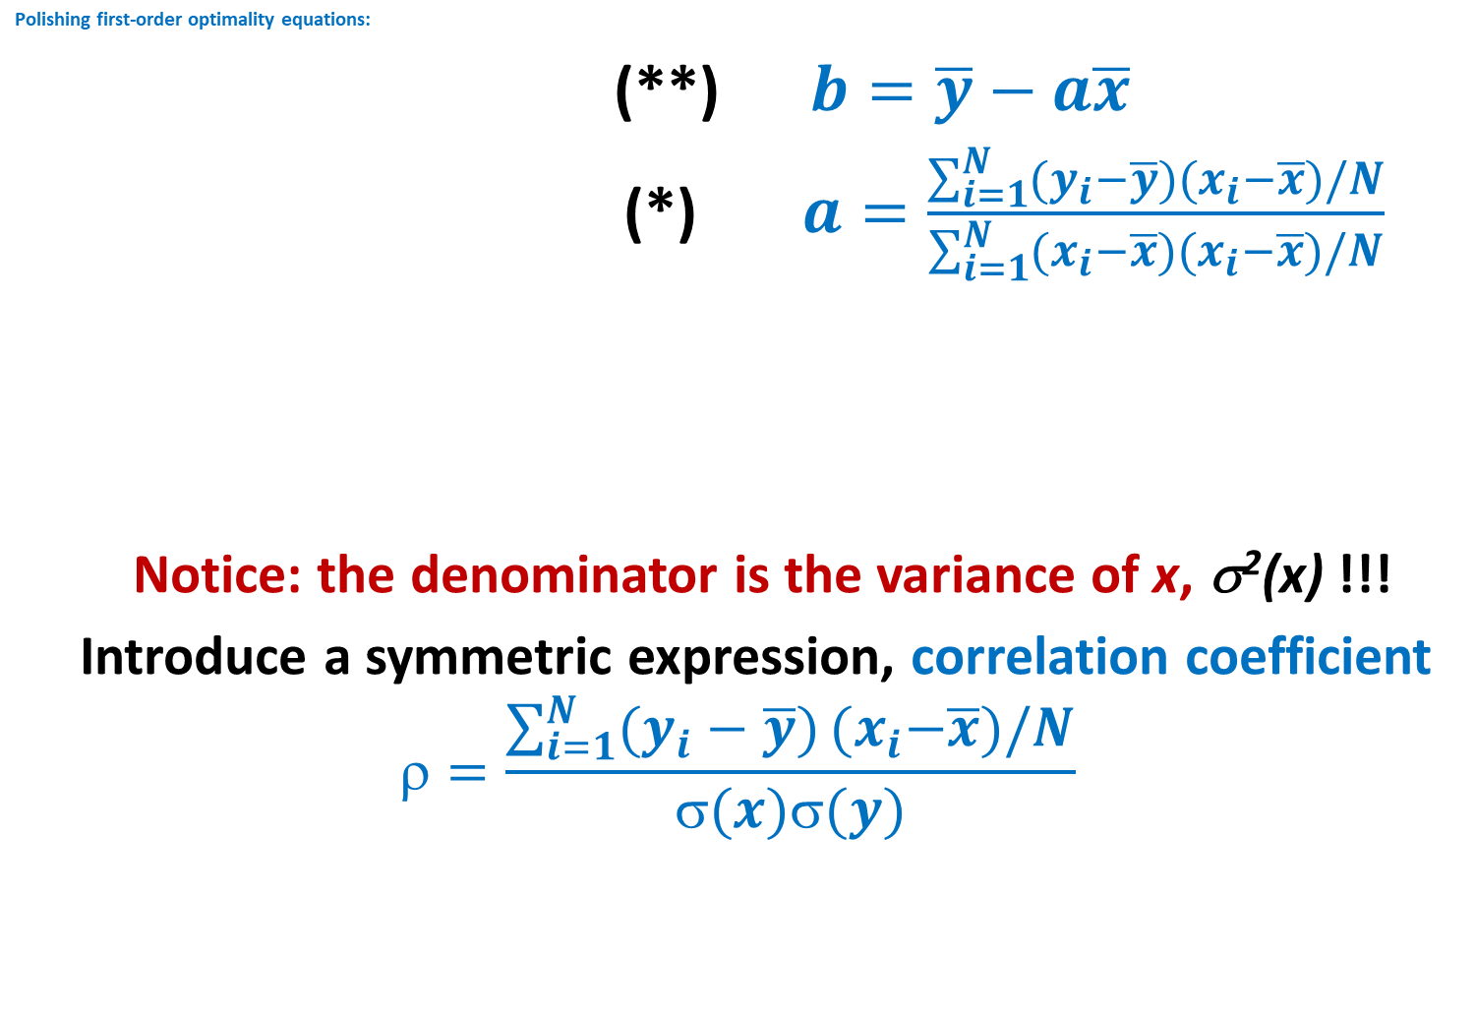
2D Linear regression, 9
Polishing first-order optimality equations:
(**) $b=\overline{y}−a\overline{x}$
(*) $a=\frac{\sum_{i=1}^{N}{(y_{i}−\overline{y})}{(x}_{i}−\overline{x})/N}{\sum_{i=1}^{N}{(x_{i}−\overline{x}}){(x}_{i}−\overline{x})/N}$
Notice: the denominator is the variance of x, σ²(x) !!!
Introduce a symmetric expression, correlation coefficient
$$=\frac{\sum_{i=1}^{N}{(y_{i}−\overline{y})}{(x}_{i}−\overline{x})/N}{σ(x)σ(y)}$$

Slide 12
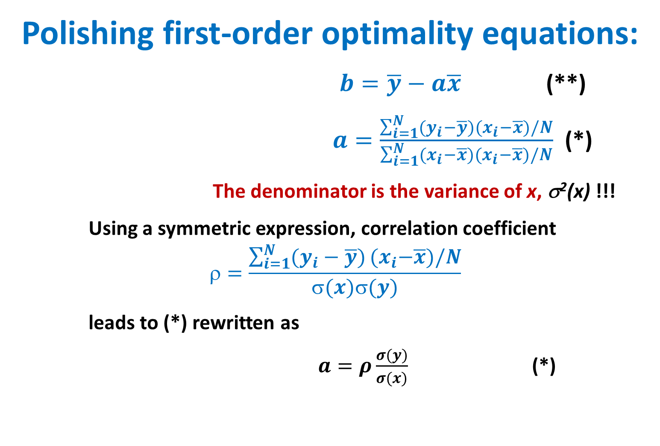
2D Linear regression, 10
Polishing first-order optimality equations:
$b=\overline{y}−a\overline{x}$ (**)
$a=\frac{\sum_{i=1}^{N}{(y_{i}−\overline{y})}{(x}_{i}−\overline{x})/N}{\sum_{i=1}^{N}{(x_{i}−\overline{x}}){(x}_{i}−\overline{x})/N}$ (*)
The denominator is the variance of x, σ²(x) !!!
Using a symmetric expression, correlation coefficient
$$=\frac{\sum_{i=1}^{N}{(y_{i}−\overline{y})}{(x}_{i}−\overline{x})/N}{σ(x)σ(y)}$$
leads to (*) rewritten as
$a=ρ\frac{σ(y)}{σ(x)}$ (*)

Slide 13
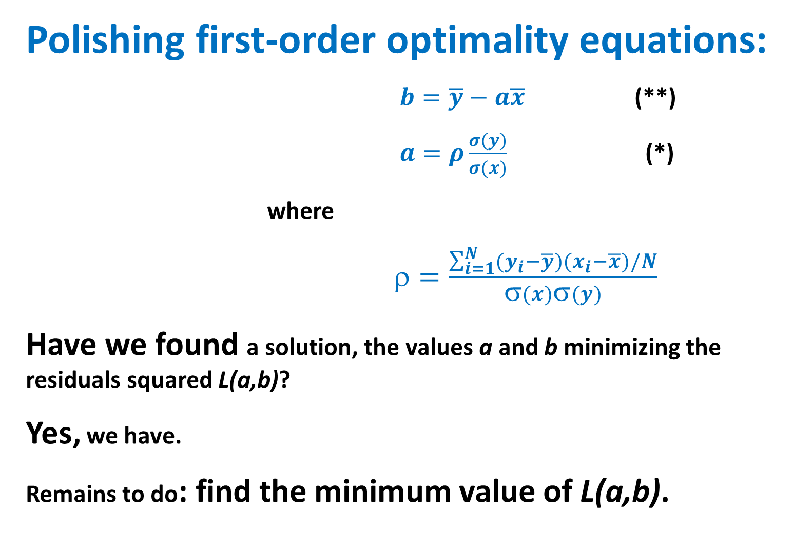
2D Linear regression, 11
Polishing first-order optimality equations:
$b=\overline{y}−a\overline{x}$ (**)
$a=ρ\frac{σ(y)}{σ(x)}$ (*)
where
$=\frac{\sum_{i=1}^{N}{(y_{i}−\overline{y})}{(x}_{i}−\overline{x})/N}{σ(x)σ(y)}$
Have we found a solution, the values a and b minimizing the residuals squared L(a,b)?
Yes, we have.
Remains to do: find the minimum value of L(a,b).

Slide 14
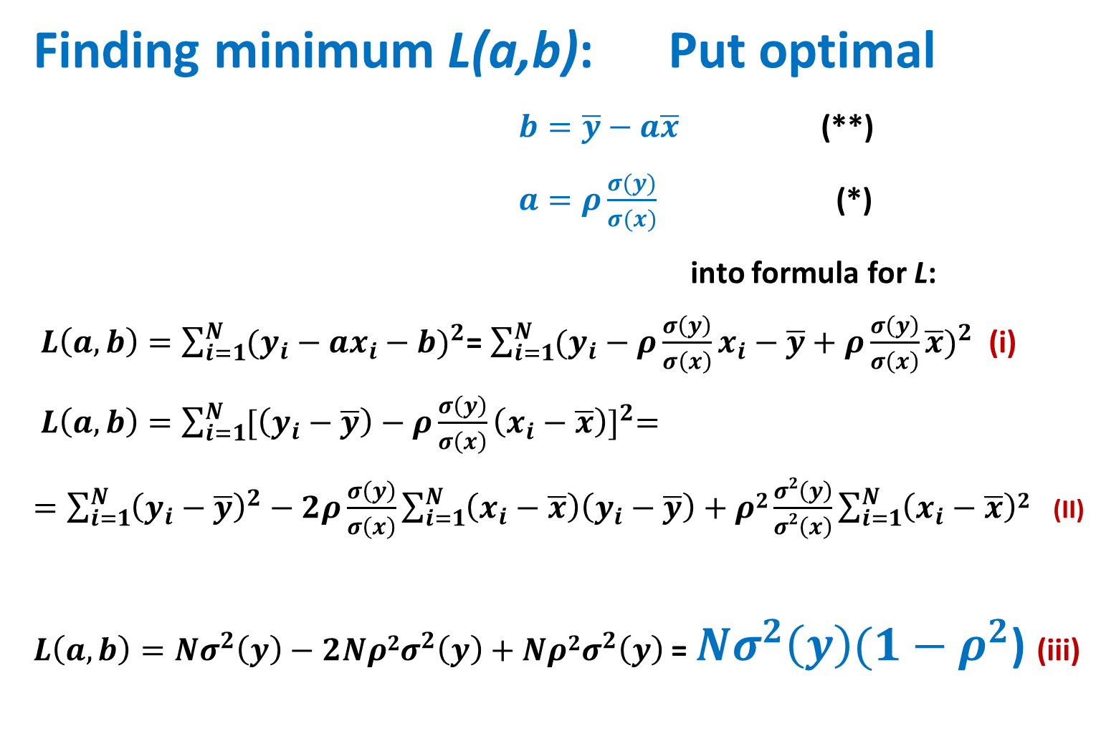
2D Linear regression, 12
Finding minimum L(a,b): Put optimal
$b=\overline{y}−a\overline{x}$ (**)
$a=ρ\frac{σ(y)}{σ(x)}$ (*)
into formula for L:
$L\left(a,b\right)=\sum_{i=1}^{N}{{(y_{i}−ax_{i}−b)}^{2}}$= $\sum_{i=1}^{N}{{(y_{i}−ρ\frac{σ\left(y\right)}{σ\left(x\right)}x_{i}−\overline{y}+ρ\frac{σ\left(y\right)}{σ\left(x\right)}\overline{x})}^{2}}$ (i)
$L\left(a,b\right)=\sum_{i=1}^{N}{{[\left(y_{i}−\overline{y}\right)−ρ\frac{σ\left(y\right)}{σ\left(x\right)}\left(x_{i}−\overline{x}\right)]}^{2}=}$
$=\sum_{i=1}^{N}{{{\left(y_{i}−\overline{y}\right)}^{2}−2ρ\frac{σ\left(y\right)}{σ\left(x\right)}\sum_{i=1}^{N}{\left(x_{i}−\overline{x}\right)\left(y_{i}−\overline{y}\right)}+ρ2\frac{σ2\left(y\right)}{σ2\left(x\right)}\sum_{i=1}^{N}{\left(x_{i}−\overline{x}\right)2}}^{}}$ (II)
$L\left(a,b\right)=Nσ^{2}\left(y\right)−2Nρ{2σ}^{2}\left(y\right)+Nρ{2σ}^{2}\left(y\right)$ = $Nσ^{2}\left(y\right)(1−ρ^{2}$) (iii)

Slide 15
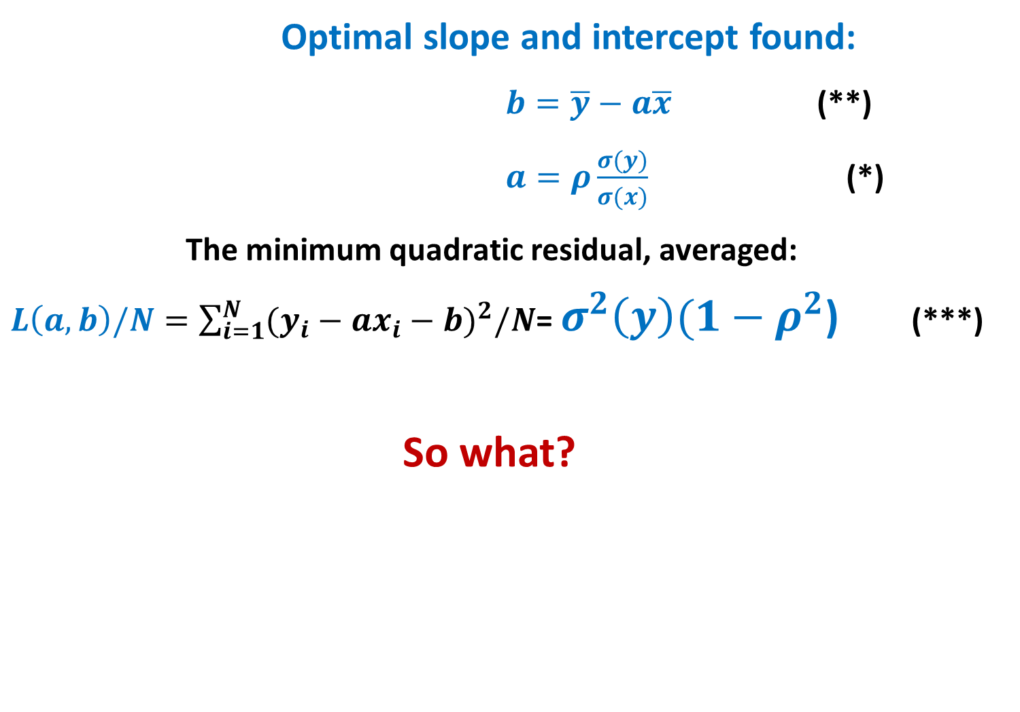
2D Linear regression, 13: all solved
Optimal slope and intercept found:
$b=\overline{y}−a\overline{x}$ (**)
$a=ρ\frac{σ(y)}{σ(x)}$ (*)
The minimum quadratic residual, averaged:
$L\left(a,b\right)/N=\sum_{i=1}^{N}{{(y_{i}−ax_{i}−b)}^{2}/N}$= $σ^{2}\left(y\right)(1−ρ^{2}$) (***)
So what?

Slide 16
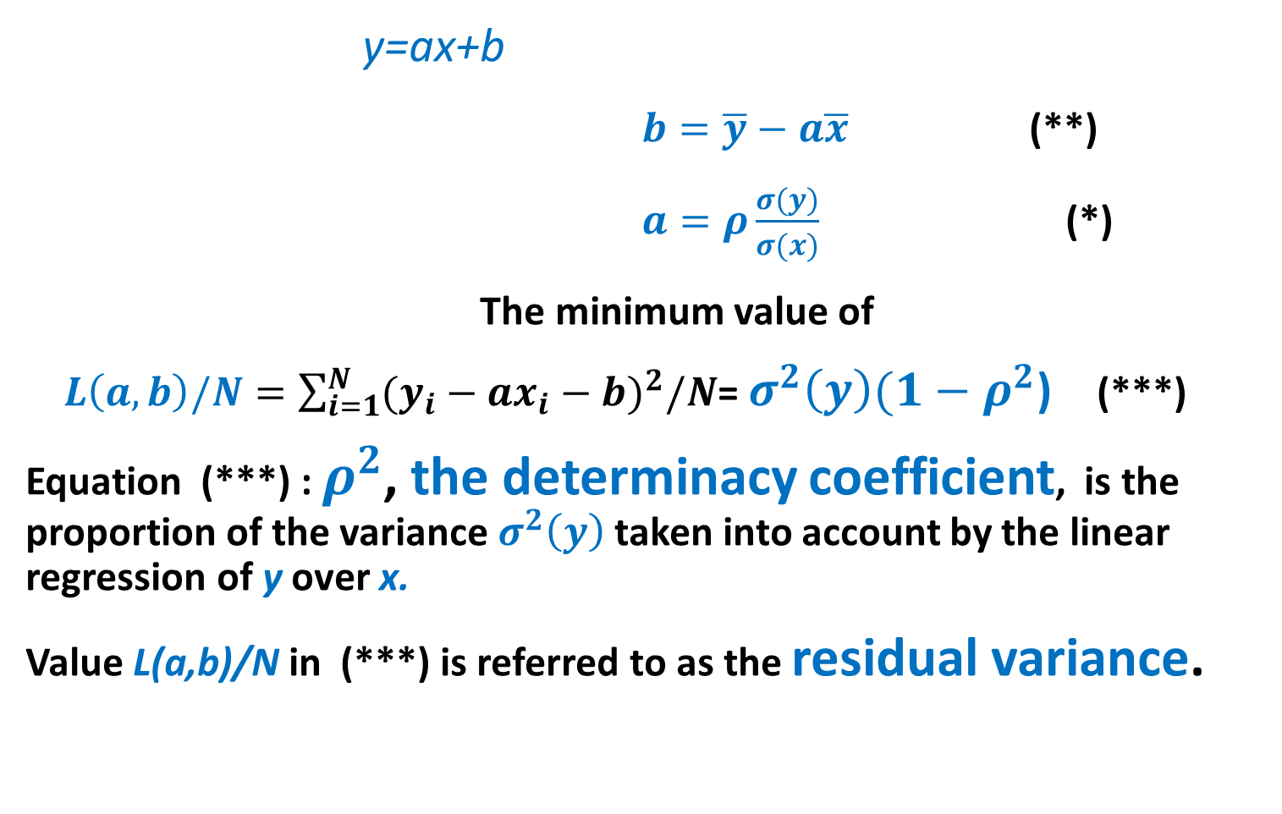
2D Correlation and determinacy coefficients: properties and meaning 1
y=ax+b
$b=\overline{y}−a\overline{x}$ (**)
$a=ρ\frac{σ(y)}{σ(x)}$ (*)
The minimum value of
$L\left(a,b\right)/N=\sum_{i=1}^{N}{{(y_{i}−ax_{i}−b)}^{2}/N}$= $σ^{2}\left(y\right)(1−ρ^{2}$) (***)
Equation (***) : $ρ^{2}$, the determinacy coefficient, is the proportion of the variance $σ^{2}\left(y\right)$ taken into account by the linear regression of y over x.
Value L(a,b)/N in (***) is referred to as the residual variance.

Slide 17
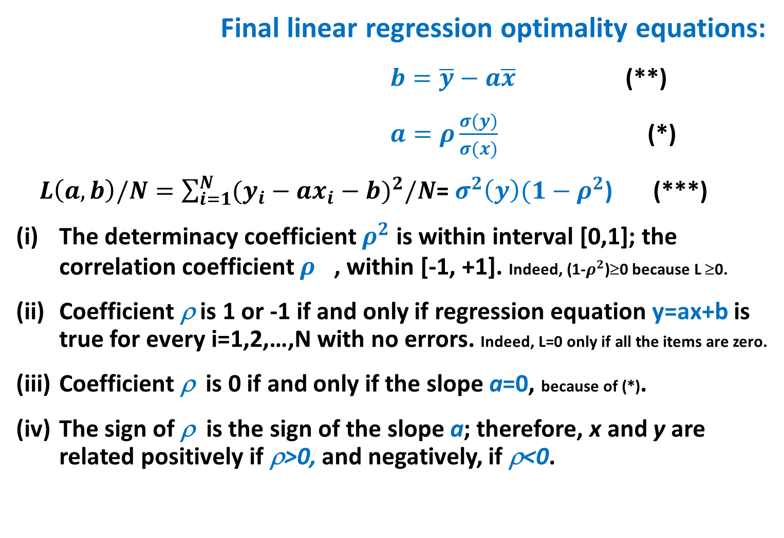
Correlation coefficient: four properties, 2
Final linear regression optimality equations:
$b=\overline{y}−a\overline{x}$ (**)
$a=ρ\frac{σ(y)}{σ(x)}$ (*)
$L\left(a,b\right)/N=\sum_{i=1}^{N}{{(y_{i}−ax_{i}−b)}^{2}/N}$= $σ^{2}\left(y\right)(1−ρ^{2}$) (***)
The determinacy coefficient $ρ^{2}$ is within interval [0,1]; the correlation coefficient $ρ^{}$, within [-1, +1]. Indeed, (1-$ρ^{2}$)≥0 because L ≥0.
Coefficient ρ is 1 or -1 if and only if regression equation y=ax+b is true for every i=1,2,…,N with no errors. Indeed, L=0 only if all the items are zero.
Coefficient ρ is 0 if and only if the slope a=0, because of (*).
The sign of ρ is the sign of the slope a; therefore, x and y are related positively if ρ>0, and negatively, if ρ<0.

Slide 18
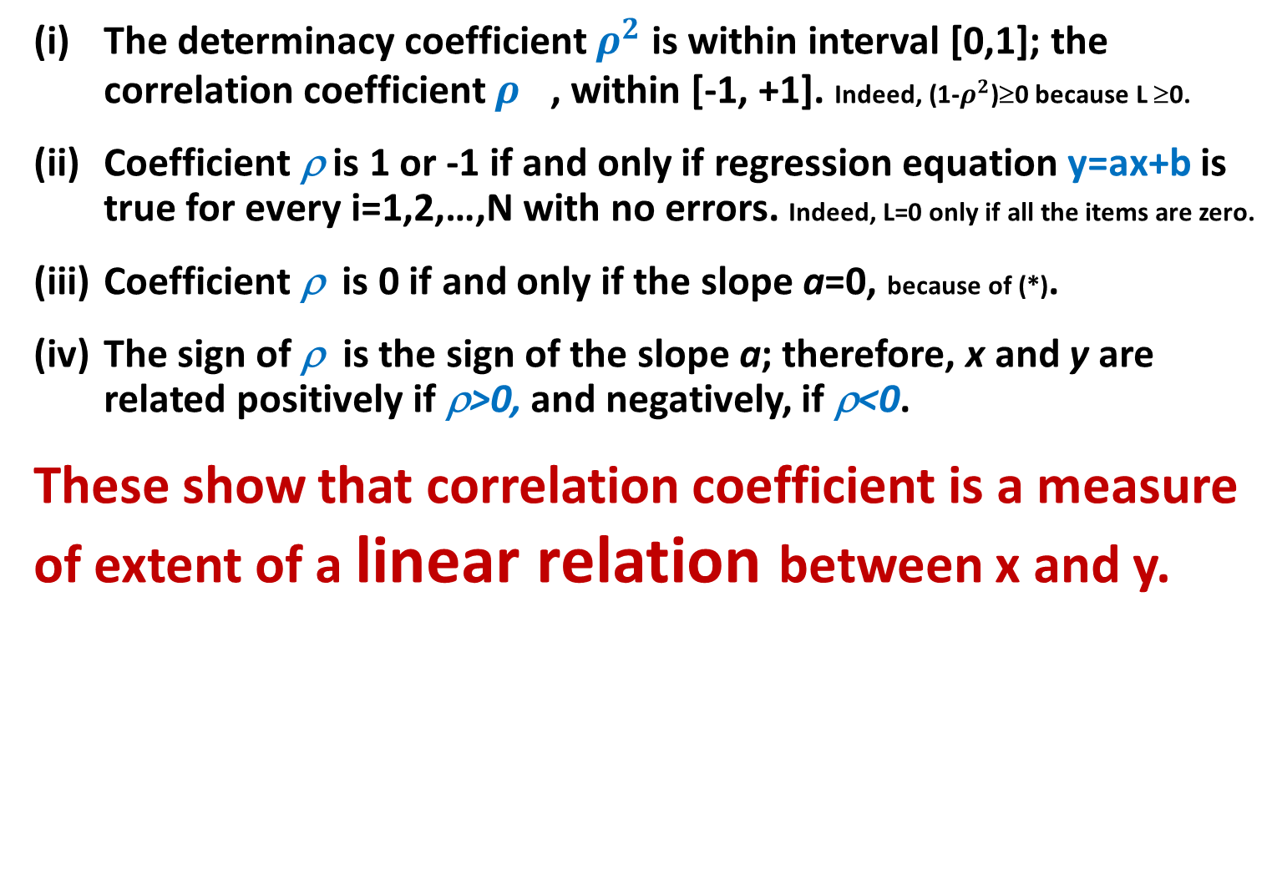
2D Correlation coefficient: properties and meaning, 3
The determinacy coefficient $ρ^{2}$ is within interval [0,1]; the correlation coefficient $ρ^{}$, within [-1, +1]. Indeed, (1-$ρ^{2}$)≥0 because L ≥0.
Coefficient ρ is 1 or -1 if and only if regression equation y=ax+b is true for every i=1,2,…,N with no errors. Indeed, L=0 only if all the items are zero.
Coefficient ρ is 0 if and only if the slope a=0, because of (*).
The sign of ρ is the sign of the slope a; therefore, x and y are related positively if ρ>0, and negatively, if ρ<0.
These show that correlation coefficient is a measure of extent of a linear relation between x and y.

Slide 19

Meaning of ρ : Good Case
Iris Petal Width through Petal Length y=a*x+b
$b=\overline{y}−a\overline{x}$ (**)
$a=ρ\frac{σ(y)}{σ(x)}$ (*)
>> x=iris(:,3);
>> y=iris(:,4);
>> ρ =corr(x,y)% ρ =0.9629
Even inspite that points (x_{i},y_{i})
are not exactly on a line, determinacy ρ ²=92.7%
(7.3% of y-scatter left unexplained)
slope = 0.4158; intercept = -0.3631 (красная линия; голубая – от руки)

Slide 20
High determinacy warrants no high precision:
Iris Petal Width=0.4158*x- 0.3631 (ℵ)
Although points (x_{i},y_{i}) do not fit
the regression line, ρ²=92.7% -
Almost unity!
Test for the errors at prediction
n. x y PWℵ error,%
23 1.4 0.1 0.22
51 4.5 1.5 1.51
86 4.3 1.3 1.42
138 5.0 1.9 1.72
142 5.7 2.5 2.01

Slide 21

DA and ML relative errors: Big difference , 1:
Iris Petal Width=0.4158*x- 0.3631 (ℵ)
Although points (x_{i},y_{i}) do not fit
the regression line, ρ²=92.7% -
Test for the errors at prediction is
not that simple.
The error is the difference between the
true value and its estimate
Two perspectives: DA and ML
What is truth? (a «good» question…)
DA: The observed. All the rest is our
thinking which can be wishful.
Science (ML, etc.): The theoretical.
Observation may be subject to noise.
Two ways to score the error: error1=$\frac{|y−PWε|}{|y|}$, error2= $\frac{|y−PWε|}{|PWε|}$
DA Science/ML

Slide 22
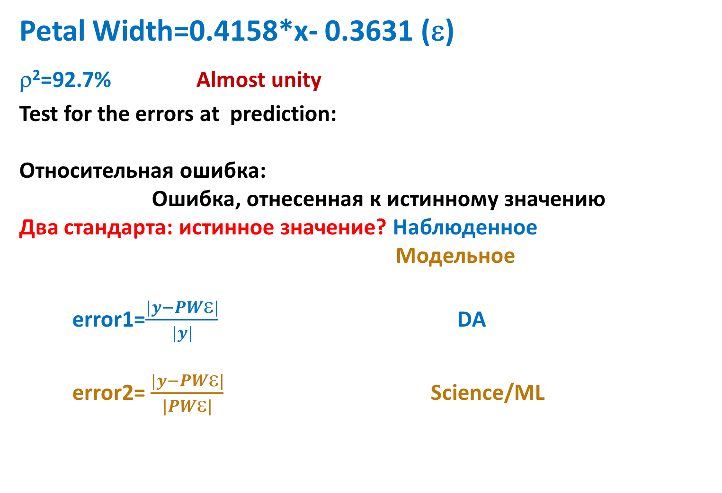
DA and ML relative errors: Big difference, 2
Petal Width=0.4158*x- 0.3631 (ε)
ρ²=92.7% Almost unity
Test for the errors at prediction:
Относительная ошибка:
Ошибка, отнесенная к истинному значению
Два стандарта: истинное значение? Наблюденное
Модельное
error1=$\frac{|y−PWε|}{|y|}$ DA
error2= $\frac{|y−PWε|}{|PWε|}$ Science/ML

Slide 23
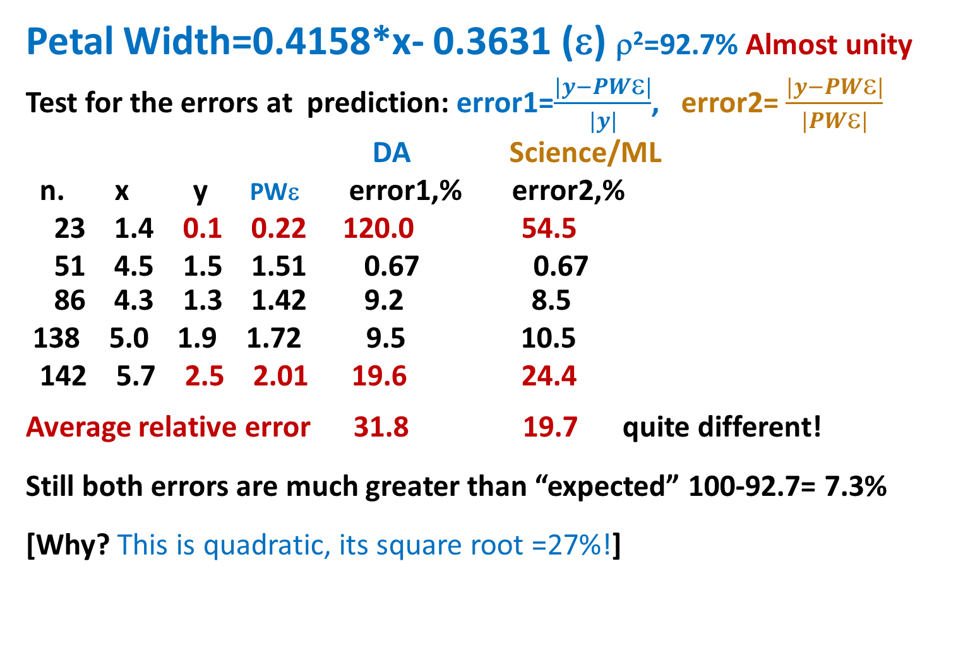
DA and ML relative errors: Big difference, 3
Petal Width=0.4158*x- 0.3631 (ε) ρ²=92.7% Almost unity
Test for the errors at prediction: error1=$\frac{|y−PWε|}{|y|}$, error2= $\frac{|y−PWε|}{|PWε|}$
DA Science/ML
n. x y PWε error1,% error2,%
23 1.4 0.1 0.22 120.0 54.5
51 4.5 1.5 1.51 0.67 0.67
86 4.3 1.3 1.42 9.2 8.5
138 5.0 1.9 1.72 9.5 10.5
142 5.7 2.5 2.01 19.6 24.4
Average relative error 31.8 19.7 quite different!
Still both errors are much greater than “expected” 100-92.7= 7.3%
[Why? This is quadratic, its square root =27%!]

Slide 24

Meaning of ρ =0: No relation? (Nope!)
$a=ρ\frac{σ(y)}{σ(x)}$ (*)
(iii) Coefficient ρ=0 if and only if the slope a=0 in the regression equation.
Три вида ситуаций с ρ=0 :
so that regression is y=b.
Random cloud Non-linear y=ax²+b Highly nonhomogeneous

Slide 25
Correlation: Weird case,1 (Simpson’s paradox)
Iris Sepal Length and Sepal Width (other pair)
This value is rather odd .
The SL and SW should go
along, with a positive,
if not high, correlation:
The greater SL, the greater SW.

Slide 26
Correlation: Weird case, 2 (Simpson’s paradox)
Iris Corr(Sepal Length, Sepal Width)=-0.1176
This rather odd value
comes from the non-homogeneity:
a mix of three taxa
correlation within each,
0.74, 0.53, 0.46,
is positive, if not quite high

Slide 27
Correlation: Weird case, 3 (Simpson’s paradox)
A scheme of FALSE negative correlation by merging different groupings
A high positive correlation within each
group, red, blue, grey; yet a negative
correlation overall !!!
Instances of data manipulation, sometimes
unintentional, should have made
great politicians (B. Disraeli, UK Prime-
Minister) to say even if they have not:
THERE are THREE LEVELS of LIE: “A LIE, DAMNED LIE, and STATISTICS!”, /Существуют три уровня лжи: ложь, наглая ложь и статистика!/

Slide 28
Correlation : Weird case , 4 (Simpson’s paradox) A quiz
A scheme of FALSE POSITIVE correlation by merging different groupings
A high NEGATIVE correlation
within each group;
yet a positive
correlation overall !!!
THREE LEVELS of LIE: “A LIE, DAMNED LIE, and STATISTICS!”,
Can you guess a proper picture for this?
Try proposing a scatter-plot for this case.

Slide 29
Correlation and regression: Weird Case 2
Inflated correlation, 1:
Random features generated:
>> g=rand(200,1);
>> h=5*rand(200,1)-3;
>> plot(g,h, 'k.')
>> corr(g,h) =0.06 % close to 0

Slide 30
Correlation and regression: Weird Case 2, 2
Inflated correlation, 2: by adding outliers
Random features generated:
On the left:
>> g=rand(200,1);
>> h=5*rand(200,1)-3;
>> rho=0.0650
On the right
TWO outliers are added:
>> g(201)=100; g(202)=-100;
>> h(201)=100; h(202)=-90;
>> rho=0.9862 % almost a unity!

Slide 31
Some observed yet unexplained correlations
Social drinking and earnings - drinkers earn more money (B.L. Peters, E. Stringham (2006), Journal of Labor Research, 27(3), 411-421).
Chocolate consumption and the numbers of Nobel prize winners, both relative to the population size (F.H. Messerli (2012), The New England Journal of Medicine, 367(16), 1562).
Numbers of: (a) newborn babies and (b) brooding pairs of storks observed across 17 countries (R. Matthews, Teaching Statistics, 2000, 22, 2, 36-38).

Slide 32
Simpson’s paradox for means (https://www.youtube.com/watch?v=t-Ci3FosqZs)
Covid fatality rate before Summer 2020:
China 2.1%
Italy 4.1% [as twice higher]
Nothing seems wrong. Explanation?
Perhaps the Chinese better obey rules, do not they?
Not at all: a wrong data analysis case

Slide 33
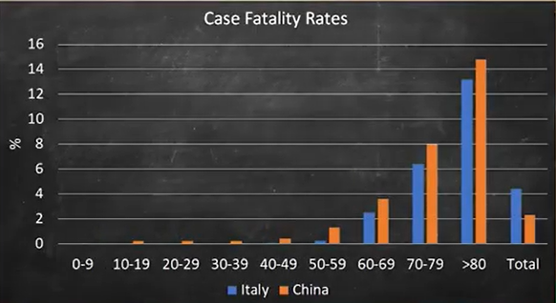
Wrong comparison: within the age groups fatalities are less in Italy!

Slide 34
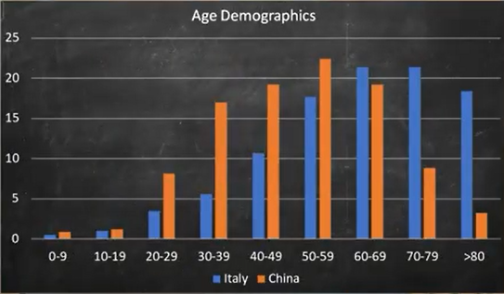
Wrong comparison: Right explanation – Age structures. Ages prevailing: China – Young, Italy – Old

Slide 35

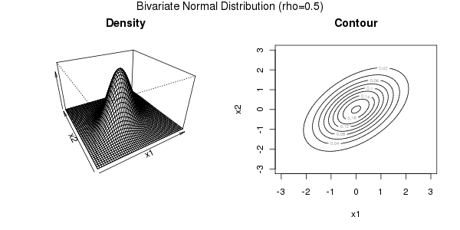
K. Pearson’s highly creative insight (probabilistic perspective at Correlation coefficient: )
At the standard Multivariate Gaussian Bivariate case
f(u, ∑)= Cexp{-u^{T}∑ ⁻¹u/2} where u=(u₁,u₂, …, u_{v}); after z-scoring
K. Pearson: Correlation coefficient is a sample-based estimate of the parameter ρ in the Gaussian density function under the conventional assumption of independent random sampling.

Slide 36
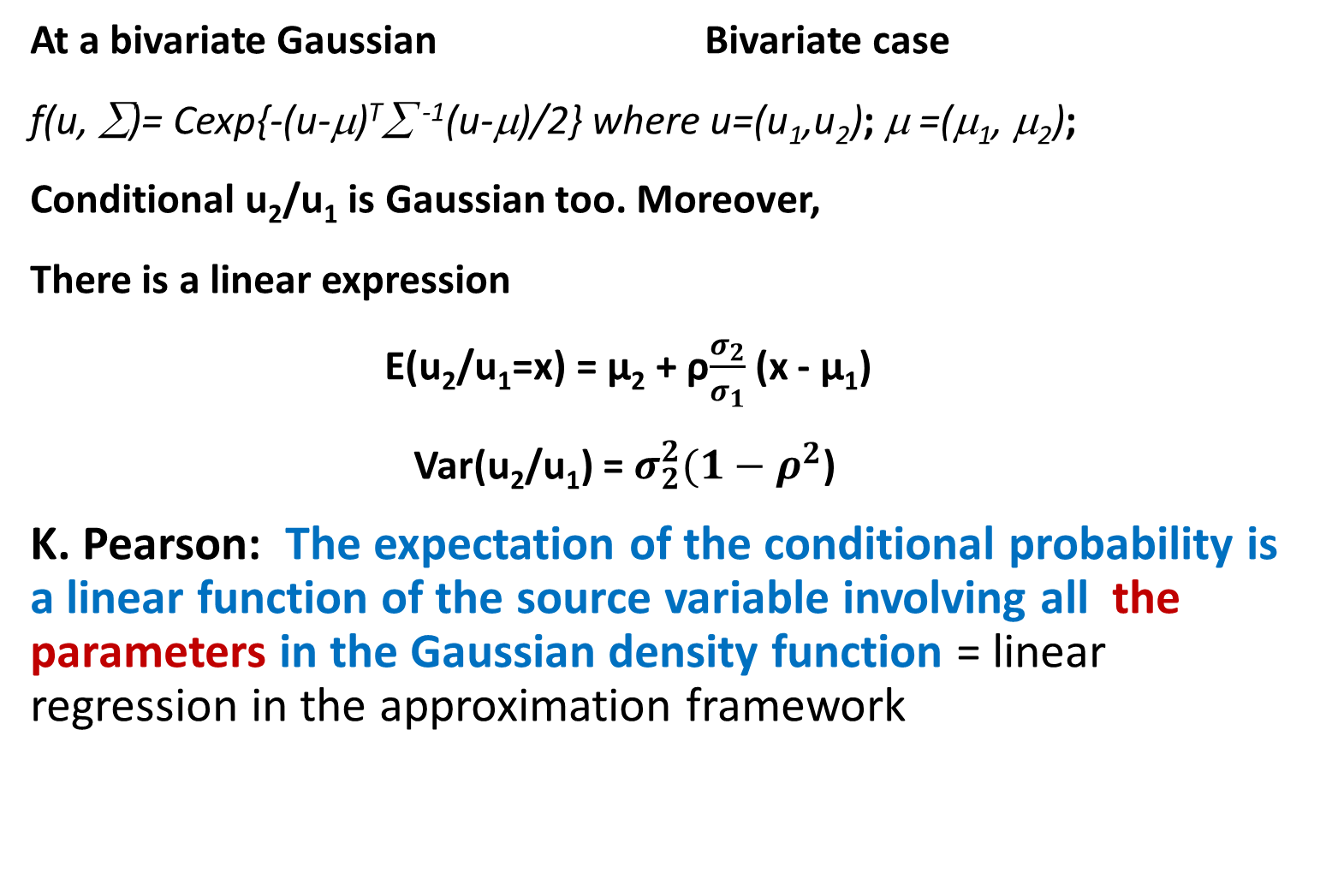
K. Pearson’s highly creative insight (probabilistic perspective at Linear Regression and correlation: )
At a bivariate Gaussian Bivariate case
f(u, ∑)= Cexp{-(u-μ)^{T}∑ ⁻¹(u-μ)/2} where u=(u₁,u₂); μ =(μ₁, μ₂);
Conditional u₂/u₁ is Gaussian too. Moreover,
There is a linear expression
E(u₂/u₁=x) = µ₂ + ρ$\frac{σ_{2}}{σ_{1}}$ (x - µ₁)
Var(u₂/u₁) = $σ_{2}^{2}(1−ρ^{2}$)
K. Pearson: The expectation of the conditional probability is a linear function of the source variable involving all the parameters in the Gaussian density function = linear regression in the approximation framework

Slide 37
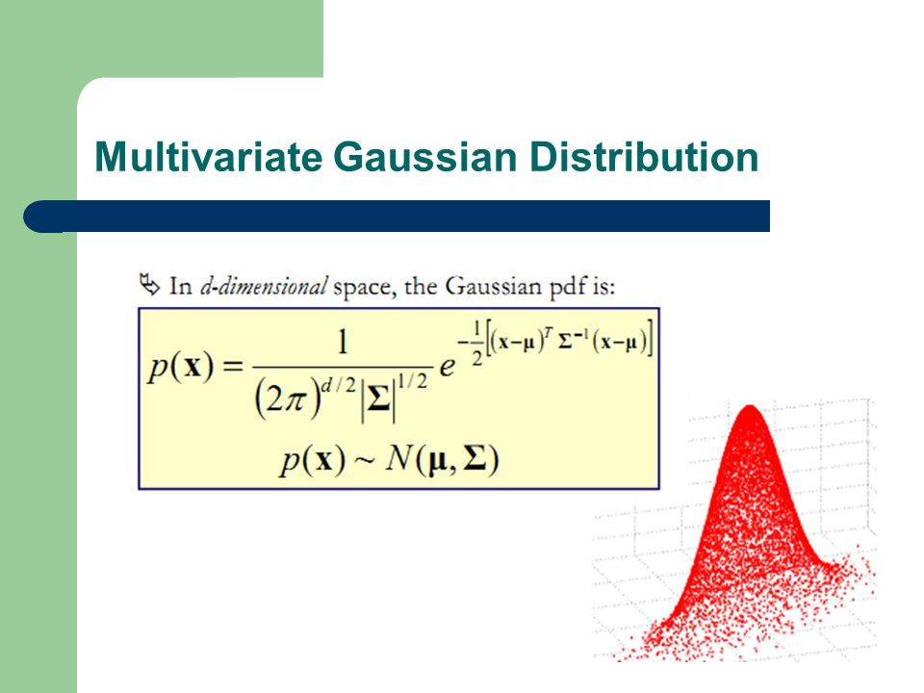

Slide 38
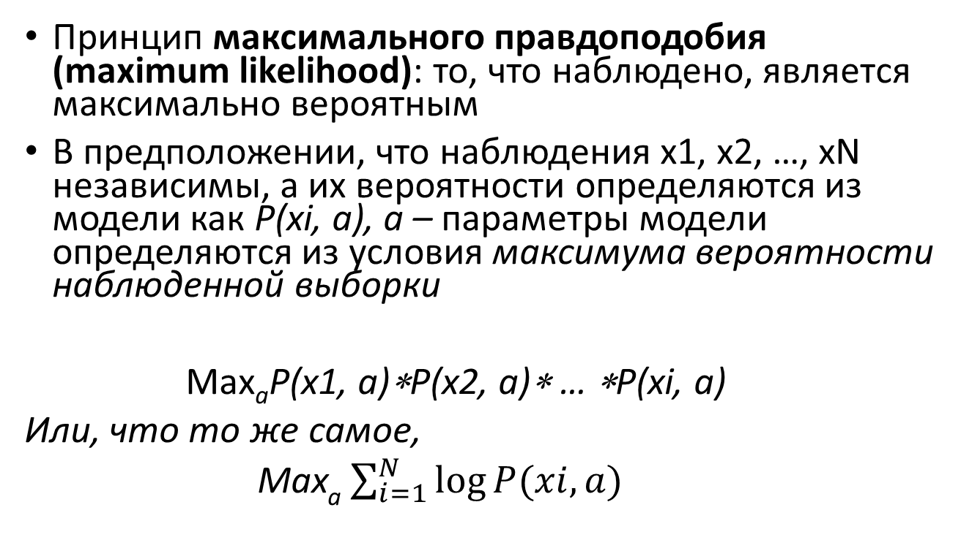
Мост между вероятностным и аппроксимационным подходами
Принцип максимального правдоподобия (maximum likelihood): то, что наблюдено, является максимально вероятным
В предположении, что наблюдения х1, x2, …, xN независимы, а их вероятности определяются из модели как P(xi, a), a – параметры модели определяются из условия максимума вероятности наблюденной выборки
Max_{a}P(x1, a)∗P(x2, a)∗ … ∗P(xi, a)
Или, что то же самое,
Max_{a} $\sum_{i=1}^{N}{log⁡P(xi,a)}$

Slide 39
Мост между вероятностным и аппроксимационным подходами
Задание студентам:
Применить принцип максимального правдоподобия в предположении, что распределение является Гауссовым для вывода формул среднего, дисперсии (случай 1Д) и коэффициента корреляции (случай 2Д)

Slide 40
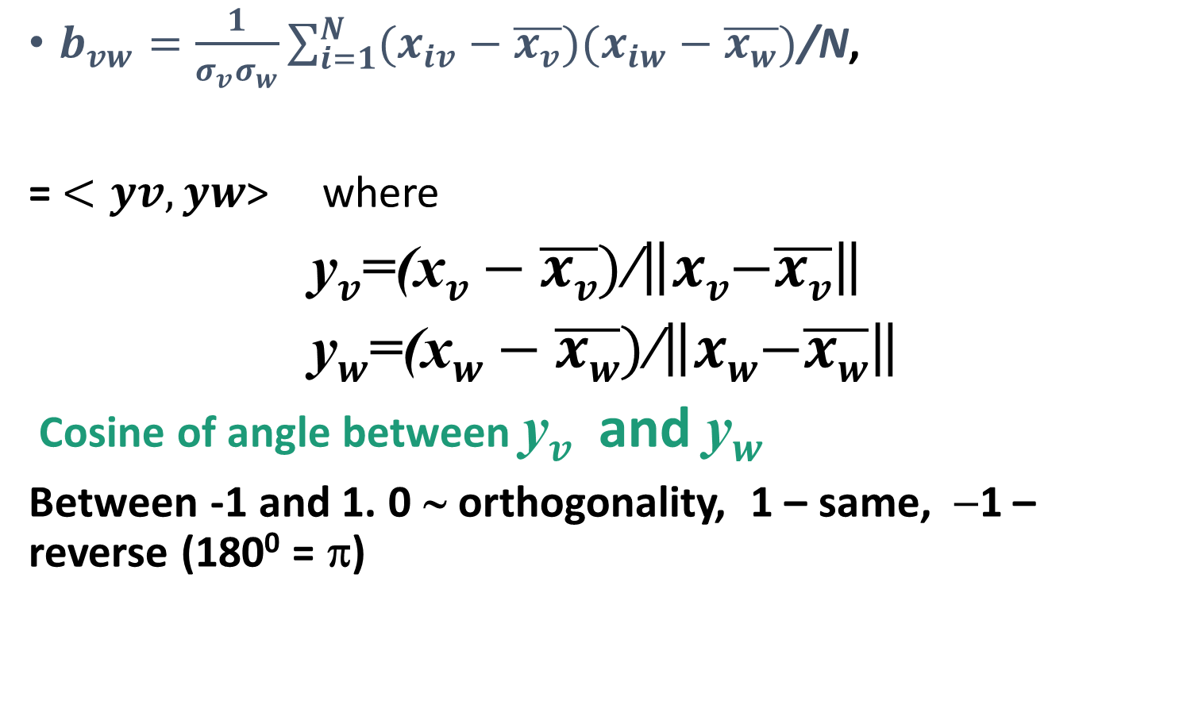
Naïve interpretation of correlation
$b_{vw}=\frac{1}{σ_{v}σ_{w}}\sum_{i=1}^{N}{(x_{iv}−\overline{x_{v}})(x_{iw}−\overline{x_{w}})}$/N,
= $<yv,yw$> where
y$v$=(x$v−\overline{xv})$/$\left\|xv\left.−\overline{xv}\right\|\right.$
y$w$=(x$w−\overline{xw})$/$\left\|xw\left.−\overline{xw}\right\|\right.$
Cosine of angle between y$v$and y$w$
Between -1 and 1. 0 ∼ orthogonality, 1 – same, −1 – reverse (180⁰ = π)

Slide 41
Meaning of correlation coefficient
A high value of ρ does not warrant any good precision of the regression
Value of ρ can be inflated by adding a few outliers
Zero value of ρ does not warrant low association between a target and predictor – this may indicate either
High non-homogeneity
High non-linearity
Probabilistic framework: parameter of bivariate Gaussian

Slide 42
Concepts learnt|Основные понятия - знать
Scatterplot/Поле рассеяния
Linear regression/Линейная регрессия
Correlation and determinacy coefficients /Коэффициенты корреляции и детерминации
High determinacy does not warrant high precision /Высокий уровень детерминации не гарантирует хорошего предсказания
ML and DA do differ - by concepts of “truth”/ Разница в понимании истины в АД и МО проявляется в определении уровня относительной ошибки регрессионной модели
False correlation: Simpson’s paradox, Inflated correlation, real cases/Ложная корреляция: парадокс Симпсона, корреляция из-за разницы в масштабах измерения
Simpson’s paradox for means/Парадокс Симпсона для средних
Bivariate Gaussian and maximum likelihood/ Двумерный Гауссиан и принцип максимального правдоподобия

Slide 43
Домашнее задание 1
По возможности, найдите два признака в Ваших данных с более или менее «линейным» полем рассеяния; представьте его на графике. Сделайте комментарий о том, насколько оно подходит для формирования линейной регрессии.
Постройте уравнение линейной регрессии одного из признаков (целевой) через другой признак (входной). Сделайте комментарий о смысле величины регрессионного коэффициента при этом другом признаке.
Найдите значения коэффициентов корреляции и детерминации; сделайте комментарий о смысле величины последнего.
Сделайте предсказание величины целевого признака на трех-четырех объектах; прокомментируйте результат.
Рассчитайте среднюю относительную ошибку регрессионного уравнения на всех объектах Вашей таблицы данных как в парадигме анализа данных, так и парадигме машинного обучения, сравните с величиной коэффициента детерминации и откомментируйте.

Slide 44
If time permits: Evolutionary optimization methods

Slide 45
A better criterion: yet mathematically hopeless
Relative error to minimize
Δ_{da}(i)=|y_{i}-ax_{i}-b|/|y_{i}|
Δ_{ml}(i)=|y_{i}-ax_{i}-b|/|ax_{i}+b|
Σ_{i}Δ(i) ⇒ min _{a, b}
A very complex function; no good methods within the classical approach (take an admissible solution, then iteratively improve, hone, and polish it)

Slide 46
Nature-inspired approach to regression: cases of non-linearity or different criteria
Relative error to minimize
Δ(i)=|y_{i}-ax_{i}-b|/|y_{i}|
Σ_{i}Δ(i) ⇒ min _{a, b}
A very complex function; no good methods in classical approaches: take an admissible solution, then hone and polish it

Slide 47
Nature-inspired approach for criterion Σ_{i}Δ(i) ⇒ min _{a, b} with Δ(i)=|y_{i}-ax_{i}-b|/|y_{i}|,1
Rather than honing a single admissible solution, run a nature-inspired evolutionary process for a population of admissible solutions
First find an area A of admissibility for pairs (a,b)
Take a population of random p admissible pairs (a(k),b(k)), k=1,2,…,p.
Define rules for: (1) the population to evolve, (2) elite maintenance, (3) halt/stopping.
Run an evolution process according to the rules for a prespecified number of iterations.
Pick up the best-found pair (a,b).

Slide 48
Popular nature-inspired approaches to optimize a function (like k-means criterion): evolution of a population, each member to represent a solution, 1
Genetic algorithms
Solution is represented as a chromosome (string, like a partition code)
Evolution:
Mutation (random change)
Cross-over of two members producing two new members

Slide 49
Popular nature-inspired approaches to optimize a function (like k-means criterion): evolution of a population, each member to represent a solution 2
Particle swarm optimization
Solution is represented by three points
Location (vector, like cluster centers)
Velocity (vector of the same size)
Best location found so far
Evolution:
Velocity is a noisy move from the previous one in the direction of individually best location and socially best location
New location is the sum of old location and velocity

Slide 50
Nature-inspired approach for Σ_{i}Δ(i) ⇒ min _{a, b} with Δ(i)=|y_{i}-ax_{i}-b|/|y_{i}|
A way for finding an area A of admissibility.
Take all the observed directions. At each i,j=1,…,N, take a(ij), b(ij) from yi=a(ij)xi+b(ij), yj=a(ij)xj+b(ij): a(ij)=(yi-yj)/(xi-xj), b(ij)=yi-a(ij)xi. Sort all a(ij) and b(ij), remove upper and lower percentile t% (say about 15%) in intervals [a1,a2] and [b1,b2], so that A=[a1,a2] ×[b1,b2].
Take a population, that is, p × 2 array f of random p pairs (a(k),b(k)) from A, k=1,2,…,p.

Slide 51
Nature-inspired approach for Σ_{i}Δ(i) ⇒ min _{a, b} with Δ(i)=|y_{i}-ax_{i}-b|/|y_{i}|, 2 A way to go:
Define rules for:
(1) the population to evolve:
(1a) take the average a and b over the population and replicate them p times in p×2 array mf, (1b) define fn=f+randn(p,2).*mf/20, (1c) trim fn to remain in A as array fr;
(2) Elite policy
(2a) find in f the best pair (a*,b*) [elite], store it, and replicate it in p × 2 array el;
(2b) define next generation array f’=0.7fr+0.3el and go to step 1 with f=f’. Change the elite if current (a*,b*) are better than those stored.
(3) Halt after 10000 iterations and output (a*,b*).

Slide 52
Nature-inspired approach for the least squares with y=ax^{b} , Experiment (1)
Find an area A of admissibility, as above, by the linearized equation log(y)=log(a)+blog(x) by using transformed variables z=log(y) and v=log(x), so that the equations are about z(ij) and v(ij).
Run the nature-inspired process above.
Example: take x and y generated as follows:
x=10*rand(1,50);
for i=1:50;yy=2*x(i)^1.07+2*randn; y(i)=max(yy,1.01); end;

Slide 53
Nature-inspired approach for the least squares with y=ax^{b} , Experiment (2)
Example:
Generate
x=10*rand(1,50),
for i=1:50;yy=2*x(i)^1.07+2*randn; y(i)= yy⏐1.01; end;
Generated a=1.07, b=2
Nature Inspired process results:
a = 2.0293, b = 1.0760, the average squared error = 0.0003
Linearized regression z=c+bv [z=log(y) and v=log(x)] results :
a = 3.0843, b = 0.8011, the average squared error 4.41.
Most important: a wrong regularity:
b=0.8 is less than 1, whereas the generated b=1.07.

