Slide 1
ОМАД 2024, Лекция 6 Кластер-анализ: метод к-средних
Смешанные шкалы: количественные, номинальные и бинарные признаки
Предобработка и стандартизация данных
Кластеры и цели кластерного анализа
Метод к-средних.
Преимущества и недостатки метода к-средних.
Критерий метода.
Выбор числа кластеров K.
Инициализация метода и K-means++
Интерпретация кластеров
Дом. Задание 3

Slide 2
Смешанные шкалы: Иллюстративные данные
Companies characterized by mixed scale features; first three companies making product A, next three making product B, and the last two product C.
Company name | Income, $bln | MShare,% | NSup | AA | Sector
Aversiona Antyops Astonite | 19.0 29.4 23.9 | 43.7 36.0 38.0 | 2 3 3 | No No No | Utility Utility Manufacture
Bayermart Breaktops Bumchista | 18.4 25.7 12.1 | 27.9 22.3 16.9 | 2 3 2 | Yes Yes Yes | Utility Manufacture Manufacture
Civiok Cyberdam | 23.9 27.2 | 30.2 58.0 | 4 5 | Yes Yes | Retail Retail

Slide 3
Company Dataset scales,1
Metadata: Object names, Features and Domain knowledge
1) Income, $ Mln;
2) MShare - Market share , per cent;
3) NSup - Number of principal suppliers;
4) AA: Affirmative Action - Yes or No;
5) Sector - (a) Retail, (b) Utility, and (c) Manufacture.
Feature: Maps entities to feature values
Quantitative scale: Arithmetic mean makes sense Examples: 1) Income, 2) MShare, 3) Nsup
Binary scale: 1/0 coding makes it quantitative (mean=proportion) Example: 4) AA binarized, m=3/4

Slide 4
Company Dataset scales,2
Metadata: Object names, Features and Domain knowledge
1) Income, $ Mln;
2) MShare - Market share , per cent;
3) NSup - Number of principal suppliers;
4) AA (Affirmative Action) - Yes or No;
5) Sector - (a) Retail, (b) Utility, and (c) Manufacture.
Plus: The names – three products, A, B, and C
Feature: Maps entities to feature values
Nominal scale: categories are exclusive, no relations (corresponds to partition of the set of objects), Example: 5) Sector
Order scale: categories are exclusive, linearly ordered ((corresponds to ranking of the set of objects) Example: ?

Slide 5
Company dataset
Company name | Income, $mln | MShare,% | NSup | AA | Sector
Aversiona Antyops Astonite | 19.0 29.4 23.9 | 43.7 36.0 38.0 | 2 3 3 | No No No | Utility Utility Manufacture
Bayermart Breaktops Bumchista | 18.4 25.7 12.1 | 27.9 22.3 16.9 | 2 3 2 | Yes Yes Yes | Utility Manufacture Manufacture
Civiok Cyberdam | 23.9 27.2 | 30.2 58.0 | 4 5 | Yes Yes | Retail Retail
Data analysis issues: if any?

Slide 6
Company dataset
Company name | Income, $mln | MShare,% | NSup | AA | Sector
Examples of Data analysis issues:
How to map companies to screen, to reflect similarity in distances between points? (Summarization)
Would clustering of companies reflect the product? What features would be involved? (Summarization)
Can rules be derived to predict the product for a company coming outside of the table? (Correlation)
Is there any relation between the structural features (NSup, AA, Sector) and market related features (Income, MShare)? (Correlation)

Slide 7
Company Dataset: Quantification
Company name | Income, $mln | MShare,% | NSup | AA | Sector
Aversiona Antyops Astonite | 19.0 29.4 23.9 | 43.7 36.0 38.0 | 2 3 3 | No No No | Utility Utility Manufacture
Bayermart Breaktops Bumchista | 18.4 25.7 12.1 | 27.9 22.3 16.9 | 2 3 2 | Yes Yes Yes | Utility Manufacture Manufacture
Civiok Cyberdam | 23.9 27.2 | 30.2 58.0 | 4 5 | Yes Yes | Retail Retail
Quantitative coding: Each category is made into a 1/0 binary (dummy) feature “Does it hold? 1 if Yes, 0 if No.”
Entity | Income | MShar | NSup | AA? | Util? | Manu? | Retail?
1 2 3 | 19.0 29.4 23.9 | 43.7 36.0 38.0 | 2 3 3 | 0 0 0 | 1 1 0 | 0 0 1 | 0 0 0
4 5 6 | 18.4 25.7 12.1 | 27.9 22.3 16.9 | 2 3 2 | 1 1 1 | 1 0 0 | 0 1 1 | 0 0 0
7 8 | 23.9 27.2 | 30.2 58.0 | 4 5 | 1 1 | 0 0 | 0 0 | 1 1
Company data 8×5 converted into a quantitative format 8×7

Slide 8
Pre-processing: - quantification/ квантификация - filling in missings/заполнение пробелов (not covered) - standardization/стандартизация
Standardization:
shift of the origin to a_{v} to compare data with a “norm” (in a_{v})
rescaling by relating to b_{v} to make features comparable
Y_{iv} = (X_{iv} –a_{v})/b_{v}
X - original data
Y – standardized data
a_{v} – shift of the origin, typically, the average
b_{v} – rescaling factor, traditionally the standard deviation (from statistics perspective), but range may be better

Slide 9
Company Dataset: Standardization
Company data 8×5 converted to the quantitative format 8×7
# | Inco | MSch | NSup | EC | Util | Indu | Reta
1 2 3 | 19.0 29.4 23.9 | 43.7 36.0 38.0 | 2 3 3 | 0 0 0 | 1 1 0 | 0 0 1 | 0 0 0
4 5 6 | 18.4 25.7 12.1 | 27.9 22.3 16.9 | 2 3 2 | 1 1 1 | 1 0 0 | 0 1 1 | 0 0 0
7 8 | 23.9 27.2 | 30.2 58.0 | 4 5 | 1 1 | 0 0 | 0 0 | 1 1
Three standardizations:
(i), (ii), (iii) (see next)
Why are that many, and what is the need in data standardization?
Goal: to sharpen the data structure
# | Inco | MSch | NSup | AA | Util | Man | Reta
1 2 3 | 19.0 29.4 23.9 | 43.7 36.0 38.0 | 2 3 3 | 0 0 0 | 1 1 0 | 0 0 1 | 0 0 0
4 5 6 | 18.4 25.7 12.1 | 27.9 22.3 16.9 | 2 3 2 | 1 1 1 | 1 0 0 | 0 1 1 | 0 0 0
7 8 Mean | 23.9 27.2 22.45 | 30.2 58.0 34.12 | 4 5 3.00 | 1 1 .625 | 0 0 .375 | 0 0 .375 | 1 1 0.25
Data standardization goals in DA (unlike in ClasStat):
Feature centering: to look at feature values against a “normal” backdrop
Feature normalization: to balance feature weights

Slide 10
Company Dataset: Standardization (i/centering)
-3.45 9.58 -1 -0.62 0.62 -0.38 -0.25
6.95 1.88 0 -0.62 0.62 -0.38 -0.25
1.45 3.88 0 -0.62 -0.38 0.62 -0.25
-4.05 -6.22 -1 0.38 0.62 -0.38 -0.25
3.25 -11.82 0 0.38 -0.38 0.62 -0.25
-10.35 -17.22 -1 0.38 -0.38 0.62 -0.25
1.45 -3.92 1 0.38 -0.38 -0.38 0.75
4.75 23.88 2 0.38 -0.38 -0.38 0.75
Structure of data at standardization
(i): centering
Color/shape corresponds
to the product (A,B,C)
This structure has nothing to do with product

Slide 11
Company Dataset: Standardization (ii: −center/range)
-0.20 0.23 -0.33 -0.62 0.62 -0.38 -0.25
0.40 0.05 0 -0.62 0.62 -0.38 -0.25
0.08 0.09 0 -0.62 -0.38 0.62 -0.25
-0.23 -0.15 -0.33 0.38 0.62 -0.38 -0.25
0.19 -0.29 0 0.38 -0.38 0.62 -0.25
-0.60 -0.42 -0.33 0.38 -0.38 0.62 -0.25
0.08 -0.10 0.33 0.38 -0.38 -0.38 0.75
0.27 0.58 0.67 0.38 -0.38 -0.38 0.75
Structure of data at standardization
(ii) centering and normalizing by range
Color/shape correspond to the product (A,B,C)
This structure somewhat relates to product

Slide 12
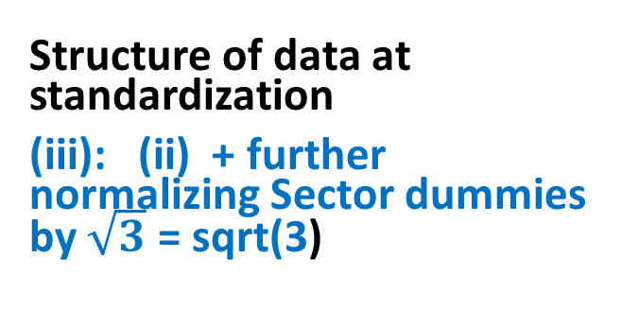
Company Dataset: Standardization (iii)
-0.20 0.23 -0.33 -0.62 0.36 -0.22 -0.14
0.40 0.05 0 -0.62 0.36 -0.22 -0.14
0.08 0.09 0 -0.62 -0.22 0.36 -0.14
-0.23 -0.15 -0.33 0.38 0.36 -0.22 -0.14
0.19 -0.29 0 0.38 -0.22 0.36 -0.14
-0.60 -0.42 -0.33 0.38 -0.22 0.36 -0.14
0.08 -0.10 0.33 0.38 -0.22 -0.22 0.43
0.27 0.58 0.67 0.38 -0.22 -0.22 0.43
Structure of data at standardization
(iii): (ii) + further normalizing Sector dummies by $\sqrt{3}$ = sqrt(3)
This structure corresponds
to product well !

Slide 13
Возможная цель кластер-анализа
Неколичественный факторный анализ: Выявить номинальный признак, объясняющий данные
В машинном обучении: Обучение без учителя
Анализ данных: Структурирование, шаг, необходимый для формирования классификации соответствующей предметной области

Slide 14
Кое-где четкая структура кластеров, кое-где - нет

Slide 15
K-Means clustering/ Метод к-средних
Method
Issues:
Number of clusters
Initialization
Interpretation of clusters
Criterion of the method

Slide 16
Clustering with K-Means: Method K-Means iterations illustrated
Cluster k: center c_{k} and set S_{k} (k=1,…, K)
(a) Initialize (b) Assign entities to nearest
center
(c) Cluster update (d) Center update

Slide 17
Clustering with K-Means, 2 K-Means iterations formulated
Cluster k: center c_{k} and set S_{k} (k=1,…, K)
K-Means method:
0. Specify K, number of clusters, and initial centers c_{k} (k=1,…, K)
Update sets S_{k} (k=1,…, K) using Minimum distance rule
Update centers c_{k} (k=1,…, K) as means of S_{k}
If new centers coincide with the previous ones, stop. Else go to 1.

Slide 18
Clustering with K-Means, 3 Explanation of the mean
Let S be in R⁴ and consist of 3 objects
i1 = (2, 1, 2, 0)
i2 = (1, 2, 0, 1)
i3 = (3, 0, 1, 5)
----------------------
Mean: 6/3 3/3 3/3 6/3
Sum/Nk (2, 1, 1, 2)

Slide 19
Clustering with K-Means, 4 Explanation of the distance
Euclidean squared distance:
dot product of the difference by itself
d(i, c_{k})=<i-c_{k},i-c_{k} >
object i = (2, 1, 2, 0)
center c_{k} = (1, 2, 0, 1)
i − c_{k}= (1, -1, 2 , -1)
Distance: d(i,c_{k}) =(1)²+(-1)²+(2)²+(-1)² = 7

Slide 20
Clustering with K-Means, 5 Applying K-Means method to Iris dataset
Step −1. Standardization (options):
No pre-processing
(Why? All measurements relate to elements of the same flower and use the same unit)
B. Z-scoring: Each feature centered by its mean and normalized by its standard deviation
(Why? Everybody does so)
C. Each feature centered by its mean and normalized by its range (Why? Dividing by range is better than by the standard deviation – see next slide)

Slide 21

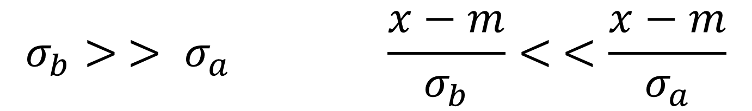
Clustering with K-Means , 6 Why dividing by range can be better than dividing by std for clustering
$$σ_{b}> > σ_{a} \frac{x−m}{σ_{b}}< <\frac{x−m}{σ_{a}}$$
Counter-intuitive: (b) divides dataset, thus better, (a) not, thus worse for clustering

Slide 22
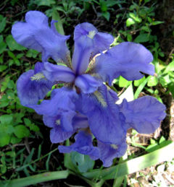
150x4 Anderson–Fisher Iris Dataset
Iris flower
Sepal / Чашелистик
Petal / Лепесток
150×4 data of three taxa:
Taxon
#1-50 Iris setosa (diploid)
#51-100 Iris versicolor (tetraploid)
#101-150 Iris virginica (hexaploid)
Features
W1 Sepal length
W2 Sepal width
W3 Petal length
W4 Petal width
Taxa
Metadata

Slide 23
Iris, features w1, w2, w3, w4
# | Iris
 | w1 w2 w3 w4
1 2 3 4 5 6 7 8 9 … 150 | 5.1 3.5 1.4 0.3 4.4 3.2 1.3 0.2 4.4 3.0 1.3 0.2 5.0 3.5 1.6 0.6 5.1 3.8 1.6 0.2 4.9 3.1 1.5 0.2 5.0 3.2 1.2 0.2 4.6 3.2 1.4 0.2 5.0 3.3 1.4 0.2 ….. 5.1 3.5 1.4 0.2

Slide 24
Clustering with K-Means,7 Preprocessing options at Iris dataset
0. Specify K=3 and specimens 1, 51, 101 as initial centers (because of preliminary knowledge). Then run iterations of K-Means:
A. (No preprocessing) Converged in 4 iterations
B. (Z scoring) Converged in 7 iterations
C. (Normalizing by range) Converged in 5 iterations

Slide 25
Clustering with K-Means, 8 Confusion regarding Ground Truth
Partition of Iris dataset using K-Means method:
Ground Truth: Taxa T1 T2 T3 Total
A. (No preprocessing) 50 0 0 50 Cl1
16 errors 0 48 14 62 Cl2
0 2 36 38 Cl3
B. (Z scoring) 50 0 0 50 Cl1
28 errors 0 39 17 56 Cl2
0 11 33 44 Cl3
C. (Norm. by range) 50 0 0 50 Cl1
17 errors 0 47 14 61 Cl2
0 3 36 39 Cl3

Slide 26
Преимущества метода к-средних
Моделирует формирование типологии (вопрос: что такое типология?)
Вычисления соответствуют интуиции
Процесс вычислений не требует дополнительной памяти и эффективен
Вычисления легко параллелизировать для больших/распределенных данных

Slide 27
Недостатки метода к-средних
(1)Непонятно, остановится ли процесс перехода к новым итерациям [Ответ: Да, доказывается далее.]
(2) Результат зависит от инициализации (см. следующие 2 слайда): Как это делать хорошо?
(3)Как помочь в выборе числа кластеров K?

Slide 28
K-Means: Results heavily depend on initialization, 1
Two clearly visible
clusters case.
Top:
Reasonable location
of initial centroids
Bottom:
Asymmetric initial centers lead to wrong clustering results

Slide 29
K-Means: Results heavily depend on initialization, 2 Four 2D points: Two stable K-means partitions
(a) (b)
(a): Initial centers in the middle
(b) Initial centers right

Slide 30
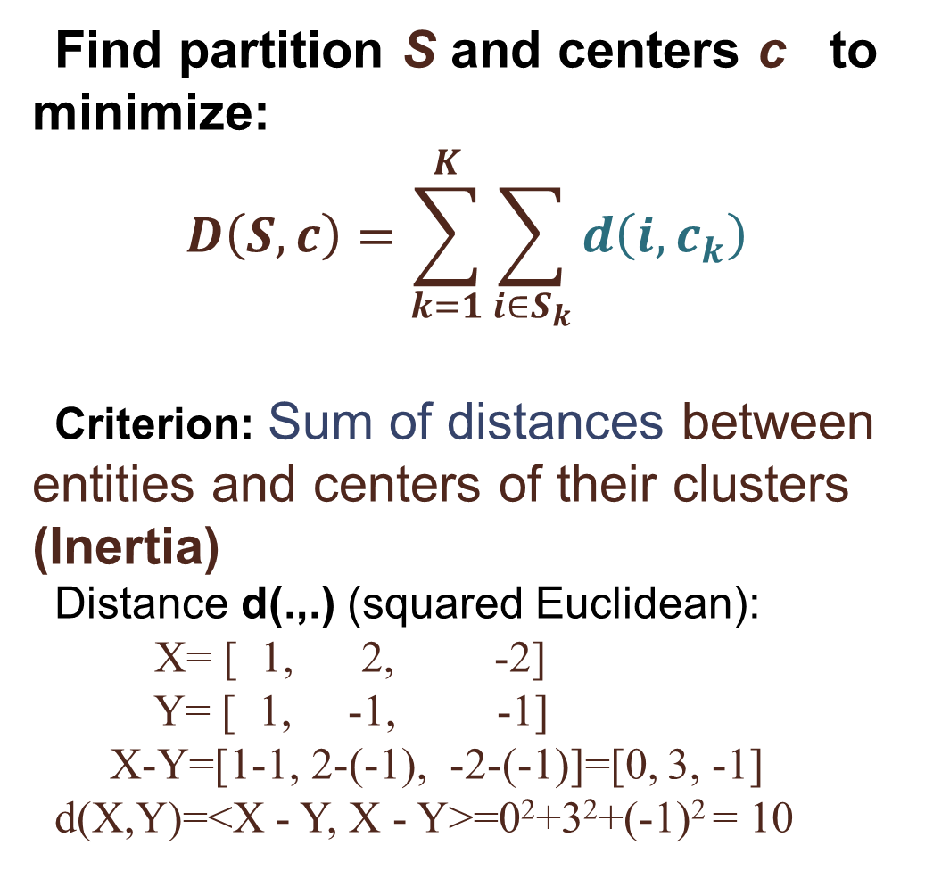
Clustering with K-Means K-Means criterion:
Find partition S and centers c to minimize:
$$D\left(S,c\right)=\sum_{k=1}^{K}{\sum_{i∈S_{k}}{d\left(i,c_{k}\right)}}$$
Criterion: Sum of distances between entities and centers of their clusters (Inertia)
Distance d(.,.) (squared Euclidean):
X= [ 1, 2, -2]
Y= [ 1, -1, -1]
X-Y=[1-1, 2-(-1), -2-(-1)]=[0, 3, -1]
d(X,Y)=<X - Y, X - Y>=0²+3²+(-1)² = 10

Slide 31
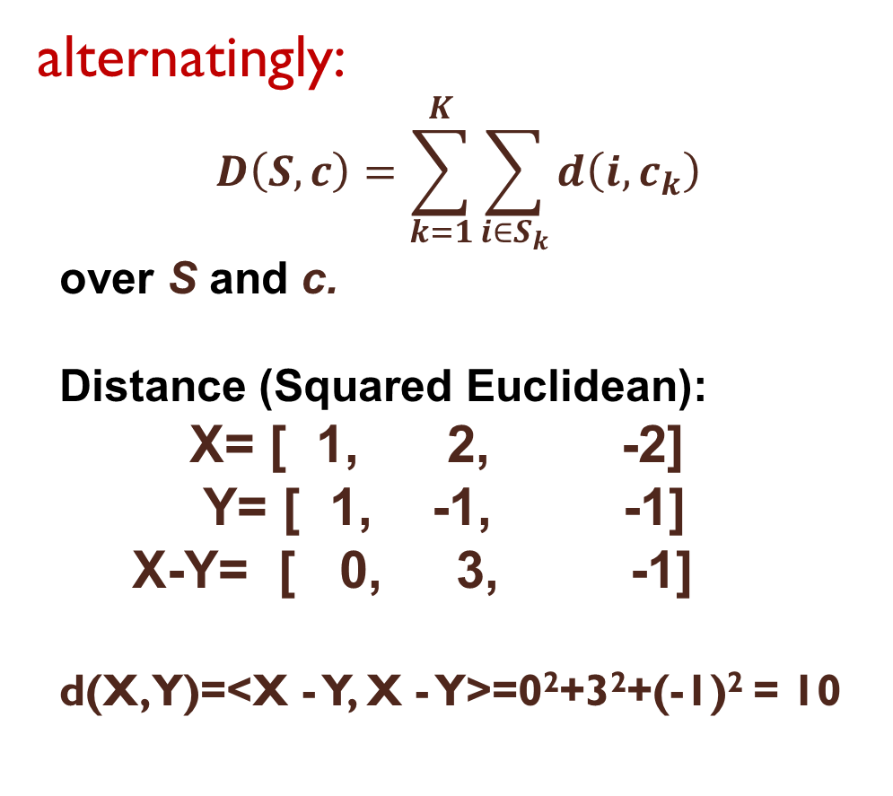
K-Means criterion: Inertia D(S,c) K-Means is alternating minimization of D(S,c)
Minimize D(S,c)
Min_{S} D(S, c):
- Clusters update
Min_{c} D(S, c):
- Centers update
D(S,c) decreases at each step:
Convergence – why? (QUIZ)
alternatingly:
$$D\left(S,c\right)=\sum_{k=1}^{K}{\sum_{i∈S_{k}}{d\left(i,c_{k}\right)}}$$
over S and c.
Distance (Squared Euclidean):
X= [ 1, 2, -2]
Y= [ 1, -1, -1]
X-Y= [ 0, 3, -1]
d(X,Y)=<X - Y, X - Y>=0²+3²+(-1)² = 10

Slide 32
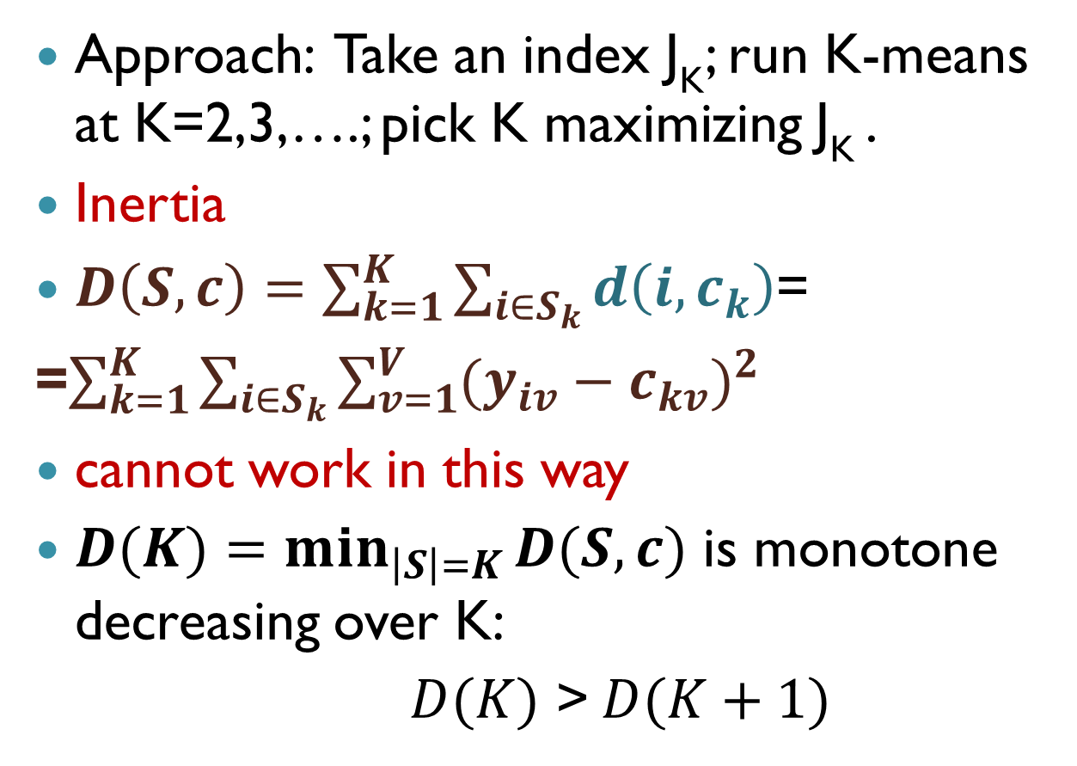
Number of clusters,1: No theory
Approach: Take an index J_{K}; run K-means at K=2,3,….; pick K maximizing J_{K} .
Inertia
$D\left(S,c\right)=\sum_{k=1}^{K}{\sum_{i∈S_{k}}{d\left(i,c_{k}\right)}}$=
=$\sum_{k=1}^{K}{\sum_{i∈S_{k}}{\sum_{v=1}^{V}{{(y_{iv}−c_{kv})}^{2}}}}$
cannot work in this way
$D(K)=\min_{\left|S\right|=K}{D(S,c)}$ is monotone decreasing over K:
$D(K)$ > $D(K+1)$

Slide 33
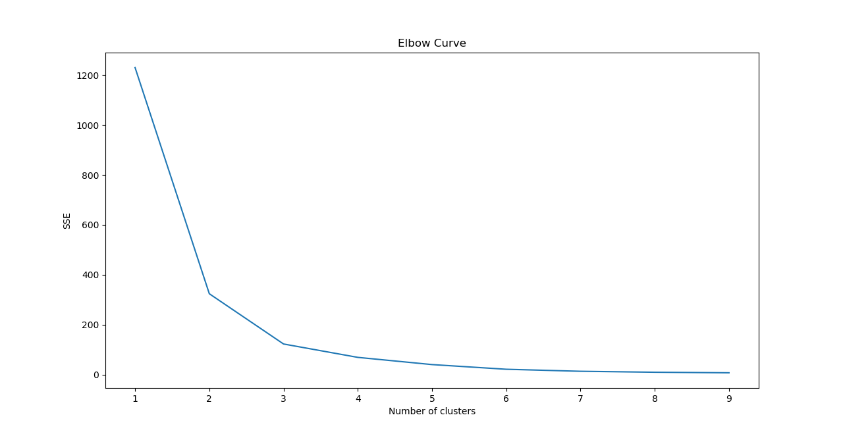
A typical graph of D(K) values

Slide 34
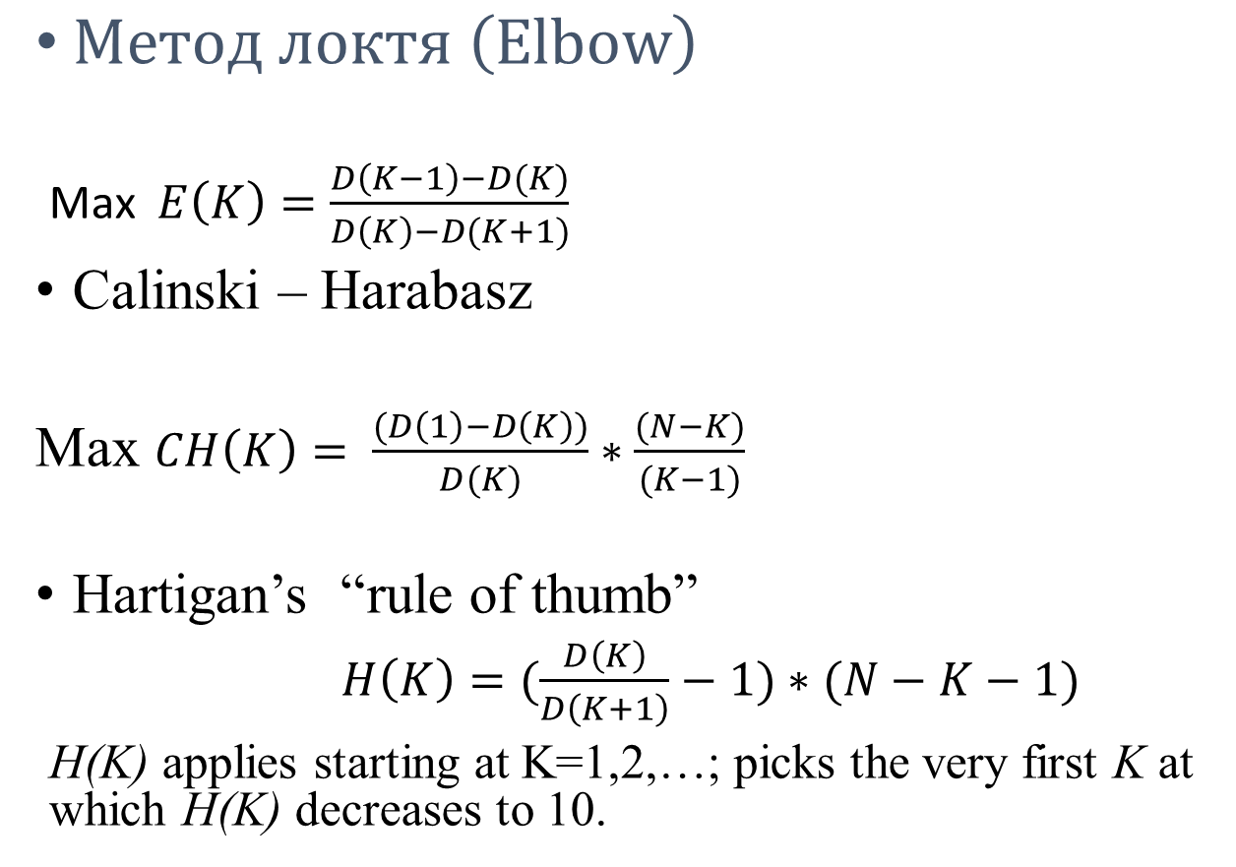
Number of clusters,2: Inertia related indexes
$Метод локтя \left(Elbow\right)$
Max $E\left(K\right)=\frac{D\left(K−1\right)−D(K)}{D\left(K\right)−D(K+1)}$
Calinski – Harabasz
Max $CH\left(K\right)= \frac{(D\left(1\right)−D\left(K\right))}{D(K)}∗\frac{(N−K)}{(K−1)}$
Hartigan’s “rule of thumb”
$H\left(K\right)=(\frac{D\left(K\right)}{D\left(K+1\right)}−1)∗(N−K−1)$
H(K) applies starting at K=1,2,…; picks the very first K at which H(K) decreases to 10.

Slide 35
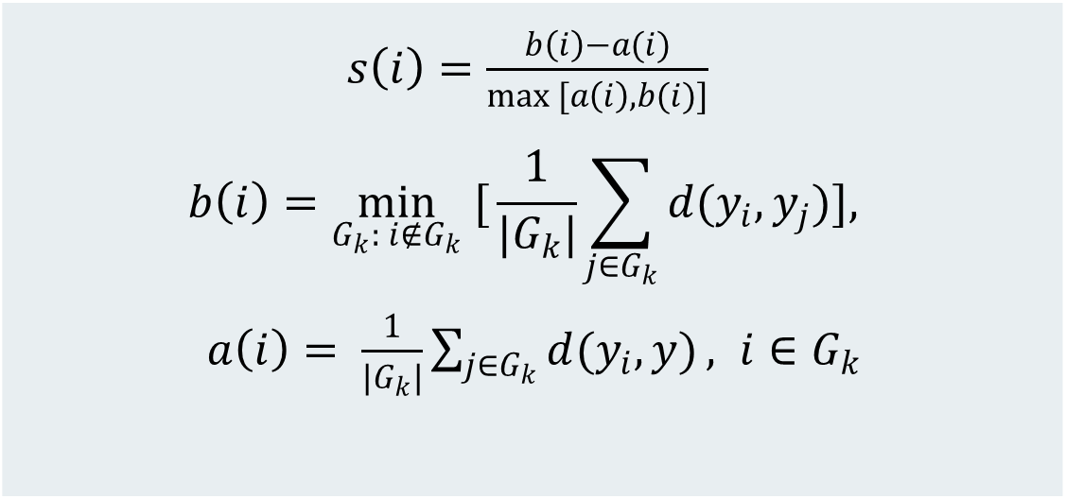
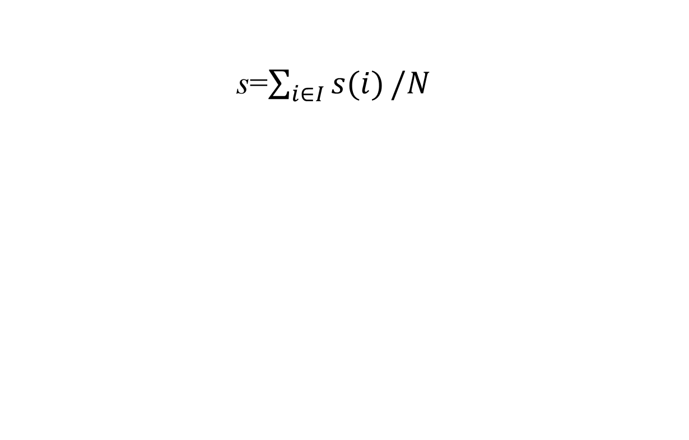
Silhouette width Ширина силуэта
s=$\sum_{i∈I}{s(i)}/N$
$s\left(i\right)=\frac{b\left(i\right)−a(i)}{max [a\left(i\right), b(i)]}$ $$b\left(i\right)=\min_{G_{k}: i∉G_{k}} [{\frac{1}{{|G}_{k}|}\sum_{j∈G_{k}}{d(y_{i},y_{j})}}],$$ $a\left(i\right)= \frac{1}{|G_{k}|}\sum_{j∈G_{k}}{d(y_{i},y)}, i∈G_{k}$

Slide 36
Experimental results (Andrei Rykov et al., 2024): 7-cluster 1000-strong 15D data generated, clusters are well intermixed with parameter A. Table shows how many times out of 100, a method leads to the estimate of 7 clusters indeed.
 | A=0.5 | A=0.8 | A=0.85
Elbow | 92 | 59 | 26
Hartigan | 0 | 0 | 0
Silhouette Width | 80 | 61 | 58
C.-Harabasz | 100 | 59 | 28

Slide 37
Инициализация k-means++
Первый центр: случайный объект из таблицы данных.
Каждый следующий центр: случайный объект с вероятностью, пропорциональной расстоянию до ближайшего из уже отобранных центров
Arthur and Vassilvitskii (2007): Результирующая инерция k-means++ ожидается в пределах
8∗(log K+2) от оптимального значения [Makarychev et al. 2020: 5∗(log K+2)].

Slide 38
Cluster interpretation
Center c_{k} for Interpretation of cluster S_{k}:
Relative differences
Iris taxon T1: Specimens number 1, 2, …, 50
Taxon T1 conceptualization: SMALL PETALs
 | SLength | SWidth | PLength | PWidth
Within-cluster mean | 5.006 | 3.428 | 1.462 | 0.246
Grand mean | 5.843 | 3.057 | 3.758 | 1.199
Difference | −0.837 | 0.371 | −2.296 | −0.953
Rel. Diff., % | −14.3 | +12.1 | −61.1 | −79.5

Slide 39
Rules for cluster interpretation. Points to be taken seriously:
Each cluster is to be interpreted separately.
A set F of features to be interpreted is selected by the user; any external (not used at clustering) feature(s) may be included too.
Original, not standardized, data are to be used for interpretation

Slide 40
Relative difference:
Given a cluster k and a quantitative feature v∈V, the relative difference is computed:
d_{kv}=100[c_{kv} /c_{v} – 1] (per cent)
Here c_{kv} is within-cluster mean of v, and c_{v} is grand mean (mean over the dataset) of v

Slide 41
Relative difference for dummy 1/0 attribute
Given a cluster k and a category v∈F, the relative difference:
q_{kv} =100[p_{kv} /(p_{k} p_{v}) – 1] (per cent)
p_{kv} = proportion of entities falling in both cluster k and category v, p_{v} is proportion of category v in the dataset,
p_{k} = proportion of cluster k in the dataset.
In fact, q_{kv} = d_{kv} if category v is represented by a 1/0 dummy.

Slide 42
Interpretative features, V⁺ and V⁻
1. Given a cluster k, pick up those features and categories v∈F for which values of d_{kv} or q_{kv} are far from 0, say, greater than 35%, forming set V_{k}⁺, or smaller than −35%, forming set V_{k}⁻.
2. Describe cluster k as that characterized by features from V_{k}⁺as those “much greater than the average” and features from V_{k}⁻ as those “much smaller than the average”. (You may use modifier “very much” for larger deviations.)

Slide 43
Conceptualization:
After you have described cluster k by sets V⁺ and V⁻, try to conceptualize the description on a deeper level, in more general terms. If you can, put your conceptualization down in writing. If you cannot, do not get frustrated: you may get more lucky next time.

Slide 44
Super-Conceptuaization:
After you have conceptualized all the clusters, take a look at all the conceptual descriptions and try conceptualize the entire partition.
If you can, put your conceptualization down in writing. If you cannot, do not get frustrated: you may get more lucky next time.

Slide 45
Example: Interpreting Iris taxon T1
Take all four Iris dataset features (Sepal length, Sepal width, Petal length, Petal width) as F set of features.

Slide 46
Example: Interpreting Iris taxon T1: 3. Compute relative differences
 | SLength | SWidth | PLength | PWidth
Taxon center c_{k}=(c_{kv}) | 5.006 | 3.428 | 1.462 | 0.246
Grand mean c=(c_{v}) | 5.843 | 3.057 | 3.758 | 1.199
Difference | −0.837 | 0.371 | −2.296 | −0.953
Relative difference, d_{kv}% | −14.3 | +12.1 | −61.1 | −79.5
d_{kv}= (c_{kv} - c_{v})/c_{v}, per cent!

Slide 47
Interpretation of taxon T1 in Iris dataset
1. V_{T1}⁺ is empty; V_{T1}⁻= {Petal length, Petal width}
2. Conceptualize taxon T1 as that characterized by this statement:
T1 = Those specimens at which the Petal is much smaller than the average (on both length and width).
3. A more parsimonious concept: T1⇔“Small petals”.

Slide 48
Conceptual interpretation of the partition of Iris in the three taxa:
Relative Difference: 100*(CMean –GMean)/GMean
SL SW PL PW
T1 -14.3297 12.1239 -61.0963 -79.4886
T2 1.5859 -9.3982 13.3582 10.5614
T3 12.7439 -2.7257 47.7382 68.9272
Conceptual descriptions:
T1 is “small petals”,
T3 is “large petals”,
T2 is “just about the average”

Slide 49
Super-Conceptual Description of the partition of Iris in three taxa:
Taxa conceptual descriptions:
- T1 is “small petals”, T3 is “large petals”, T2 is “just about the average” all about petals
- A deeper level yet:
“Sepal is not used in the description”
Why is that? I am not a botanist, cannot explain. Should undertake a research inspired by the data analysis. (Yet the goal of the data analysis is accomplished!)

Slide 50
Concepts learnt
Feature types:
quantitative
binary
nominal
Quantization of mixed data
Data standardization
Goal of centering, goal of rescaling
K-means clustering method
Advantages of K-means
Initialization issue; K-means++
Number of clusters: Elbow method, Hartigan Index, Calinski-Harabasz indexes
Using relative difference for cluster interpretation
Conceptualization

Slide 51
Домашний проект 3: Метод К-средних
1. Выберите 3-6 количественных признаков,
объясните выбор и примените метод К-средних:
для K=5
для K=9
В каждом случае сделайте порядка 10 случайных инициализаций и выберите то, которое доставляет минимум критерию метода
2. Проинтерпретируйте оба полученных разбиения с помощью признаков таблицы данных путем сравнения внутри-кластерных средних с общими средними, т.е. вычисления относительных отклонений внутри-кластерных средних от общего среднего.
Объясните, какое из разбиений лучше с точки зрения интерпретации.

