Slide 1
Основные методы анализа данных Лекция 3, 2024: Линейная регрессия и нейронные сети
Цель курса – научить основным методам, используемым в анализе данных, с тем, чтобы освоив его, студент мог бы разработать аналогичные методы для решения новых задач/ на других типах данных
В отличие от освоения систем таких, как scikit-learn, которые можно использовать без какого-либо понимания методов

Slide 2
Содержание
Общее: Коррелирование; регрессия и классификация
Линейная регрессия и линейный классификатор
Искусственный нейрон; функция активации
Архитектура нейронной сети с одним скрытым слоем; веса соединений и функция, реализуемая сетью
Квадратичная ошибка и задача отыскания оптимальных весов
Градиентный спуск для задачи минимизации
Алгоритм обратного распространения ошибки для отыскания весов соединений
Пример

Slide 3
Коррелирование: Входные признаки X (input) и целевые (выходные) признаки Y в таблице данных
Problem:
Given a set of mappings F, find decision rule F∈F so that
F(X)≈Y (up to an error, of course)
That is, Ŷ=F(X) so that Ŷ ≈Y.
F must be not that big, nor that small: the number of parameters specifying F must be considerably smaller than the data size.

Slide 4
Проблемы, которые можно изучать на Ирисах, 1
#
 | w1 w2 w3 w4
1 2 3 4 5 6 7 8 9 … 150 | 5.1 3.5 1.4 0.3 4.4 3.2 1.3 0.2 4.4 3.0 1.3 0.2 5.0 3.5 1.6 0.6 5.1 3.8 1.6 0.2 4.9 3.1 1.5 0.2 5.0 3.2 1.2 0.2 4.6 3.2 1.4 0.2 5.0 3.3 1.4 0.2 6.5 3.2 5.1 2.0
- Build a predictor of petal sizes w3, w4 from the sepal sizes w1, w2 (say, to lessen the burden of measurement)

Slide 5
Correlation: Features X (input) and features Y (target) in Data table
F(X)≈Y (up to an error, of course)
That is, Ŷ=F(X) so that Ŷ ≈Y.
Usually, Y is just one feature.
Then F is classifier if Y is categorical, F is regression if Y is quantitative.
Quiz: What feature is quantitative?

Slide 6
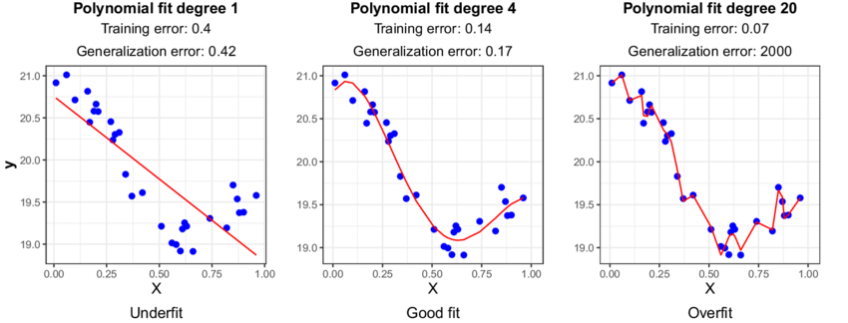
Correlation: Features X (input) and feature Y (target) in Data table
Regression
Underfitting – Overfitting: No good theory so far, 1

Slide 7
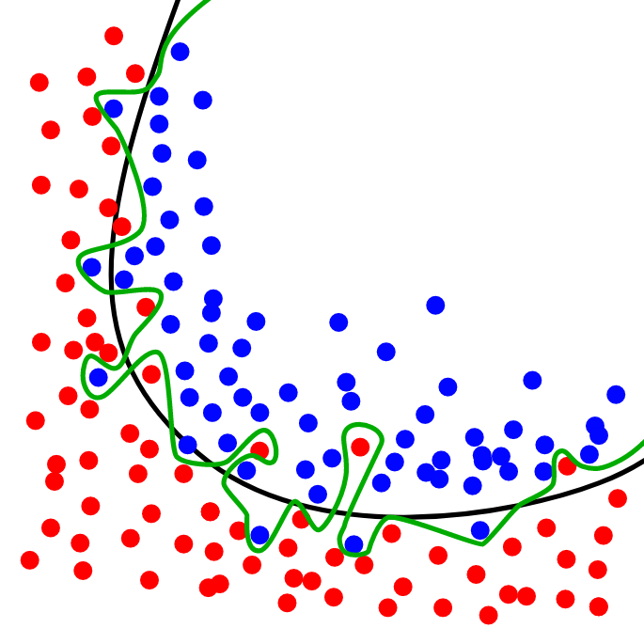
Correlation: Features X (input) and feature Y (target) in Data table
Good versus Overfitting: No good theory so far, 2
Classifier

Slide 8
Linear regression, 1 u = f(x₁, x₂,… x_{p})
u = w1*x₁+w2*x₂+…+wp*x_{p}+w0 ?
where w0, w1,…, wp are unknown
u, x₁, x₂,…, x_{p} are given N×1 columns
Define N×(p+1) data matrix X=(x₁,x₂,…, x_{p}, x₀) with p+1 features x₁,x₂,…, x_{p}, x₀;
all x₀ components are 1 (unity).
Problem: Find w=(w₁,w₂,…, w_{p}, w₀) so that Xw-u were as near to 0, as possible

Slide 9
Linear regression, 2 u = f(x₁, x₂,… x_{p})
u = w1*x₁+w2*x₂+…+wp*x_{p}+w0 ?
Define N×(p+1) data matrix X=(x₁,x₂,…, x_{p}, x₀)
Least squares:
Find w=(w₁,w₂,…, w_{p}, w₀) so that û=Xw minimizes
ǁu- ûǁ² (over all possible w)

Slide 10
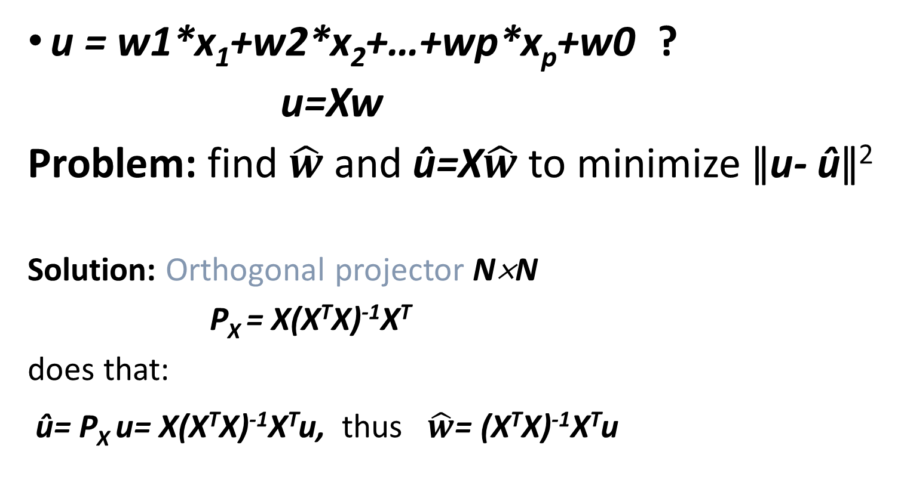
Linear regression, 3 u = f(x₁, x₂,… x_{p})
u = w1*x₁+w2*x₂+…+wp*x_{p}+w0 ?
u=Xw
Problem: find $\hat{w}$ and û=X$\hat{w}$ to minimize ǁu- ûǁ²
Solution: Orthogonal projector N×N
P_{X} = X(X^{T}X)⁻¹X^{T}
does that:
û= P_{X} u= X(X^{T}X)⁻¹X^{T}u, thus $\hat{w}$= (X^{T}X)⁻¹X^{T}u

Slide 11
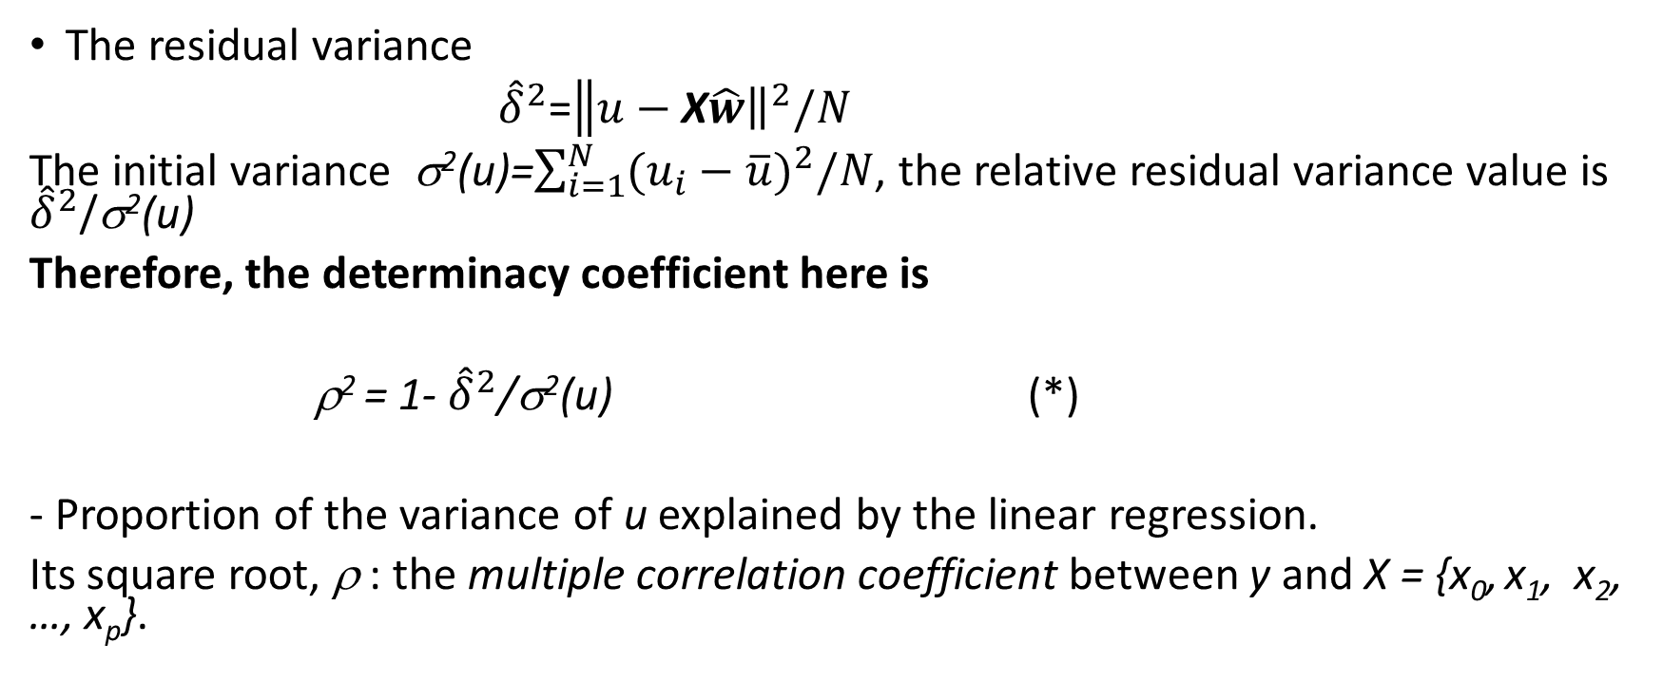
The quality of linear regression
The residual variance
${\hat{δ}}^{2}$=$\left\|{\left.u−\text{X}\hat{w}\right\|}^{2}\right./N$
The initial variance σ²(u)=$\sum_{i=1}^{N}{{(u_{i}−\overline{u})}^{2}/N}$, the relative residual variance value is ${\hat{δ}}^{2}$/σ²(u)
Therefore, the determinacy coefficient here is
ρ² = 1- ${\hat{δ}}^{2}$/σ²(u) (*)
- Proportion of the variance of u explained by the linear regression.
Its square root, ρ : the multiple correlation coefficient between y and X = {x₀, x₁, x₂, …, x_{p}}.

Slide 12
Linear classifier
Function to discriminate between two classes, stars and circles: dashed line u = <w, x> + b
u
x

Slide 13
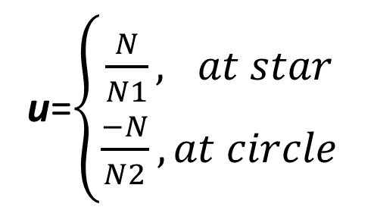

Linear classifier as regression
Dashed line: u=<w, x>+b
- Fisher (maximizes ratio of var between & within classes)
u=$\left\{\begin{aligned}1,at star \\ −1, at circle\end{aligned}\right.$
Bayes (maximum posterior
probability)
u can get any coding…
u=$\left\{\begin{aligned}\frac{N}{N1}, at star \\ \frac{−N}{N2}, at circle\end{aligned}\right.$
u

Slide 14
Case (A): dots and stars, linearly separable (a, c) Case (B): same case noise-perturbed (b, d)
Example of Fisher’s rule
being wrong:
case b is linearly separable
Fisher leads to point (4,1)
wrongly classified at d,
(Mirkin, 2019, p. 197-199)
(A) (B)

Slide 15
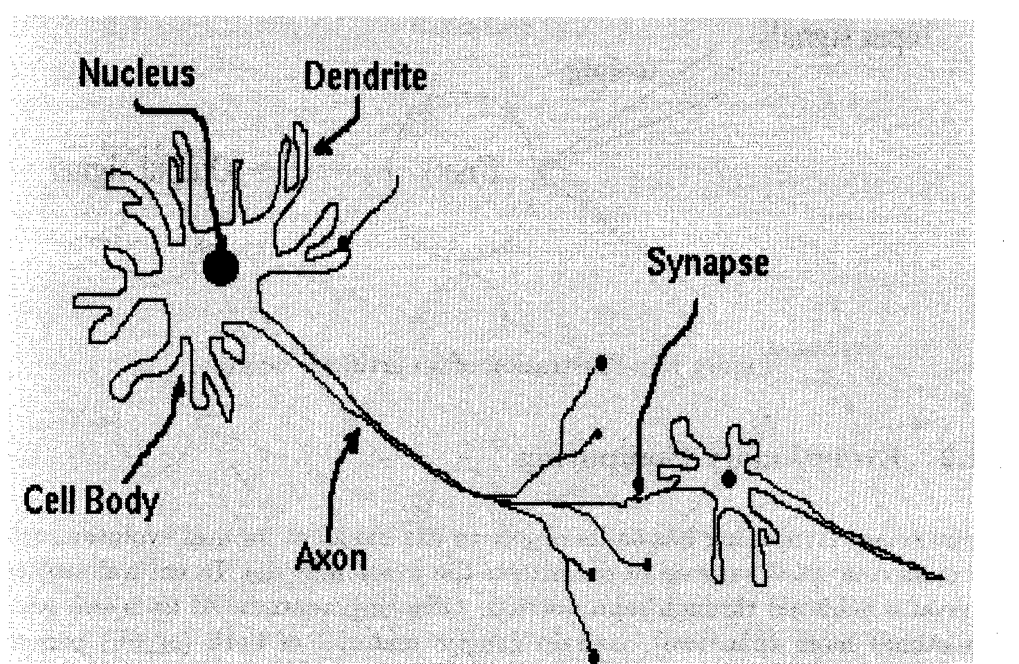
Neural Network Decision Rule
Neuron: Synapse is a point at which signal goes to another neuron.
Upon receiving enough signals, neuron fires.

Slide 16
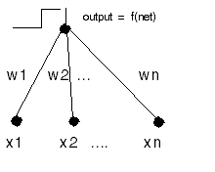
Artificial neuron
U=f(w₁*x₁+w₂*x₂+…+w_{n}*x_{n}), fires if w₁*x₁+w₂*x₂+…+w_{n}*x_{n} > a,
that is, w₁*x₁+w₂*x₂+…+w_{n}*x_{n} +a*(-1) > 0,
that is, w₁*x₁+w₂*x₂+…+w_{n}*x_{n} + w_{n+1}*x_{n+1} > 0.
a is “bias”

Slide 17
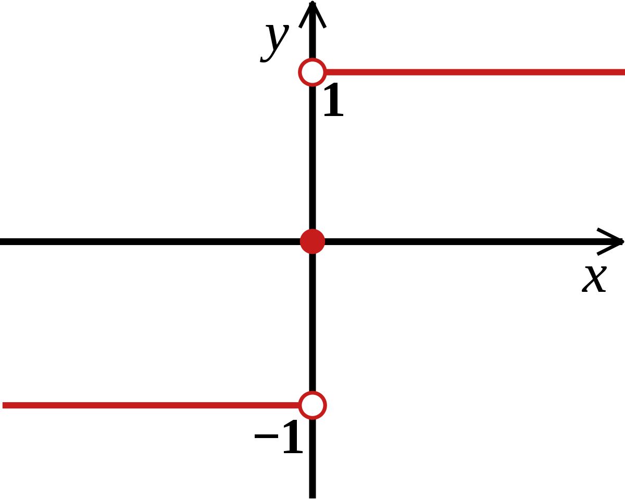
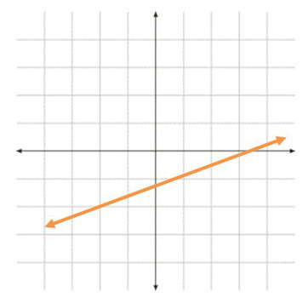
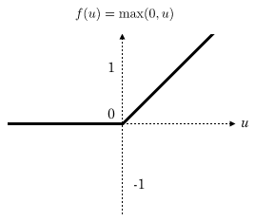
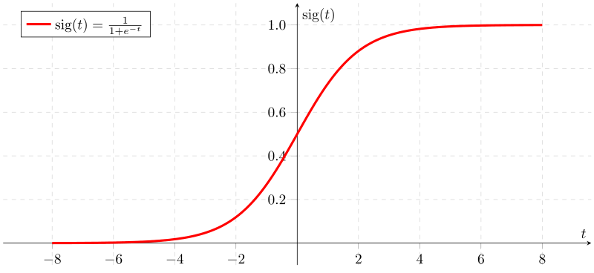
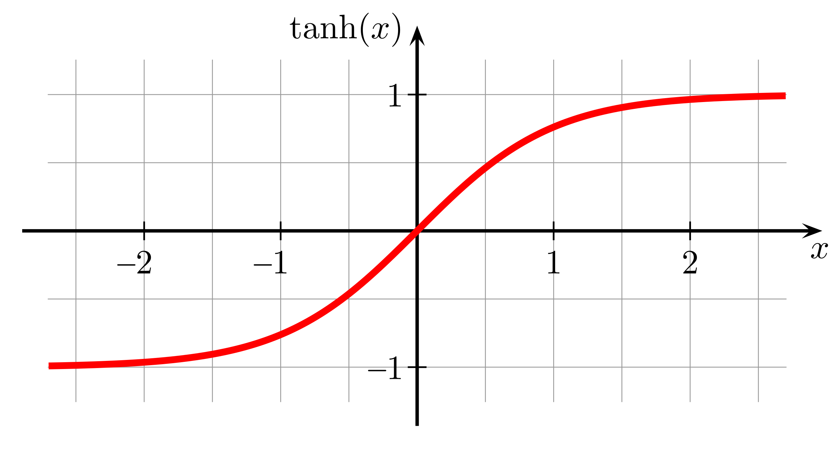
activation function u=f(w₁*x₁+w₂*x₂+…+w_{n}*x_{n})
1
2
3
4
5
Popular:
sign function û =sign(u),
linear function, û = au+b,
ReLU (Rectified linear unit), û = max(0, au+b),
sigmoid (logistic) activation function û =s(u),
s(u) = 1/(1 + exp(-u)),
5. tanh activation function û =tanh(u)=2s(2u) - 1,
A smoothed version of sign(u), a symmetric
version of s(u): tanh(-x)=tanh(x)

Slide 18
Issue: Build a feed-forward NN to relate Iris sepal sizes with petal sizes; weights w_{ij} and v_{jk} unknown [V=(v_{jk}), W=(w_{ij})}
ŷ ₁ ŷ ₂
k
v11 v12 v21 v22 v31 v32
III1
III2
Output layer (identical)
Hidden layer (th)
II1
II2
II3
j
w21 w22 w23
w11 w12 w13 w31 w32 w33
i
I1
I2
I3
x₁ x₂ x₀ = 1 Input (linear)
Quiz: What sizes are of W and V?

Slide 19
Mapping ŷ = F(x)? Hidden layer: unit j input : zj=w_{1j}∗x₁ + w_{2j}∗x₂+w_{3j}∗x₃ , vector: z=x∗W unit j output: th(zj), vector: u=th(x∗W) Output layer: unit k input=output: ∑ _{j} v_{jk}∗th(zj), vector: ŷ = th(z)*V=th(x∗W)*V
ŷ ₁ ŷ ₂
k
v11 v12 v21 v22 v31 v32
III1
III2
Output layer (identical)
Hidden layer (th)
II1
II2
II3
j
w21 w22 w23
w11 w12 w13 w31 w32 w33
i
I1
I2
I3
x₁ x₂ x₀ = 1 Input (linear)

Slide 20
Mapping ŷ = th(x∗W)*V Matrices W, V are unknown. Use data to estimate W and W. How? Minimize quadratic error! Observed: y=(y₁, y₂), Computed: ŷ=(ŷ₁, ŷ₂), Error: e = y − ŷ =(y₁− ŷ₁, y₂ − ŷ₂) Squared error E=<y− ŷ, y− ŷ > = <y − th(x*W)*V, y − th(x*W)*V >
ŷ ₁ ŷ ₂
k
v11 v12 v21 v22 v31 v32
III1
III2
Output layer (identical)
Hidden layer (th)
II1
II2
II3
j
w21 w22 w23
w11 w12 w13 w31 w32 w33
i
I1
I2
I3
x₁ x₂ x₀ = 1 Input (linear)

Slide 21
Minimize quadratic error over unknown W, V: E=<y− ŷ, y− ŷ > = <y − th(x∗W)∗V, y − th(x∗W)∗V>/2 th(u) = 2(1+ e^{-2u})⁻¹ - 1
A journey into general optimization of functions H(x)
Gradient descent: sequence x0, x1,…, xn, …
x(t+1)=x(t) −μ∗grad(H(x(t)), grad(H(x))=(∂H/∂x_{i})
- step size (learning rate), should tend to 0 at t tending to infinity, but not too fast
may be constant at quadratic H

Slide 22
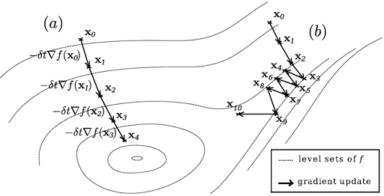
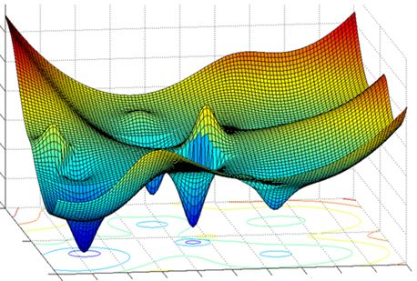
Gradient descent (Steepest descent)
Effective (converges) Local minimum
(not necessarily a global minimum)
Easy to extend to minimization with constraints

Slide 23
Steepest descent for E = [y₁ − ∑_{j}v_{j1}∗th(w_{1j}∗x₁ + w_{2j}∗x₂+w_{3j}∗x₃)]²/2+ [y₂ − ∑_{j}v_{j2}∗th(w_{1j}∗x₁ + w_{2j}∗x₂+w_{3j}∗x₃)]²/2
v_{jk}(t+1)=v_{jk} (t) - μ∗∂ E/∂v_{jk} ,
w_{ij}(t+1)=w_{ij}(t) - μ∗∂ E/∂w_{ij} (i∈I, j∈II, k∈III)
Derivatives:
∂E/∂v_{jk} = –(y_{k} – ŷ_{k})∗∂ ŷ_{k} /∂ v_{jk} = –(y_{k} – ŷ_{k})∗th(w_{1j}∗x₁ + w_{2j}∗x₂+w_{3j}∗x₃)
∂E/∂w_{ij} = ∑_{k}[–(y_{k} – ŷ_{k})∗∂ ŷ_{k} /∂w_{ij}]=
∂ ŷ_{k} /∂w_{ij} = v_{jk}∗th′(∑_{i} x_{i}∗w_{ij})∗x_{i} = v_{jk}∗(1+th(∑_{i} x_{i}∗w_{ij}))∗(1–th(∑_{i} x_{i}∗w_{ij}))∗x_{i} , since
th′(u)=4∗s(2u)∗[1-s(2(u)]=(1+th(u))∗(1–th(u))

Slide 24
Steepest descent for squared error E
v_{jk}(t+1)=v_{jk} (t) - μ∗∂ E/∂v_{jk} ,
w_{ij}(t+1)=w_{ij}(t) - μ∗∂ E/∂w_{ij} (i∈I, j∈II, k∈III) (*)
Derivatives:
∂E/∂v_{jk} = –(y_{k} – ŷ_{k})∗∂ ŷ_{k} /∂ v_{jk} = –(y_{k} – ŷ_{k})∗th(w_{1j}∗x₁ + w_{2j}∗x₂+w_{3j}∗x₃)
∂E/∂w_{ij} = ∑_{k}[–(y_{k} – ŷ_{k})∗v_{jk}∗(1+th(∑_{i} x_{i}∗w_{ij}))∗(1–th(∑_{i} x_{i}∗w_{ij}))∗x_{i}
How this can be applied to learning NN? Where to start? How to move forward?
Rumelhart, David E.; Hinton, Geoffrey E.; Williams, Ronald J. proposed a way to go in 1985

Slide 25
Error back-propagation mimicking Steepest descent for squared error E
v_{jk}(t+1)=v_{jk} (t) - μ∗∂ E/∂v_{jk} ,
w_{ij}(t+1)=w_{ij}(t) - μ∗∂ E/∂w_{ij} (i∈I, j∈II, k∈III) where (*)
∂E/∂v_{jk} = –(y_{k} – ŷ_{k})∗th(∑_{i} x_{i}∗w_{ij})
∂E/∂w_{ij} = ∑_{k}[–(y_{k} – ŷ_{k})∗v_{jk}∗(1+th(∑_{i} x_{i}∗w_{ij}))∗(1–th(∑_{i} x_{i}∗w_{ij}))∗x_{i} (**)
Algorithm
0. Specify NE, number of epochs. Standardize features to [-1,1] interval. Generate W, V N(0,1) randomly.
Epoch. In a loop over objects (x,y)
1.1. Forward computation: Find ŷ=F(x) and error e=y – ŷ
1.2. Error back-propagation: Use formulas (**) to estimate derivatives of E
1.3. Weights update: Use formulas (*) to update V and W
Halting test: If the number of epochs reached NE, output e, E, V, W and halt; else: randomize the order of objects and go to 1.

Slide 26
Error back-propagation mimicking Steepest descent for squared error E
Algorithm
0. Specify NE, number of epochs. Standardize features to [-1,1] interval. Generate W, V N(0,1) randomly.
Epoch. In a loop over objects (x,y)
1.1. Forward computation: Find ŷ=F(x) and error e=y – ŷ
1.2. Error back-propagation: Use formulas (**) to estimate derivatives of E
1.3. Weights update: Use formulas (*) to update V and W
Halting test: If the number of epochs reached NE, output e, E, V, W and halt; else: randomize the order of objects and go to 1.
Quiz 1: What is halt?
Quiz 2: Any other halting test?

Slide 27
Prediction of petal sizes from sepal sizes, at 10000 epochs, features normalized to [-10,10]; 3 runs (Matlab pseudocode in Mirkin’s Text, p. 513)
At 3 hidden units
e = 1.1488 1.7518 || 1.0630 1.7677 || 1.1394 1.7505
At 13 hidden units
e = 0.9520 1.5995 || 0.9763 1.5879 || 0.9390 1.5349
At 20 hidden units
e = 0.8657 1.4729 || 0.8413 1.4236 || 0.9256 1.5186
At 40 hidden units
e = 0.8297 1.4135 || 0.7970 1.4173|| 0.8292 1.3763

Slide 28
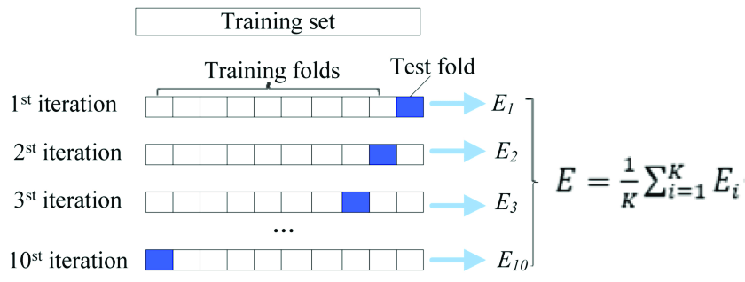
To mimic learning, dataset should be randomly divided in training part /testing part
Cross-validation (divide entity set in K folds, using each fold as test set) – скользящий контроль
Leave-one-out

Slide 29
Рассмотренные понятия
Регрессия, классификатор
Overfitting (переобучение), underfitting
Искусственный нейрон
Функция активации
Сигмоида, гиперболический тангенс
Нейронная сеть
Скрытый слой
Весовые матрицы
Градиентный спуск; скорость обучения
Метод обратного распространения ошибки
Эпоха
Кросс-валидация (скользящий контроль)

