Slide 1
ОМАД2024 Лекция 9: Интерпретация и формирование разбиений (продолжение)
Сравнение средних
Классический подход
Бутстрэп
Валидация центра
Сравнение центров
Домашнее задание 5

Slide 2
Classic Statistics: Center, 1
Probabilistic view: observed N values of feature x=(x_{i}) – set of N independent random variables with the same density function f(x).
f(x)
0 x

Slide 3
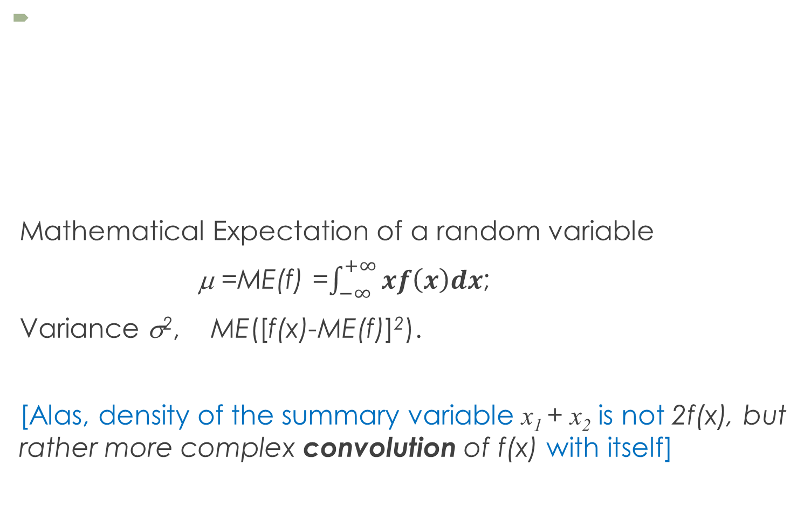
Classic Statistics: Center, 2
Mathematical Expectation of a random variable
μ =ME(f) =$\int_{−∞}^{+∞}{xf\left(x\right)dx}$;
Variance σ², ME([f(x)-ME(f)]²).
[Alas, density of the summary variable x₁ + x₂ is not 2f(x), but rather more complex convolution of f(x) with itself]
f(x)
0 x

Slide 4
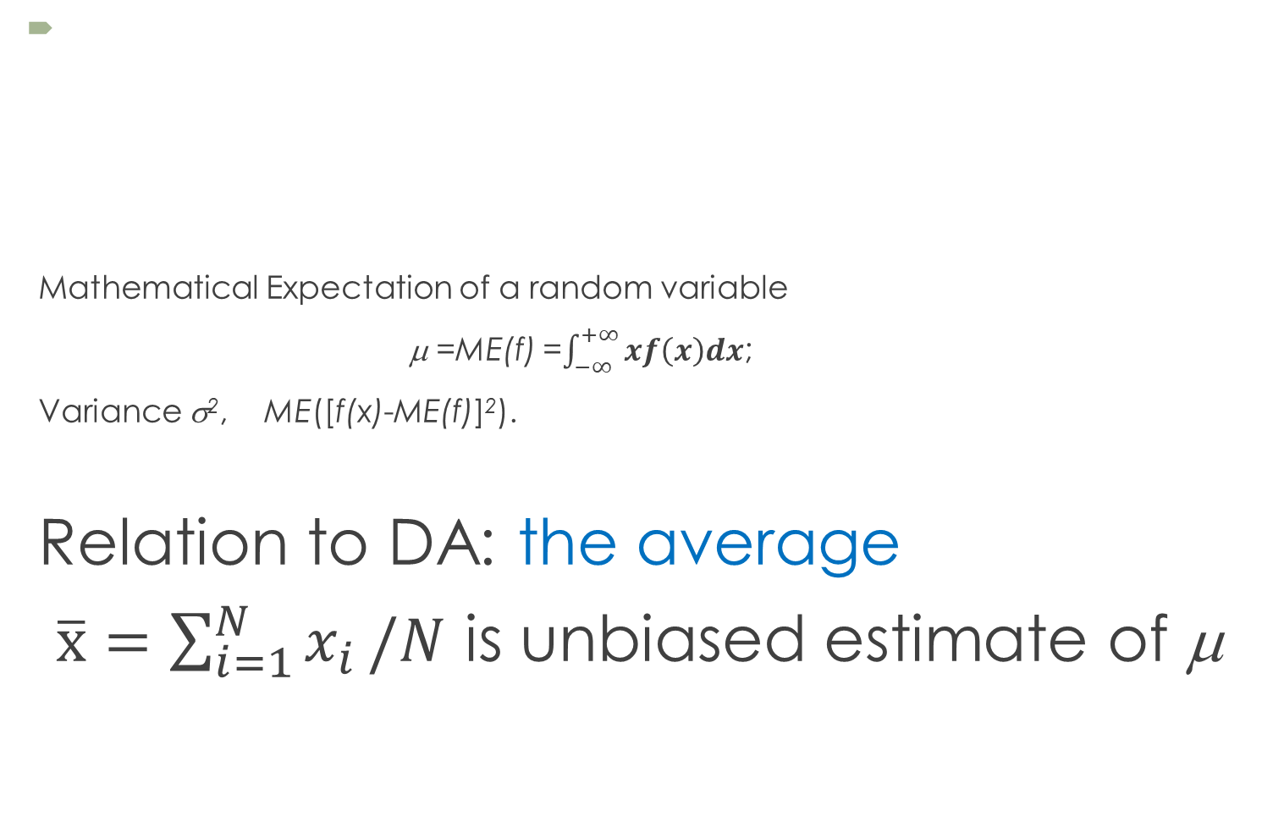
Classic Statistics: Center, 3
Mathematical Expectation of a random variable
μ =ME(f) =$\int_{−∞}^{+∞}{xf\left(x\right)dx}$;
Variance σ², ME([f(x)-ME(f)]²).
Relation to DA: the average
$\overline{х}=\sum_{i=1}^{N}{x_{i}}/N$ is unbiased estimate of μ
f(x)
0 x

Slide 5
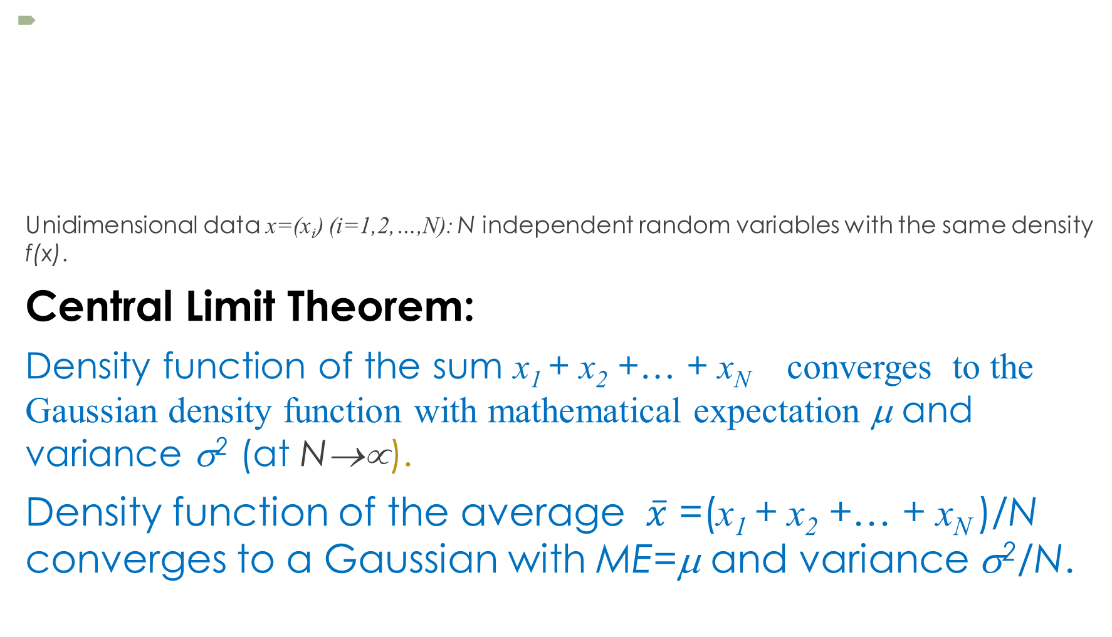
Classic Statistics: Center, 4
Unidimensional data x=(x_{i}) (i=1,2,…,N): N independent random variables with the same density f(x).
Central Limit Theorem:
Density function of the sum x₁ + x₂ +… + x_{N} converges to the Gaussian density function with mathematical expectation μ and variance σ² (at N→∝).
Density function of the average $\overline{x}$ =(x₁ + x₂ +… + x_{N} )/N converges to a Gaussian with ME=μ and variance σ²/N.
f(x)
0 x

Slide 6
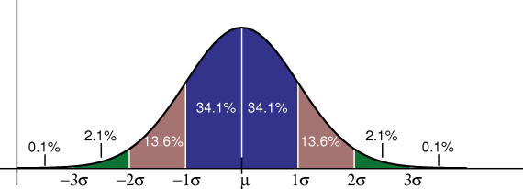
Estimation of center: Probabilistic perspective
Gaussian density function
p(x)=C exp[-(x-μ)²/2σ²]

Slide 7
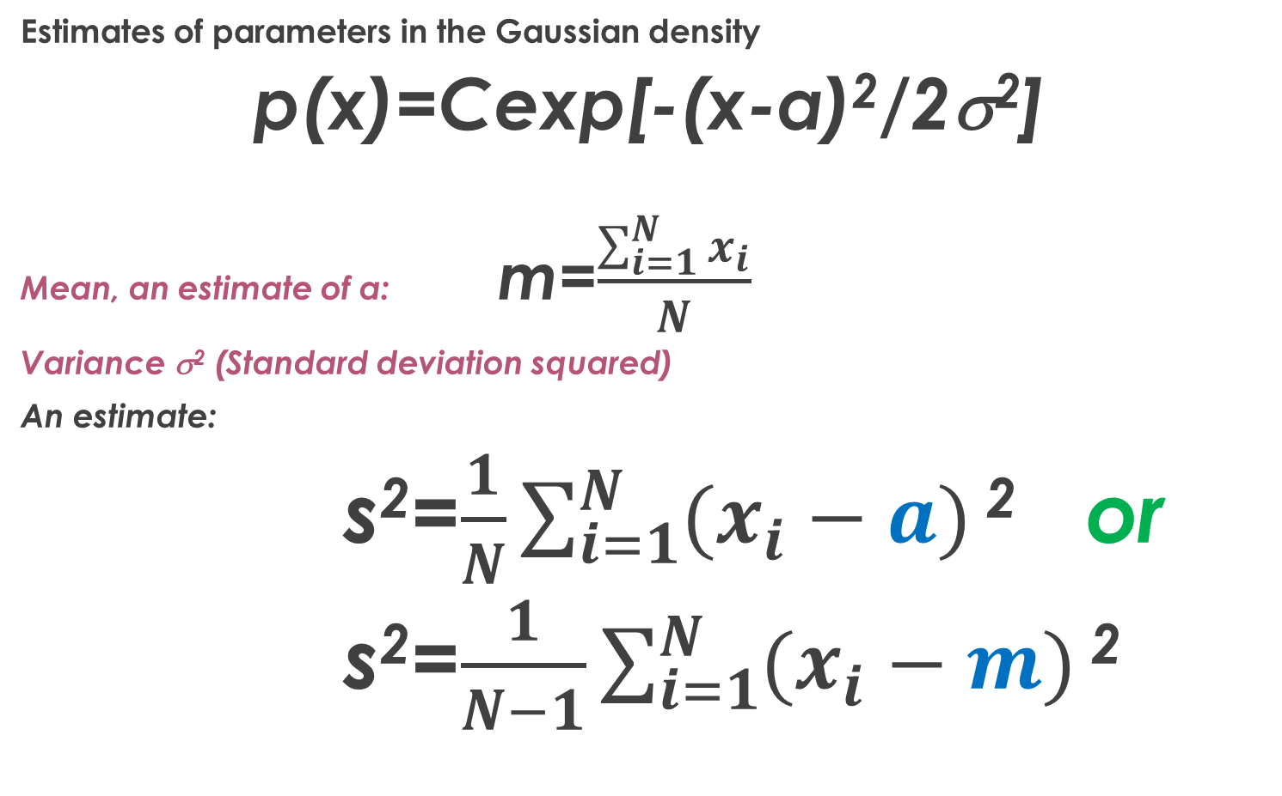
What is center: Probabilistic perspective
Estimates of parameters in the Gaussian density
p(x)=Cexp[-(x-a)²/2σ²]
Mean, an estimate of a: m=$\frac{\sum_{i=1}^{N}{x_{i}}}{N}$
Variance σ² (Standard deviation squared)
An estimate:
s²=$\frac{1}{N}\sum_{i=1}^{N}{(x_{i}−a)}$ ² or
s²=$\frac{1}{N−1}\sum_{i=1}^{N}{(x_{i}−m)}$ ²

Slide 8
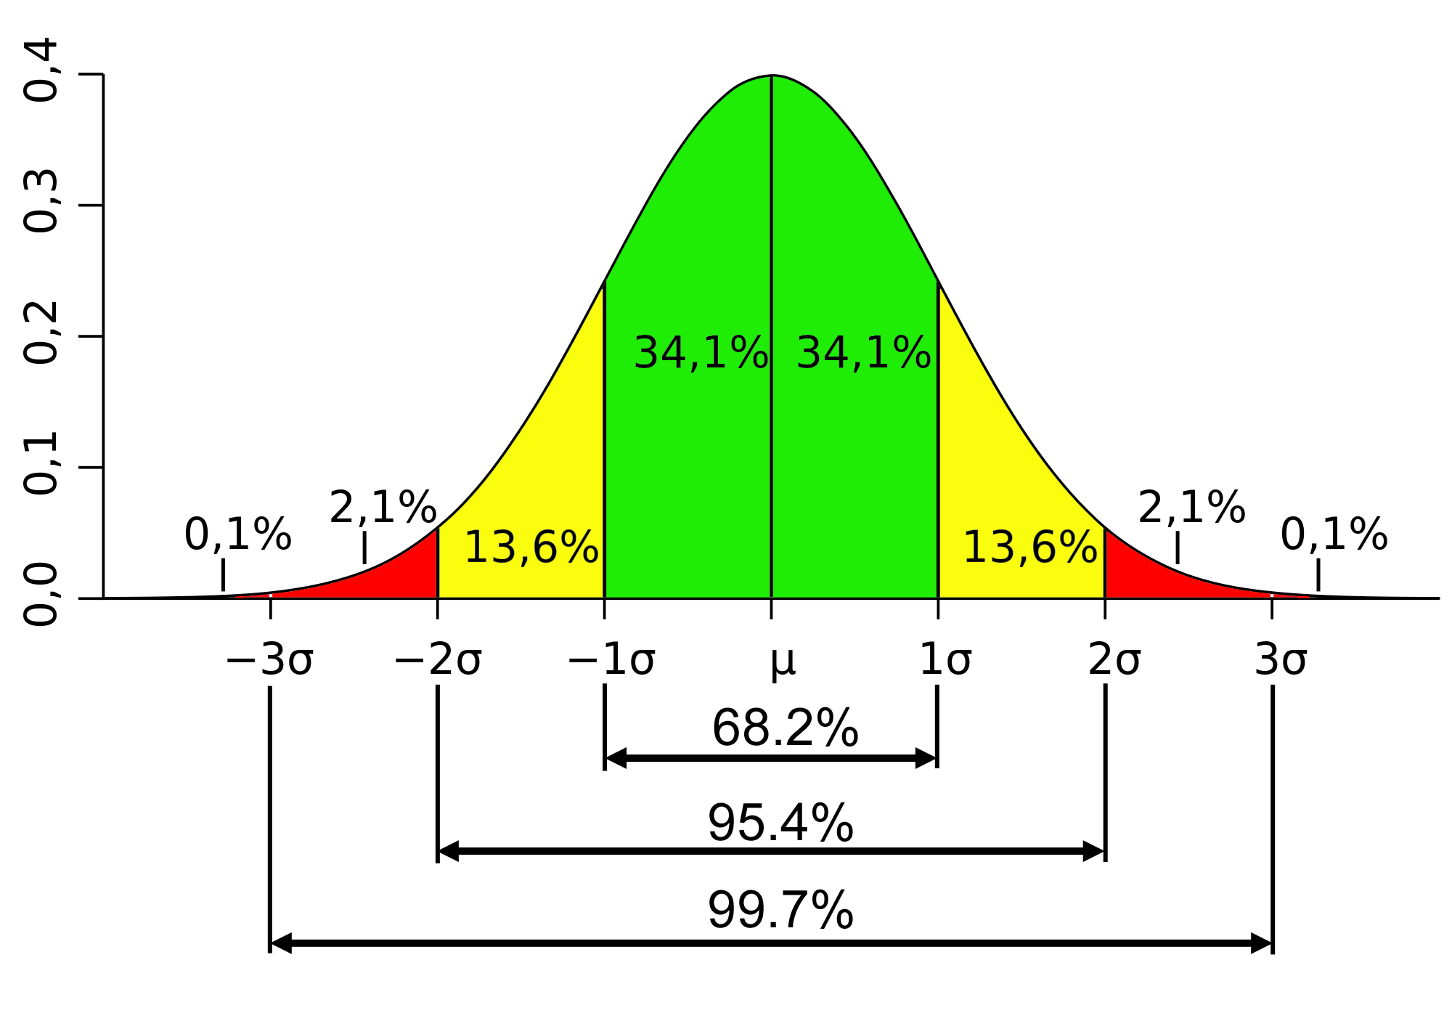
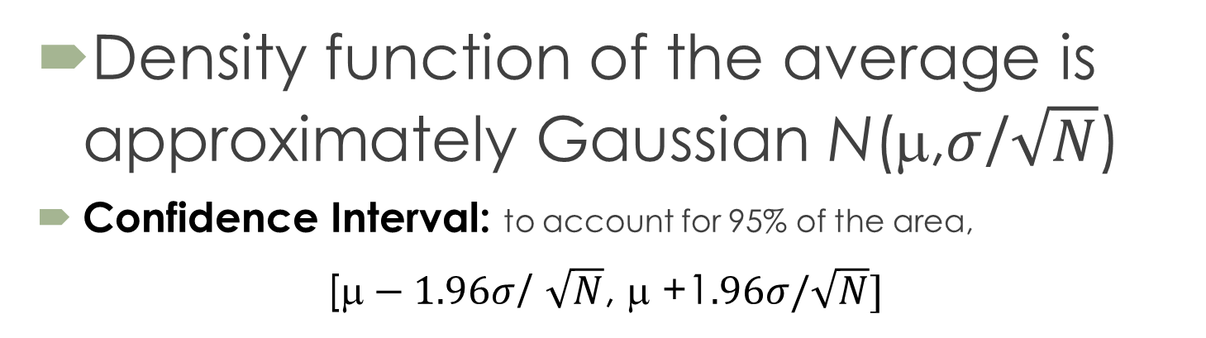
Classic Statistics: Validating Center
Density function of the average is approximately Gaussian N(μ,$σ$/$\sqrt{N}$)
Confidence Interval: to account for 95% of the area,
[$\text{}−1.96σ$/ $\sqrt{N}$, μ +1$.96σ/\sqrt{N}]$

Slide 9
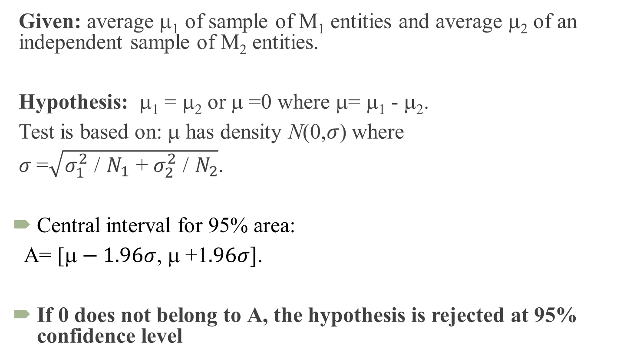
Classic Statistics: Comparing Centers
Given: average μ₁ of sample of М₁ entities and average μ₂ of an independent sample of М₂ entities.
Hypothesis: μ₁ = μ₂ or μ =0 where μ= μ₁ - μ₂.
Test is based on: μ has density N(0,$σ$) where
$σ$=$\sqrt{σ_{1}^{2}\text{ /} N_{1}\text{ + }σ_{2}^{2}\text{ /} N_{2}}$.
Central interval for 95% area:
А= [$\text{}−1.96σ$, μ +1$.96σ]$.
If 0 does not belong to А, the hypothesis is rejected at 95% confidence level

Slide 10
Classical statistics: Bootstrap
Bootstrap: Computational estimate of density function and its central 95% confidence interval A
In the case of hypothesis μ= μ₁ - μ₂ =0, the density of μ is estimated.
If 0∉А, the hypothesis is rejected at 95% confidence level.

Slide 11
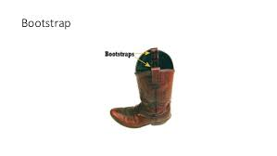
Bootstrapping for comparing means
After Baron Munchausen’s stories

Slide 12
Computational validation of Mean using bootstrap: intro 1
Consider a feature, say x=iris(:,1) % 1st column of Iris data
Its histogram hist(x,15):
resembles Gaussian, although not quite
Its mean m = 5.8433
std=0.8253

Slide 13

Computational validation of Mean using bootstrap, intro 2
Plausible boundaries for mean?
One way to go: using classical math statistics
According to the Central Limit Theorem applied to random independent samples, the density function of $\overline{x}$ approximates Gaussian distribution with a=5.8433 and σ=0.8253/√N.

Slide 14
Computational validation of Mean using bootstrap, intro 3
Consider a feature, say x=iris(:,1)
Its mean m = 5.8433, std=0.8253
Plausible boundaries for m? 95%
One way to go: using classical math statistics
Assume x to be a random independent sample from a Gaussian distribution with a=5.8433 and σ=0.8253:
m is Gaussian too, with a=m and σ=std/N^{½} (N=150)
Therefore, with 95% confidence
Lb= a - 1.96*std /N^{½}= 5.7108
Rb= a + 1.96*std /N^{½}= 5.9759
Conclusion:
m within [5.7108, 5.9759] with confidence 95% (as approximately Gaussian)

Slide 15
Computational validation of Mean using bootstrap
Plausible boundaries for m?
Another way to go: using computing power
Bootstrap
Multiple entity samples of same size N (with replacement) случайные выборки размера с возвращением
Meaning: indices are sampled to form a try (попытка)
MatLab:
>> N=4;K=3; r=ceil(N*rand(N,K))
1 4 4 N=4, the number of entities
r= 3 1 4 K=3, the number of tries (столбцы)
3 1 3 First try: entities 1, 3 (twice), 2
2 3 1 (entity 4 is missed: why?)

Slide 16
Missing indices at sampling with replacement
Probability to miss an index in a trial
1 − 1/N
Probability to miss an index in 2 trials
(1 − 1/N)²
Probability to miss an index in N trials
(1 − 1/N)^{N}
2d remarkable limit from calculus
(1 − 1/N)^{N} ⇒ e⁻¹ = 0.3679 (at N tending to infinity)
About 37% indices are to be skipped over at bootstrap (at large N)

Slide 17
Computational validation of Mean using bootstrap
Consider a feature, say x=iris(:,1)
Its mean = 5.8433, std=0.8253
Plausible boundaries for m?
Bootstrap
Псевдокод:
>> N=150;R=5000; r=ceil(N*rand(N,R));
>> xr=x(r);
>> mx=mean(xr);
This gives R=5000 means of random samples from x

Slide 18
Computational validation of Mean using bootstrap, 2
Plausible boundaries for m?
Bootstrap
>> M=150;K=5000; r=ceil(M*rand(M,K));
>> xr=x(r); mr=mean(xr);
Histogram of K=5000 means
Rather Gaussian, n’est ce pas?

Slide 19
Computational validation of Mean using bootstrap 3
Feature x=iris(:,1); = 5.8433, std=0.8253
Plausible boundaries for m?
Bootstrap Histogram of K=5000 means mr
A. Pivotal method
(95% confidence)
Assume mr be Gaussian
>> mmr=mean(mr); % 5.8444
>> smr=std(mr); % 0.0675
>> lbp=mmr-1.96*smr; % 5.7121
>> rbp=mmr+1.96*smr; % 5.9767

Slide 20
Computational validation of Mean using bootstrap 4
Feature x=iris(:,1); = 5.8433, std=0.8253
Plausible boundaries for m?
Bootstrap Histogram of K=5000 means mr
B. Non-pivotal method
(95% confidence)
No assumptions, just
Take 2.5% and 97.5% percentiles
as the boundaries
1% of 5000 is 50;
2.5% is 125; 97.5% is 4875
>> somr=sort(mr); % sorting
>> lbn=somr(126); % 5.7120
>> rbn=somr(4875); % 5.9773

Slide 21
Computational validation of Mean using bootstrap 5
Consider a feature, say x=iris(:,1)
Its mean = 5.8433, std=0.8253
Plausible boundaries for m
with confidence 95%?
Three different methods – m must be within :
[5.7108, 5.9759] (under Gaussian assumption)
[5.7121, 5.9767] (Bootstrap pivotal)
[5.7120, 5.9773] (Bootstrap non-pivotal)
with 95% confidence
Very much similar…

Slide 22
Comparing means using Bootstrap,1
Compare mean Sepal lengths in Taxa 2 and 3:
Bootstrap distributions of K trial means in T2 and in T3
Differences D=Mean(T2)−Mean(T3) over all K trials
95% confidence interval A for D
Checking whether zero is in A or not. If not, one Mean is greater than the other.

Slide 23
Comparing means using Bootstrap,1I
Compare mean Sepal length in Taxa 2, 3, All set:
>> n=150;m=5000;r=ceil(n*rand(n,m));
>> x=iris(:,1); xr=x(r); mr=mean(xr);%All set
In Taxa t{2} and t{3}:
>> for k=1:5000; y=r(:,k); p=ismember(y,t{2}); n2=sum(p);y2=sum(p.*x(y));m2(k)=y2/n2;end
>> for k=1:5000; y=r(:,k); p=ismember(y,t{3}); n3=sum(p); y3=sum(p.*x(y));m3(k)=y3/n3;end
mr, m2, m3 – 5000-strong bootstrap means

Slide 24
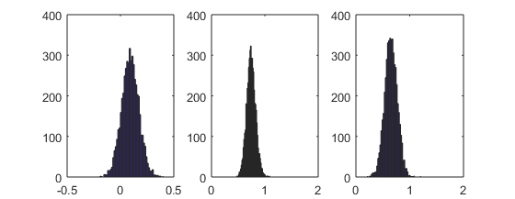
Comparing means using Bootstrap,III
Compare mean Sepal length in Taxa 2, 3, All set:
m2-mr m3-mr m2 -m3
bootstrap mean differences
Вывод: Принимаем гипотезу m2= mr.
Отвергаем гипотезы, что m3=mr и m2=m3. Очевидно, m2>m3 , m3 > mr.

Slide 25
Домашнее задание 5. Бутстрэп
Для одного из полученных по методу к-средних разбиений и одного из признаков:
1. Найдите 95% доверительный интервал для среднего значения признака на всем множестве объектов, используя бутстрэп.
2. Сравните средние по признаку в двух кластерах, используя бутстрэп.
3. Для того из кластеров, среднее по которому – ближайшее к общему среднему, проведите сравнение общего среднего с средним внутри кластера, используя бутстрэп
Примечание: каждое применение бутстрэпа должно быть обоими методами, с опорой и без. Не забывайте комментировать результаты.

