Slide 1
ОМАД Лекция 8 2024 Интерпретация кластеров номинальными признаками и таблицы сопряженности
Категоризация количественного признака
Интерпретация кластера категориями
Индексы Кетле: локальный и средний
Таблицы сопряженности и статистическая независимость
Индекс и критерий независимости Пирсона
Индекс Кетле = Индекс хи-квадрат Пирсона
Дом. Задание 4: Таблица сопряженности

Slide 2
Developing a nominal feature/ Категоризация количественного признака
How to categorize a quantitative feature. Partition and its distribution.
Manually or automatically

Slide 3
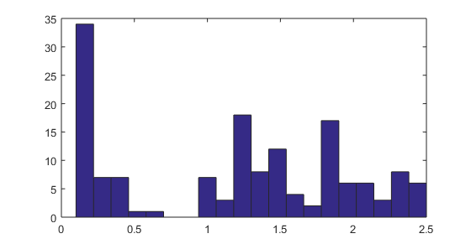
Произвольный количественный признак
>>iris=load(‘Data/iris.dat’) % 150x4 dataset
>>w=iris(:,4); %4th feature, Petal width
>> hist(w,20); %Histogram with 20 bins
Выборка не однородна. В каком смысле?

Slide 4
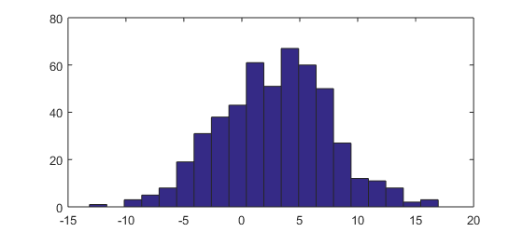
Пример однородной выборки
>> x=5*randn(500,1)+3;hist(x,20);
Как узнать? А вот как: Нет ярко выраженных минимумов!

Slide 5
Homogeneity versus non-homogeneity
No deep minima
(homogeneity)
There are deep minima (non-homogeneity)

Slide 6
Однородные группы в неоднородной выборке (на глаз)
non-homogeneity
Homogeneous groups in intervals
A=[0, 0.8], B=[0.8, 1.7], C=[1.7 2.5] -
Define a nominal (or order) feature with 3 categories, A, B C.

Slide 7
Categorized feature as partition, 1
Non-homogeneity
Nominal feature with 3 categories:
A=[0, 0.8], B=[0.8, 1.7], C=[1.7 2.5]
Corresponds to partition on the object set: S={S_{A}, S_{B}, S_{C}}
S_{A}={i: 0<x(i)<=0.8},
S_{B}={i: 0.8<x(i)<=1.7}, S_{C}={i: 1.7<x(i)<=2.5}

Slide 8
Categorized feature as partition, 2
Nominal/order feature with 3 categories:
A=[0, 0.8], B=[0.8, 1.7], C=[1.7 2.5]
Corresponds to (ordered) partition on the object set:
S={S{1}, S{2}, S{3}} [Quiz: What is partition? ]
Pseudo-Code:
>>f=[0 0.8 1.7 2.5];
>>for k=1:3; s{k}=find(x>f(k) & x<=f(k+1)); end;

Slide 9
Categorized feature as partition, 3 : Distribution
Nominal/order feature with 3 categories:
A=[0, 0.8], B=[0.8, 1.7], C=[1.7 2.5]
Corresponds to partition of the object set:
S={S{1}, S{2}, S{3}}
Frequencies: [|S{1}|, |S{2}|, |S{3}|}={50, 54, 46}
Relative frequencies (Distribution):
p = {50, 54, 46}/150= {0.33, 0.36, 0.31}

Slide 10
Contingency table/Таблица сопряженности, 1
Two sets of categories on the same entity set, k=1,…K, and v=1,…,L
Cross-classify them by putting k in rows and v in columns: the frequency of (k,v) cases, N_{kv}, the relative frequency (частота) p_{kv}
Conditional frequency (probability)
p(v/k)= p_{kv} / p_{k}

Slide 11
Contingency table/Таблица сопряженности, 2
Iris data: 150×4. Nominal features? What is about three of them?
A feature Taxon is available, 3 categories: T1, T2, T3 (50 specimens each) – a partition
Let us develop two nominal features out of Sepal measures:
Sepal Length and Sepal Width

Slide 12
Categorize a quantitative feature, 1
Iris data: 150×4. Nominal features?
Let us categorize
Sepal Length by using
its Histogram S.L.
Minima define boundaries of categories (in red)

Slide 13
Categorize a quantitative feature, 2
Iris data: 150×4 table. Nominal features?
Define categories of
Sepal Length,
separated by “minima” in its
histogram in 20 bins
Boundaries between categories
>>a=[4 5.2 6.1 7.0 8]
5 items, here 4 and 8 – are endpoints of the range interval.

Slide 14
Categorize a quantitative feature, 3
Define 4 categories of Sepal Length
over dividers in (a):
>>a=[4 5.2 6.1 7.0 8]
pseudocode:
>>for k=1:4;f=find(sl>=a(k) & sl<a(k+1));g(f)=k; end;
Here sl – is a 150х1 array with Sepal Length feature;
find - operation, for finding those indices, for which the predicate holds
sl>=a(k) & sl<a(k+1)); “selects indices of the objects falling between boundaries in k-th category, with the exception of a(k+1)”; g –the nominal feature being defined

Slide 15
Sepal Width partition
Categories of Sepal Width are
defined by the break and end
points in its histogram:
>>b=[2 2.5 3.0 3.6 4.5]
to generate a nominal feature h:
>>for k=1:4;f=find(sw>=b(k) & sw<b(k+1));h(f)=k; end;
Here sw is a feature Sepal Width 150×1 array;
find, a command returning indices of entities satisfying the predicate in ()
and h, the defined nominal feature assigning label k to all those entities.

Slide 16
“Taxon” partition
The innate Taxon nominal feature t is generated in computer according to the rule: first 50 specimen belong to T1, next 50 to T2, and the last 50, to T3:
>>for k=1:3;f1=(k-1)*50+1; f2=k*50; t([f1:f2])=k; end;
Here f1:f2 is interval of integers between 1 and 50 at k=1, between 51 and 100 at k=2, and between 101 and 150 at k=3;
t, the nominal feature assigning label k to entities from taxon Tk (k=1, 2, 3).

Slide 17
Интерпретация кластера категориями,1
Category v quantified: Category v
1 0
2 1
N objects … …
i 1
… …
N 0
Average p_{v}
(proportion of v /доля категории v)

Slide 18
Интерпретация кластера категориями,2
Category v quantified: Average: p_{v} - proportion of v
Category v within cluster S_{k} with | S_{k} |= N_{k} objects
i1 0
i2 1
N_{k} objects … …
ij 1
… …
N_{k} 0
Average: p(v/k) =N_{vk}/N_{k}= p_{vk}/p_{k}
- proportion of v in S_{k} = probability [relative frequency] of v under condition S_{k} (вероятность v при условии S_{k} )

Slide 19
Интерпретация кластера категориями,3
Category v quantified: Average: p_{v} - proportion of v
Within-cluster average:
p(v/k) - proportion of v in S_{k} = probability [relative frequency] of v under condition S_{k}
Interpretation, full analogy to the quantitative case: the center of S_{k} at v relates to the mean of v:
I_{kv}=[p(v/k) - p_{v}]/p_{v} = p(v/k)/p_{v}-1

Slide 20
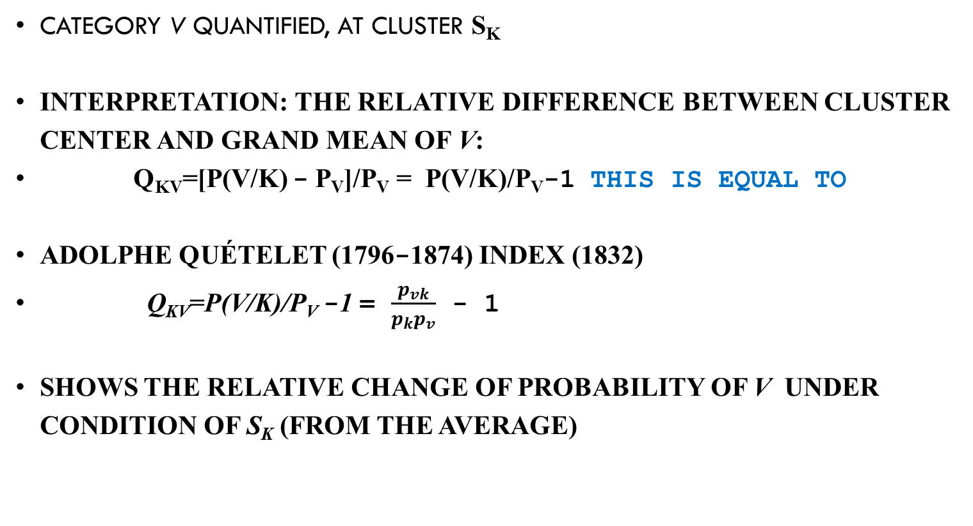
Интерпретация кластера категориями,4
Category v quantified, at cluster S_{k}
Interpretation: the relative difference between cluster center and grand mean of v:
q_{kv}=[p(v/k) - p_{v}]/p_{v} = p(v/k)/p_{v}-1 This is equal to
Adolphe Quételet (1796-1874) index (1832)
q_{kv}=p(v/k)/p_{v} -1 = $\frac{p_{vk}}{p_{k}p_{v}}$ - 1
Shows the relative change of probability of v under condition of S_{k} (from the average)

Slide 21
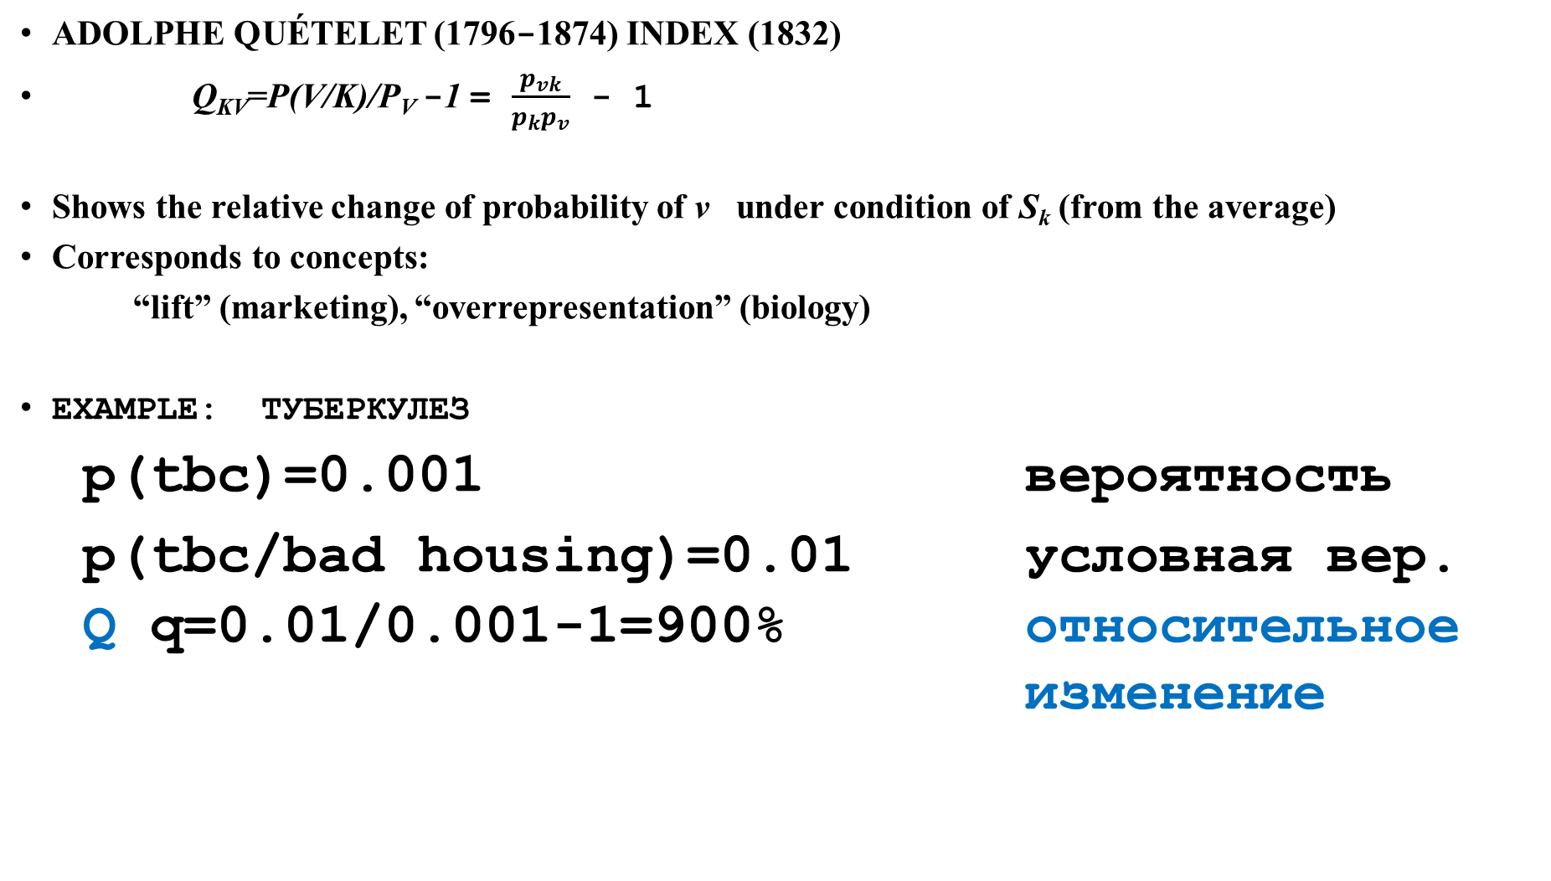
Интерпретация кластера категориями,5
Adolphe Quételet (1796-1874) index (1832)
q_{kv}=p(v/k)/p_{v} -1 = $\frac{p_{vk}}{p_{k}p_{v}}$ - 1
Shows the relative change of probability of v under condition of S_{k} (from the average)
Corresponds to concepts:
“lift” (marketing), “overrepresentation” (biology)
Example: туберкулез
p(tbc)=0.001 вероятность
p(tbc/bad housing)=0.01 условная вер.
Q q=0.01/0.001-1=900% относительное
изменение

Slide 22
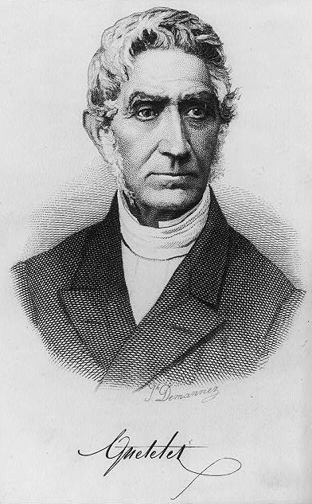
Lambert Adolphe Jacques Quételet (22.02.1796 – 17.02.1874, Belgium), founding father of social statistics

Slide 23
Quetelet index
q(Hk/Gl) change of probability of SW-category Hk under condition SL-category Gl, per cent:
H4, given G4, is 82% more frequent than on average
This could not be seen using conditional probabilities
SW Cat | Quetelet 100*q(Hk/Gl) |  |  |  | Prob. p(Hk)
 | G1 | G2 | G3 | G4
H1 | 33 | 42 | -43 | - 100 | 0.073
H2 | -76 | 36 | 29 | 0 | 0.301
H3 | 33 | -40 | 14 | - 6 | 0.493
H4 | 35 | 48 | -100 | 82 | 0.127

Slide 24
Quetelet index, 2
Quetelet index q(h/g) for category h of SW at given g of SL:
H4 at G4, is 82% more frequent than the average
Why cannot we see that with conditional prob.? In contrast, p(H4|G4) =0.231, the minimum value in the column
SW-Cat | Cond. Probability SW|SL |  |  |  | Total
 | G1 | G2 | G3 | G4
H1 | 0.098 | 0.104 | 0.042 | 0 | 11
H2 | 0.073 | 0.417 | 0.396 | 0.308 | 46
H3 | 0.658 | 0.292 | 0.562 | 0.462 | 74
H4 | 0.171 | 0.188 | 0 | 0.231 | 19
Total | 41 | 48 | 48 | 13 | 150

Slide 25
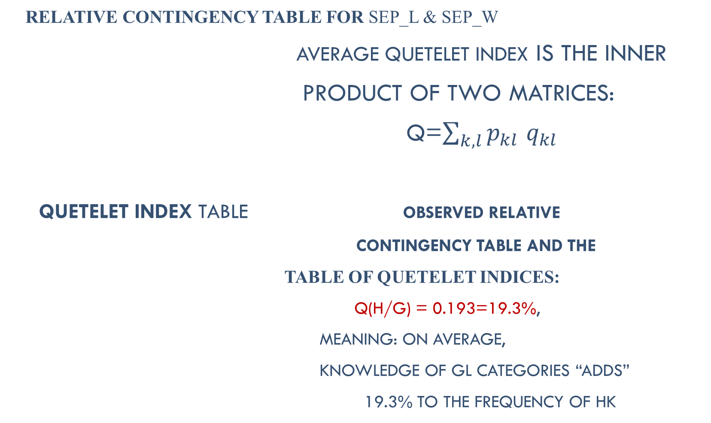
Average Quetelet index
Relative contingency table for Sep_L & Sep_W
Average Quetelet index is the inner
product of two matrices:
Q=$\sum_{k, l}{p_{kl}}$ $q_{kl}$
Quetelet index table Observed relative
contingency table and the
table of Quetelet indices:
Q(H/G) = 0.193=19.3%,
Meaning: on average,
knowledge of Gl categories “adds”
19.3% to the frequency of Hk
 | G1 | G2 | G3 | G4
H1 | 0.027 | 0.033 | 0.013 | 0
H2 | 0.020 | 0.133 | 0.127 | 0.027
H3 | 0.180 | 0.093 | 0.180 | 0.040
H4 | 0.047 | 0.060 | 0 | 0.020
 | G1 | G2 | G3 | G4
H1 | 0.33 | 0.42 | -0.43 | -1
H2 | -0.76 | 0.36 | 0.29 | 0
H3 | 0.33 | -0.40 | 0.14 | - 0.06
H4 | 0.35 | 0.48 | -1 | 0.82

Slide 26
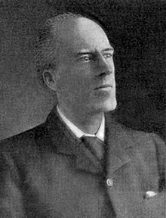
Karl Pearson (27 March 1857 – 27 April 1936, UK), a founding father of data science and mathematical statistics

Slide 27
Contingency table, 3
Taxon (Tk) and Categorized_Sepal_Length (Gl)
19 in cell (T2,G3) – the number of objects in the intersection of T2 and G3
Taxon | Sepal_Length_Category |  |  |  | Total
 | G1 | G2 | G3 | G4
T1 | 36 | 14 | 0 | 0 | 50
T2 | 4 | 26 | 19 | 1 | 50
T3 | 1 | 8 | 29 | 12 | 50
Total | 41 | 48 | 48 | 13 | 150

Slide 28
Contingency table, 4
Taxon (Tk) and Categorized_Sepal_Length (Gl)
MatLab:
>> for k=1:3;for l=1:4; nl(k,l)=length(find(g==l & t==k));end;end
Taxon | Sepal_Length_Category |  |  |  | Total
 | G1 | G2 | G3 | G4
T1 | 36 | 14 | 0 | 0 | 50
T2 | 4 | 26 | 19 | 1 | 50
T3 | 1 | 8 | 29 | 12 | 50
Total | 41 | 48 | 48 | 13 | 150

Slide 29
Contingency table, 5
Taxon (Tk) and Categorized_Sepal_Length (Gl)
Marginal frequencies: totals of rows and columns – frequencies of Tk and Gl
Taxon | Sepal_Length_Category |  |  |  | Total
 | G1 | G2 | G3 | G4
T1 | 36 | 14 | 0 | 0 | 50
T2 | 4 | 26 | 19 | 1 | 50
T3 | 1 | 8 | 29 | 12 | 50
Total | 41 | 48 | 48 | 13 | 150

Slide 30
Contingency table, 6
Taxon (Tk) and Categorized_Sepal_Length (Gl)
Relative frequencies
Proportions of the total (found by dividing frequencies by N=150)
Taxon | Sepal_Length_Category |  |  |  | Total
 | G1 | G2 | G3 | G4
T1 | 0.240 | 0.093 | 0 | 0 | 0.333
T2 | 0.027 | 0.173 | 0.127 | 0.007 | 0.333
T3 | 0.007 | 0.053 | 0.193 | 0.080 | 0.333
Total | 0.273 | 0.320 | 0.320 | 0.087 | 1

Slide 31
Conditional probability, 1
Taxon (Tk) and Categorized_Sepal_Length (Gl)
Conditional probability p(Tk|Gl) of taxon Tk at SL-category Gl:
Taxon | Sepal_Length_Category |  |  |  | Total
 | G1 | G2 | G3 | G4
T1 | 36/41 | 14/48 | 0/48 | 0/13 | 50
T2 | 4/41 | 26/48 | 19/48 | 1/13 | 50
T3 | 1/41 | 8/48 | 29/48 | 12/13 | 50
Total | 41 | 48 | 48 | 13 | 150

Slide 32
Conditional probability, 2
Taxon Tk and Sepal_Length_Category Gl
Conditional probability p(Tk|Gl) of taxon Tk given Sl-category Gl:
Those highlighted by bold are indicative, especially T1/ given G1 and T3/given G4:
almost conceptual rules G1⇒T1 and G4 ⇒T3.
Taxon | Sepal_Length_Category |  |  |  | Total
 | G1 | G2 | G3 | G4
T1 | 0.878 | 0.292 | 0 | 0 | 50
T2 | 0.098 | 0.542 | 0.396 | 0.077 | 50
T3 | 0.024 | 0.167 | 0.604 | 0.923 | 50
Total | 41 | 48 | 48 | 13 | 150

Slide 33
Conditional probability, 3
Taxon (Tk) as a function of Categorized_Sepal_Length (Gl)
Some values (very high or very low) are useful
Next will be shown a dull table, at which the conditional probability does not help.
Taxon | Sepal_Length_Category |  |  |  | Total
 | G1 | G2 | G3 | G4
T1 | 0.878 | 0.292 | 0 | 0 | 50
T2 | 0.098 | 0.542 | 0.396 | 0.077 | 50
T3 | 0.024 | 0.167 | 0.604 | 0.923 | 50
Total | 41 | 48 | 48 | 13 | 150

Slide 34
A dull contingency table: no contrasts (categories of CSW as functions of CSL)
SW-Cat | Cond. Probability SW|SL |  |  |  | Total
 | G1 | G2 | G3 | G4
H1 | 0.098 | 0.104 | 0.042 | 0 | 11
H2 | 0.073 | 0.417 | 0.396 | 0.308 | 46
H3 | 0.658 | 0.292 | 0.562 | 0.462 | 74
H4 | 0.171 | 0.188 | 0 | 0.231 | 19
Total | 41 | 48 | 48 | 13 | 150

Slide 35
Statistical independence and Pearson’s chi-squared/ статистическая независимость и хи-квадрат Пирсона

Slide 36
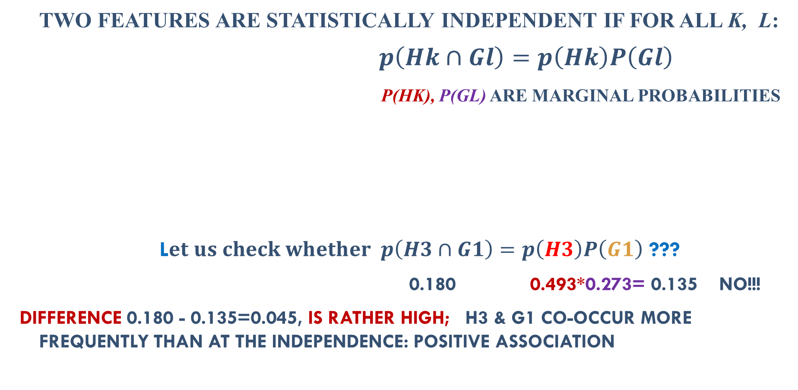
Statistical independence, 1
Two features are statistically independent if for all k, l:
$$p\left(Hk∩Gl\right)=p\left(Hk\right)P\left(Gl\right)$$
p(Hk), p(Gl) are marginal probabilities
L$et us check whether p\left(H3∩G1\right)=p\left(H3\right)P\left(G1\right)$ ???
0.180 0.493*0.273= 0.135 NO!!!
Difference 0.180 - 0.135=0.045, is rather high; H3 & G1 co-occur more frequently than at the independence: positive association
SW-Cat | Sepal_Length_Category |  |  |  | Total
 | G1 | G2 | G3 | G4
H1 | 0.027 | 0.033 | 0.013 | 0 | 0.073
H2 | 0.020 | 0.133 | 0.127 | 0.027 | 0.307
H3 | 0.180 | 0.093 | 0.180 | 0.040 | 0.493
H4 | 0.047 | 0.060 | 0 | 0.020 | 0.127
Total | 0.273 | 0.320 | 0.320 | 0.087 | 1

Slide 37
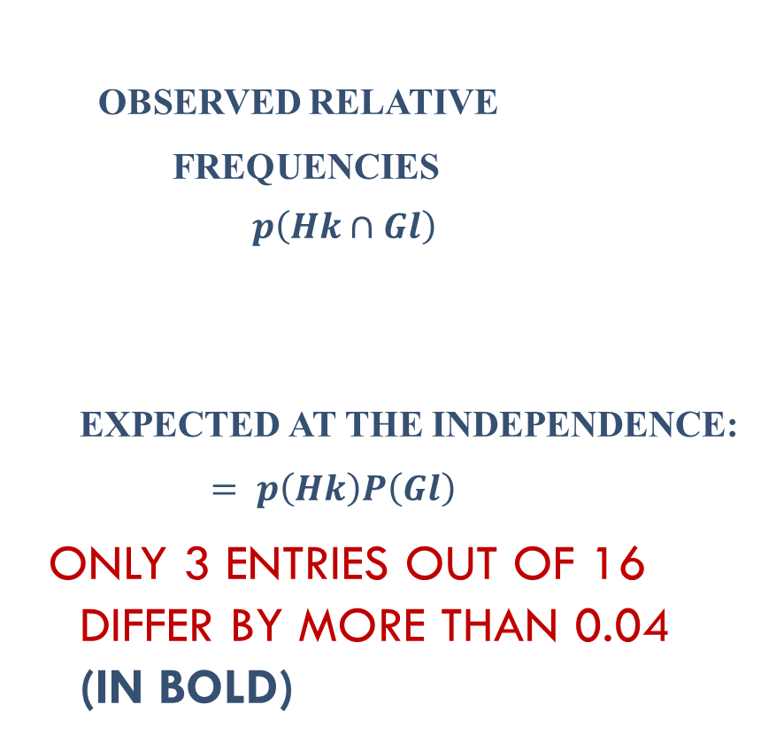
Statistical independence, 2
0.027 | 0.033 | 0.013 | 0 | 0.073
0.020 | 0.133 | 0.127 | 0.027 | 0.307
0.180 | 0.093 | 0.180 | 0.040 | 0.493
0.047 | 0.060 | 0 | 0.020 | 0.127
0.273 | 0.320 | 0.320 | 0.087 | 1
Observed relative
frequencies
$$p\left(Hk∩Gl\right)$$
Expected at the independence:
$= p\left(Hk\right)P\left(Gl\right)$
Only 3 entries out of 16 differ by more than 0.04 (in bold)
0.020 | 0.024 | 0.024 | 0.006 | 0.073
0.084 | 0.098 | 0.098 | 0.027 | 0.307
0.135 | 0.158 | 0.158 | 0.043 | 0.493
0.035 | 0.040 | 0.040 | 0.011 | 0.127
0.273 | 0.320 | 0.320 | 0.087 | 1

Slide 38
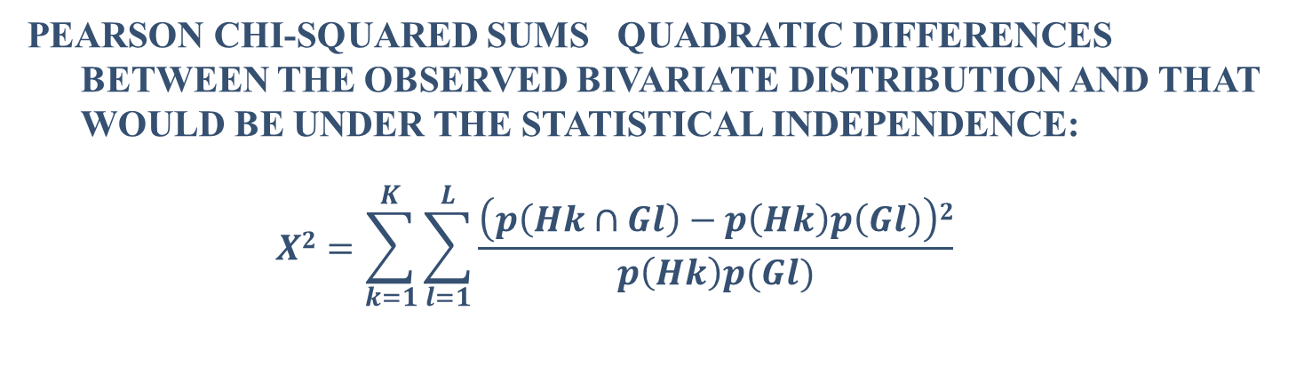


Testing independence with Pearson chi-squared, 1
$$p\left(Hk∩Gl\right)$$
$$p\left(Hk\right)P\left(Gl\right)$$
0.027 | 0.033 | 0.013 | 0 | 0.073
0.020 | 0.133 | 0.127 | 0.027 | 0.307
0.180 | 0.093 | 0.180 | 0.040 | 0.493
0.047 | 0.060 | 0 | 0.020 | 0.127
0.273 | 0.320 | 0.320 | 0.087 | 1
0.020 | 0.024 | 0.024 | 0.006 | 0.073
0.084 | 0.098 | 0.098 | 0.027 | 0.307
0.135 | 0.158 | 0.158 | 0.043 | 0.493
0.035 | 0.040 | 0.040 | 0.011 | 0.127
0.273 | 0.320 | 0.320 | 0.087 | 1
Pearson chi-squared sums quadratic differences between the observed bivariate distribution and that would be under the statistical independence:
$$X2=\sum_{k=1}^{K}{\sum_{l=1}^{L}{\frac{\left(p\left(Hk∩Gl\right)−p\left(Hk\right)p\left(Gl\right)\right)2}{p\left(Hk\right)p(Gl)}}}$$

Slide 39
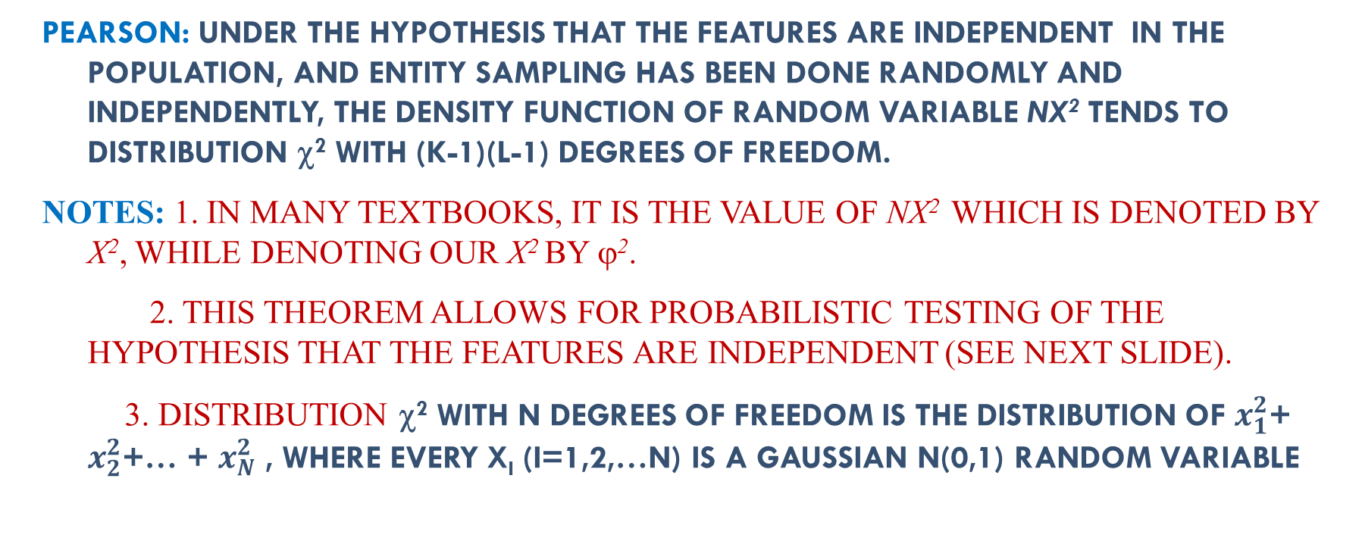


Pearson chi-squared, 2
$$p\left(Hk∩Gl\right)$$
$$p\left(Hk\right)P\left(Gl\right)$$
0.027 | 0.033 | 0.013 | 0 | 0.073
0.020 | 0.133 | 0.127 | 0.027 | 0.307
0.180 | 0.093 | 0.180 | 0.040 | 0.493
0.047 | 0.060 | 0 | 0.020 | 0.127
0.273 | 0.320 | 0.320 | 0.087 | 1
0.020 | 0.024 | 0.024 | 0.006 | 0.073
0.084 | 0.098 | 0.098 | 0.027 | 0.307
0.135 | 0.158 | 0.158 | 0.043 | 0.493
0.035 | 0.040 | 0.040 | 0.011 | 0.127
0.273 | 0.320 | 0.320 | 0.087 | 1
Pearson: Under the hypothesis that the features are independent in the population, and entity sampling has been done randomly and independently, the density function of random variable NX² tends to distribution χ² with (K-1)(L-1) degrees of freedom.
Notes: 1. In many textbooks, it is the value of NX² which is denoted by X², while denoting our X² by ϕ².
2. This theorem allows for probabilistic testing of the hypothesis that the features are independent (see next slide).
3. Distribution χ² with n degrees of freedom is the distribution of $x_{1}^{2}$+ $x_{2}^{2}$+… + $x_{N}^{2}$ , where every x_{i} (i=1,2,…n) is a Gaussian N(0,1) random variable

Slide 40


Pearson chi-squared, 3
$$p: p\left(Hk∩Gl\right)$$
pn: $p\left(Hk\right)P\left(Gl\right)$
0.027 | 0.033 | 0.013 | 0 | 0.073
0.020 | 0.133 | 0.127 | 0.027 | 0.307
0.180 | 0.093 | 0.180 | 0.040 | 0.493
0.047 | 0.060 | 0 | 0.020 | 0.127
0.273 | 0.320 | 0.320 | 0.087 | 1
0.020 | 0.024 | 0.024 | 0.006 | 0.073
0.084 | 0.098 | 0.098 | 0.027 | 0.307
0.135 | 0.158 | 0.158 | 0.043 | 0.493
0.035 | 0.040 | 0.040 | 0.011 | 0.127
0.273 | 0.320 | 0.320 | 0.087 | 1
Pearson: Under the hypothesis that the features are independent in the population, and entity sampling has been done randomly and independently, the density function of random variable NX² tends to distribution χ² with f=(K-1)(L-1) degrees of freedom.
Apply this theorem to our case.
K=4, L=4, therefore f=9. At f=9, there is a 5% chance that the NX² value will be greater than 16.92 if the hypothesis of independence is true. In our case X² =0.1929, N=150 so that NX² =28.93 > 16.92. The hypothesis is to be rejected with 95% confidence (even with 99.9% confidence: the critical value is 27.88). Amusingly, if there were only 50 specimen, NX² =9.64: the independence could not be rejected.
I do not like that the judgement depends on the number of objects

Slide 41


Pearson chi-squared, 4
$p: p\left(Hk∩Gl\right)$ are here
pn: $p\left(Hk\right)P\left(Gl\right)$ are here
0.027 | 0.033 | 0.013 | 0 | 0.073
0.020 | 0.133 | 0.127 | 0.027 | 0.307
0.180 | 0.093 | 0.180 | 0.040 | 0.493
0.047 | 0.060 | 0 | 0.020 | 0.127
0.273 | 0.320 | 0.320 | 0.087 | 1
0.020 | 0.024 | 0.024 | 0.006 | 0.073
0.084 | 0.098 | 0.098 | 0.027 | 0.307
0.135 | 0.158 | 0.158 | 0.043 | 0.493
0.035 | 0.040 | 0.040 | 0.011 | 0.127
0.273 | 0.320 | 0.320 | 0.087 | 1
Pearson: Under the hypothesis that the features are independent in the population, and entity sampling has been done randomly and independently, the density function of random variable NX² tends to distribution χ² with f=(K-1)(L-1) degrees of freedom.
In statistics texts, Pearson chi-squared is not recommended as a correlation measure - to be used for testing the independence only.
I disagree.

Slide 42

Интерпретация chi-squared индексами Кетле, 1
Категории $k, l$ двух номинальных признаков
(Было: категория v и кластер S_{k})
Adolphe Quételet (1796-1874) index (1832)
q_{kl} = p(l/k)/p_{l} - 1 = $\frac{p_{kl}}{p_{k}p_{l}}$ - 1
Относительное изменение вероятности l при условии k

Slide 43
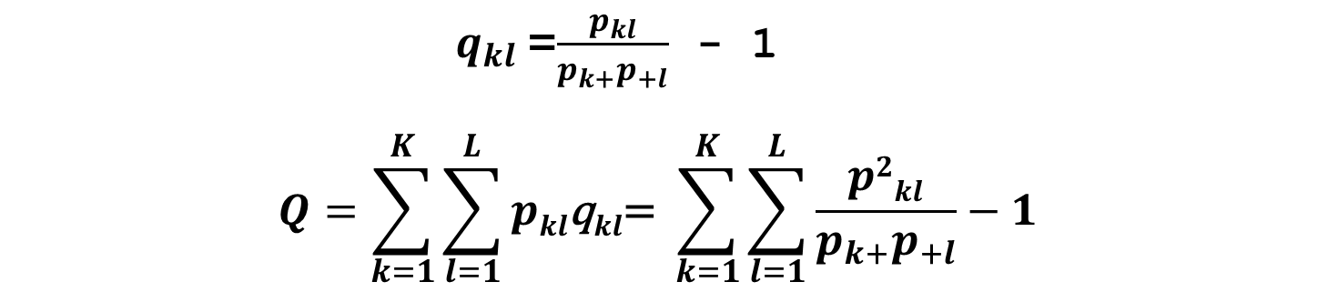
average Quetelet index
F1_Cat | F2_Categories |  |  |  | Total
 | G1 | G2 | G3 | G4
H1 | p₁₁ | p₁₂ | p₁₃ | p₁₄ | P₁₊
H2 | p₂₁ | p₂₂ | p₂₃ | p₂₄ | p₂₊
H3 | p₃₁ | p₃₂ | p₃₃ | p₃₄ | P₃₊
Total | P₊₁ | P₊₂ | P₊₃ | P₊₄ | 1.00
$q_{kl}$=$\frac{p_{kl}}{p_{k+}p_{+l}}\text{ − 1}$
$$Q=\sum_{k=1}^{K}{\sum_{l=1}^{L}{pkl\text{q}kl\text{=} }\sum_{k=1}^{K}{\sum_{l=1}^{L}{\frac{p2kl}{p_{k+}p_{+l}}−1 }}}$$

Slide 44
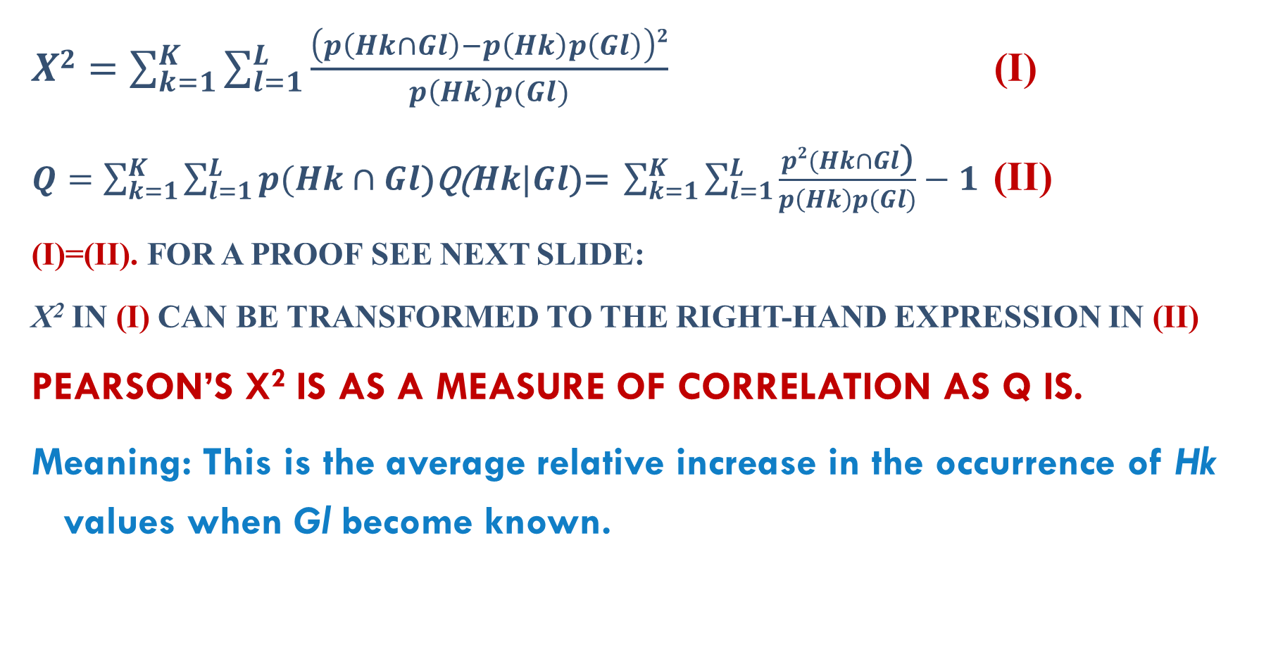
Average Quetelet index Q = Pearson chi-squared, 1
$X2=\sum_{k=1}^{K}{\sum_{l=1}^{L}{\frac{\left(p\left(Hk∩Gl\right)−p\left(Hk\right)p\left(Gl\right)\right)2}{p\left(Hk\right)p(Gl)}}}$ (I)
$Q=\sum_{k=1}^{K}{\sum_{l=1}^{L}{p(Hk∩Gl\text{)}\text{q}\text{(}Hk|Gl\text{)=} }\sum_{k=1}^{K}{\sum_{l=1}^{L}{\frac{p2(Hk∩Gl\text{)}}{p\left(Hk\right)p(Gl)}−1 }}}$ (II)
(i)=(ii). For a proof see next slide:
X² in (i) can be transformed to the right-hand expression in (ii)
Pearson’s X² is as a measure of correlation as Q is.
Meaning: This is the average relative increase in the occurrence of Hk values when Gl become known.

Slide 45
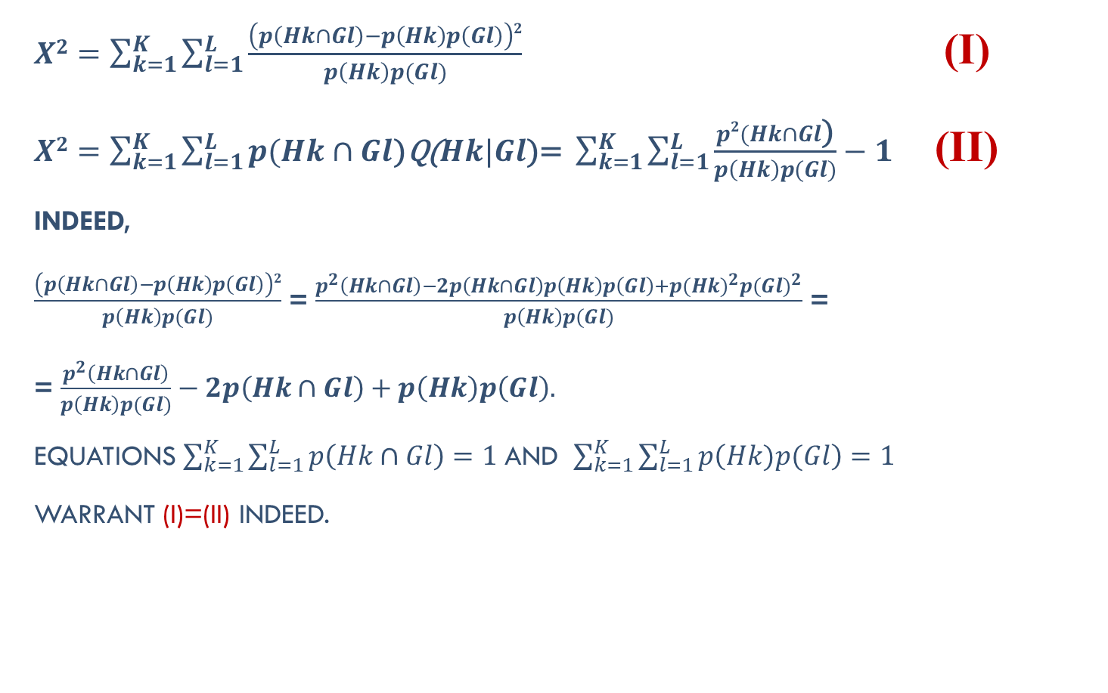
Q=Pearson chi-squared, 2: (i) = (ii)
$X2=\sum_{k=1}^{K}{\sum_{l=1}^{L}{\frac{\left(p\left(Hk∩Gl\right)−p\left(Hk\right)p\left(Gl\right)\right)2}{p\left(Hk\right)p(Gl)}}}$ (i)
$X2=\sum_{k=1}^{K}{\sum_{l=1}^{L}{p(Hk∩Gl\text{)}\text{q}\text{(}Hk|Gl\text{)=} }\sum_{k=1}^{K}{\sum_{l=1}^{L}{\frac{p2(Hk∩Gl\text{)}}{p\left(Hk\right)p(Gl)}−1 }}}$ (ii)
Indeed,
$\frac{\left(p\left(Hk∩Gl\right)−p\left(Hk\right)p\left(Gl\right)\right)2}{p\left(Hk\right)p(Gl)}$ = $\frac{p^{2}\left(Hk∩Gl\right)−2p\left(Hk∩Gl\right)p\left(Hk\right)p\left(Gl\right)+{p(Hk)}^{2}{p(Gl)}^{2}}{p\left(Hk\right)p(Gl)}$ =
= $\frac{p^{2}\left(Hk∩Gl\right)}{p\left(Hk\right)p(Gl)}−2p\left(Hk∩Gl\right)+p\left(Hk\right)p\left(Gl\right).$
Equations $\sum_{k=1}^{K}{\sum_{l=1}^{L}{p\left(Hk∩Gl\right)=1}}$ and $\sum_{k=1}^{K}{\sum_{l=1}^{L}{p\left(Hk)p(Gl\right)=1}}$
warrant (i)=(ii) indeed.

Slide 46
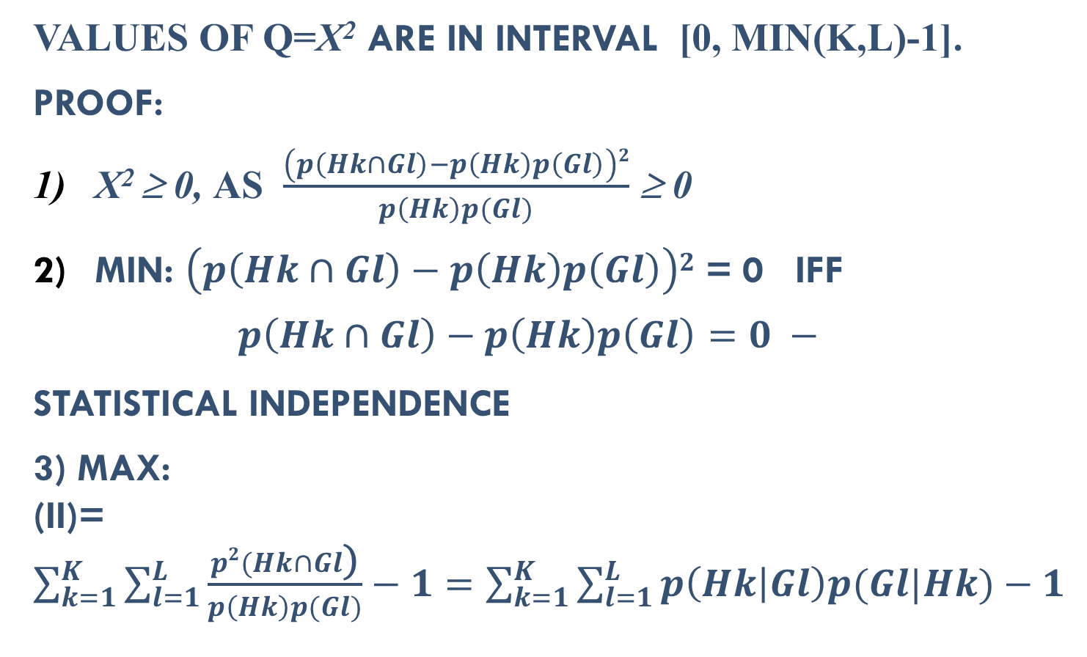
Chi-squared (and Q) as association measure, 1
Values of Q=X² are in interval [0, min(K,L)-1].
Proof:
X² ≥ 0, as $\frac{\left(p\left(Hk∩Gl\right)−p\left(Hk\right)p\left(Gl\right)\right)2}{p\left(Hk\right)p(Gl)}$ ≥ 0
Min: $\left(p\left(Hk∩Gl\right)−p\left(Hk\right)p\left(Gl\right)\right)2$ = 0 iff
$$p\left(Hk∩Gl\right)−p\left(Hk\right)p\left(Gl\right)=0 −$$
statistical independence
3) Max: (ii)=$\sum_{k=1}^{K}{\sum_{l=1}^{L}{\frac{p2(Hk∩Gl\text{)}}{p\left(Hk\right)p(Gl)}−1=\sum_{k=1}^{K}{\sum_{l=1}^{L}{p\left(Hk | Gl\right)p(Gl|Hk)−1 }}}}$

Slide 47
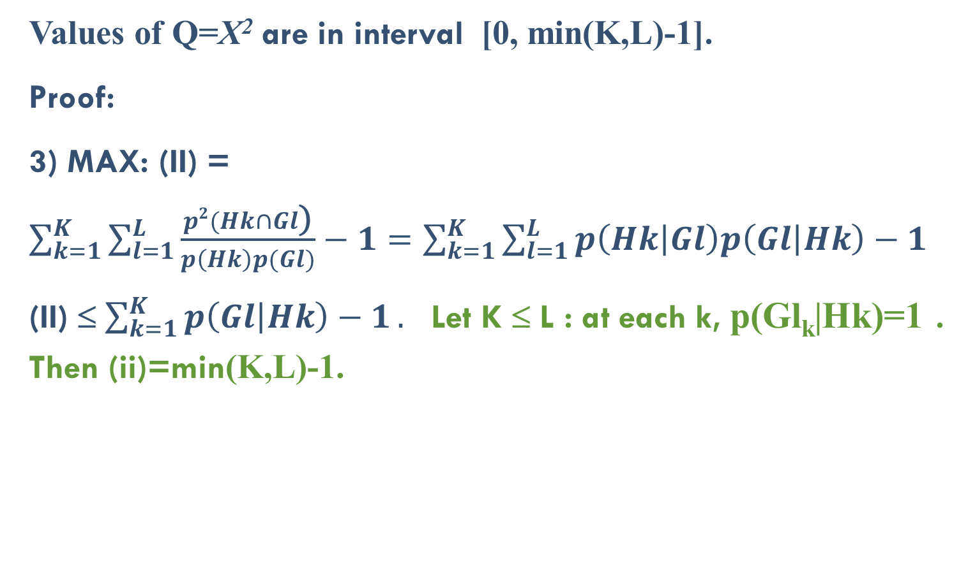
Chi-squared (and Q) as association measure, 2
Values of Q=X² are in interval [0, min(K,L)-1].
Proof:
3) Max: (ii) = $\sum_{k=1}^{K}{\sum_{l=1}^{L}{\frac{p2(Hk∩Gl\text{)}}{p\left(Hk\right)p(Gl)}−1=\sum_{k=1}^{K}{\sum_{l=1}^{L}{p\left(Hk | Gl\right)p\left(Gl | Hk\right)−1}}}}$
(ii) ≤$\sum_{k=1}^{K}{p\left(Gl | Hk\right)−1}.$ Let K ≤ L : at each k, p(Gl_{k}|Hk)=1 . Then (ii)=min(K,L)-1.
 | l=1 |  |  | l=L
k=1 | 0 | p₁ | 0 | 0 | p₁
k=2 | 0 | 0 | p₂ | 0 | p₂
k=K | 0 | p_{K} | 0 | 0 | p_{K}

Slide 48
Chi-squared (and Q) as association measure, 3
3) Max Q=X² =min(K,L)-1 at
This is a case of LOGICAL / CONCEPTUAL association (out of statistical association):
k=1 ⇒ l=2
k=2 ⇒ l=3
…………………
k=K ⇒ l=2
 | l=1 | l=2 | l=3 | l=L
k=1 | 0 | p₁ | 0 | 0 | p₁
k=2 | 0 | 0 | p₂ | 0 | p₂
……. k=K | … 0 | … p_{K} | … 0 | … 0 | … p_{K}

Slide 49
Chi-squared (and Q) as an association measure, 4
Min Q=X² = 0
STATISTICAL INDEPENDENCE
Max Q=X² =min(K,L)-1
LOGICAL/CONCEPTUAL association

Slide 50
Пример: Pew Research Center: USA 2014 survey Income × Voting preference
Party Income | Resp | Undec | Demo | Total |  | R | U | D
 | Respondent numbers
(1) 30K− | 2388 | 2034 | 4423 | 8845 |  | -0.3034 | 0.4629 | 0.0985
(2) | 2286 | 938 | 2696 | 5920 |  | -0.0037 | 0.0079 | 0.0004
(3) | 3885 | 1126 | 3712 | 8723 |  | 0.1491 | -0.1788 | -0.0652
(4) 100K+ | 3258 | 695 | 3049 | 7002 |  | 0.2005 | -0.3686 | -0.0435
Value Q=Χ²=0.0345, out of Maximum=3:
“Association is quite weak”
4793 13880 30490 Quetelet index Globally: No association. Locally: There are rather clear associations. Rich prefer R (+20%), do not like U (-37%). Poor are indifferent (U +46%), do not like R (-30%).

Slide 51
Concepts learned
Contingency table
Marginal row and column
Statistical independence and testing it
Chi-squared and degrees of freedom
Quetelet index, interpreting a category in cluster
Average Quetelet index
Q=Chi-Squared

Slide 52
Домашнее задание 4: Таблица сопряженности
Сформируйте три номинальных признака х1, х2 и х3 на Ваших данных (один, но не больше, может быть взят из Вашей таблицы данных)
Сформируйте две таблицы сопряженности, х1 и х2, х1 и х3. Постройте также матрицы условных вероятностей (х1 от х2 и х1 от х3) и таблицы коэффициентов Кетле. Прокомментируйте связи между категориями признака х1 и категориями х2 и х3 с использованием условных вероятностей и индекса Кетле .
Вычислите среднее значение индекса Кетле на построенных таблицах сопряженности. В какой таблице связь больше и почему?
Рассчитайте значение коэффициента хи-квадрат для обеих таблиц; сравните со значениями среднего индекса Кетле.

