Slide 1
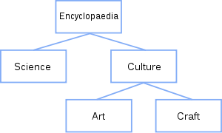
EXERCISE
This exercise will help you understand how command line work on windows, please perform all these tasks using the command prompt.
1) Display all the contain of your local disk drive c:\>
2) Create these directories in your desktop folder:
3) Inside science folder create 3 empty files called Mathematical, Physical and chemistry.
4) Move the file called Chemistry into Craft folder and copy the file called Physical into culture folder.
5) Rename the file Chemistry and the new name will be PLANE.
6) Delete all files and directories.

