Slide 1
Basic algebra for data analysis
Introduction

Slide 2




About me
Valeriya Strizhkova
valeriya.strizhkova@inria.fr
1st year PhD student @ Inria & 3IA & UCA
Research topics: emotion detection, computer vision, deep learning
3+ years of industrial experience in AI

Slide 3
About the course
The aim of the course is to refresh your knowledge in linear algebra and calculus
More applied math, less pure math
Less formal proofs, theorems and definitions to lemmas

Slide 4
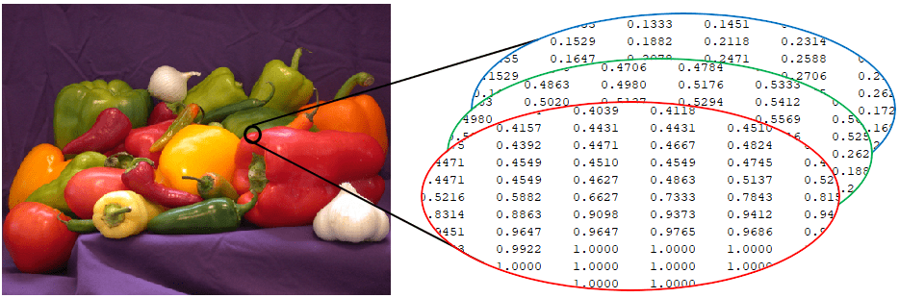
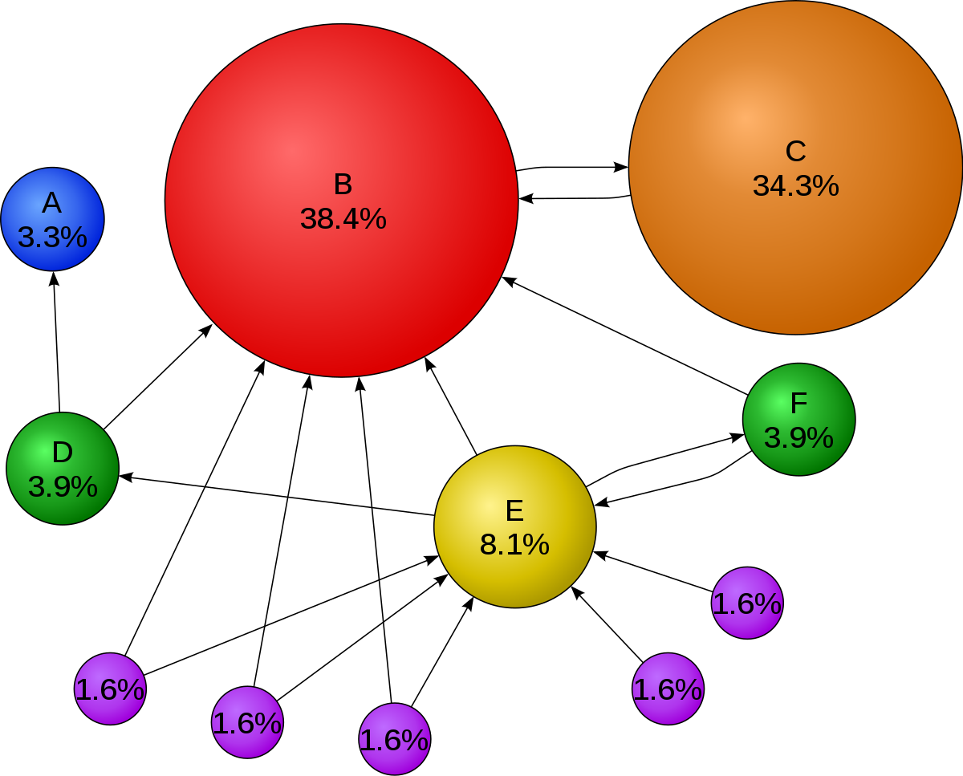
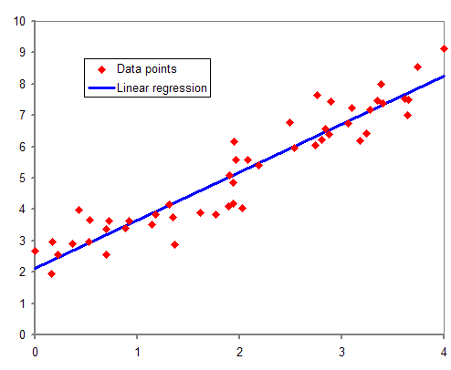
Algebra in data analysis
images are matrices of numbers
matrix = (# web pages) x (# web pages)
Image processing
PageRank
Regression
Source:
https://en.wikipedia.org/wiki/Regression_analysis
https://www.mathworks.com/help/images/image-types-in-the-toolbox.html
https://en.wikipedia.org/wiki/PageRank

Slide 5
Topics of the course
Linear algebra:
Vectors
Matrices
Transpose of matrix
Inverse of matrix
Determinant of a matrix
Trace of matrix
Scalar products
Eigenvalues
Eigenvectors
Calculus:
Partial derivatives
Differentiability
Higher order derivatives
Chain rule of differentiation
Maxima and minima

Slide 6
Structure of lectures and TDs
4 lectures + 4 TDs:
1. Vector spaces, norms, linear systems
2. Scalar products
3. Eigenvalues and eigenvectors
4. Derivatives

Slide 7
Evaluation
homework + exam

Slide 8
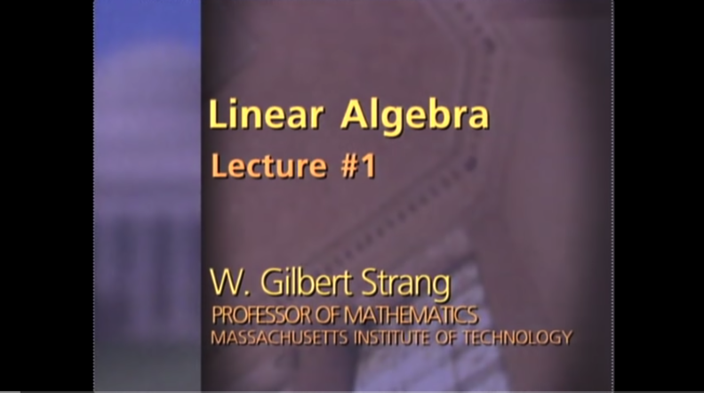


Sources
This year UCA course
Last year UCA course

Slide 9
Lecture 1. Vector spaces, linear systems, norms nbviewer
TD 1. Linear Systems colab
TD 1. Gaussian Elimination colab
TD 1. Matrix Algebra colab

