Slide 1



India's Privacy-First Wealth Dashboard
One offline-first workspace for investing, tax visibility, scoring and family finance — built for Indian investors.
100% OFFLINE
ZERO SERVER
YOUR DEVICE ONLY
ValeurFin — Investor Pitch Deck
v4.0 · 2026
"Your money. Your device. Your story."
01
Notes:
[Sources] - User-provided product brief and logo supplied in chat. - Product website: https://valeurfin-app.github.io/

Slide 2

VALEURFIN
Indian investors deserve better
Today’s retail investor stack is fragmented, over-shared and reactive.
5+ apps, zero unified view
The current experience
Zerodha, Groww, bank apps and spreadsheets still have to be stitched together manually.
5+
0
apps
single truth
Privacy becomes the product
PAN, bank and portfolio data are routinely replicated across third-party servers.
BROKER
BANK
Tax surprises at year-end
SPREADSHEET
TAX SHEET
Most investors discover LTCG/STCG implications only when filing or speaking to a CA.
REMINDERS
No exit discipline
Without alerts, people often hold losers too long and sell winners too early.
India’s mutual fund industry crossed ₹80 lakh crore AUM in late 2025 — but privacy-first portfolio control remains underserved.
Family tracking is messy
A single household may span spouse SIPs, parent FDs, child goals and insurance policies.
02
Notes:
[Sources] - User-provided product brief and problem framing. - AMFI / ET summary of industry scale: India mutual fund AUM reached about ₹80.55 lakh crore by Nov 2025 (Economic Times summary of AMFI data, Dec 2025). - Product website positioning and privacy language: https://valeurfin-app.github.io/

Slide 3
VALEURFIN
Introducing ValeurFin
A single privacy-first dashboard that brings investing, risk, tax and family planning into one offline product.
ONE dashboard.
EVERY financial asset.
ZERO data leaves your device.
12 investment types
Insurance + wealth scoring
Live NSE stock prices
Family mode
ValeurBot AI assistant
Installable offline PWA
Tax calculator · LTCG / STCG
No signup · no tracking
Built for Indian investors. By an Indian founder.
No signup. No server. No tracking. Just your finances — your way.
03
Notes:
[Sources] - User-provided product brief. - Product website sections listing dashboard areas, AI settings, tax calculator, exit signals, family mode and privacy policy: https://valeurfin-app.github.io/

Slide 4

VALEURFIN
Six pillars that make the product defendable
Not just portfolio tracking — ValeurFin combines monitoring, insight, security and planning in one workflow.
01
02
03
Smart Tracking
Live Market
AI Assistant
12 investment types across equity, debt, hybrid and alternatives — with invested, live value, return and owner tags.
NSE-oriented live prices, market pulse, heatmap, gainers/losers and 52-week context from one screen.
ValeurBot handles portfolio, tax, allocation, goals and insurance questions — with optional Gemini AI.
04
05
06
Tax Intelligence
Scoring Engine
Privacy-First
Holding-period aware logic for LTCG/STCG, maturity cues and signals that bring selling discipline into the app.
Wealth and insurance scores convert scattered financial facts into a single prioritized action list.
100% client-side with IndexedDB + localStorage + session + cookie failsafe, plus PIN protection.
04
Notes:
[Sources] - User-provided product brief. - Product website sections and privacy policy: https://valeurfin-app.github.io/

Slide 5
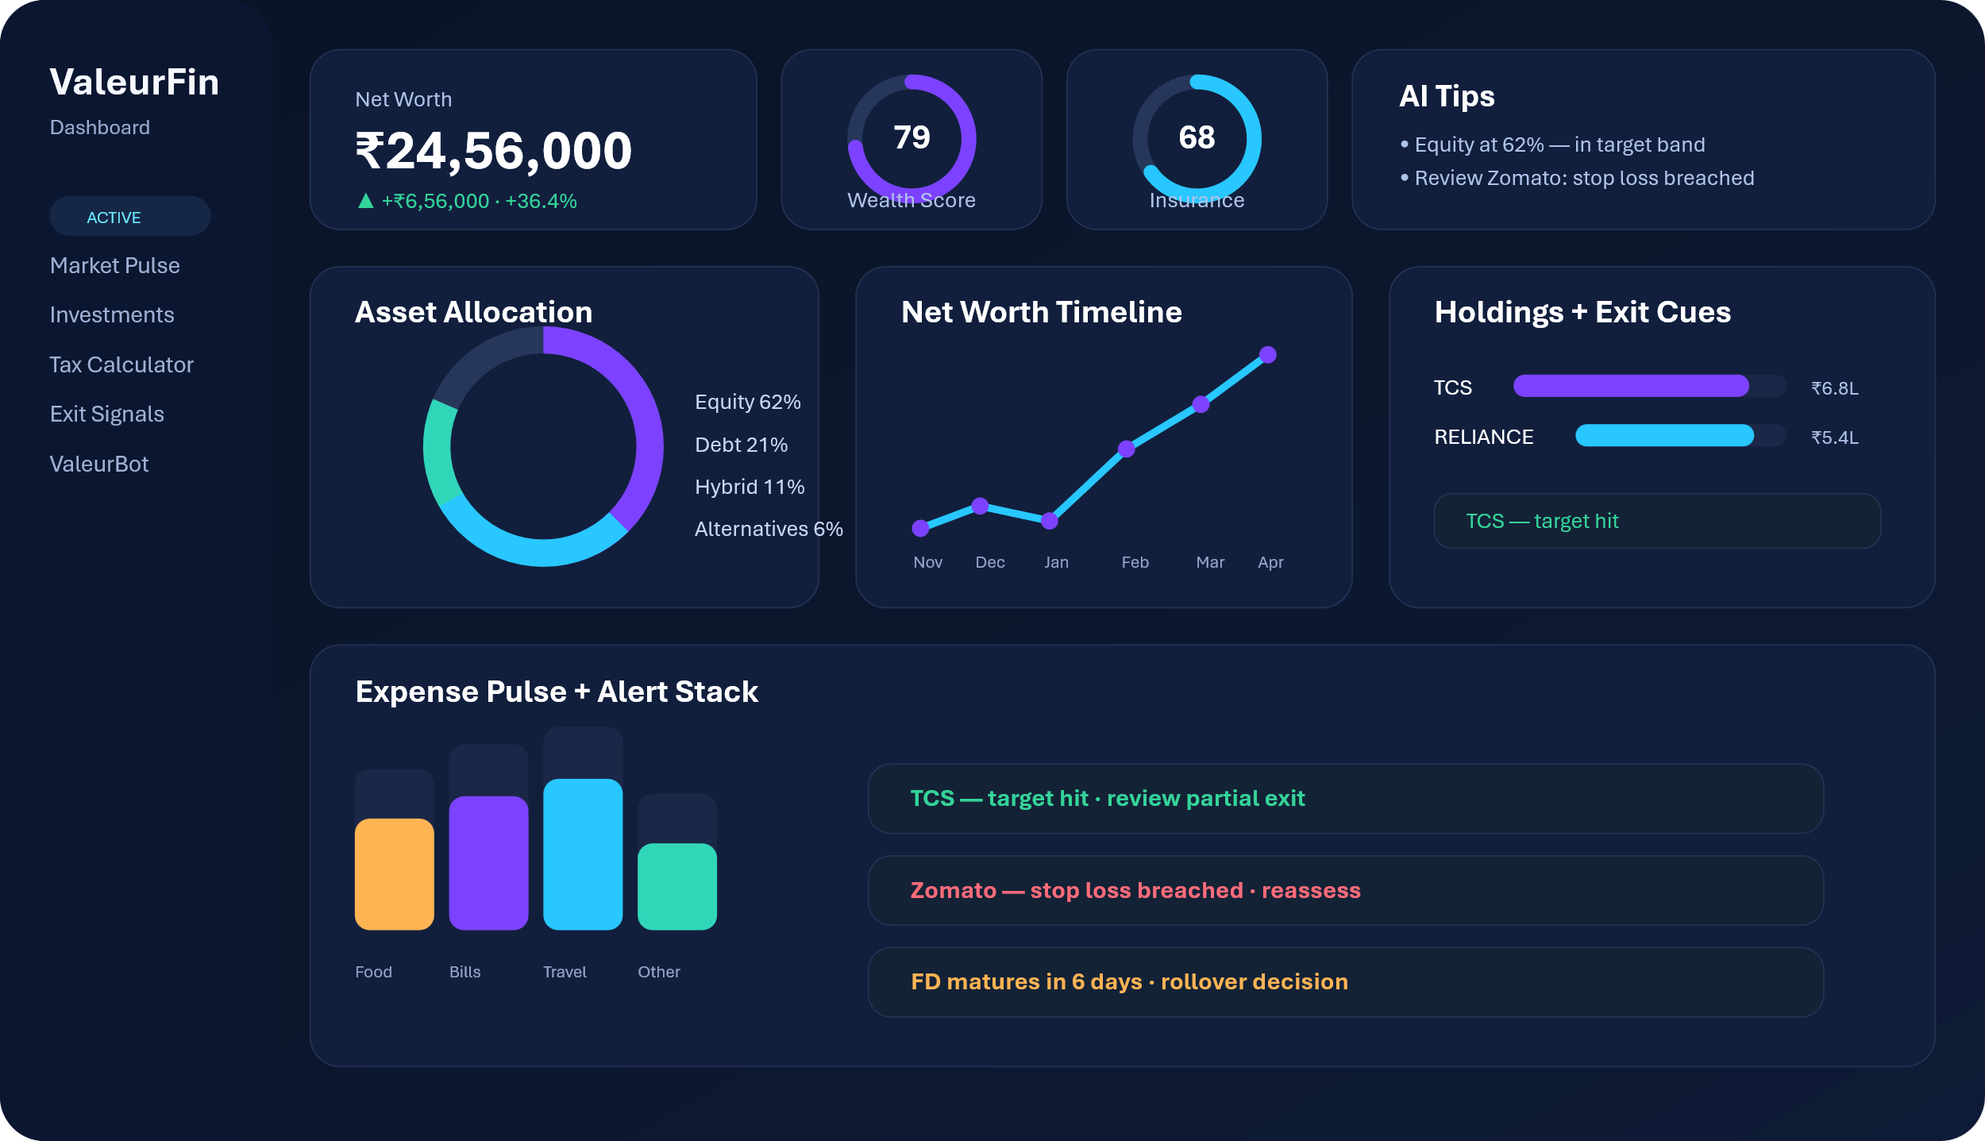
VALEURFIN
Everything at a glance
The home dashboard compresses net worth, scoring, allocation, alerts and action cues into one operating screen.
1 Net worth hero card
2 Wealth + insurance rings
3 AI tips surface
4 Asset allocation donut
5 Sector mix
6 Net worth timeline
7 Top holdings
8 Exit cues
9 Expense pulse
10 Recent alerts
05
Notes:
[Sources] - Dashboard mock visual created for this deck based on the user-provided product brief and product website sections. - Product website dashboard sections: https://valeurfin-app.github.io/

Slide 6
VALEURFIN
12 asset classes. One view.
Designed for the reality of Indian households — not just listed stocks.
SIP / Mutual Funds
EQUITY
Stocks / ETF
EQUITY
Reliance Industries
Stocks · RELIANCE · Zerodha
Invested
₹5,00,000
Fixed Deposit
DEBT
Recurring Deposit
DEBT
Current
₹6,84,750 LIVE
Returns
+₹1,84,750
PPF
DEBT
NPS
HYBRID
Return %
+36.9%
Tax
LTCG
Gold / SGB
ALTERNATIVE
Crypto
ALTERNATIVE
Signal
Hold
Real Estate
ALTERNATIVE
ELSS
EQUITY
Bonds
DEBT
Others
ALTERNATIVE
Also includes MF search, symbol mapping, step-up SIP, maturity tracking and platform tagging.
06
Notes:
[Sources] - User-provided product brief. - Product website sections for investments, tax calculator and live market: https://valeurfin-app.github.io/

Slide 7
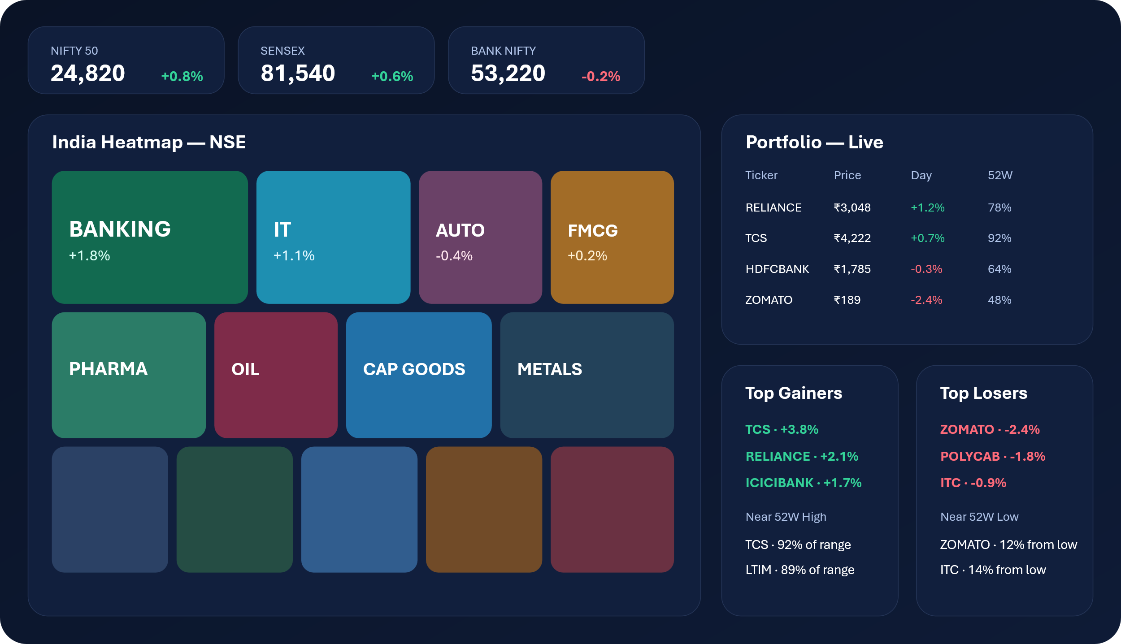
VALEURFIN
Market pulse — live from NSE context
A portfolio view that stays connected to what the Indian market is doing right now.
Index overview
NIFTY 50, SENSEX, BANK NIFTY
Portfolio live
price, day move, 52-week range
Auto-ranked top gainers and losers
52-week context for review decisions
Embedded NSE heatmap for sector leadership
UPDATES WITH ONE TAP
07
Notes:
[Sources] - Market mock visual created for this deck based on the product brief. - Product website references Yahoo Finance, MFAPI.in and TradingView widgets in the privacy policy: https://valeurfin-app.github.io/

Slide 8
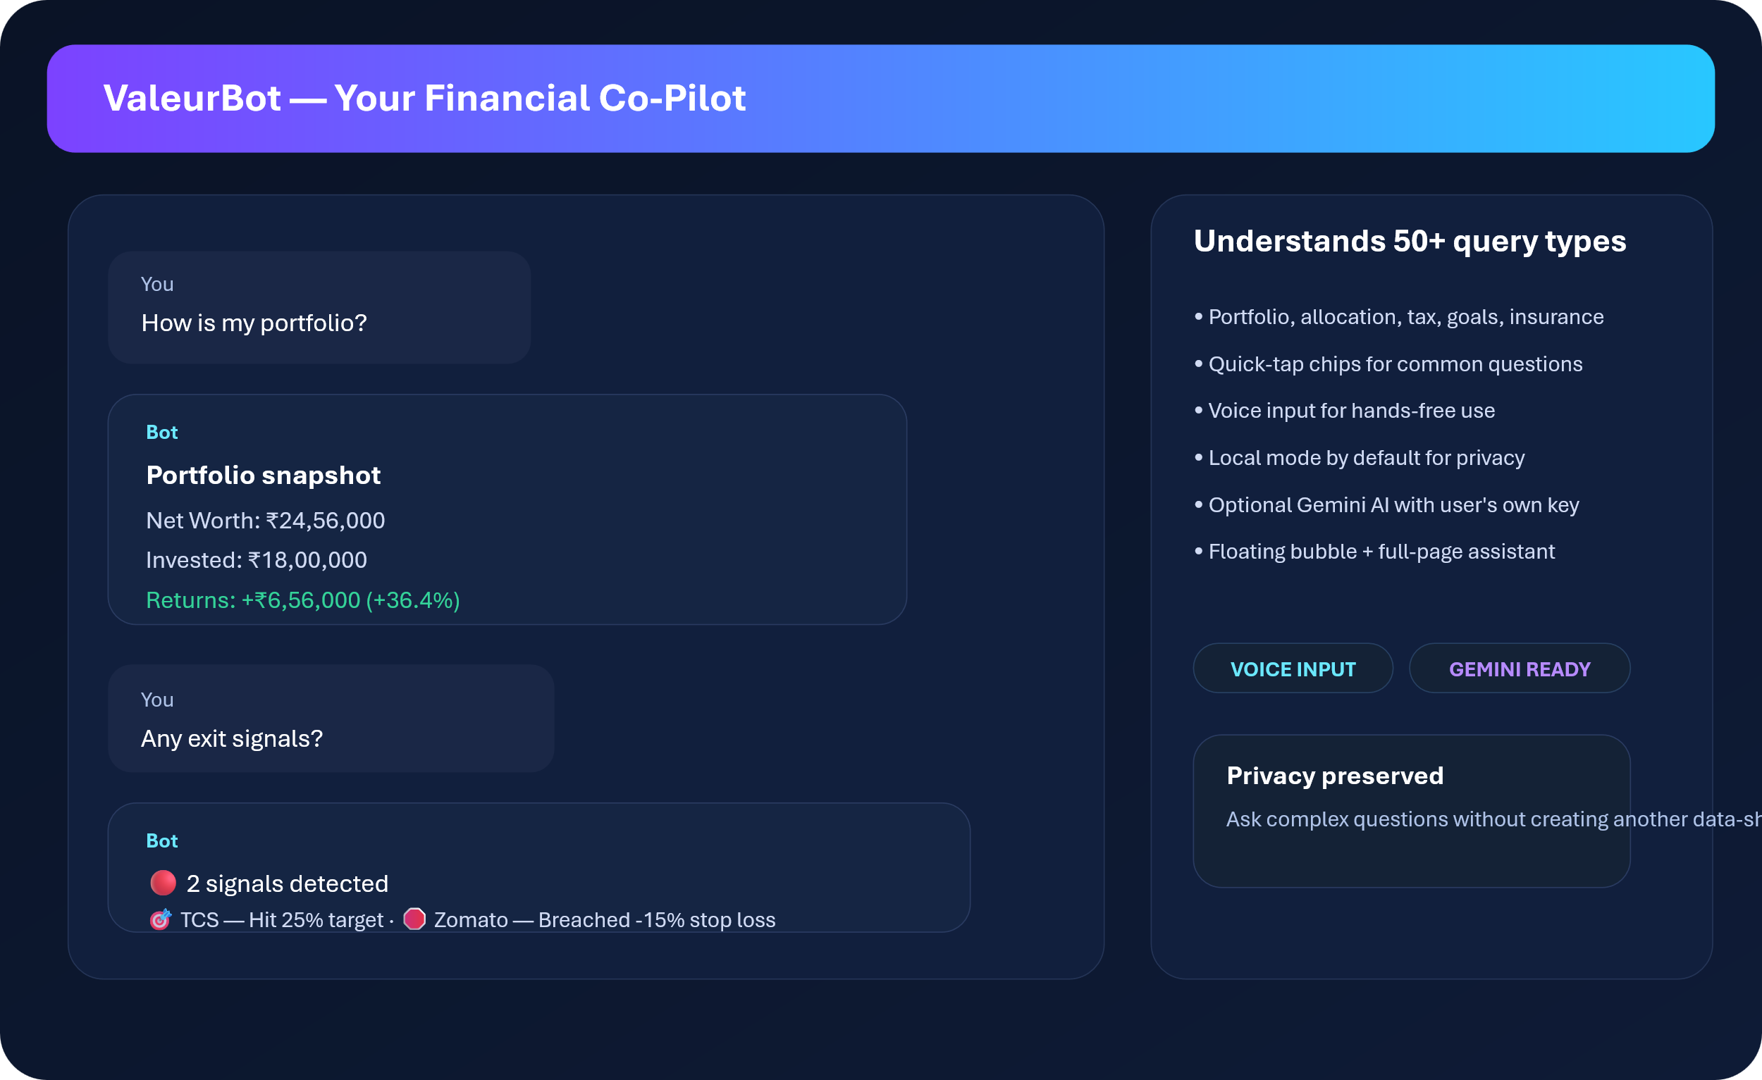
VALEURFIN
ValeurBot — your financial co-pilot
The assistant is designed to answer practical, portfolio-aware questions without forcing users into another app.
Portfolio Q&A
Tax + exit cues
Goals + insurance
Voice input
Local by default
Optional Gemini mode
08
Notes:
[Sources] - AI assistant mock visual created for this deck based on the product brief. - Product website AI settings and ValeurBot section: https://valeurfin-app.github.io/

Slide 9
VALEURFIN
Tax calculator + exit intelligence
A planning layer that helps users understand what happens before they sell.
Indicative tax logic
Exit signal engine
Asset
Short term
Long term
Listed equity / ELSS
20% STCG
12.5% LTCG · ₹1.25L exempt
Target hit
Return % ≥ your target
Gold / land
Slab / applicable rules
12.5% LTCG (indicative)
Stop loss
Return % ≤ your stop loss
FD / RD
Slab rate
Slab rate
Matured
FD / RD maturity passed
PPF
Exempt
Exempt
52W low
Within 5% of 52-week low
Crypto / VDA
30% flat
30% flat
Overweight
Single holding > 30% of portfolio
ValeurFin auto-classifies holdings by duration and shows an estimated tax lens inside the app.
Deep loss
Down > 20%
09
Notes:
[Sources] - User-provided tax and exit-signal brief. - India capital gains changes: PIB press release on Budget 2024 changes including 20% STCG and 12.5% LTCG with ₹1.25 lakh exemption for listed equity/equity-oriented assets. - Crypto/VDA flat 30% tax is consistent with widely reported 2025 guidance and summaries. - This slide should be presented as indicative product logic, not tax advice.

Slide 10
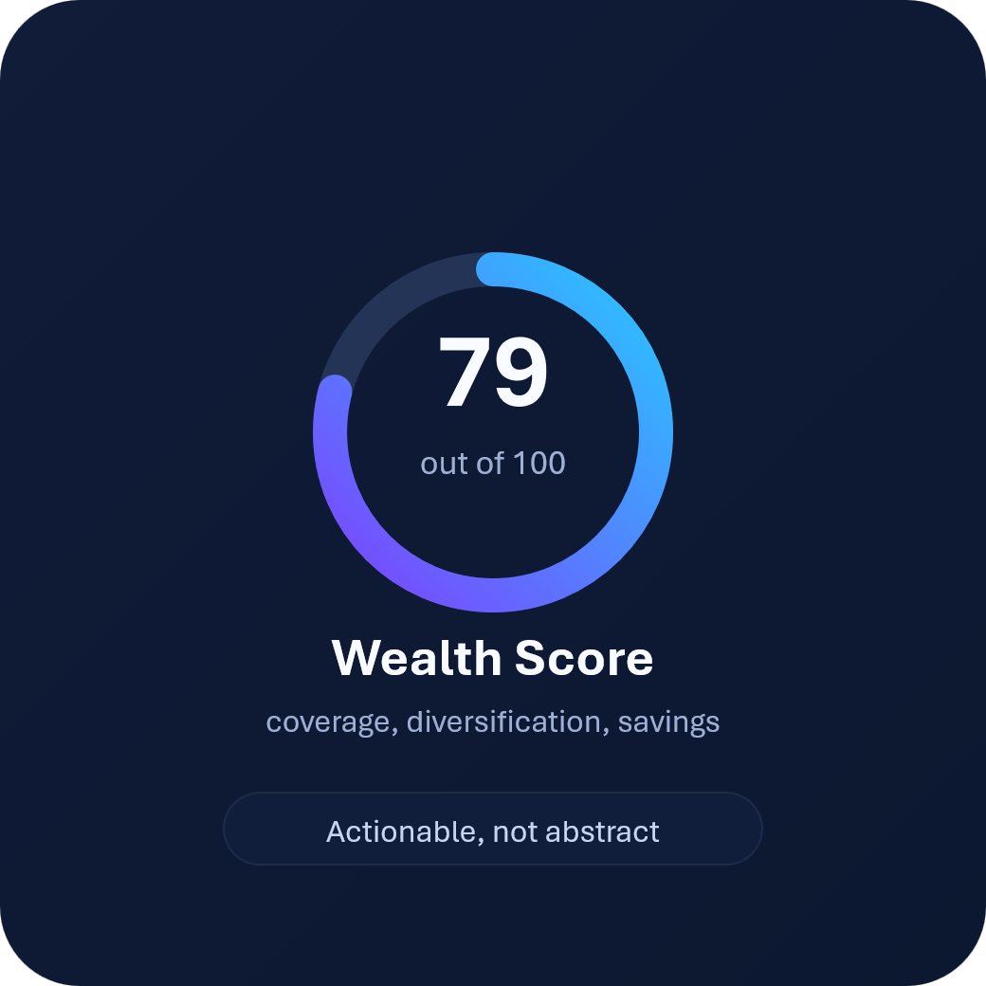

VALEURFIN
Know your financial health instantly
Scoring converts scattered accounts into a clear improvement agenda.
Wealth score inputs
• Emergency fund
• Savings rate
• Diversification
• Returns performance
• Goal progress
• Insurance factor
Insurance score weights
• Term life
• Health
• Accident
• Critical illness
• Vehicle / home
• Travel / child / others
Grades: Excellent 85+ · Good 70+ · Fair 50+ · Needs work <50
10
Notes:
[Sources] - User-provided product brief. - Score visuals created for this deck; the parameters shown are based on the user-provided scoring model.

Slide 11

VALEURFIN
Your data never leaves your device
This is not “privacy policy as fine print” — it is the core product architecture.
Zero server communication
No signup, no email, no phone number required.
No analytics or tracking
Cookies are used only as a storage failsafe, not as a behavioral tracker.
PIN lock + recovery
4-digit PIN, cooldown and security question flows are built into the app.
Quad-backup storage
IndexedDB + localStorage + sessionStorage + cookie fallback.
Export / import + wipe
Manual backup, restore and full wipe with confirmation.
Installable PWA
Works offline after first load and behaves like a native app shell.
11
Notes:
[Sources] - Product website privacy policy and security section: https://valeurfin-app.github.io/ - User-provided product brief.

Slide 12
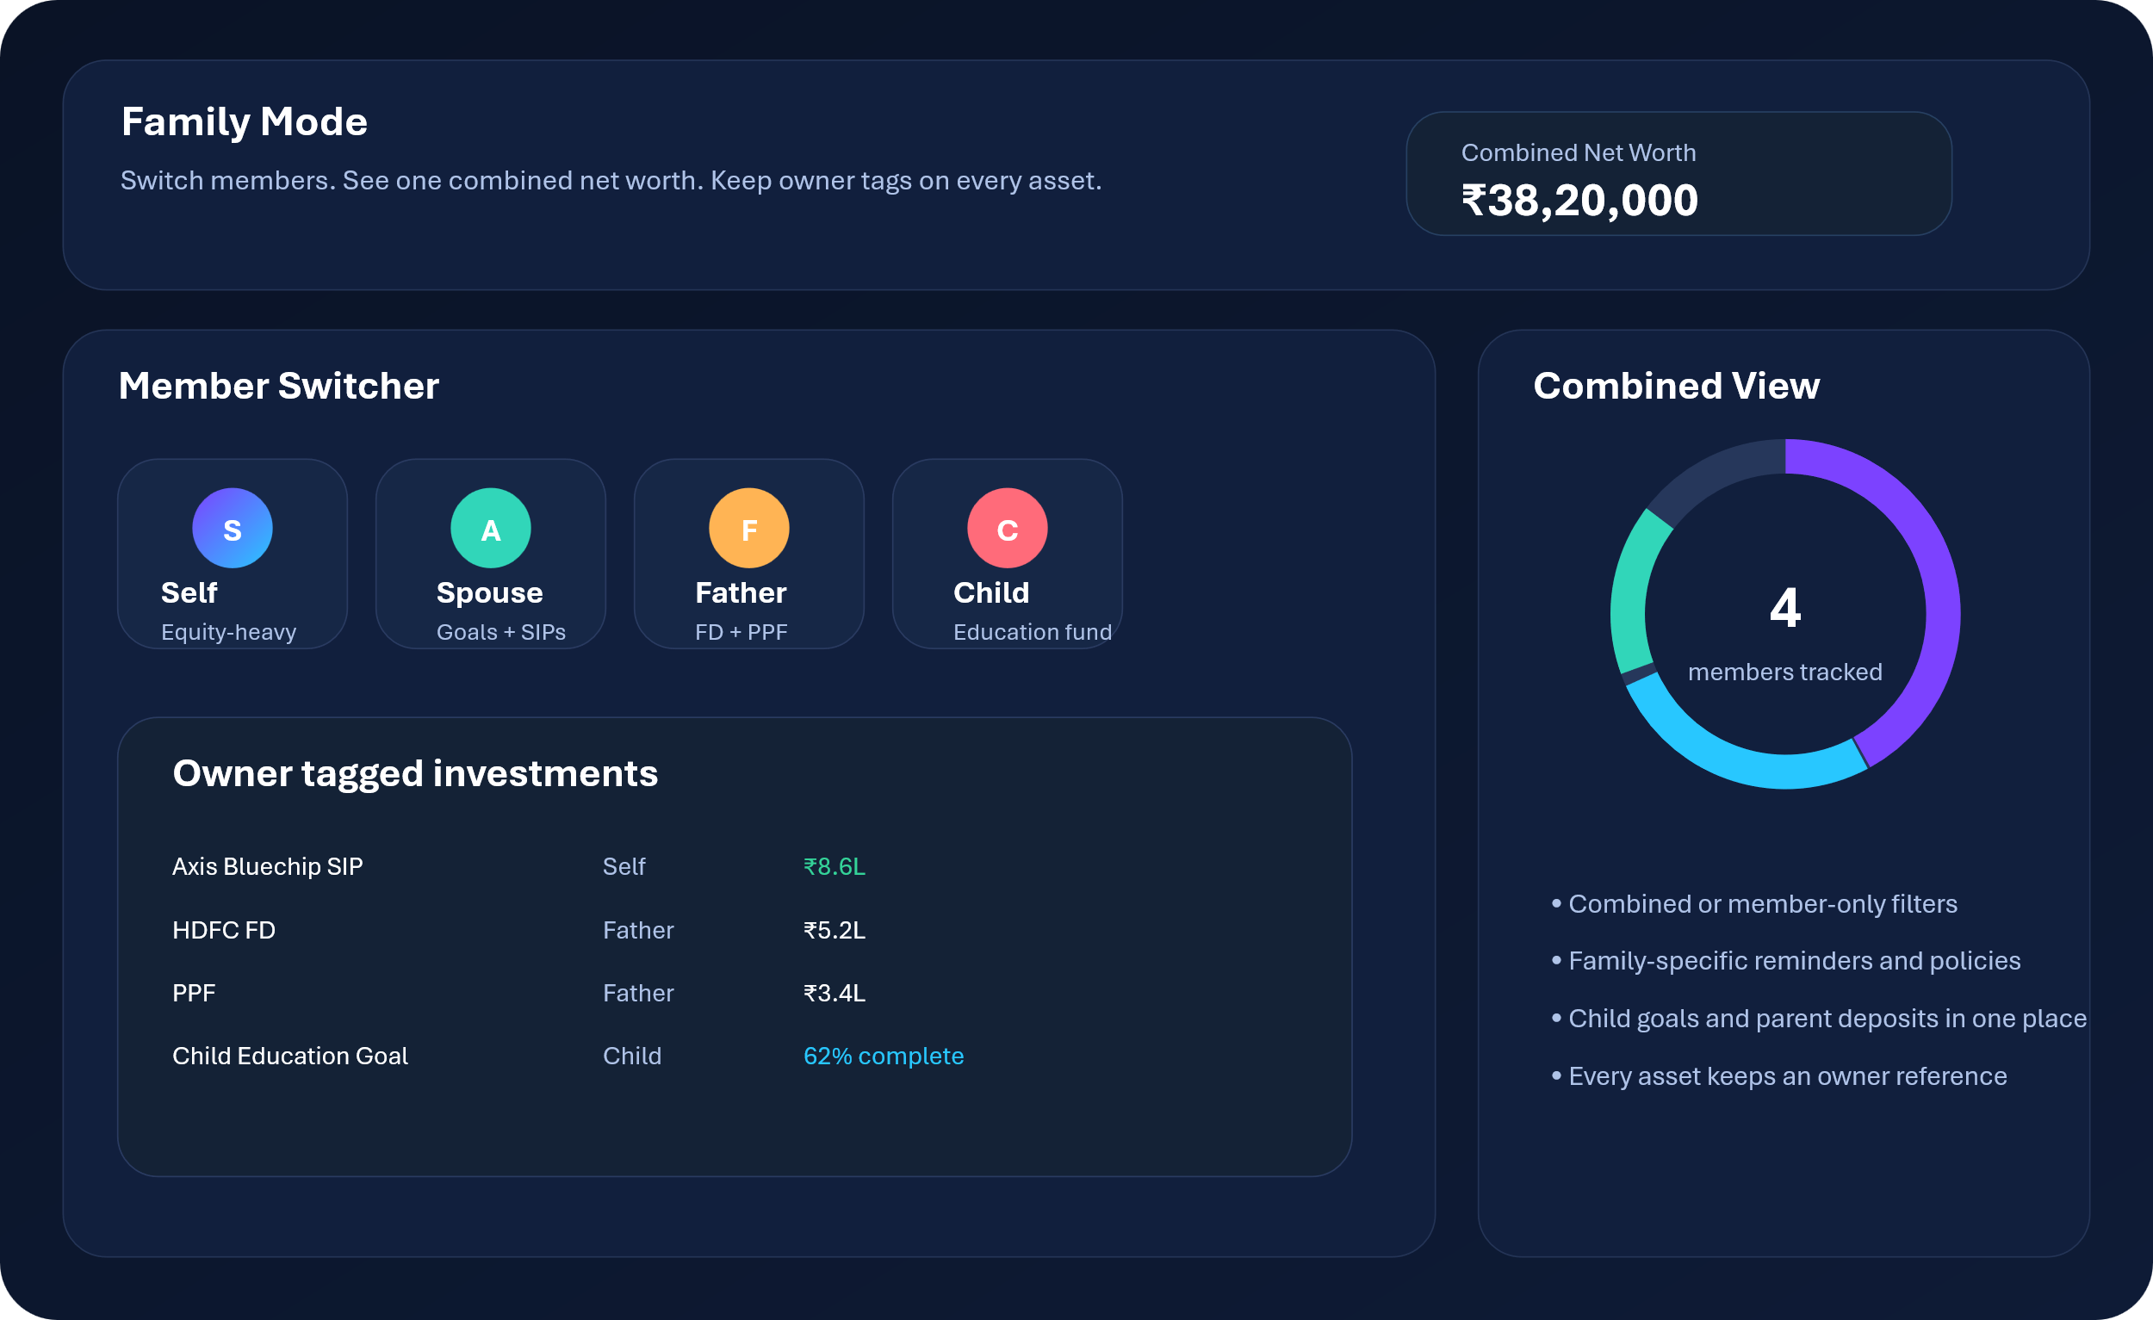
VALEURFIN
Family finances. One dashboard.
ValeurFin expands from solo investing into a household operating system for savings, protection and goals.
Core family mode value
• Switch members from one selector
• Combined or individual net-worth views
• Every investment tagged to an owner
• Useful for spouse, parents and child goals
Beyond investing
• Expense tracking
• Income management
• Payment reminders
• Financial goals
• Dividend tracker
• What-if engine
• Transaction log
• Dark / light theme
12
Notes:
[Sources] - User-provided product brief. - Product website family, reminders, goals, dividends, what-if, transaction log and settings sections: https://valeurfin-app.github.io/

Slide 13
VALEURFIN
Built different
The architecture is intentionally simple: client-only state, redundant local storage and read-only market APIs.
BROWSER (PWA)
Why this matters
index.html
mobile.html
sw.js
• Single HTML app per platform
UI shell
UI shell
offline cache
• No heavy framework dependency
SINGLE STATE OBJECT (S)
• Runs on file://, localhost and https://
investments · expenses · income · insurance · goals · dividends · reminders · snapshots · family
• External APIs are read-only
READ-ONLY EXTERNAL APIS
• Yahoo Finance
• User data stays client-side
• MFAPI.in
• TradingView
• Gemini AI (optional)
IndexedDB
localStorage
Cookie / Session
primary
backup
failsafe
13
Notes:
[Sources] - User-provided product brief and architecture notes. - Product website privacy policy for third-party read-only services: https://valeurfin-app.github.io/

Slide 14
VALEURFIN
Why ValeurFin wins
The clearest wedge is not just tracking breadth — it is private, offline control plus decision support.
Feature
ValeurFin
Groww
INDmoney
Excel
Privacy (no server)
YES
NO
NO
YES
12 asset types
YES
NO
PARTIAL
YES
Live NSE prices
YES
YES
YES
NO
AI assistant
YES
NO
NO
NO
Tax calculator
YES
NO
PARTIAL
NO
Exit signals
YES
NO
NO
NO
Insurance scoring
YES
NO
NO
NO
Family mode
YES
NO
NO
PARTIAL
Works offline
YES
NO
NO
YES
No signup required
YES
NO
NO
YES
POSITIONING TO VALIDATE PRE-LAUNCH
14
Notes:
[Sources] - Comparison matrix based on the user-provided positioning brief. - For external distribution, validate competitor feature states against current public product surfaces before presenting.

Slide 15

Master Your Financial Story
Ready to bring private, offline-first wealth operating software to Indian investors?
valeurfin-app.github.io/
valeurfin.masteryourfinances@gmail.com
Siddharth Tiwari — Founder
Scan to open the app
YOUR MONEY · YOUR DEVICE · YOUR STORY
© 2026 ValeurFin Technologies · Built with care in India
15
Notes:
[Sources] - User-provided contact details, product brief and logo. - Product website URL: https://valeurfin-app.github.io/

