Slide 1
Height ‘O Meter
World class height measurements for the Swedish people.

Slide 2
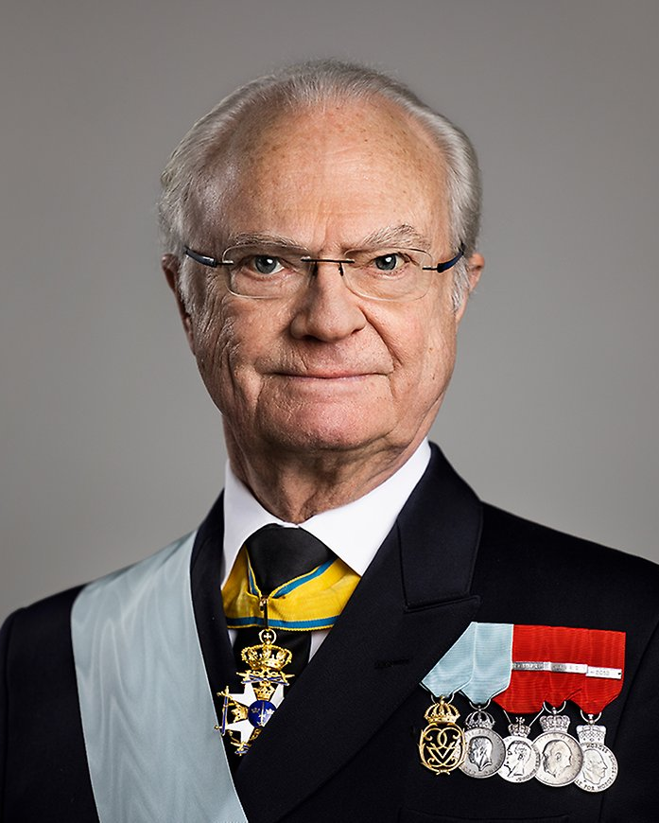

The client: VertiScan AI
CEO: Magnus Höjd
Founded in 2023 by Magnus Höjd, VertiScan AI is a Swedish tech gem hailing from the innovation hub of Stockholm. With a playful nod to their heritage, the name Höjd translates to "height," reflecting the company's focus on cutting-edge AI solutions for vertical measurements.
Under the leadership of CEO Magnus Höjd, VertiScan AI has quickly risen to new heights, offering state-of-the-art tools for industries like construction, real estate, and forestry. Their flagship product, the VertiScan AI Platform, combines advanced AI algorithms with Swedish precision to deliver unmatched accuracy and user-friendliness.

Slide 3

Mission Statement
Helping Swedes measure heights.

Slide 4

Problem
In Sweden, people do not want to measure using traditional boring methods, thus ball dropping is the only solution.

Slide 5

Dropping methods

Slide 6

The Solution
Harnessing the revolutionary power of next gen state-of-the-art BIG AI we can tell you the height of the drop using the Height-O-Meter extension to the VertiScan AI Platform

Slide 7

Milestones
Understand the problem
Create a dataset
Pick a Model
Train using Fortuna Algorithm
Create BIG AI powered app
Live demo and presentation

Slide 8

R&D Flow: Limitations
Heights in [10cm, 250cm]
Simple Web App w/Flask or similar
Model must be trained/fitted using Fortuna Algorithm
Must use in-house algorithms.
No scikit-learn or similar
Target audience: Gjennomsnittliga Jonas that likes to measure heights

Slide 9




R&D Flow: “Must Have’s”
Requirements each projects must have.
Short user manual
Expected performance
Working web-app
Short pitch (using Fremtiden Consulting slide template)

