Slide 1
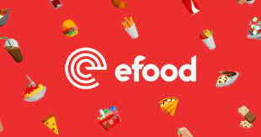
VALIA TSIAKKA
Customer Segmentation & Insights

Slide 2
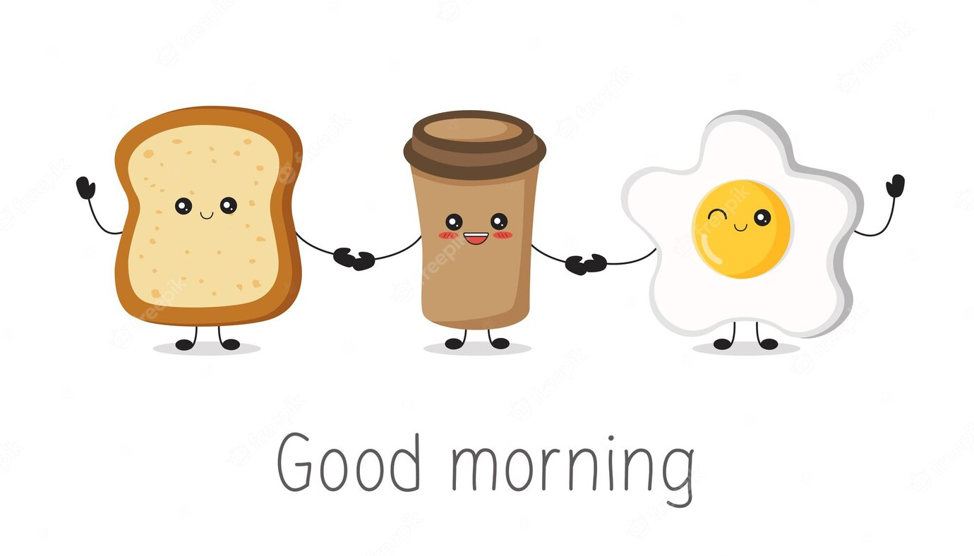

Exploratory Data Analysis
Python & SQL
Data Frame: Cities > 1000 orders
Fix the date format
Extensive Group-by Operations :city, orders, user id
Metrics

Slide 3
RFM Analysis
RFM (Recency, Frequency, Monetary) analysis is a powerful technique used to segment customers based on their transaction history.
Recency: How recently a customer has purchased
Frequency: How often they purchase
Monetary: How much the customer spends
Create Scores RFM scores based on quantiles of distribution
Date from customer's last purchase: The nearest date gets 4 and the furthest date gets 1.
Total number of purchases: The least frequency gets 1 and the maximum frequency gets 4.
Total spend by the customer: The least money gets 1, the most money gets 4.
SUM of total RFM Score
Segments Creation
Based on RFM Analysis, users were split into 12 segments.
For example:
VIP: Customers with RFM scores in the range of 344.
Top Recent: Customers with RFM scores in the range of 234 or 244.
Top at Risk: Customers with RFM scores in the range of 114, 124, 134, or 144.

Slide 4
Exploring Breakfast Order Dominance: Unveiling the Top 5 Cities
ΒΟΛΟΣ
Βόλος is leading in terms of total orders, but it has the second lowest basket size.
ΛΑΡΙΣΑ
Λάρισα has the lowest breakfast order volume, 25%.
ΞΑΝΘΗ
Even though Ξάνθης Breakfast basket represents a significant proportion of the total e-food basket (approximately 67%), it has relatively low order numbers and basket size.

Slide 5
Exploring Breakfast Order Dominance: Unveiling the Top 5 Cities
ΡΟΔΟΣ
Ρόδος has the largest breakfast basket, indicating that it has the highest average order value and the highest percentage of users who have ordered breakfast more than three times.
It accounts for 60% of the total e-basket, showing significant participation.
The frequency of ordering is 3.7, which is remarkably high.
Breakfast orders on Ρόδος are 22% more expensive compared to Βόλος, which has the highest number of orders.

Slide 6
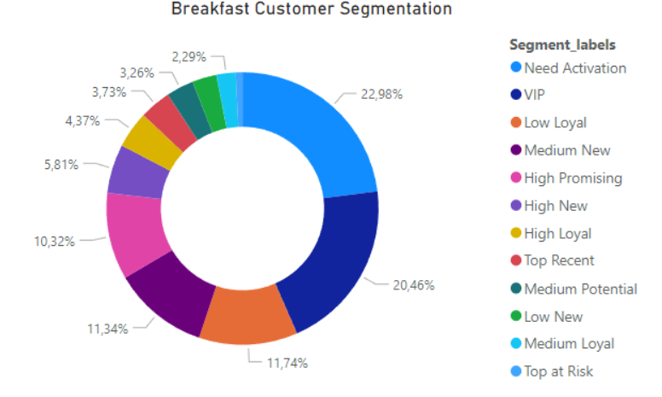
Customer Segmentation

Slide 7
DISCUSSION
Question:
Ordering Breakfast via efood is a quite new habit that Marketing thinks could create more loyal customers. Which segment could be a valuable target group for a Marketing campaign about “Breakfast” cuisine_parent?
The segment that could be a valuable target group is the Need Activation Customers . These segment contributes 2.64% of the total monetary%, surpassing the combined contribution of the Medium New Customers and Low Loyal Customers, which account for 1,568 of the total monetary%. Additionally the mean frequency of the Need Activation Customers is 1.40, indicating higher engagement compared to the other two segments.
Email campaigns
Reward marketing promotion strategy
Coupons or some extra credits

Slide 8
THANK YOU!!!

