Slide 1

AL FAREEDHA
SUPER MARKET
User Id:
Password:
Terminal:
Sign in
Exit

Slide 2
Menu
User:
Date:
AL FAREEDHA
SUPER MARKET
Terminal:
F1 - Estimate
F4 - Download
F2 - Invoice
F5 - Upload
F3 - Cash
F6 - Settings
Esc - Sign Out

Slide 3
Estimate Entry
User:
Date:
AL FAREEDHA
SUPER MARKET
Terminal:
Estimate No.
Barcode:
Item Name:
Line Items:
Barcode | Item Name | Unit | Qty | MRP | Disc. | Price | Tax | Net
Total Qty:
Total Price:
Tax:
Net Price:
↑
7
8
9
↓
5
6
↓
4
→
1
2
3
←
0
ENTER
F1
Help
F2
Del Item
F3
Lookup Item
F4
Change Qty
F5
Change Price
F6
Get Weight
PgUp
PgDn
.
CLR
F7
New Estimate
F8
Del Estimate
F10
List Estimates
F12
Print Estimate
Esc-Exit

Slide 4
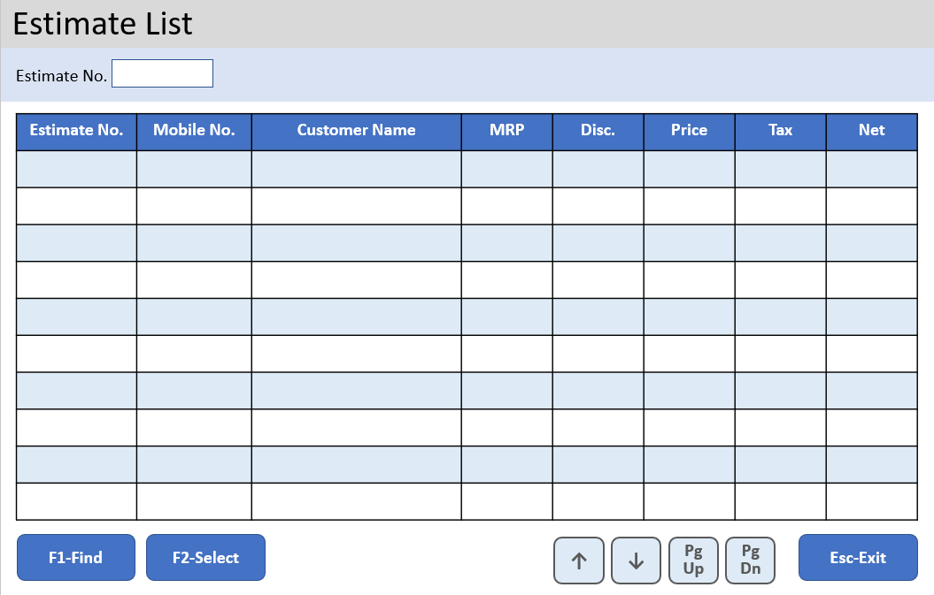
Estimate Entry
User:
Date:
AL FAREEDHA
SUPER MARKET
Terminal:
Estimate No.
Barcode:
Item Name:
Line Items:
Barcode | Item Name | Unit | Qty | MRP | Disc. | Price | Tax | Net
Total Qty:
Total Price:
Tax:
Net Price:
↑
7
8
9
↓
5
6
↓
4
→
1
2
3
←
0
ENTER
F1
Help
F2
Del Item
F3
Lookup Item
F4
Change Qty
F5
Change Price
F6
Get Weight
PgUp
PgDn
.
CLR
F7
New Estimate
F8
Del Estimate
F10
List Estimates
F12
Print Estimate
Esc-Exit

Slide 5
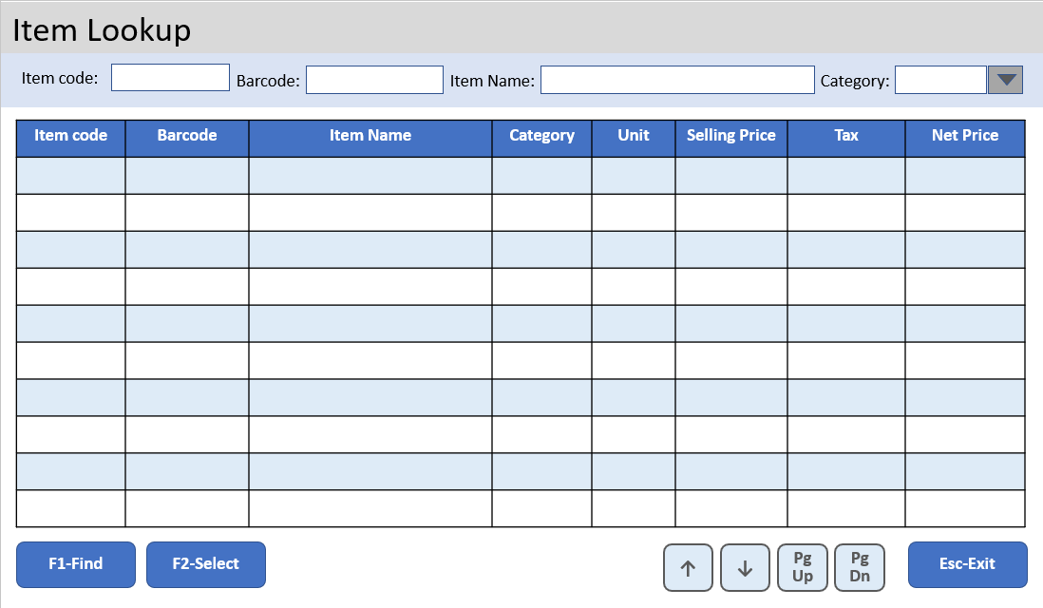
Estimate Entry
User:
Date:
AL FAREEDHA
SUPER MARKET
Terminal:
Estimate No.
Barcode:
Item Name:
Line Items:
Barcode | Item Name | Unit | Qty | MRP | Disc. | Price | Tax | Net
Total Qty:
Total Price:
Tax:
Net Price:
↑
7
8
9
↓
5
6
↓
4
→
1
2
3
←
0
ENTER
F1
Help
F2
Del Item
F3
Lookup Item
F4
Change Qty
F5
Change Price
F6
Get Weight
PgUp
PgDn
.
CLR
F7
New Estimate
F8
Del Estimate
F10
List Estimates
F12
Print Estimate
Esc-Exit

Slide 6
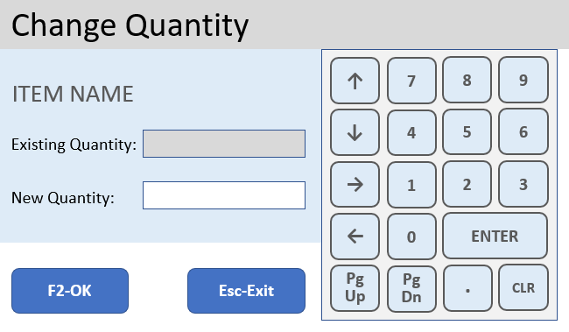
Estimate Entry
User:
Date:
AL FAREEDHA
SUPER MARKET
Terminal:
Estimate No.
Barcode:
Item Name:
Line Items:
Barcode | Item Name | Unit | Qty | MRP | Disc. | Price | Tax | Net
Total Qty:
Total Price:
Tax:
Net Price:
↑
7
8
9
↓
5
6
↓
4
→
1
2
3
←
0
ENTER
F1
Help
F2
Del Item
F3
Lookup Item
F4
Change Qty
F5
Change Price
F6
Get Weight
PgUp
PgDn
.
CLR
F7
New Estimate
F8
Del Estimate
F10
List Estimates
F12
Print Estimate
Esc-Exit

Slide 7
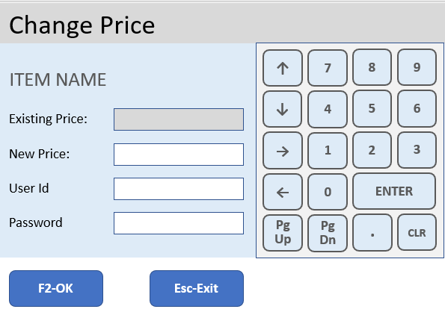
Estimate Entry
User:
Date:
AL FAREEDHA
SUPER MARKET
Terminal:
Estimate No.
Barcode:
Item Name:
Line Items:
Barcode | Item Name | Unit | Qty | MRP | Disc. | Price | Tax | Net
Total Qty:
Total Price:
Tax:
Net Price:
↑
7
8
9
↓
5
6
↓
4
→
1
2
3
←
0
ENTER
F1
Help
F2
Del Item
F3
Lookup Item
F4
Change Qty
F5
Change Price
F6
Get Weight
PgUp
PgDn
.
CLR
F7
New Estimate
F8
Del Estimate
F10
List Estimates
F12
Print Estimate
Esc-Exit

Slide 8
Invoice Entry
User:
Date:
AL FAREEDHA
SUPER MARKET
Terminal:
Invoice No.
Mobile No.
0000000000
Customer:
Walk In Customer
UNPAID
Barcode:
Item code:
Item Name:
Line Items:
Barcode | Item Name | Unit | Qty | MRP | Disc. | Price | Tax | Net
Total Qty:
Total Price:
Tax:
Net Price:
Discount:
Invoice Amt:
Paid Amt:
↑
7
8
9
↓
4
5
6
→
1
2
3
←
.
ENTER
F1
Help
F2
Del Item
F3
Lookup Item
F4
Change Qty
F5
Change Price
F6
Get Weight
+
-
DEL
CLR
F7
New Invoice
F8
Del Invoice
F9
Lookup Cust
F10
List Invoices
F11
Print Invoice
F12
Payment
Esc-Exit

Slide 9
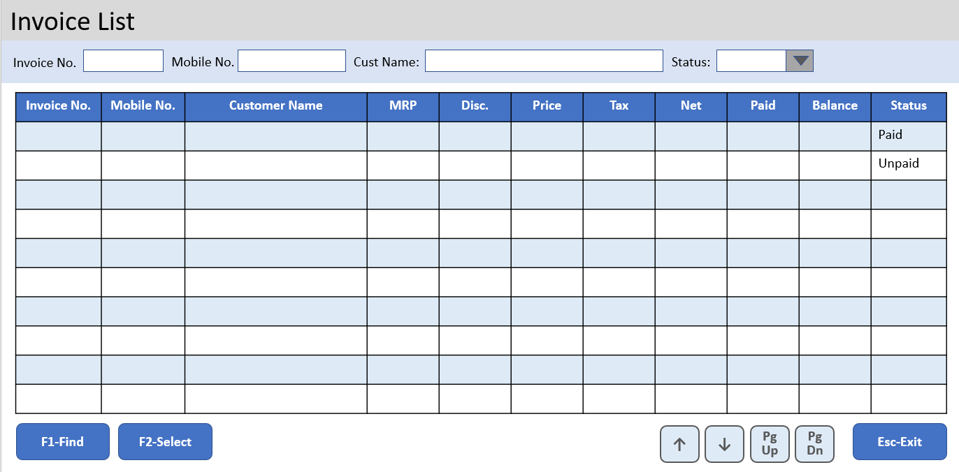
Invoice Entry
User:
Date:
AL FAREEDHA
SUPER MARKET
Terminal:
Invoice No.
Mobile No.
0000000000
Customer:
Walk In Customer
UNPAID
Barcode:
Item code:
Item Name:
Line Items:
Barcode | Item Name | Unit | Qty | MRP | Disc. | Price | Tax | Net
Total Qty:
Total Price:
Tax:
Net Price:
Discount:
Invoice Amt:
Paid Amt:
↑
7
8
9
↓
4
5
6
→
1
2
3
←
.
ENTER
F1
Help
F2
Del Item
F3
Lookup Item
F4
Change Qty
F5
Change Price
F6
Get Weight
+
-
DEL
CLR
F7
New Invoice
F8
Del Invoice
F9
Lookup Cust
F10
List Invoices
F11
Print Invoice
F12
Payment
Esc-Exit

Slide 10
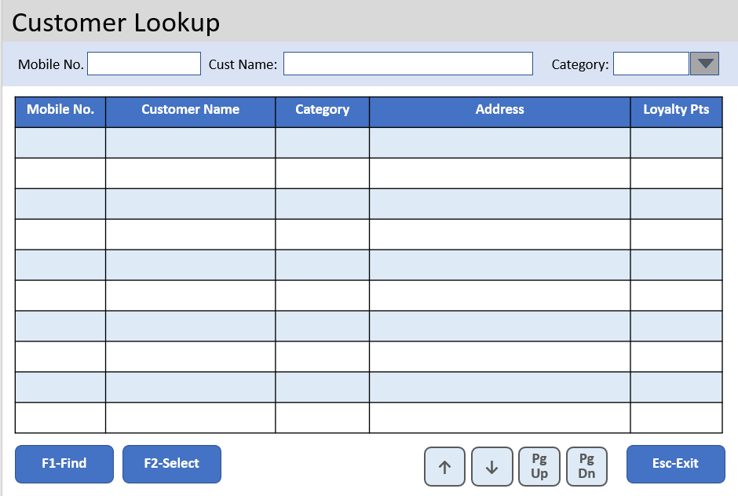
Invoice Entry
User:
Date:
AL FAREEDHA
SUPER MARKET
Terminal:
Invoice No.
Mobile No.
0000000000
Customer:
Walk In Customer
UNPAID
Barcode:
Item code:
Item Name:
Line Items:
Barcode | Item Name | Unit | Qty | MRP | Disc. | Price | Tax | Net
Total Qty:
Total Price:
Tax:
Net Price:
Discount:
Invoice Amt:
Paid Amt:
↑
7
8
9
↓
4
5
6
→
1
2
3
←
.
ENTER
F1
Help
F2
Del Item
F3
Lookup Item
F4
Change Qty
F5
Change Price
F6
Get Weight
+
-
DEL
CLR
F7
New Invoice
F8
Del Invoice
F9
Lookup Cust
F10
List Invoices
F11
Print Invoice
F12
Payment
Esc-Exit

Slide 11
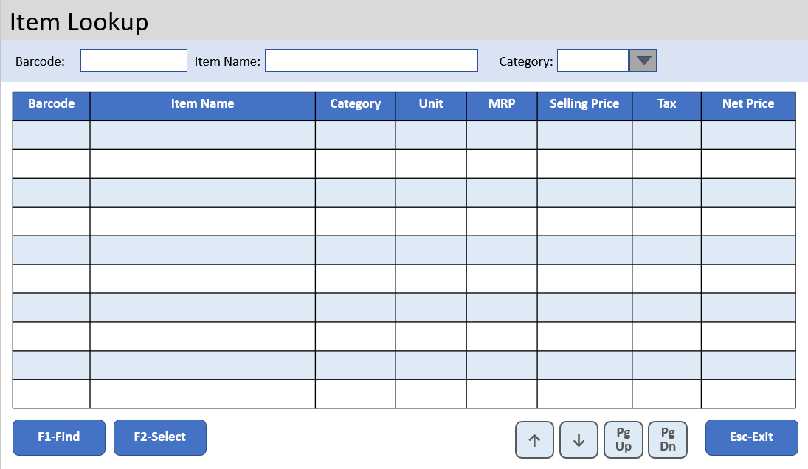
Invoice Entry
User:
Date:
AL FAREEDHA
SUPER MARKET
Terminal:
Invoice No.
Mobile No.
0000000000
Customer:
Walk In Customer
UNPAID
Barcode:
Item code:
Item Name:
Line Items:
Barcode | Item Name | Unit | Qty | MRP | Disc. | Price | Tax | Net
Total Qty:
Total Price:
Tax:
Net Price:
Discount:
Invoice Amt:
Paid Amt:
↑
7
8
9
↓
4
5
6
→
1
2
3
←
.
ENTER
F1
Help
F2
Del Item
F3
Lookup Item
F4
Change Qty
F5
Change Price
F6
Get Weight
+
-
DEL
CLR
F7
New Invoice
F8
Del Invoice
F9
Lookup Cust
F10
List Invoices
F11
Print Invoice
F12
Payment
Esc-Exit

Slide 12
Invoice Entry
User:
Date:
AL FAREEDHA
SUPER MARKET
Terminal:
Invoice No.
Mobile No.
0000000000
Customer:
Walk In Customer
UNPAID
Barcode:
Item code:
Item Name:
Line Items:
Barcode | Item Name | Unit | Qty | MRP | Disc. | Price | Tax | Net
Total Qty:
Total Price:
Tax:
Net Price:
Discount:
Invoice Amt:
Paid Amt:
↑
7
8
9
↓
4
5
6
→
1
2
3
←
.
ENTER
F1
Help
F2
Del Item
F3
Lookup Item
F4
Change Qty
F5
Change Price
F6
Get Weight
+
-
DEL
CLR
F7
New Invoice
F8
Del Invoice
F9
Lookup Cust
F10
List Invoices
F11
Print Invoice
F12
Payment
Esc-Exit

Slide 13
Invoice Entry
User:
Date:
AL FAREEDHA
SUPER MARKET
Terminal:
Invoice No.
Mobile No.
0000000000
Customer:
Walk In Customer
UNPAID
Barcode:
Item Name:
Line Items:
Barcode | Item Name | Unit | Qty | MRP | Disc. | Price | Tax | Net
Total Qty:
Total Amt:
Tax:
Net Amt:
Discount:
Invoice Amt:
Paid Amt:
↑
7
8
9
↓
4
5
6
→
1
2
3
←
.
ENTER
F1
Help
F2
Del Item
F3
Lookup Item
F4
Change Qty
F5
Change Price
F6
Get Weight
+
-
DEL
CLR
F7
New Invoice
F8
Del Invoice
F9
Lookup Cust
F10
List Invoices
F11
Print Invoice
F12
Payment
Esc-Exit

Slide 14
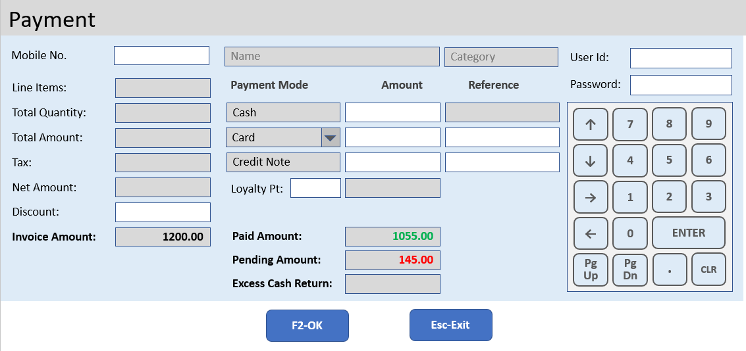
Invoice Entry
User:
Date:
AL FAREEDHA
SUPER MARKET
Terminal:
Invoice No.
Mobile No.
0000000000
Customer:
Walk In Customer
UNPAID
Barcode:
Item code:
Item Name:
Line Items:
Barcode | Item Name | Unit | Qty | MRP | Disc. | Price | Tax | Net
Total Qty:
Total Price:
Tax:
Net Price:
Discount:
Invoice Amt:
Paid Amt:
↑
7
8
9
↓
4
5
6
→
1
2
3
←
.
ENTER
F1
Help
F2
Del Item
F3
Lookup Item
F4
Change Qty
F5
Change Price
F6
Get Weight
+
-
DEL
CLR
F7
New Invoice
F8
Del Invoice
F9
Lookup Cust
F10
List Invoices
F11
Print Invoice
F12
Payment
Esc-Exit

Slide 15
ERPNext
alignPOS
Sale Invoice
Payment Entry
Delivery Note
alignPOS
ERP
Interface
GET Login
alignPOS
client
GET Customer
Customer
CUSTOM EXTENSION
Hook
Process
GET Item
Item
GET Item Tax
Item Tax
MariaDB
10.2.37
GET Item Stock
Item Stock
POST Pos Invoice
Pos
Invoice
Authentication &
POS Data
alignPOS components
ERPNext components

Slide 16

ERPNext Custom Extensions
align-pos
Module Name | Alignpos Integration
Document Type | Pos Invoice
Child Document Types | Pos Invoice Item
 | Pos Invoice Payment
Report | Pos Daily Sales Report

Slide 17
Invoice List
Invoice No.
Mobile No.
Cust Name:
Status:
Invoice No. | Mobile No. | Customer Name | MRP | Disc. | Price | Tax | Net | Paid | Balance | Status
 |  |  |  |  |  |  |  |  |  | Paid
 |  |  |  |  |  |  |  |  |  | Unpaid
F1-Find
F2-Select
↑
↓
PgUp
PgDn
Esc-Exit

Slide 18
Estimate List
Estimate No.
Estimate No. | Mobile No. | Customer Name | MRP | Disc. | Price | Tax | Net
F1-Find
F2-Select
↑
↓
PgUp
PgDn
Esc-Exit

Slide 19
Customer Lookup
Mobile No.
Cust Name:
Category:
Mobile No. | Customer Name | Category | Address | Loyalty Pts
F1-Find
F2-Select
↑
↓
PgUp
PgDn
Esc-Exit

Slide 20
Item Lookup
Item code:
Barcode:
Item Name:
Category:
Item code | Barcode | Item Name | Category | Unit | Selling Price | Tax | Net Price
F1-Find
F2-Select
↑
↓
PgUp
PgDn
Esc-Exit

Slide 21
Payment
Mobile No.
Name
Category
User Id:
Line Items:
Payment Mode
Amount
Reference
Password:
Total Quantity:
Cash
↑
7
8
9
Total Amount:
Card
↓
5
6
Tax:
Credit Note
↓
4
Net Amount:
Loyalty Pt:
→
1
2
3
Discount:
Invoice Amount:
Paid Amount:
←
0
ENTER
1200.00
1055.00
Pending Amount:
145.00
PgUp
PgDn
.
CLR
Excess Cash Return:
F2-OK
Esc-Exit

Slide 22
Change Quantity
↑
7
8
9
ITEM NAME
↓
5
6
↓
4
Existing Quantity:
→
1
2
3
New Quantity:
←
0
ENTER
F2-OK
Esc-Exit
PgUp
PgDn
.
CLR

Slide 23
Change Price
↑
7
8
9
ITEM NAME
↓
5
6
↓
4
Existing Price:
New Price:
→
1
2
3
User Id
←
0
ENTER
Password
PgUp
PgDn
.
CLR
F2-OK
Esc-Exit

Slide 24
Change Price
↑
7
8
9
ITEM NAME
↓
5
6
↓
4
Existing Price:
New Price:
→
1
2
3
Password
←
0
ENTER
Token
PgUp
PgDn
.
CLR
F2-OK
Esc-Exit

Slide 25
Change Price
ITEM NAME
↑
7
8
9
DISCOUNT
PRICE
↓
5
6
↓
4
Existing:
→
1
2
3
New:
←
0
ENTER
Password
Token
PgUp
PgDn
.
CLR
F2-OK
Esc-Exit

