Slide 1

AL FAREEDHA
SUPER MARKET
User Id:
Password:
Terminal:
Sign in
Exit

Slide 2
Menu
User:
Date:
AL FAREEDHA
SUPER MARKET
Terminal:
F1 - Estimate
F4 - Download
F2 - Invoice
F5 - Upload
F3 - Cash
F6 - Settings
Esc - Sign Out

Slide 3
Estimate Entry
User:
Date:
AL FAREEDHA
SUPER MARKET
Terminal:
Estimate No.
Barcode:
Item code:
Item Name:
Line Items:
Item Code | Barcode | Item Name | Unit | Qty | Standard Price | Applied Price | Tax | Net
Total Qty:
Total Price:
Tax:
Net Price:
↑
7
8
9
↓
5
6
↓
4
→
1
2
3
←
0
ENTER
F1
Help
F2
Del Item
F3
Find Item
F4
Change Qty
F5
Change Price
F6
Get Weight
PgUp
PgDn
.
CLR
F7
New Estimate
F8
Del Estimate
F9
Find Customer
F10
List Estimates
F11
Print Estimate
F12
Create Invoice
Esc-Exit

Slide 4
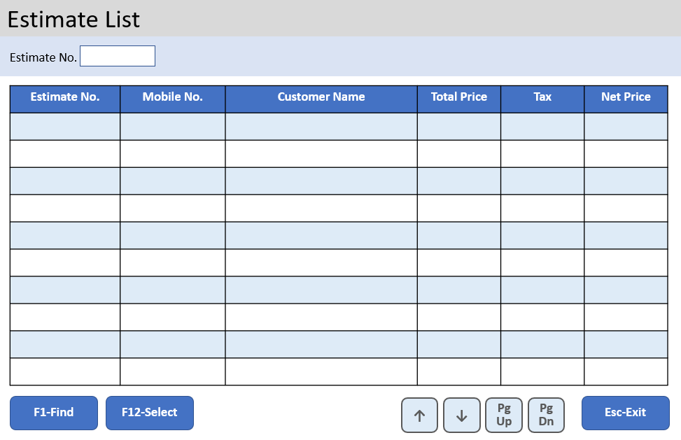
Estimate Entry
User:
Date:
AL FAREEDHA
SUPER MARKET
Terminal:
Estimate No.
Barcode:
Item code:
Item Name:
Line Items:
Item Code | Barcode | Item Name | Unit | Qty | Standard Price | Applied Price | Tax | Net
Total Qty:
Total Price:
Tax:
Net Price:
↑
7
8
9
↓
5
6
↓
4
→
1
2
3
←
0
ENTER
F1
Help
F2
Del Item
F3
Find Item
F4
Change Qty
F5
Change Price
F6
Get Weight
PgUp
PgDn
.
CLR
F7
New Estimate
F8
Del Estimate
F9
Find Customer
F10
List Estimates
F11
Print Estimate
F12
Create Invoice
Esc-Exit

Slide 5
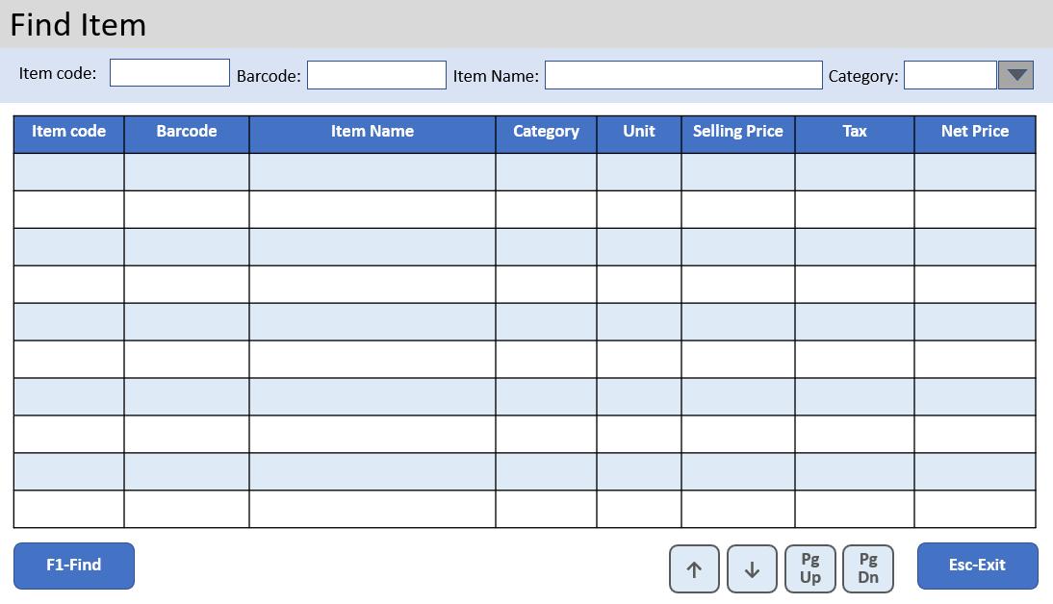
Estimate Entry
User:
Date:
AL FAREEDHA
SUPER MARKET
Terminal:
Estimate No.
Barcode:
Item Name:
Line Items:
Item Code | Barcode | Item Name | Unit | Qty | Standard Price | Applied Price | Tax | Net
Total Qty:
Total Price:
Tax:
Net Price:
↑
7
8
9
↓
5
6
↓
4
→
1
2
3
←
0
ENTER
F1
Help
F2
Del Item
F3
Find Item
F4
Change Qty
F5
Change Price
F6
Get Weight
PgUp
PgDn
.
CLR
F7
New Estimate
F8
Del Estimate
F9
Find Customer
F10
List Estimates
F11
Print Estimate
F12
Create Invoice
Esc-Exit

Slide 6
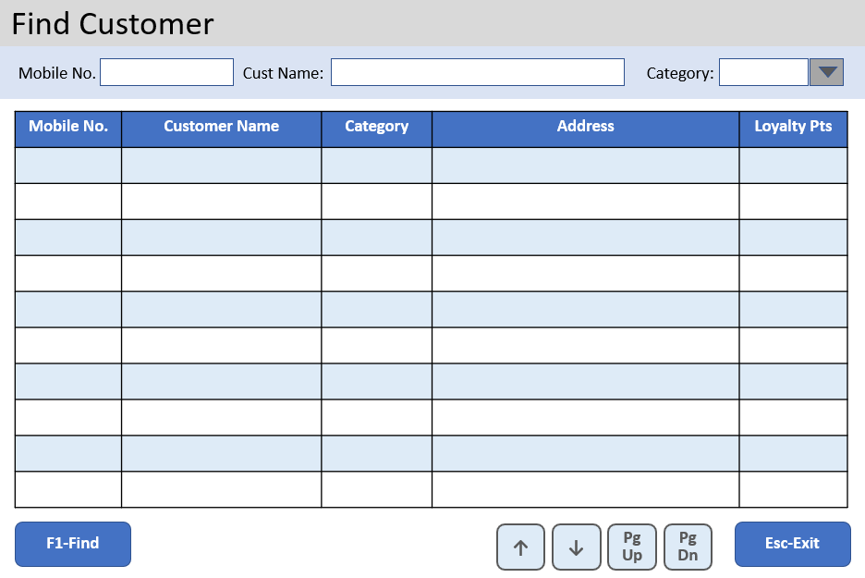
Estimate Entry
User:
Date:
AL FAREEDHA
SUPER MARKET
Terminal:
Estimate No.
Barcode:
Item Name:
Line Items:
Item Code | Barcode | Item Name | Unit | Qty | Standard Price | Applied Price | Tax | Net
Total Qty:
Total Price:
Tax:
Net Price:
↑
7
8
9
↓
5
6
↓
4
→
1
2
3
←
0
ENTER
F1
Help
F2
Del Item
F3
Find Item
F4
Change Qty
F5
Change Price
F6
Get Weight
PgUp
PgDn
.
CLR
F7
New Estimate
F8
Del Estimate
F9
Find Customer
F10
List Estimates
F11
Print Estimate
F12
Create Invoice
Esc-Exit

Slide 7
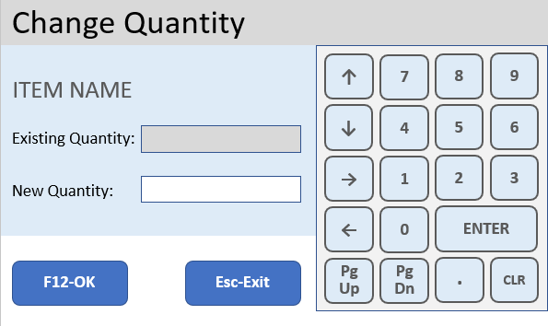
Estimate Entry
User:
Date:
AL FAREEDHA
SUPER MARKET
Terminal:
Estimate No.
Barcode:
Item Name:
Line Items:
Item Code | Barcode | Item Name | Unit | Qty | Standard Price | Applied Price | Tax | Net
Total Qty:
Total Price:
Tax:
Net Price:
↑
7
8
9
↓
5
6
↓
4
→
1
2
3
←
0
ENTER
F1
Help
F2
Del Item
F3
Find Item
F4
Change Qty
F5
Change Price
F6
Get Weight
PgUp
PgDn
.
CLR
F7
New Estimate
F8
Del Estimate
F9
Find Customer
F10
List Estimates
F11
Print Estimate
F12
Create Invoice
Esc-Exit

Slide 8
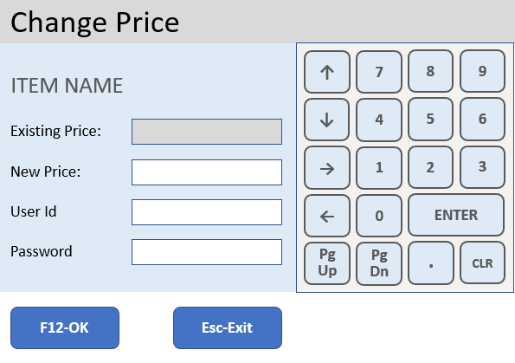
Estimate Entry
User:
Date:
AL FAREEDHA
SUPER MARKET
Terminal:
Estimate No.
Barcode:
Item Name:
Line Items:
Item Code | Barcode | Item Name | Unit | Qty | Standard Price | Applied Price | Tax | Net
Total Qty:
Total Price:
Tax:
Net Price:
↑
7
8
9
↓
5
6
↓
4
→
1
2
3
←
0
ENTER
F1
Help
F2
Del Item
F3
Find Item
F4
Change Qty
F5
Change Price
F6
Get Weight
PgUp
PgDn
.
CLR
F7
New Estimate
F8
Del Estimate
F9
Find Customer
F10
List Estimates
F11
Print Estimate
F12
Create Invoice
Esc-Exit

Slide 9
Invoice Entry
User:
Date:
AL FAREEDHA
SUPER MARKET
Terminal:
Invoice No.
Reference No.
Mobile No:
0000000000
UNPAID
Barcode:
Item code:
Item Name:
Line Items:
Item Code | Barcode | Item Name | Unit | Qty | Standard Price | Applied Price | Tax | Net
Total Qty:
Total Price:
Tax:
Net Price:
Discount:
Invoice Amt:
Paid Amt:
↑
7
8
9
↓
4
5
6
→
1
2
3
←
.
ENTER
F1
Help
F2
Del Item
F3
Find Item
F4
Change Qty
F5
Change Price
F6
Get Weight
+
-
DEL
CLR
F7
New Invoice
F8
Del Invoice
F9
Find Customer
F10
List Invoices
F11
Print Invoice
F12
Payment
Esc-Exit

Slide 10
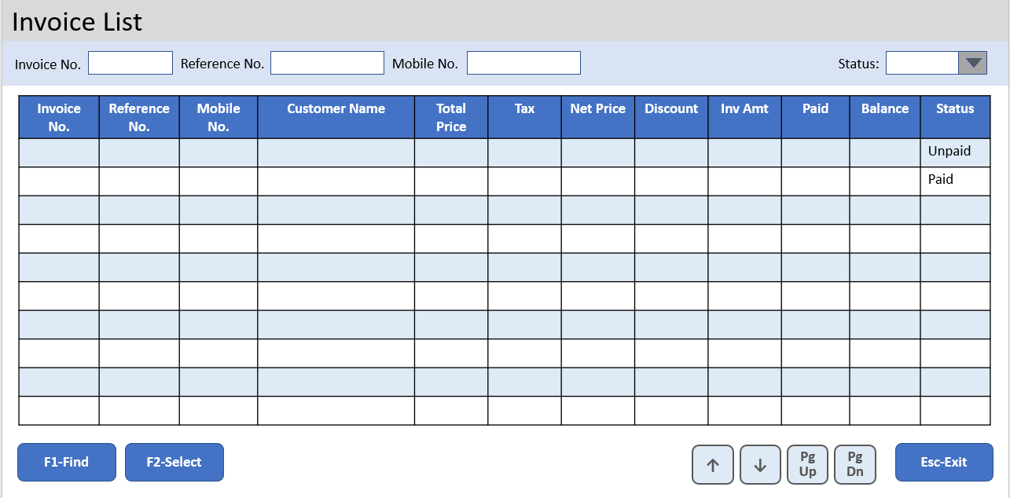
Invoice Entry
User:
Date:
AL FAREEDHA
SUPER MARKET
Terminal:
Invoice No.
Reference No.
Mobile No:
0000000000
UNPAID
Barcode:
Item code:
Item Name:
Line Items:
Item Code | Barcode | Item Name | Unit | Qty | Standard Price | Applied Price | Tax | Net
Total Qty:
Total Price:
Tax:
Net Price:
Discount:
Invoice Amt:
Paid Amt:
↑
7
8
9
↓
4
5
6
→
1
2
3
←
.
ENTER
F1
Help
F2
Del Item
F3
Find Item
F4
Change Qty
F5
Change Price
F6
Get Weight
+
-
DEL
CLR
F7
New Invoice
F8
Del Invoice
F9
Find Customer
F10
List Invoices
F11
Print Invoice
F12
Payment
Esc-Exit

Slide 11
Invoice Entry
User:
Date:
AL FAREEDHA
SUPER MARKET
Terminal:
Invoice No.
Reference No.
Mobile No:
0000000000
UNPAID
Barcode:
Item code:
Item Name:
Line Items:
Item Code | Barcode | Item Name | Unit | Qty | Standard Price | Applied Price | Tax | Net
Total Qty:
Total Price:
Tax:
Net Price:
Discount:
Invoice Amt:
Paid Amt:
↑
7
8
9
↓
4
5
6
→
1
2
3
←
.
ENTER
F1
Help
F2
Del Item
F3
Find Item
F4
Change Qty
F5
Change Price
F6
Get Weight
+
-
DEL
CLR
F7
New Invoice
F8
Del Invoice
F9
Find Customer
F10
List Invoices
F11
Print Invoice
F12
Payment
Esc-Exit

Slide 12
Invoice Entry
User:
Date:
AL FAREEDHA
SUPER MARKET
Terminal:
Invoice No.
Reference No.
Mobile No:
0000000000
UNPAID
Barcode:
Item code:
Item Name:
Line Items:
Item Code | Barcode | Item Name | Unit | Qty | Standard Price | Applied Price | Tax | Net
Total Qty:
Total Price:
Tax:
Net Price:
Discount:
Invoice Amt:
Paid Amt:
↑
7
8
9
↓
4
5
6
→
1
2
3
←
.
ENTER
F1
Help
F2
Del Item
F3
Find Item
F4
Change Qty
F5
Change Price
F6
Get Weight
+
-
DEL
CLR
F7
New Invoice
F8
Del Invoice
F9
Find Customer
F10
List Invoices
F11
Print Invoice
F12
Payment
Esc-Exit

Slide 13
Invoice Entry
User:
Date:
AL FAREEDHA
SUPER MARKET
Terminal:
Invoice No.
Reference No.
Mobile No:
0000000000
UNPAID
Barcode:
Item code:
Item Name:
Line Items:
Item Code | Barcode | Item Name | Unit | Qty | Standard Price | Applied Price | Tax | Net
Total Qty:
Total Price:
Tax:
Net Price:
Discount:
Invoice Amt:
Paid Amt:
↑
7
8
9
↓
4
5
6
→
1
2
3
←
.
ENTER
F1
Help
F2
Del Item
F3
Find Item
F4
Change Qty
F5
Change Price
F6
Get Weight
+
-
DEL
CLR
F7
New Invoice
F8
Del Invoice
F9
Find Customer
F10
List Invoices
F11
Print Invoice
F12
Payment
Esc-Exit

Slide 14
Invoice Entry
User:
Date:
AL FAREEDHA
SUPER MARKET
Terminal:
Invoice No.
Reference No.
Mobile No:
0000000000
UNPAID
Barcode:
Item Name:
Line Items:
Item Code | Barcode | Item Name | Unit | Qty | Standard Price | Applied Price | Tax | Net
Total Qty:
Total Amt:
Tax:
Net Amt:
Discount:
Invoice Amt:
Paid Amt:
↑
7
8
9
↓
4
5
6
→
1
2
3
←
.
ENTER
F1
Help
F2
Del Item
F3
Find Item
F4
Change Qty
F5
Change Price
F6
Get Weight
+
-
DEL
CLR
F7
New Invoice
F8
Del Invoice
F9
Find Customer
F10
List Invoices
F11
Print Invoice
F12
Payment
Esc-Exit

Slide 15
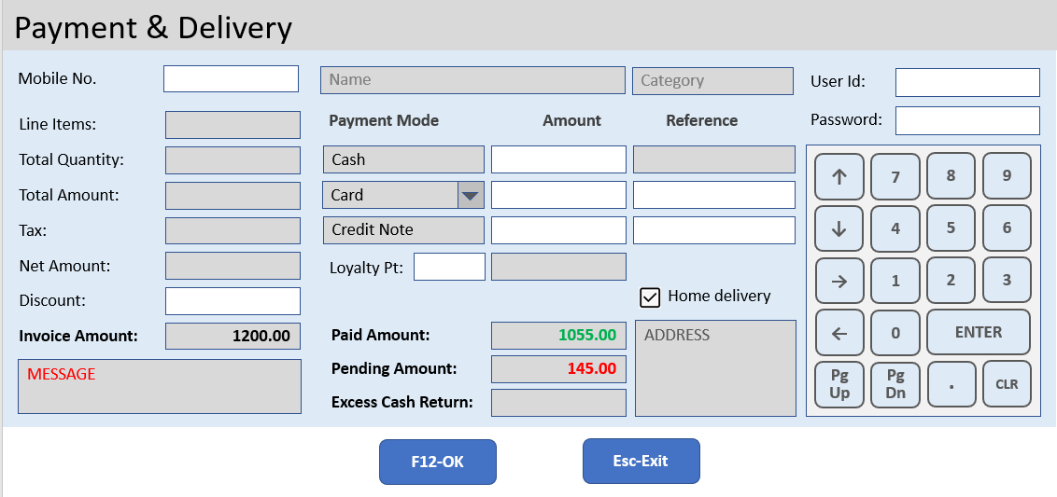
Invoice Entry
User:
Date:
AL FAREEDHA
SUPER MARKET
Terminal:
Invoice No.
Reference No.
Mobile No:
0000000000
UNPAID
Barcode:
Item code:
Item Name:
Line Items:
Item Code | Barcode | Item Name | Unit | Qty | Standard Price | Applied Price | Tax | Net
Total Qty:
Total Price:
Tax:
Net Price:
Discount:
Invoice Amt:
Paid Amt:
↑
7
8
9
↓
4
5
6
→
1
2
3
←
.
ENTER
F1
Help
F2
Del Item
F3
Find Item
F4
Change Qty
F5
Change Price
F6
Get Weight
+
-
DEL
CLR
F7
New Invoice
F8
Del Invoice
F9
Find Customer
F10
List Invoices
F11
Print Invoice
F12
Payment
Esc-Exit

Slide 16
Payment
FIELD SETTINGS & BEHAVIOR:
Default Mobile Number is ‘0000000000’, which means Walk-in customer
If Mobile Number is not = ‘0000000000’, then Customer Name, Category and Address should be fetched and displayed
First line of Payment mode should be always Cash
Second line of Payment mode combo should not have Cash option
Home Delivery field by default should be un ticked
All Validation errors should be displayed in Message Field
CALCULATIONS:
Line Items = Total number of Items in the Invoice
Total Quantity = Sum of Quantity of all Items in the Invoice
Total amount = Sum of Total amount of all Items in the Invoice
Tax amount = Sum of Tax amount of all Items in the Invoice
Net amount = Sum of Net amount of all Items in the Invoice
Invoice amount = Net amount – Discount amount
Paid amount = Payment mode 1 amount + Payment mode 2 amount + Credit Note amount + Loyalty amount
If Paid amount is lesser than Invoice amount, the difference should be shown as Pending amount
If Paid amount is more than Invoice amount, the difference should be shown as Excess Cash Return amount, and Paid amount should be set as the Invoice amount
Cash Payment Reference = Cash Payment amount – Excess Cash Return amount
Loyalty amount = Loyalty Points x Conversion Rate in Settings

Slide 17
Payment
VALIDATIONS:
Only Cash Payment amount can be more than Invoice amount
Non-cash payment amount should not be more than Invoice amount
Credit Note amount should not be more than Invoice amount
Loyalty amount should not be more than Invoice amount
Sum of Non-cash payment amount + Credit Note amount + Loyalty amount, should not be more than Invoice amount
Reference field is mandatory for Non-cash payment amount and Credit Note amount
If Mobile Number = ‘0000000000’, then Discount, Credit Note amount and Loyalty Points fields should not be entered
If Mobile Number is not = ‘0000000000’, then it should exist in Customer table
Loyalty Points should not be more than the available points in Customer table
Payment cannot be saved if Pending Amount > 0
If Mobile Number = ‘0000000000’, then Home Delivery option should not be ticked

Slide 18
Payment
EXCEPTIONS:
Supervisor’s User Id and Password should be accepted if any of the following conditions arise:
Discount amount entered
Credit Note amount entered
Loyalty Points entered
Excess Cash amount is more than Cash Payment amount
DATABASE SAVE:
Cash Payment Reference field should be stored as Cash Payment amount in the Invoice Payment table
Invoice Number will be generated by incrementing the ‘last_invoice_number’ prefixed by ‘invoice_number_prefix’ in the Settings table
Redeemed Loyalty Points should be reduced from the Customer table
Each Payment mode should be saved as separate records in the Invoice Payment table

Slide 19
ERPNext
alignPOS
Sale Invoice
Payment Entry
Delivery Note
alignPOS
ERP
Interface
GET Login
alignPOS
client
GET Customer
Customer
CUSTOM EXTENSION
Hook
Process
GET Item
Item
GET Item Tax
Item Tax
MariaDB
10.2.37
GET Item Stock
Item Stock
POST Pos Invoice
Pos
Invoice
Authentication &
POS Data
alignPOS components
ERPNext components

Slide 20

ERPNext Custom Extensions
align-pos
Module Name | Alignpos Integration
Document Type | Pos Invoice
Child Document Types | Pos Invoice Item
 | Pos Invoice Payment
Report | Pos Daily Sales Report

Slide 21
Invoice List
Invoice No.
Reference No.
Mobile No.
Status:
Invoice No. | Reference No. | Mobile No. | Customer Name | Total Price | Tax | Net Price | Discount | Inv Amt | Paid | Home Delivery | Status
 |  |  |  |  |  |  |  |  |  | Yes | Unpaid
 |  |  |  |  |  |  |  |  |  | No | Paid
F1-Find
F12-Select
↑
↓
PgUp
PgDn
Esc-Exit

Slide 22
Estimate List
Estimate No.
Estimate No. | Mobile No. | Customer Name | Total Price | Tax | Net Price
F1-Find
F12-Select
↑
↓
PgUp
PgDn
Esc-Exit

Slide 23
Find Customer
Mobile No.
Cust Name:
Category:
Mobile No. | Customer Name | Category | Address | Loyalty Pts
F1-Find
↑
↓
PgUp
PgDn
Esc-Exit

Slide 24
Find Item
Item code:
Barcode:
Item Name:
Category:
Item code | Barcode | Item Name | Category | Unit | Selling Price | Tax | Net Price
F1-Find
↑
↓
PgUp
PgDn
Esc-Exit

Slide 25

Payment & Delivery
Mobile No.
Name
Category
User Id:
Line Items:
Payment Mode
Amount
Reference
Password:
Total Quantity:
Cash
↑
7
8
9
Total Amount:
Card
↓
5
6
Tax:
Credit Note
↓
4
Net Amount:
Loyalty Pt:
→
1
2
3
Discount:
Home delivery
Invoice Amount:
1200.00
Paid Amount:
1055.00
ADDRESS
←
0
ENTER
MESSAGE
Pending Amount:
145.00
PgUp
PgDn
.
CLR
Excess Cash Return:
F12-OK
Esc-Exit

Slide 26
Change Quantity
↑
7
8
9
ITEM NAME
↓
5
6
↓
4
Existing Quantity:
→
1
2
3
New Quantity:
←
0
ENTER
F12-OK
Esc-Exit
PgUp
PgDn
.
CLR

Slide 27
Change Price
↑
7
8
9
ITEM NAME
↓
5
6
↓
4
Existing Price:
New Price:
→
1
2
3
User Id
←
0
ENTER
Password
PgUp
PgDn
.
CLR
F12-OK
Esc-Exit

Slide 28
Change Price
ITEM NAME
↑
7
8
9
DISCOUNT
PRICE
↓
5
6
↓
4
Existing:
→
1
2
3
New:
←
0
ENTER
Password
Token
PgUp
PgDn
.
CLR
F2-OK
Esc-Exit

Slide 29
+
!
@
#
$
%
^
&
*
(
)
+
[
_
Tab
Q
W
E
R
T
Y
U
I
O
P
]
-
|
F
K
↓
\
↓
D
↓
J
L
/
A
S
G
H
CapsLock
Z
X
C
V
B
N
M
,
~
>
<
PgUp
↑
7
8
9
PgDn
↓
5
6
↓
4
.
→
1
2
3
CLR
←
0
ENTER

