Slide 1

AL FAREEDHA
SUPER MARKET
User Id:
Password:
Terminal:
F12
Sign in
Esc - Exit

Slide 2
Sign In
FIELD SETTINGS & BEHAVIOR:
Terminal:
Pick from ‘terminal_id’ in ‘alignpos.json’
BUTTON ACTIONS:
Esc-Exit:
Close the Sign in Screen and go back to OS prompt
F12-Sign In:
Close Sign In screen
Move Terminal, User Id and Current Date to Session Variable
Open Menu Screen
Display the above Session Variables at the top of Menu Screen
VALIDATIONS:
User Id should exist in tabUser table in db
Password should be corresponding to the User Id in the tabUser table in db

Slide 3
Menu
User:
Date:
AL FAREEDHA
SUPER MARKET
Terminal:
F1 - Estimate
F2 - Invoice
F3 - Cash
F4 - Settings
Esc - Sign Out

Slide 4

Estimate Entry
User:
Date:
AL FAREEDHA
SUPER MARKET
Terminal:
Estimate No.
PgUp
Prev
PgDn
Next
Barcode / Item code:
Item Name:
Line Items:
Item Code | Barcode | Item Name | Unit | Qty | Standard Price | Applied Price | Tax | Net
Total Qty:
Total Price:
Tax:
Net Price:
↑
7
8
9
↓
4
5
6
→
1
2
3
←
.
ENTER
F1
Help
F2
Del Item
F3
Find Item
F4
Change Qty
F5
Change Price
F6
Get Weight
DEL
<
TAB
F7
New Estimate
F8
Del Estimate
F9
Find Customer
F10
List Estimates
F11
Print Estimate
F12
Create Invoice
Esc-Exit

Slide 5
Estimate Entry
FIELD SETTINGS & BEHAVIOR:
When the screen loads first time
Estimate Number should be blank
Set the focus to Barcode/Item code field
Barcode / Item code:
If the entered / scanned barcode starts with numbers 0 to 9
Field length should be 13 digits
Fetch the Item corresponding to the Barcode from the tabItem table in db
If the item exists in the tabItem table in db
insert the item in the Item list with Quantity = 1.
Compute and display the Tax and Net Price.
Set the focus back to Barcode/Item code field
Else
Set the focus to Barcode/Item code field
If the entered / scanned barcode starts with letter ‘I’
Field length should be 9 digits
Fetch the Item corresponding to the Item code from the tabItem table in db
If the item exists in the tabItem table
Insert the item in the Item list with Quantity = 1.
Compute and display the Tax and Net Price.
Set the focus back to Barcode/Item code field
Else
Set the focus back to Barcode/Item code field
Item name:
After typing first 3 characters of the Item Name, the combo box should be populated with the list of Items matching with the name.
Scroll the list and click the desired Item.
Fetch the Item corresponding to the Barcode from the tabItem table in db
insert the item in the item list with Quantity = 1.
Compute and display the Tax and Net Price.
Set the focus to Barcode field.

Slide 6
Estimate Entry
CALCULATIONS:
Estimate Item Table Fields:
Standard Price = Selling Price fetched from tabItem table in db
Applied Price = Standard Price (initially both are same until the Price is changed)
Tax = Applied Price x (cgst_tax_rate + sgst_tax_rate, fetched from tabItem table in db) / 100
Net = Applied Price + Tax
Summary Fields:
Line Items = Total number of Items in the Invoice
Total Quantity = Sum of Quantity of all Items in the Invoice
Total amount = Sum of Total amount of all Items in the Invoice
Tax amount = Sum of Tax amount of all Items in the Invoice
Net amount = Sum of Net amount of all Items in the Invoice
Invoice amount = Net amount – Discount amount
BUTTON ACTIONS:
Esc-Exit:
Close the Estimate Entry Screen and go back to menu
F1-Help:
Currently no action required
F2-Delete Item:
Delete the currently focused item in the Item list
Recalculate the Summary Fields
F3-Find Item:
Open the ‘Find Item’ popup screen
F4-Change Quantity:
Open the ‘Change Quantity’ popup screen displaying the Quantity of the currently focused item in the item list, as the Existing Quantity and New Quantity
F5-Change Price:
Open the ‘Change Price’ popup screen displaying the Applied Price of the currently focused item in the item list, as the Existing Price
F6-Get Weight:
Currently no action required

Slide 7
Estimate Entry
F7-New Estimate:
Save the current Estimate to Database
Print the Estimate
Clear all the fields
Set the focus to Barcode
F8-Delete Invoice:
Delete the current Estimate from the Database (if already saved)
Clear all the fields
Set the focus to Barcode
F9-Find Customer:
Open the Find Item popup screen
F10-List Estimates:
Save the current Estimate to Database
Open the Estimate List popup screen
F11-Print Estimate:
Currently no action required
F12-Create Invoice:
From Estimate details, create a new Invoice in the database
Display the Invoice number in the popup message box
Save the current Estimate to Database
Clear all the fields
Set the focus to Barcode
Right Arrow / + Key:
Quantity of the currently focused item in the item list should be incremented by 1
Left Arrow / - Key:
Quantity of the currently focused item in the item list should be decremented by 1
PgUp-Prev:
Save the current Estimate to Database
Load previous Estimate into the screen
PgDn-Next:
Save the current Estimate to Database
Load next Estimate into the screen

Slide 8
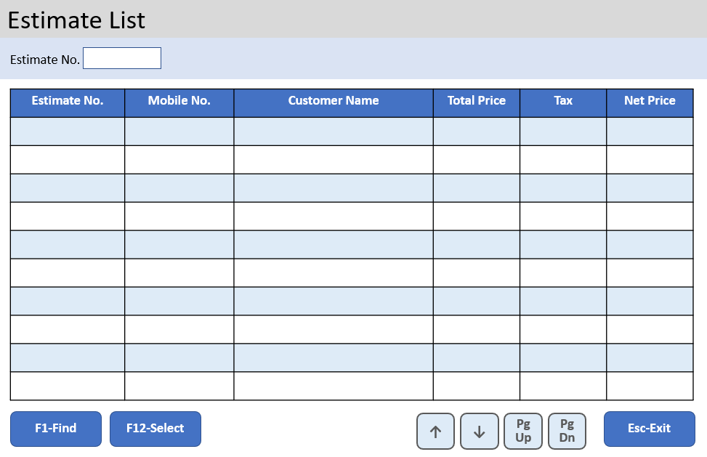
Estimate Entry
User:
Date:
AL FAREEDHA
SUPER MARKET
Terminal:
Estimate No.
PgUp
Prev
PgDn
Next
Estimate No.
Barcode / Item code:
Item Name:
Line Items:
Item Code | Barcode | Item Name | Unit | Qty | Standard Price | Applied Price | Tax | Net
Total Qty:
Total Price:
Tax:
Net Price:
↑
7
8
9
↓
4
5
6
→
1
2
3
←
.
ENTER
F1
Help
F2
Del Item
F3
Find Item
F4
Change Qty
F5
Change Price
F6
Get Weight
DEL
<
TAB
F7
New Estimate
F8
Del Estimate
F9
Find Customer
F10
List Estimates
F11
Print Estimate
F12
Create Invoice
Esc-Exit

Slide 9
Estimate List
BUTTON ACTIONS:
Esc-Exit:
Close the Estimate List Screen and go back to Estimate Entry Screen
F1-Find:
From the database, fetch all the Estimates pertaining to the Current date, Current Terminal, Estimate Number and list them in the screen
Set focus to the first row in the Estimate List
F12-Select:
From the database, fetch the Estimate details of the Estimate number pertaining to currently focused row in the Estimate List
Load the contents of the Estimate in the Estimate Entry Screen
Close the Estimate List Screen and go back to Estimate Entry Screen
Up Arrow:
Set focus to the row above in the Estimate List.
If already in the first row, no action required
Down Arrow:
Set focus to the row below in the Estimate List.
If already in the last row, no action required
Page Up:
Set focus to the 10th row above in the Estimate List.
If already in the first row, no action required
Page Down:
Set focus to the 10th row below in the Estimate List.
If already in the last row, no action required

Slide 10
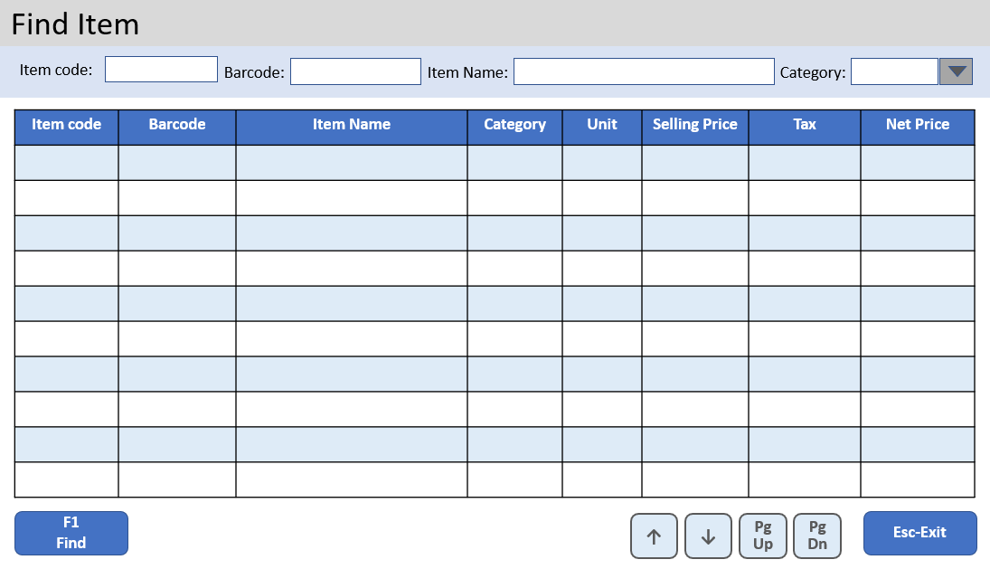
Estimate Entry
User:
Date:
AL FAREEDHA
SUPER MARKET
Terminal:
Estimate No.
PgUp
Prev
PgDn
Next
Estimate No.
Barcode / Item code:
Item Name:
Line Items:
Item Code | Barcode | Item Name | Unit | Qty | Standard Price | Applied Price | Tax | Net
Total Qty:
Total Price:
Tax:
Net Price:
↑
7
8
9
↓
4
5
6
→
1
2
3
←
.
ENTER
F1
Help
F2
Del Item
F3
Find Item
F4
Change Qty
F5
Change Price
F6
Get Weight
DEL
<
TAB
F7
New Estimate
F8
Del Estimate
F9
Find Customer
F10
List Estimates
F11
Print Estimate
F12
Create Invoice
Esc-Exit

Slide 11
Find Item
BUTTON ACTIONS:
Esc-Exit:
Close the Find Item Screen and go back to Estimate Entry Screen
F1-Find:
From the database, fetch the Items pertaining to the Barcode, Item Code, Item Name and Category, and list it in the screen
Set focus to the first row in the Item List
Up Arrow:
Set focus to the row above in the Item List.
If already in the first row, no action required
Down Arrow:
Set focus to the row below in the Item List.
If already in the last row, no action required
Page Up:
Set focus to the 10th row above in the Item List.
If already in the first row, no action required
Page Down:
Set focus to the 10th row below in the Item List.
If already in the last row, no action required

Slide 12
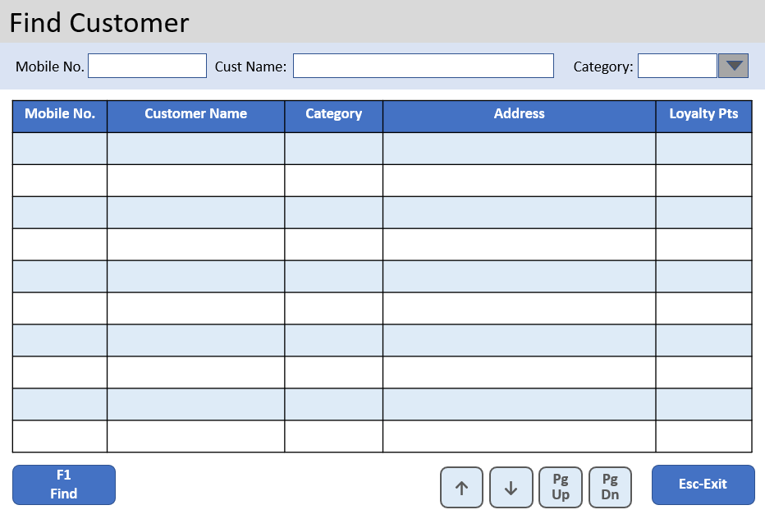
Estimate Entry
User:
Date:
AL FAREEDHA
SUPER MARKET
Terminal:
Estimate No.
PgUp
Prev
PgDn
Next
Barcode / Item code:
Item Name:
Line Items:
Item Code | Barcode | Item Name | Unit | Qty | Standard Price | Applied Price | Tax | Net
Total Qty:
Total Price:
Tax:
Net Price:
↑
7
8
9
↓
4
5
6
→
1
2
3
←
.
ENTER
F1
Help
F2
Del Item
F3
Find Item
F4
Change Qty
F5
Change Price
F6
Get Weight
DEL
<
TAB
F7
New Estimate
F8
Del Estimate
F9
Find Customer
F10
List Estimates
F11
Print Estimate
F12
Create Invoice
Esc-Exit

Slide 13
Find Customer
BUTTON ACTIONS:
Esc-Exit:
Close the Find Customer Screen and go back to Estimate Entry Screen
F1-Find:
From the database, fetch all the Customers pertaining to the Mobile Number, Customer Name and Category, and list it in the screen
Set focus to the first row in the Customer List
Up Arrow:
Set focus to the row above in the Customer List.
If already in the first row, no action required
Down Arrow:
Set focus to the row below in the Customer List.
If already in the last row, no action required
Page Up:
Set focus to the 10th row above in the Customer List.
If already in the first row, no action required
Page Down:
Set focus to the 10th row below in the Customer List.
If already in the last row, no action required

Slide 14
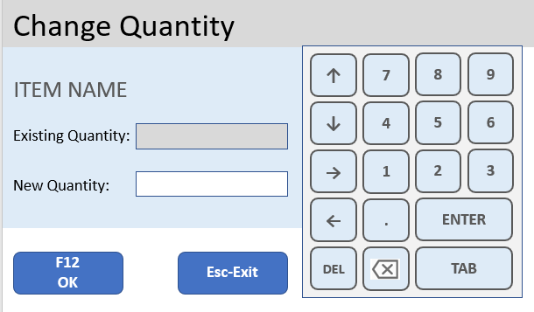
Estimate Entry
User:
Date:
AL FAREEDHA
SUPER MARKET
Terminal:
Estimate No.
PgUp
Prev
PgDn
Next
Barcode / Item code:
Item Name:
Line Items:
Item Code | Barcode | Item Name | Unit | Qty | Standard Price | Applied Price | Tax | Net
Total Qty:
Total Price:
Tax:
Net Price:
↑
7
8
9
↓
4
5
6
→
1
2
3
←
.
ENTER
F1
Help
F2
Del Item
F3
Find Item
F4
Change Qty
F5
Change Price
F6
Get Weight
DEL
<
TAB
F7
New Estimate
F8
Del Estimate
F9
Find Customer
F10
List Estimates
F11
Print Estimate
F12
Create Invoice
Esc-Exit

Slide 15
Change Quantity
FIELD SETTINGS & BEHAVIOR:
When the screen loads first time
Display the Item Name of the selected item
Display the Existing Quantity of the selected item
Set the focus to New Quantity field
VALIDATIONS:
Zero or Negative Quantity are not allowed in the New Quantity field
New Quantity cannot be same as the Existing Quantity
BUTTON ACTIONS:
Esc-Exit:
Discard the changes, Close the Change Quantity Screen and go back to Estimate Entry Screen
F12-Ok:
Update the New Quantity as the Quantity in the currently focused Item row in the Estimate Entry screen
Close the Change Quantity Screen and go back to Estimate Entry Screen

Slide 16
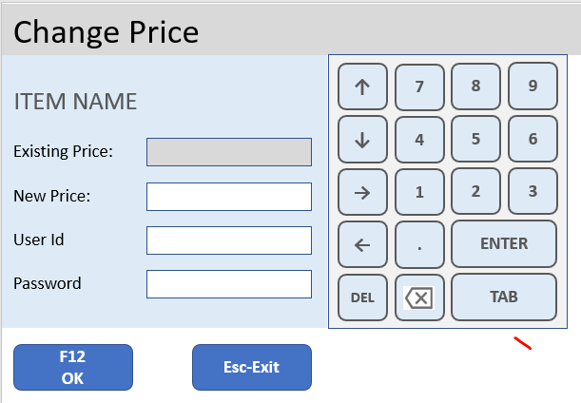
Estimate Entry
User:
Date:
AL FAREEDHA
SUPER MARKET
Terminal:
Estimate No.
PgUp
Prev
PgDn
Next
Barcode / Item code:
Item Name:
Line Items:
Item Code | Barcode | Item Name | Unit | Qty | Standard Price | Applied Price | Tax | Net
Total Qty:
Total Price:
Tax:
Net Price:
↑
7
8
9
↓
4
5
6
→
1
2
3
←
.
ENTER
F1
Help
F2
Del Item
F3
Find Item
F4
Change Qty
F5
Change Price
F6
Get Weight
DEL
<
TAB
F7
New Estimate
F8
Del Estimate
F9
Find Customer
F10
List Estimates
F11
Print Estimate
F12
Create Invoice
Esc-Exit

Slide 17
Change Price
FIELD SETTINGS & BEHAVIOR:
When the screen loads first time
Display the Item Name of the selected item
Display the Existing Price of the selected item
Set the focus to New Price field
VALIDATIONS:
Zero and Negative Price are not allowed in the New Price field
New Price can be only 10% above or below Existing Price
New Price cannot be same as the Existing Price
User Id should exist in tabUser table in db
Password should be corresponding to the User Id in the tabUser table in db
User Id should not be the same as login user id
Role of the user should be ‘Supervisor’ or ‘Manager’ in the tabUser table in db
BUTTON ACTIONS:
Esc-Exit:
Discard the changes, Close the Change Price Screen and go back to Estimate Entry Screen
F12-Ok:
Update the New Price into the Applied Price in the currently focused Item in the Estimate Entry screen
Close the Change Price Screen and go back to Estimate Entry Screen

Slide 18
Invoice Entry
User:
Date:
AL FAREEDHA
SUPER MARKET
Terminal:
Invoice No.
Reference No.
Mobile No:
0000000000
UNPAID
PgUp
Prev
PgDn
Next
Barcode / Item code:
Item Name:
Line Items:
Item Code | Barcode | Item Name | Unit | Qty | Standard Price | Applied Price | Tax | Net
Total Qty:
Total Price:
Tax:
Net Price:
Discount:
Invoice Amt:
Paid Amt:
↑
7
8
9
↓
4
5
6
→
1
2
3
←
.
ENTER
F1
Help
F2
Del Item
F3
Find Item
F4
Change Qty
F5
Change Price
F6
Get Weight
DEL
<
TAB
F7
New Invoice
F8
Del Invoice
F9
Find Customer
F10
List Invoices
F11
Print Invoice
F12
Payment
Esc-Exit

Slide 19
Invoice Entry
FIELD SETTINGS & BEHAVIOR:
When the screen loads first time
Invoice Number should be blank
Set the focus to Barcode/Item code field
Barcode / Item code:
If the entered / scanned barcode starts with numbers 0 to 9
Field length should be 13 digits
Fetch the Item corresponding to the Barcode from the tabItem table in db
If the item exists in tabItem table in db
insert the item in the Item list with Quantity = 1.
Compute and display the Tax and Net Price.
Set the focus back to Barcode/Item code field
Else
Set the focus to Barcode/Item code field
If the entered / scanned barcode starts with letter ‘I’
Field length should be 9 digits
Fetch the Item corresponding to the item code from the tabItem table in db
If the item exists in the Item db table
Insert a row in the Invoice Item ui table with Quantity = 1.
Compute and display the Tax and Net Price.
Set the focus back to Barcode/Item code field
Else
Set the focus back to Barcode/Item code field
If the entered / scanned barcode starts with letter ‘E’
Field length should be 8 digits
Fetch the Estimate Items corresponding to the Estimate Number from the ‘tabEstimate Item’ table in db
If the items exists in ‘tabEstimate Item’ table in db
Insert each item into the Item list along with unit, qty, price, tax details
Set the focus back to Barcode/Item code field
Else
Set the focus back to Barcode/Item code field

Slide 20
Invoice Entry
FIELD SETTINGS & BEHAVIOR:
Item name:
After typing first 3 characters of the Item Name, the combo box should be populated with the list of Items matching with the name.
Scroll the list and click the desired Item.
Fetch the Item corresponding to the Barcode from the tabItem table in db
insert the item in the item list with Quantity = 1.
Compute and display the Tax and Net Price.
Set the focus to Barcode field.

Slide 21
Invoice Entry
CALCULATIONS:
Invoice Item Table Fields:
Standard Price = Selling Price fetched from tabItem table in db
Applied Price = Standard Price (initially both are same until the Price is changed)
Tax = Applied Price x (cgst_tax_rate + sgst_tax_rate, fetched from tabItem table) / 100
Net = Applied Price + Tax
Summary Fields:
Line Items = Total number of Items in the Invoice
Total Quantity = Sum of Quantity of all Items in the Invoice
Total amount = Sum of Total amount of all Items in the Invoice
Tax amount = Sum of Tax amount of all Items in the Invoice
Net amount = Sum of Net amount of all Items in the Invoice
Invoice amount = Net amount – Discount amount
Paid amount = 0 initially. After the Payment is made, this field will be filled accordingly.
BUTTON ACTIONS:
Esc-Exit:
Close the Invoice Entry Screen and go back to menu
F1-Help:
Currently no action required
F2-Delete Item:
Delete the currently focused item in the Item list
Recalculate the Summary Fields
F3-Find Item:
Open the Find Item popup screen
F4-Change Quantity:
Open the Change Quantity popup screen displaying the Quantity of the currently focused item in the Item list as the Existing Quantity and New Quantity
F5-Change Price:
Open the Change Price popup screen displaying the Applied Price of the currently focused item in the Item list as the Existing Price
F6-Get Weight:
Currently no action required

Slide 22
Invoice Entry
F7-New Invoice:
Save the current Invoice to db
Reference Number will be generated by incrementing the ‘last_reference_number’
Invoice Number will be null (will be allocated only in Payment screen)
Clear all the fields
Set the focus to Barcode
F8-Delete Invoice:
Not allowed if the invoice is already paid
Delete the current Invoice from the db (if already saved)
Clear all the fields
Set the focus to Barcode
F9-Find Customer:
Open the Find Item popup screen
F10-List Invoices:
Save the current Invoice to db
Open the Invoice List popup screen
F11-Print Invoice:
Currently no action required
F12-Pay:
Save the current Invoice to db
Open the Payment & Delivery popup screen
Right Arrow / + Key:
Quantity of the currently focused item in the Item list, should be incremented by 1
Left Arrow / - Key:
Quantity of the currently focused item in the Item list, should be decremented by 1
PgUp-Prev:
Save the current Invoice to db
Load previous Invoice into the screen
PgDn-Next:
Save the current Invoice to db
Load next Invoice into the screen

Slide 23
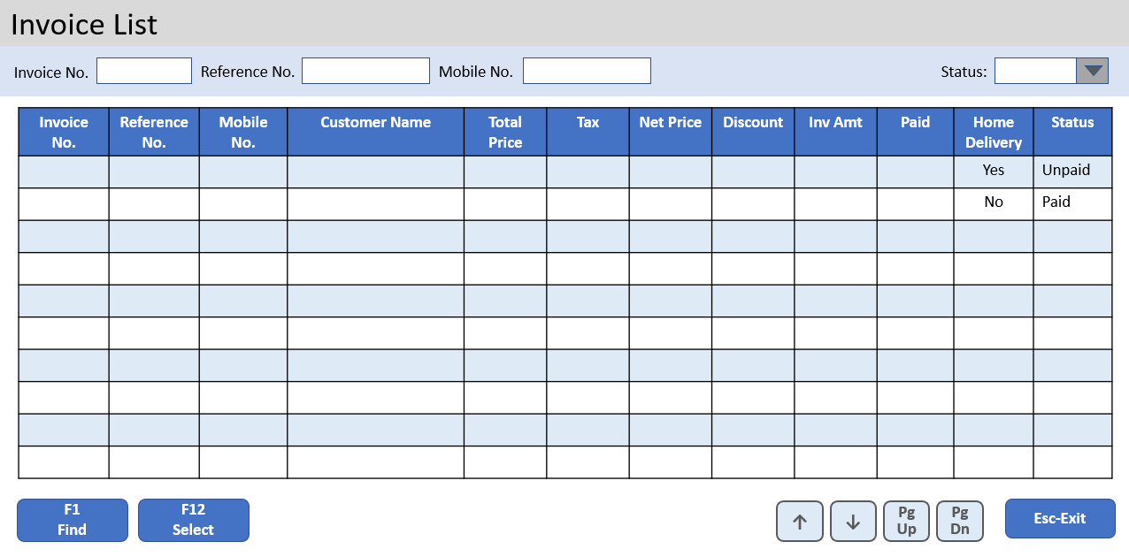
Invoice Entry
User:
Date:
AL FAREEDHA
SUPER MARKET
Terminal:
Invoice No.
Reference No.
Mobile No:
0000000000
UNPAID
PgUp
Prev
PgDn
Next
Barcode / Item code:
Item Name:
Line Items:
Item Code | Barcode | Item Name | Unit | Qty | Standard Price | Applied Price | Tax | Net
Total Qty:
Total Price:
Tax:
Net Price:
Discount:
Invoice Amt:
Paid Amt:
↑
7
8
9
↓
4
5
6
→
1
2
3
←
.
ENTER
F1
Help
F2
Del Item
F3
Find Item
F4
Change Qty
F5
Change Price
F6
Get Weight
DEL
<
TAB
F7
New Invoice
F8
Del Invoice
F9
Find Customer
F10
List Invoices
F11
Print Invoice
F12
Payment
Esc-Exit

Slide 24
Invoice List
BUTTON ACTIONS:
Esc-Exit:
Close the Invoice List Screen and go back to Invoice Entry Screen
F1-Find:
From the db, fetch all the Invoices pertaining to the Current date, Current Terminal, Invoice Number, Reference Number, Mobile Number and Status, and list it in the screen
Set focus to the first row in the Invoice List
F12-Select:
Load the details of the currently focused Invoice into the Invoice Entry Screen
Close the Invoice List Screen and go back to Invoice Entry Screen
Up Arrow:
Set focus to the row above in the Invoice List.
If already in the first row, no action required
Down Arrow:
Set focus to the row below in the Invoice List.
If already in the last row, no action required
Page Up:
Set focus to the 10th row above in the Invoice List.
If already in the first row, no action required
Page Down:
Set focus to the 10th row below in the Invoice List.
If already in the last row, no action required

Slide 25
Invoice Entry
User:
Date:
AL FAREEDHA
SUPER MARKET
Terminal:
Invoice No.
Reference No.
Mobile No:
0000000000
UNPAID
PgUp
Prev
PgDn
Next
Barcode / Item code:
Item Name:
Line Items:
Item Code | Barcode | Item Name | Unit | Qty | Standard Price | Applied Price | Tax | Net
Total Qty:
Total Price:
Tax:
Net Price:
Discount:
Invoice Amt:
Paid Amt:
↑
7
8
9
↓
4
5
6
→
1
2
3
←
.
ENTER
F1
Help
F2
Del Item
F3
Find Item
F4
Change Qty
F5
Change Price
F6
Get Weight
DEL
<
TAB
F7
New Invoice
F8
Del Invoice
F9
Find Customer
F10
List Invoices
F11
Print Invoice
F12
Payment
Esc-Exit

Slide 26
Find Item
BUTTON ACTIONS:
Esc-Exit:
Close the Find Item Screen and go back to Invoice Entry Screen
F1-Find:
From the db, fetch the Items pertaining to the Barcode, Item Code, Item Name and Category, and list in the screen
Set focus to the first row in the Item List
Up Arrow:
Set focus to the row above in the Item List.
If already in the first row, no action required
Down Arrow:
Set focus to the row below in the Item List.
If already in the last row, no action required
Page Up:
Set focus to the 10th row above in the Item List.
If already in the first row, no action required
Page Down:
Set focus to the 10th row below in the Item List.
If already in the last row, no action required

Slide 27
Invoice Entry
User:
Date:
AL FAREEDHA
SUPER MARKET
Terminal:
Invoice No.
Reference No.
Mobile No:
0000000000
UNPAID
PgUp
Prev
PgDn
Next
Barcode / Item code:
Item Name:
Line Items:
Item Code | Barcode | Item Name | Unit | Qty | Standard Price | Applied Price | Tax | Net
Total Qty:
Total Price:
Tax:
Net Price:
Discount:
Invoice Amt:
Paid Amt:
↑
7
8
9
↓
4
5
6
→
1
2
3
←
.
ENTER
F1
Help
F2
Del Item
F3
Find Item
F4
Change Qty
F5
Change Price
F6
Get Weight
DEL
<
TAB
F7
New Invoice
F8
Del Invoice
F9
Find Customer
F10
List Invoices
F11
Print Invoice
F12
Payment
Esc-Exit

Slide 28
Find Customer
BUTTON ACTIONS:
Esc-Exit:
Close the Find Customer Screen and go back to Invoice Entry Screen
F1-Find:
From the db, fetch the Customers pertaining to the Mobile Number, Customer Name and Category, and list in the screen
Set focus to the first row in the Customer List
Up Arrow:
Set focus to the row above in the Customer List.
If already in the first row, no action required
Down Arrow:
Set focus to the row below in the Customer List.
If already in the last row, no action required
Page Up:
Set focus to the 10th row above in the Customer List.
If already in the first row, no action required
Page Down:
Set focus to the 10th row below in the Customer List.
If already in the last row, no action required

Slide 29
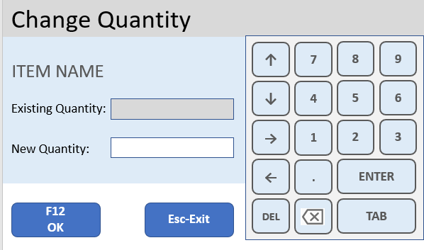
Invoice Entry
User:
Date:
AL FAREEDHA
SUPER MARKET
Terminal:
Invoice No.
Reference No.
Mobile No:
0000000000
UNPAID
PgUp
Prev
PgDn
Next
Barcode / Item code:
Item Name:
Line Items:
Item Code | Barcode | Item Name | Unit | Qty | Standard Price | Applied Price | Tax | Net
Total Qty:
Total Price:
Tax:
Net Price:
Discount:
Invoice Amt:
Paid Amt:
↑
7
8
9
↓
4
5
6
→
1
2
3
←
.
ENTER
F1
Help
F2
Del Item
F3
Find Item
F4
Change Qty
F5
Change Price
F6
Get Weight
DEL
<
TAB
F7
New Invoice
F8
Del Invoice
F9
Find Customer
F10
List Invoices
F11
Print Invoice
F12
Payment
Esc-Exit

Slide 30
Change Quantity
FIELD SETTINGS & BEHAVIOR:
When the screen loads first time
Display the Item Name of the selected item
Display the Existing Quantity of the selected item
Set the focus to New Quantity field
VALIDATIONS:
Zero and Negative Quantity are not allowed in the New Quantity field
New Quantity field cannot be same as the Existing Quantity field
BUTTON ACTIONS:
Esc-Exit:
Discard the changes, Close the Change Quantity Screen and go back to Invoice Entry Screen
F12-Ok:
Update the New Quantity as the Quantity in the currently focused Item row in the Invoice Entry screen
Close the Change Quantity Screen and go back to Invoice Entry Screen

Slide 31
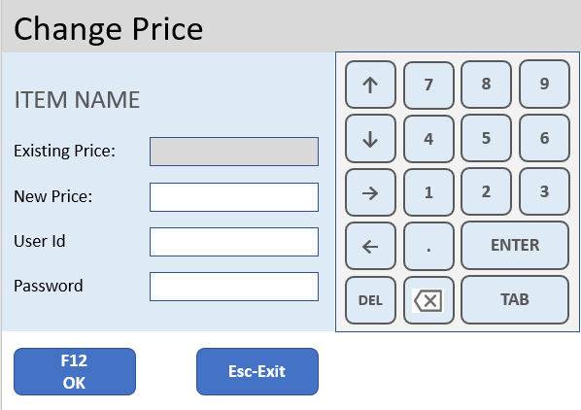
Invoice Entry
User:
Date:
AL FAREEDHA
SUPER MARKET
Terminal:
Invoice No.
Reference No.
Mobile No:
0000000000
UNPAID
PgUp
Prev
PgDn
Next
Barcode / Item code:
Item Name:
Line Items:
Item Code | Barcode | Item Name | Unit | Qty | Standard Price | Applied Price | Tax | Net
Total Qty:
Total Amt:
Tax:
Net Amt:
Discount:
Invoice Amt:
Paid Amt:
↑
7
8
9
↓
4
5
6
→
1
2
3
←
.
ENTER
F1
Help
F2
Del Item
F3
Find Item
F4
Change Qty
F5
Change Price
F6
Get Weight
DEL
<
TAB
F7
New Invoice
F8
Del Invoice
F9
Find Customer
F10
List Invoices
F11
Print Invoice
F12
Payment
Esc-Exit

Slide 32
Change Price
FIELD SETTINGS & BEHAVIOR:
When the screen loads first time
Display the Item Name of the selected item
Display the Existing Price of the selected item
Set the focus to New Price field
VALIDATIONS:
Zero and Negative Price are not allowed in the New Price field
New Price can be only 10% above or below Existing Price
New Price cannot be same as the Existing Price
User Id should exist in tabUser table in db
Password should be corresponding to the User Id in the tabUser table in db
User Id should not be the same as login user id
Role of the user should be ‘Supervisor’ or ‘Manager’ in the tabUser table in db
BUTTON ACTIONS:
Esc-Exit:
Discard the changes, Close the Change Price Screen and go back to Invoice Entry Screen
F12-Ok:
Update the New Price into the Applied Price in the currently focused Item in the item list in the Invoice Entry screen
Close the Change Price Screen and go back to Invoice Entry Screen

Slide 33
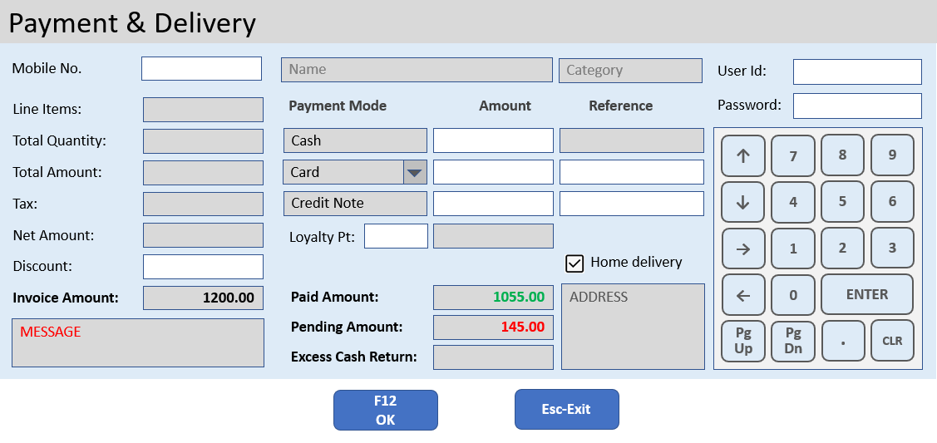
Invoice Entry
User:
Date:
AL FAREEDHA
SUPER MARKET
Terminal:
Invoice No.
Reference No.
Mobile No:
0000000000
UNPAID
PgUp
Prev
PgDn
Next
Barcode / Item code:
Item Name:
Line Items:
Item Code | Barcode | Item Name | Unit | Qty | Standard Price | Applied Price | Tax | Net
Total Qty:
Total Price:
Tax:
Net Price:
Discount:
Invoice Amt:
Paid Amt:
↑
7
8
9
↓
4
5
6
→
1
2
3
←
.
ENTER
F1
Help
F2
Del Item
F3
Find Item
F4
Change Qty
F5
Change Price
F6
Get Weight
DEL
<
TAB
F7
New Invoice
F8
Del Invoice
F9
Find Customer
F10
List Invoices
F11
Print Invoice
F12
Payment
Esc-Exit

Slide 34
Payment
FIELD SETTINGS & BEHAVIOR:
When the screen loads first time
Set the focus to Mobile No. field
Default Mobile Number is ‘0000000000’, which means Walk-in customer
If Mobile Number is not = ‘0000000000’, then Customer Name, Category and Address should be fetched and displayed
First line of Payment mode should be always Cash
Second line of Payment mode combo should not have Cash option
Home Delivery field by default should be unticked
All Validation errors should be displayed in Message Field
CALCULATIONS:
Line Items = Total number of Items in the Invoice
Total Quantity = Sum of Quantity of all Items in the Invoice
Total amount = Sum of Total amount of all Items in the Invoice
Tax amount = Sum of Tax amount of all Items in the Invoice
Net amount = Sum of Net amount of all Items in the Invoice
Invoice amount = Net amount – Discount amount
Paid amount = Payment mode 1 amount + Payment mode 2 amount + Credit Note amount + Loyalty amount
If Paid amount is lesser than Invoice amount, the difference should be shown as Pending amount
If Paid amount is more than Invoice amount, the difference should be shown as Excess Cash Return amount, and Paid amount should be set as the Invoice amount
Cash Payment Reference = Cash Payment amount – Excess Cash Return amount
Loyalty amount = Loyalty Points x Conversion Rate in Settings

Slide 35
Payment
VALIDATIONS:
Only Cash Payment amount can be more than Invoice amount
Non-cash payment amount should not be more than Invoice amount
Credit Note amount should not be more than Invoice amount
Loyalty amount should not be more than Invoice amount
Sum of Non-cash payment amount + Credit Note amount + Loyalty amount, should not be more than Invoice amount
Reference field is mandatory for Non-cash payment amount and Credit Note amount
If Mobile Number = ‘0000000000’, then Discount, Credit Note amount and Loyalty Points fields should not be entered
Mobile Number should exist in Customer table
Loyalty Points should not be more than the available points in Customer table
Payment cannot be saved if Pending Amount > 0
If Mobile Number = ‘0000000000’, then Home Delivery option should not be ticked

Slide 36
Payment
EXCEPTIONS:
Supervisor’s User Id and Password should be accepted if any of the following conditions arise:
Discount amount entered
Credit Note amount entered
Loyalty Points entered
Excess Cash amount is more than Cash Payment amount
User Id should not be the same as login user id
Role of the user should be ‘Supervisor’ or ‘Manager’ in the tab User table in db
BUTTON ACTIONS:
Esc-Exit:
Close the Payment Screen and go back to Invoice Screen and continue with the existing Invoice
F12-OK:
Cash Payment Reference field should be stored as Cash Payment amount
Invoice Number will be generated by incrementing the ‘last_invoice_number’ prefixed by ‘invoice_number_prefix’ in the tabSettings table in db
Redeemed Loyalty Points should be reduced from the tabCustomer table in db
Each Payment mode should be saved as separate records in the ‘tabInvoice Payment’ table in db
Print the Invoice
Close the Payment Screen and go back to Invoice Entry Screen after clearing all the fields, so that a new Invoice can be entered.

Slide 37
ERPNext
alignPOS
Sale Invoice
Payment Entry
Delivery Note
alignPOS
ERP
Interface
GET Login
alignPOS
client
GET Customer
Customer
CUSTOM EXTENSION
Hook
Process
GET Item
Item
GET Item Tax
Item Tax
MariaDB
10.2.37
GET Item Stock
Item Stock
POST Pos Invoice
Pos
Invoice
Authentication &
POS Data
alignPOS components
ERPNext components

Slide 38
End of Document

Slide 39
Invoice List
Invoice No.
Reference No.
Mobile No.
Status:
Invoice No. | Reference No. | Mobile No. | Customer Name | Total Price | Tax | Net Price | Discount | Inv Amt | Paid | Home Delivery | Status
 |  |  |  |  |  |  |  |  |  | Yes | Unpaid
 |  |  |  |  |  |  |  |  |  | No | Paid
F1
Find
F12
Select
↑
↓
PgUp
PgDn
Esc-Exit

Slide 40
Estimate List
Estimate No.
Estimate No. | Mobile No. | Customer Name | Total Price | Tax | Net Price
F1
Find
F12
Select
↑
↓
PgUp
PgDn
Esc-Exit

Slide 41
Find Customer
Mobile No.
Cust Name:
Category:
Mobile No. | Customer Name | Category | Address | Loyalty Pts
F1
Find
↑
↓
PgUp
PgDn
Esc-Exit

Slide 42
Find Item
Item code:
Barcode:
Item Name:
Category:
Item code | Barcode | Item Name | Category | Unit | Selling Price | Tax | Net Price
F1
Find
↑
↓
PgUp
PgDn
Esc-Exit

Slide 43

Payment & Delivery
Mobile No.
Name
Category
User Id:
Line Items:
Payment Mode
Amount
Reference
Password:
Total Quantity:
Cash
↑
7
8
9
Total Amount:
Card
↓
5
6
Tax:
Credit Note
↓
4
Net Amount:
Loyalty Pt:
→
1
2
3
Discount:
Home delivery
Invoice Amount:
1200.00
Paid Amount:
1055.00
ADDRESS
←
0
ENTER
MESSAGE
Pending Amount:
145.00
PgUp
PgDn
.
Excess Cash Return:
F12
OK
Esc-Exit

Slide 44
Change Quantity
↑
7
8
9
ITEM NAME
↓
5
6
↓
4
Existing Quantity:
→
1
2
3
New Quantity:
←
0
ENTER
F12
OK
Esc-Exit
PgUp
PgDn
.

Slide 45
Change Price
↑
7
8
9
ITEM NAME
↓
4
5
6
Existing Price:
New Price:
→
1
2
3
User Id
←
.
ENTER
Password
DEL
<
TAB
F12
OK
Esc-Exit

Slide 46

!
@
#
$
%
^
&
*
(
)
+
[
_
+
Q
W
E
R
T
Y
U
I
O
P
]
-
F
K
↓
\
↓
D
↓
J
L
/
A
S
G
H
Z
X
C
V
B
N
M
,
~
>
<
PgUp
Prev Inv
PgDn
Next Inv

