Slide 1


Apli
By: Ahmet Fatih Efeoglu
Valentin Lyashenko

Slide 2
Getting a Job just got SIMPLE
Create a profile
01
Pick a challenge
02
Crush it and get an internship
03

Slide 3
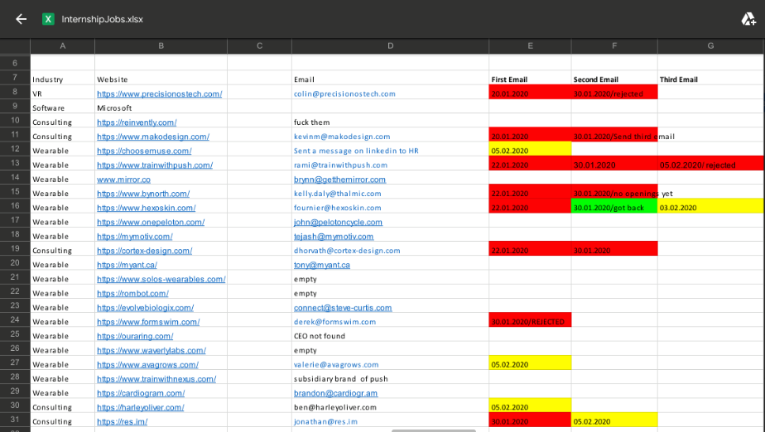
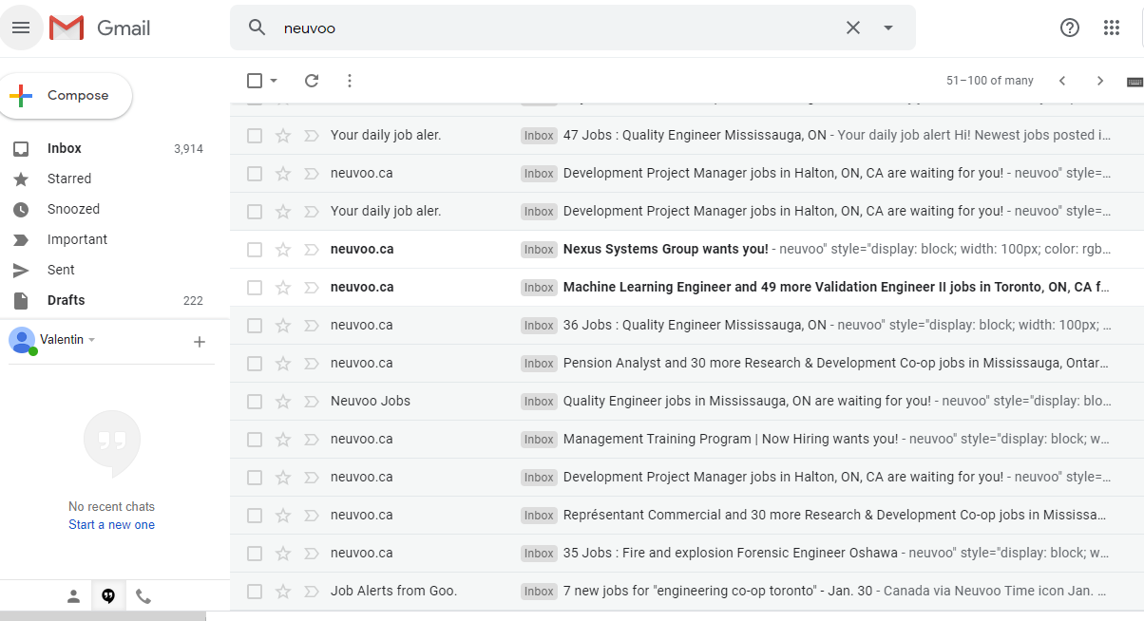
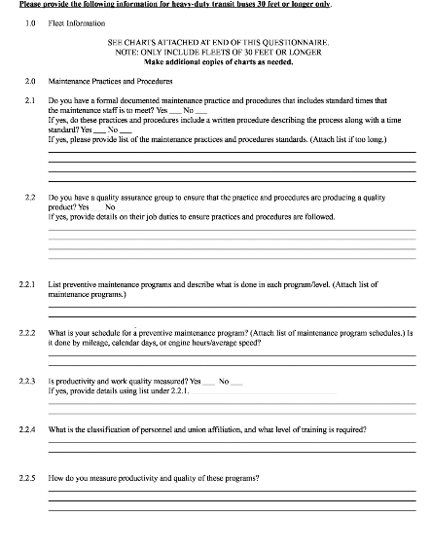
EXCEL SUCKS
MAIN PAIN POINTS
NOTIFICATIONS SUCK
LONG FORMS SUCK

Slide 4
Apli is the ultimate Solution!
Watch our video demonstration to see exactly how it works!

Slide 5
THANK YOU!
THANK YOU FOR WATCHING!
ANY QUESTIONS?!

