Slide 1
Valiton
Harbourmaster
Single Sign-On Lösung

Slide 2




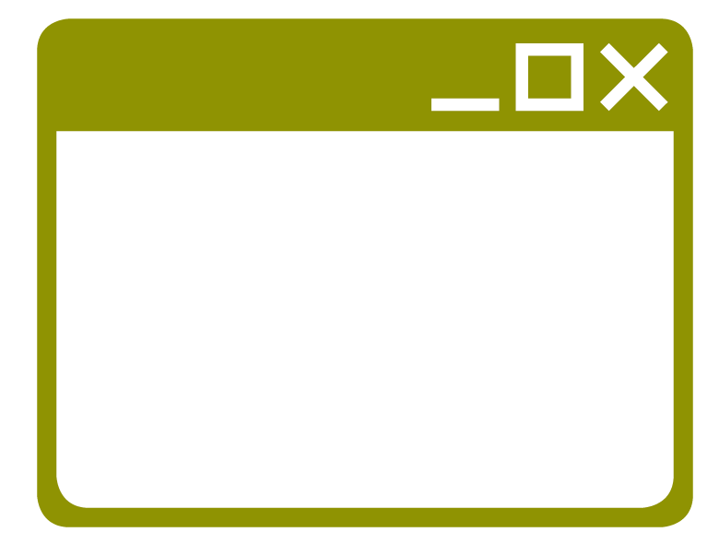




Harbourmaster SSO Multiple Domain
Thunder
User Manager
(Login, Registration, Forgot password, My Account)
Internet User
www.thunder.dev
Harbourmaster
(Policy Server / User Directory)
thunder.dev
usermanager.thunder.dev
harbourmaster.thunder.dev
MongoDB
Controlcenter
(Admin)
Admin
controlcenter.thunder.dev

Slide 3
Harbourmaster SSO Multiple Domain
Thunder
User Manager
(Login, Registration, Forgot password, My Account)
www.thunder.dev
Internet User
thunder.dev
usermanager.thunder.dev
Harbourmaster
(Policy Server / User Directory)
Thunder
www.thunder.local
User Manager
(Login, Registration, Forgot password, My Account)
harbourmaster.thunder.dev
MongoDB
thunder.local
usermanager.thunder.local
Controlcenter
(Admin)
Admin
controlcenter.thunder.dev

Slide 4
Harbourmaster SSO System Components
Thunder
Internet User
User Manager
(Login, Registration, Forgot password, My Account)
Harbourmaster
(Policy Server / User Directory)
Controlcenter
(Admin)
Admin
MongoDB

