Slide 1
FIFA World Cup 2026
O'yinchilar samaradorligi tahlili
Excel (Pivot Table) + Python (pandas) — QA tomonidan tasdiqlangan

Slide 2
DATASET
54,600 qator ma'lumot, to'liq tozalangan
54,600
75
1,248
1,050
48
4
qator
ustun
noyob o'yinchi
o'yin
jamoa
pozitsiya
Har bir qator — bitta o'yinchining bitta o'yindagi statistikasi
NULL qiymat va dublikat qator yo'q
FIFA World Cup 2026 — Player Performance tahlili
2

Slide 3
METODOLOGIYA
Ikki bosqichli mustaqil tekshiruv — farq topilmadi
Excel
Python
Excel Table + 6 ta pivot table
bitta umumiy PivotCache'dan
Dashboard: 4 KPI, 3 grafik, 2 slicer
pandas bilan barcha pivot natijalar
mustaqil qayta hisoblandi
Excel natijalari bilan solishtirildi
Natija: sonli farq topilmadi
FIFA World Cup 2026 — Player Performance tahlili
3

Slide 4
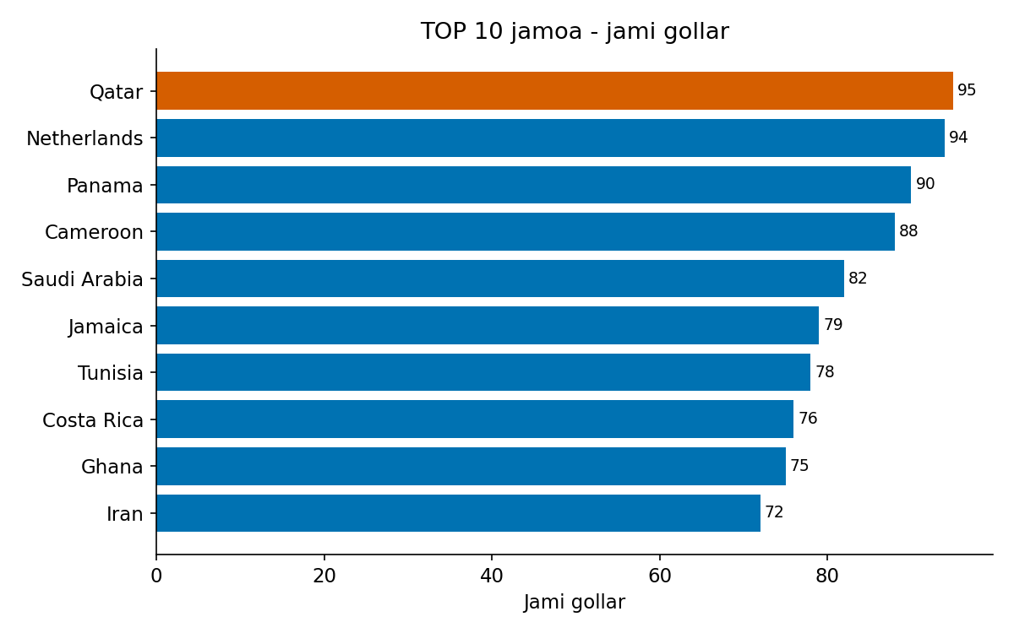
XULOSA 1
Qatar — turnirning eng ko'p gol urgan jamoasi
95 gol
Netherlands (94) va Panama (90) dan oldinda —
TOP-3 orasidagi farq atigi 1-5 gol.
FIFA World Cup 2026 — Player Performance tahlili
4

Slide 5
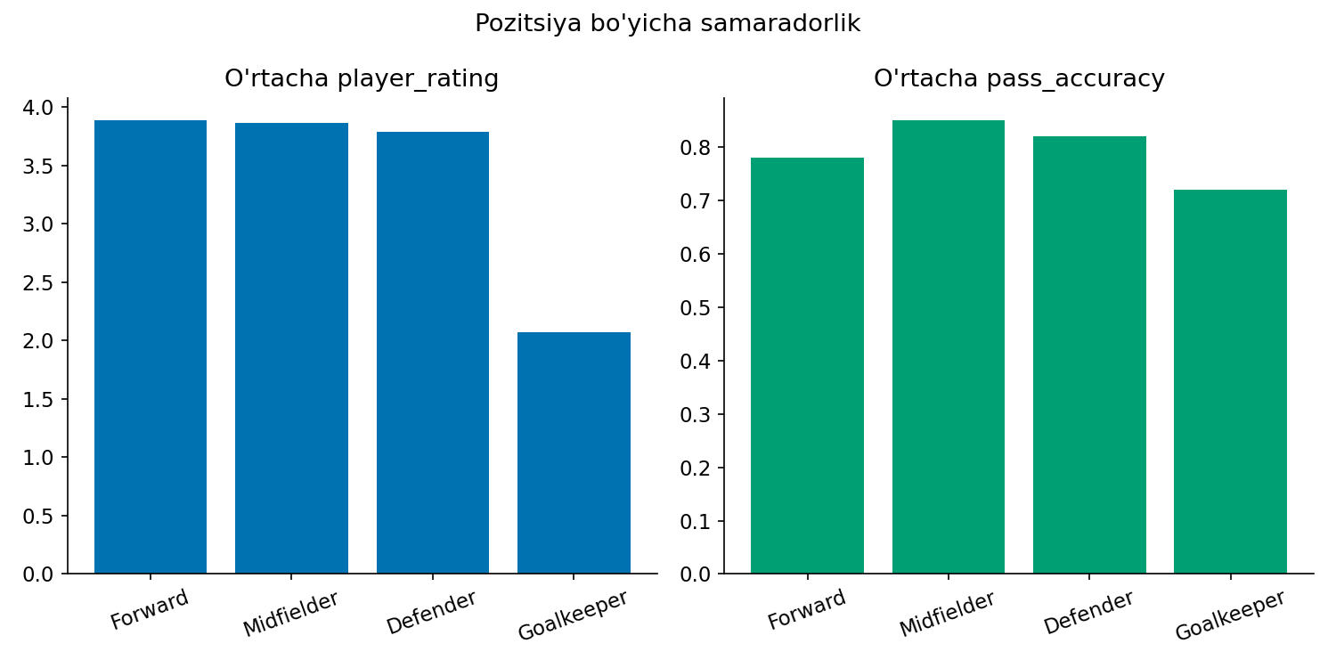
XULOSA 2
Forward — eng yuqori o'rtacha reyting
3.88 ball
Defenderdan (3.79) +0.09, Goalkeeperdan (2.07)
+1.82 ball yuqori.
Pas aniqligida esa Midfielder yetakchi (85.0%).
FIFA World Cup 2026 — Player Performance tahlili
5

Slide 6
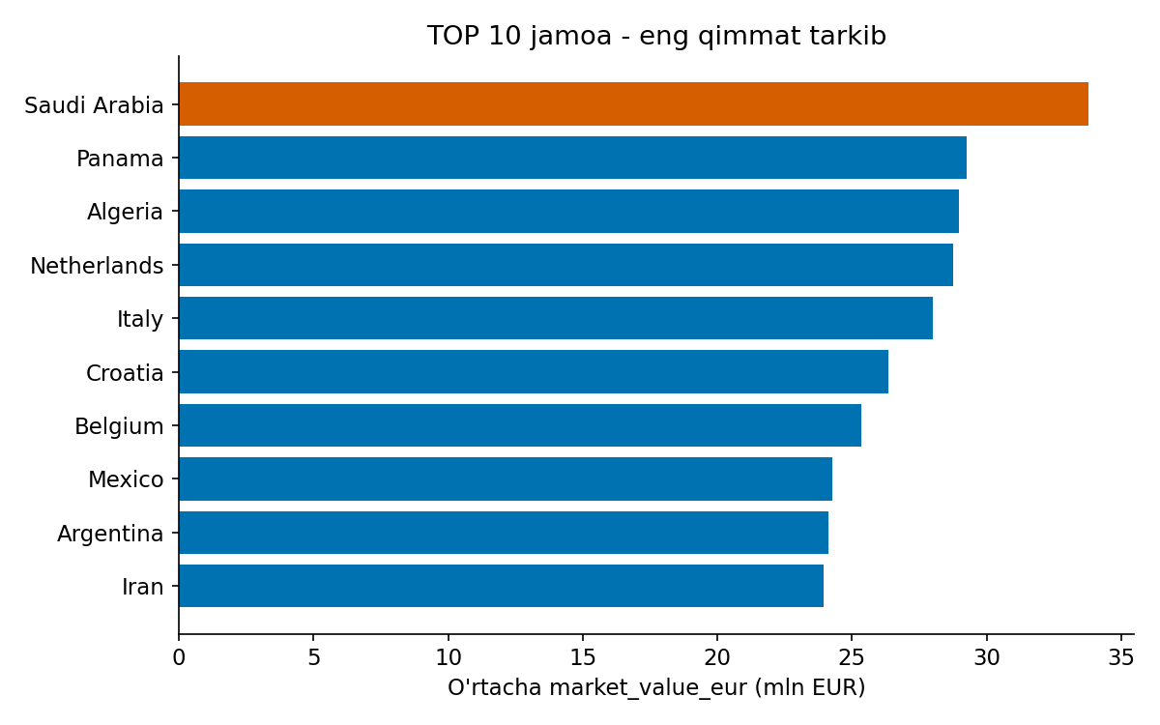
XULOSA 3
Saudi Arabia — eng qimmat tarkibga ega jamoa
~33.8M EUR
TOP-10'dagi 10-o'rin Iran'dan (~23.9M EUR)
sezilarli farq bilan.
FIFA World Cup 2026 — Player Performance tahlili
6

Slide 7
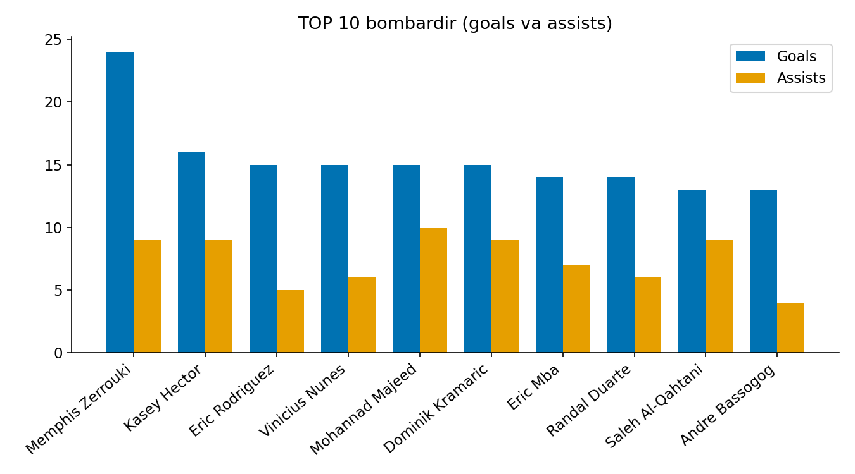
XULOSA 4
Memphis Zerrouki — turnirning eng samarali o'yinchisi
33 ball
24 gol + 9 gol uzatish = 33.
Ikkinchi o'rindagi Kasey Hectordan (16 gol)
8 golga ustun.
FIFA World Cup 2026 — Player Performance tahlili
7

Slide 8
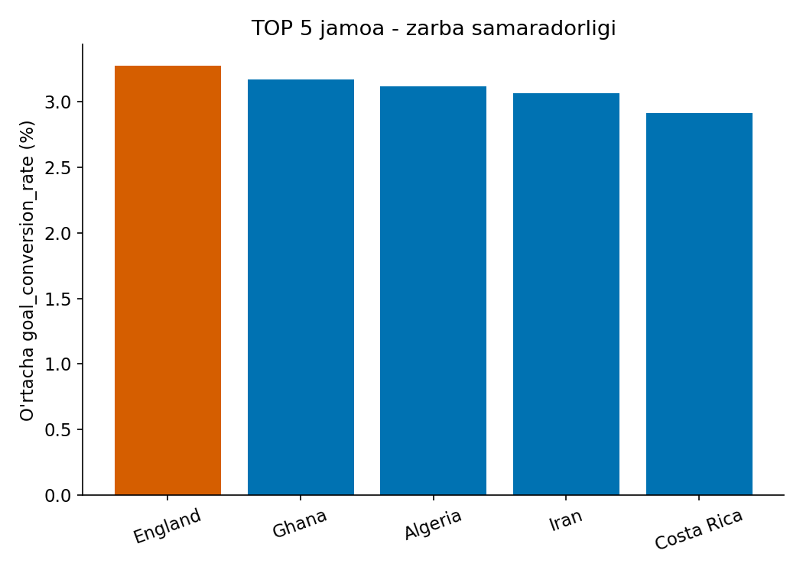
XULOSA 5
England — zarbani golga eng yaxshi aylantiruvchi jamoa
3.27%
Jami gollar bo'yicha TOP-10'ga kirmasa-da —
kamroq, lekin aniqroq zarba qiladi.
FIFA World Cup 2026 — Player Performance tahlili
8

Slide 9
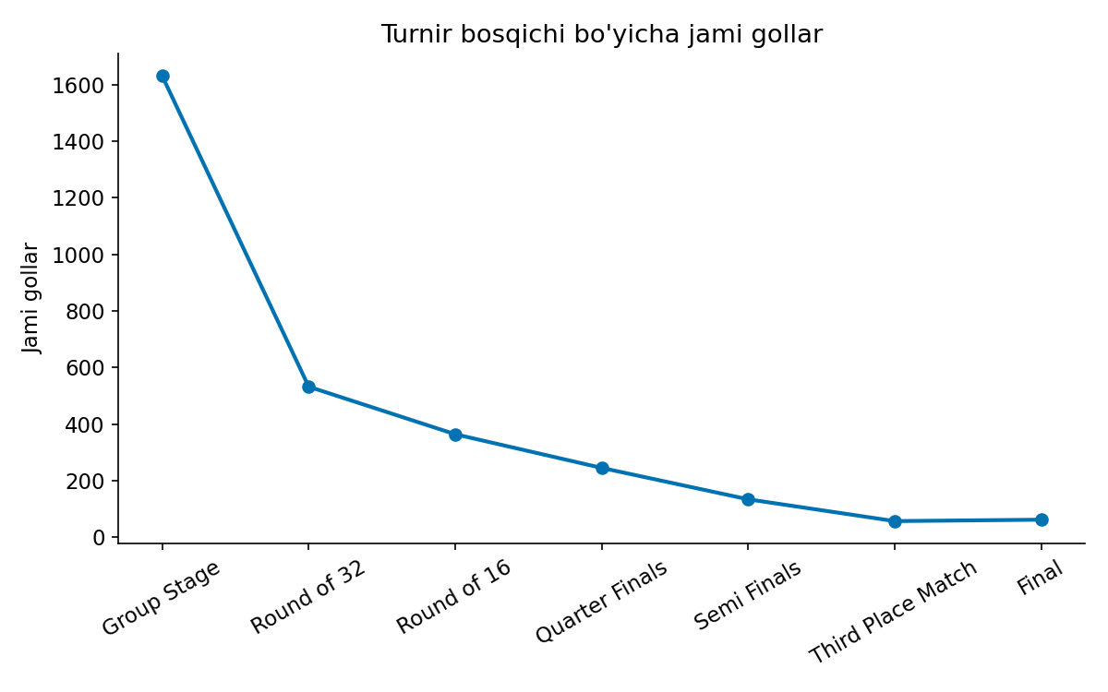
QO'SHIMCHA KONTEKST
Group Stage'da eng ko'p gol qayd etilgan
1,630 gol
Turnir bosqichi oshgan sari gollar soni
keskin kamayib boradi.
FIFA World Cup 2026 — Player Performance tahlili
9

Slide 10
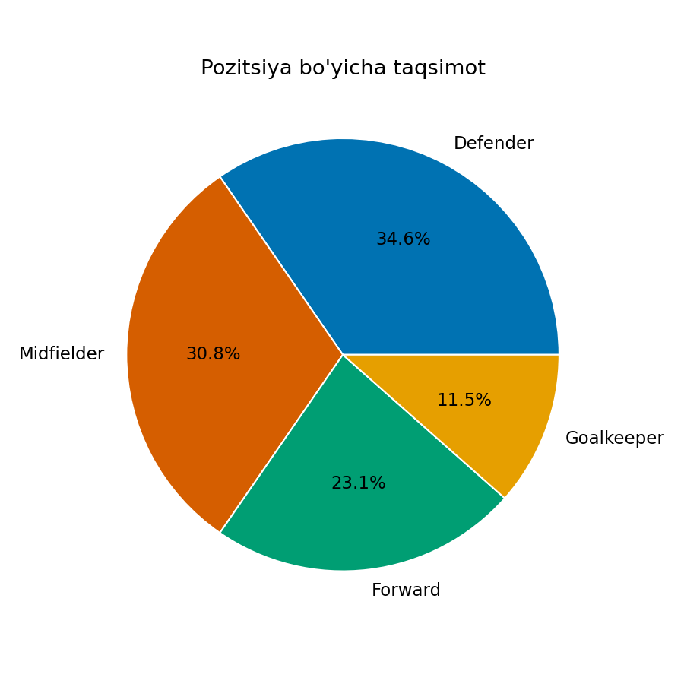
QO'SHIMCHA KONTEKST
Defender — o'yinchilar orasida eng ko'p sonli pozitsiya
34.6%
Midfielder 30.8%, Forward 23.1%,
Goalkeeper 11.5%.
FIFA World Cup 2026 — Player Performance tahlili
10

Slide 11
YAKUNIY XULOSA
5 ta asosiy topilma
Qatar
gol samaradorligida yetakchi jamoa (95 gol)
Forward / Midfielder
reytingda va pas aniqligida yetakchi pozitsiyalar
Saudi Arabia
eng qimmat tarkibga ega jamoa (~33.8M EUR)
Memphis Zerrouki
turnirning eng samarali o'yinchisi (33 ball)
England
zarbani golga eng aniq aylantiruvchi jamoa (3.27%)
Barcha ko'rsatkichlar Excel va Python dual-method orqali QA tomonidan tasdiqlangan.

