Slide 1
Explanation about Authentication and Authorization in a full-stack app
Frontend
Possible third party authentication/authorization service
Backend
Database server
©2022 Juhani Välimäki

Slide 2

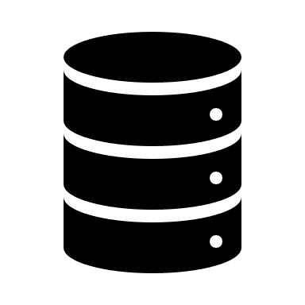




user | email | admin | worker | passwordHash (passwords never stored)
mikkok | mikko.käki@abb.fi | 1 | 1 | DSA2SDFIK3SFS4ADFLA93SDFL…
matti86 | masa@jopo.fi | 0 | 1 | UAPOD1WJF02AWELADFJ2AW…
Third party auth system (often used). E.g. w. OAuth tokens
username, password ->
Database server and database
Frontend
Backend
DB tables
<- authorization token (e.g. w. JWT), user+roles
third party module for checking the authorization token
DB roles
DB views
SQL data table
mikkok (roles: admin,
worker)
admin_role
Admin SQL views
CRUD
Admin feature 1
[role: admin]
DB login: webapp_admin
SQL data table
Login view
R
Admin views
Worker SQL views
requests
with
auth tokens
Admin feature 2
[role: admin]
worker_role
Worker feature 1
[role: worker]
DB login: webapp_worker
Triggers, stored procedures, functions, domains etc.
Worker views
Worker feature 2
[role: worker]
Project table (Also data can be used for per item authorization!)
matti86 (roles: worker)
id | name | ownerId | date | description
301 | Mercurion | matti86 | mmmm | Xxxxx xxxx xxxxxxx xxxx
302 | Lonavala | matti86 | nnnnnn | Xxxx xxxx xxxxx xxxxx
DB login: dba (etc.)
TOP SCARED! Watch the associated
video explanation!
Some developer building/maintaining DB and DB logins directly
©2022 Juhani Välimäki

Slide 3
user | email | admin | worker | passwordHash (passwords never stored)
mikkok | mikko.käki@abb.fi | 1 | 1 | DSA2SDFIK3SFS4ADFLA93SDFL…
matti86 | masa@jopo.fi | 0 | 1 | UAPOD1WJF02AWELADFJ2AW…
Third party authentication system (often used)
Frequent option, just one
DB user for the webapp
username, password ->
Database server and database
Frontend
Backend
DB tables
<- authentication token (e.g. w. JWT), user+roles
third party module for checking the auth token
DB roles
DB views
SQL data table
mikkok (roles: admin,
worker)
admin_role
Admin SQL views
CRUD
Admin feature 1
[role: admin]
SQL data table
Login view
R
Admin views
Worker SQL views
requests
with
auth tokens
Admin feature 2
[role: admin]
DB login: webapp
worker_role
Worker feature 1
[role: worker]
Triggers, stored procedures, functions, domains etc.
Worker views
Worker feature 2
[role: worker]
Project table (Also data can be used for per item authorization!)
matti86 (roles: worker)
id | name | ownerId | date | description
301 | Mercurion | matti86 | mmmm | Xxxxx xxxx xxxxxxx xxxx
302 | Lonavala | matti86 | nnnnnn | Xxxx xxxx xxxxx xxxxx
DB login: dba (etc.)
TOP SCARED! Watch the associated
video explanation!
Some developer building/maintaining DB and DB logins directly
©2022 Juhani Välimäki

Slide 4
SECURITY NOTES
Especially when database server usually is on another server, behind the internet and firewall, consider these:
Call you DB user something else than ’app’, ’webapp’, or ’webapp_user’, or ’backend’ like 50-90% of the developers call it
e.g. call it ’bunker_rat’ or ’sochi’, those would not be any criminals guesses. Or, maybe they are now, so maybe something else random.
Whitelist/allow in only those IP addresses from where database connections are allowed.
Backend server
DBA (database admins computer)
In all security related aspects, write/collect them to one document and harden them before publishing any systems!
©2022 Juhani Välimäki

