Slide 1
scanner
PE static analysis platform

Slide 2
PE static analysis platform
CLI && GUI
Plugins
Analysis database
Developer oriented

Slide 3
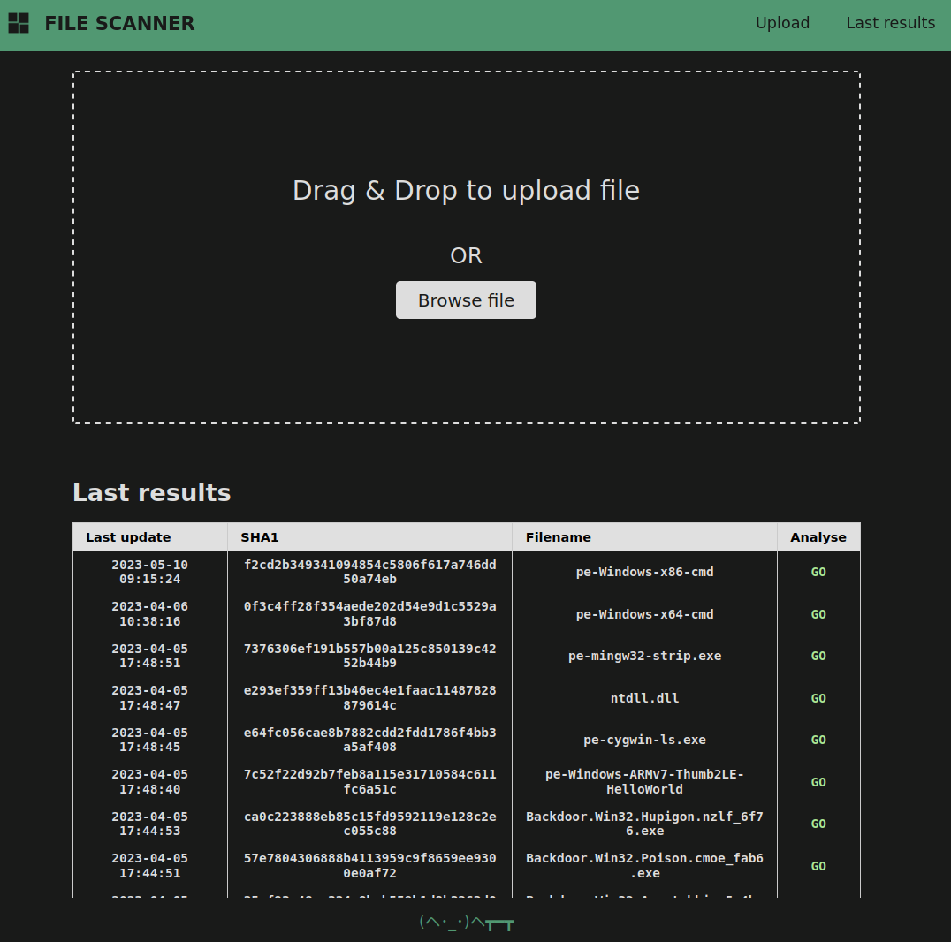
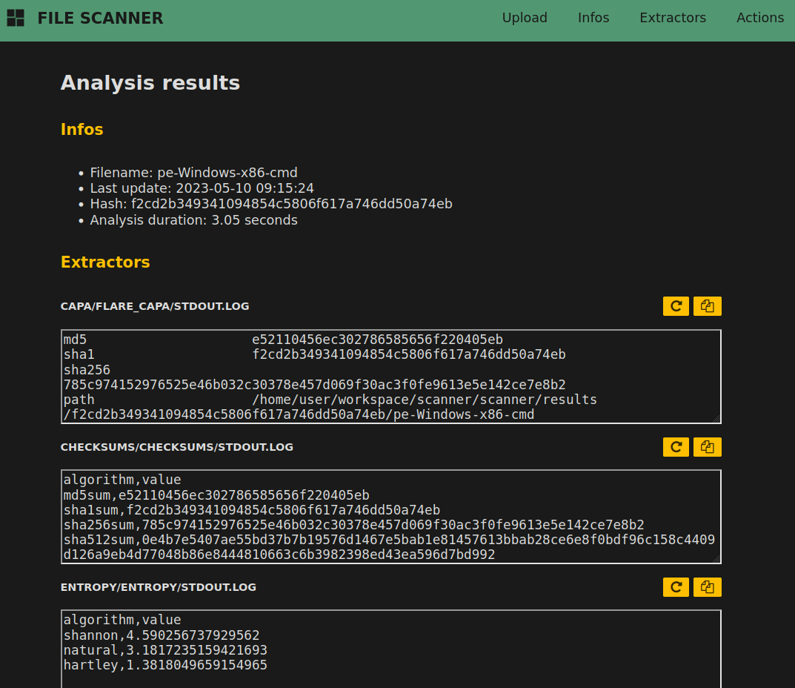
Show me the code interface

Slide 4
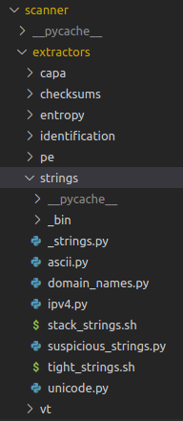
Extractors
Drop your exec
Categorize with folders
Write to stdout / stderr
Prefix deps with _

Slide 5
Extractors full list
capa | capa -vv
checksums | Md5, sha1, sha256
entropy | Calcul shannon, natural, hartley
identification | file (1)
pe/authenticode | Authenticode display
pe/debug | PE debug infos (e.g. pdb path)
pe/exports | Exports listing
pe/features | Has suspicious imphash, has native subsystem, ...
pe/header | PE header infos (addr of entrypoint, size of code, ...)
pe/imports_hash | Imports hash computation (pefile / lief based)
pe/imports | Imports listing
pe/packers | Packer detection

Slide 6
pe/resources | Rsrc listing
pe/rich_header | rich header infos (vs2022 up to date!)
pe/sections | Pe section infos
pe/stamps | PE timestamps
pe/subsystem | PE subsystem output
pe/suspicious_imports | Suspicious imports listing (e.g. antidebug)
pe/suspicious_modules | Suspicious modules listing (e.g. libraries)
pe/suspicious_sections | Suspicious sections listing (e.g. packers)
strings/ascii | Ascii strings listing
strings/domain_names | Domain names listing
strings/ipv4 | Ipv4 listing

Slide 7
strings/stack_strings | Stack strings listing
strings/suspicious_strings | Suspicious strings (e.g. cmd.exe)
strings/tight_strings | Tight strings listing
strings/unicode | Utf16le strings listing
vt/by_hash | VT hash report download

Slide 8
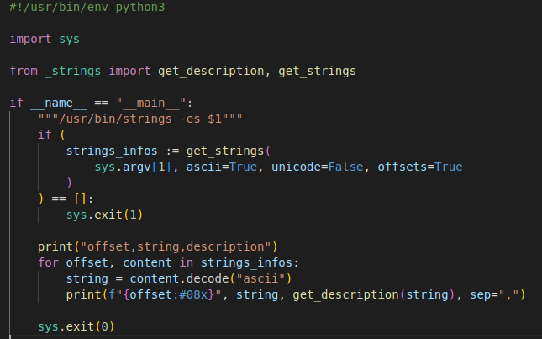
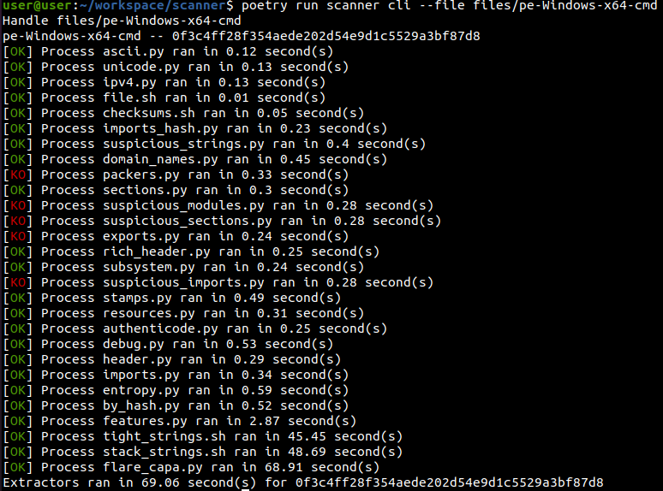
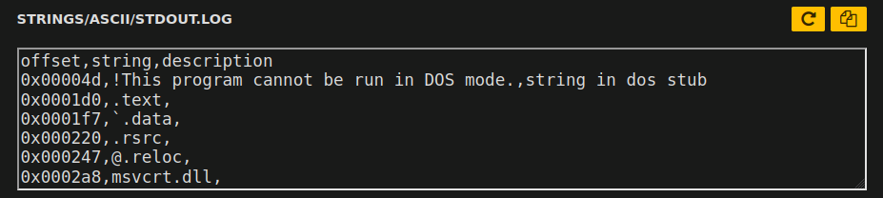
Example
Write extractor ...
... under extractors/ ...
... collect output.
... run the scanner ...

Slide 9
Installation
Python -m venv .env
. .env/bin/activate
Pip install scanner.tar.gz
Poetry run scanner

