Slide 1
Exploiting IA-32 redundancy
Charles Paulet

Slide 2
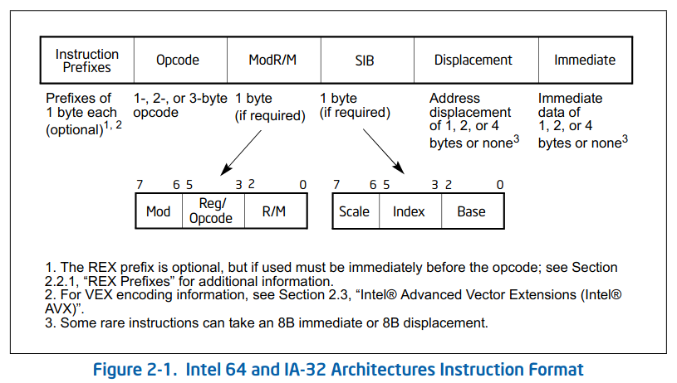
Instructions encoding (IA-32e)

Slide 3
Operands encoding
Operand encoding = addressing method + operand type
Abbreviations revealing possible mutations :
Abbr | Description
E | A ModR/M byte follows the opcode and specifies the operand.
G | The ModR/M reg part selects a general register
I | Immediate data
b | Byte
v | Word, doubleword or quadword depending on operand-size attribute

Slide 4
Opcodes encoding
1, 2 or 3-byte opcodes
3 opcode tables
ModR/M and SIB bytes for specific addressing modes

Slide 5
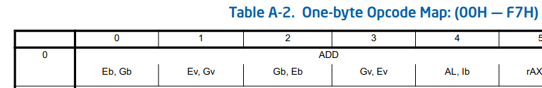
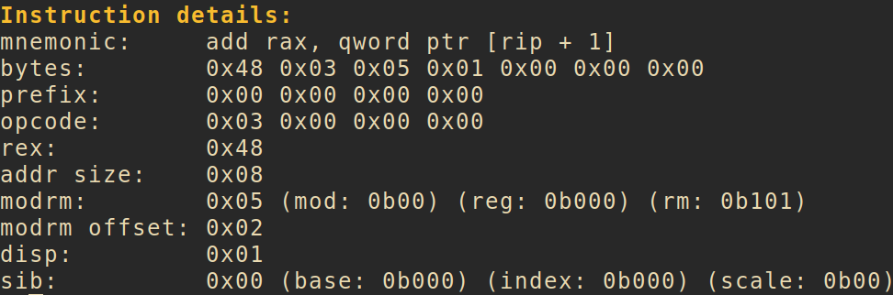
Example (ADD Gv, Ev)

Slide 6
Register operands and the ModR/M byte
Instruction | bytes | opcode | ModR/M
add eax, ebx | 01 d8 | 01 | d8 (mod: 0b11) (reg: 0b011) (rm: 0b000)
add ebx, eax | 03 d8 | 03 | d8 (mod: 0b11) (reg: 0b011) (rm: 0b000)
add eax, ebx | 03 c3 | 03 | c3 (mod: 0b11) (reg: 0b000) (rm: 0b011)

Slide 7
Register operands and the SIB byte
When SIB.scale is 0b00 :
Instruction | bytes | SIB
mov rax, qword ptr [rbx + rcx] | 48 8b 04 0b | 0x0b (index: 0b001, rcx) (base: 0b011, rbx)
mov rax, qword ptr [rcx + rbx] | 49 8b 04 19 | 0x19 (index: 0b011, rbx) (base: 0b001, rcx)
Instruction | bytes | SIB
mov byte ptr [eax + ebx], 5 | 67 c6 04 18 05 | 0x18 (index: 0b011, ebx) (base: 0b000, eax)
mov byte ptr [ebx + eax], 5 | 67 c6 04 03 05 | 0x03 (index: 0b000, eax) (base: 0b011, ebx)

Slide 8
Duplicate opcode extensions
Group 0xf6
Instruction | bytes | ModR/M reg
test bl, 0x10 | f6 c3 10 | 0b000
test bl, 0x10 | f6 cb 10 | 0b001
Group 0xf7
Instruction | bytes | ModR/M reg
test ebx, 0xaabbccdd | f7 c3 dd cc bb aa | 0b000
test ebx, 0xaabbccdd | f7 cb dd cc bb aa | 0b001

Slide 9
Duplicate opcodes in 32-bit mode
Group 1 have duplicated opcodes for 0x80 and 0x82 on x86 when working with imm8 (or Ib)
Instruction | bytes
add byte ptr [eax], 0x10 | 80 00 10
add byte ptr [eax], 0x10 | 82 00 10
Also works for ADD, OR, ADC, SBB, AND, SUB, XOR, CMP depending on the ModR/M reg

Slide 10
Duplicate opcodes in 32/64-bit mode
Group 1 have duplicated opcodes for 0x81 and 0x83 when working with imm8 (or Ib)
Instruction | bytes
add eax, 0x10 | 83 c0 10
add eax, 0x10 | 81 c0 10 00 00 00
add rax, 0x10 | 48 83 c0 10
add rax, 0x10 | 48 81 c0 10 00 00 00

Slide 11
Duplicates for the acc register
The acc register can be mutated using the x4 and x5 opcodes
Instruction | bytes
add al, 0x10 | 04 10
add al, 0x10 | 80 c0 10
add eax, 0x10 | 05 10 00 00 00
add eax, 0x10 | 81 c0 10 00 00 00
add eax, 0x10 | 83 c0 10
add eax, 0x10 | 48 05 10 00 00 00 00
add rax, 0x10 | 48 81 c0 10 00 00 00
add rax, 0x10 | 48 83 c0 10
And for ADD, OR, ADC, SBB, AND, SUB, XOR, CMP, depending on the ModR/M reg

Slide 12
Duplicates using zero displacements
Instruction | bytes | ModR/M mod
add dword ptr [eax], eax | 67 01 00 | 0b00
add dword ptr [eax + 00], eax | 67 01 40 00 | 0b01
add dword ptr [eax + 00000000], eax | 67 01 80 00 00 00 00 | 0b10

Slide 13
SIB scale/index corner case
When SIB.index is 0b100, SIB.scale is useless
Instruction | bytes | SIB.scale
mov byte ptr [0xaabbccdd], 0xff | c6 04 25 dd cc bb aa ff | 0b00
mov byte ptr [0xaabbccdd], 0xff | c6 04 65 dd cc bb aa ff | 0b01
mov byte ptr [0xaabbccdd], 0xff | c6 04 a5 dd cc bb aa ff | 0b10
mov byte ptr [0xaabbccdd], 0xff | c6 04 e5 dd cc bb aa ff | 0b11
Instruction | bytes | SIB.scale
mov byte ptr [ebp + 0x56], 0xff | c6 44 25 56 ff | 0b00
mov byte ptr [ebp + 0x56], 0xff | c6 44 65 56 ff | 0b01
mov byte ptr [ebp + 0x56], 0xff | c6 44 a5 56 ff | 0b10
mov byte ptr [ebp + 0x56], 0xff | c6 44 e5 56 ff | 0b11

Slide 14
Legacy prefixes
In 32-bit mode, we can omit some legacy prefixes:
Instruction | bytes
add qword ptr [eax], eax | 67 01 00
add qword ptr [eax], eax | 01 00
Some instructions might accept one or more prefixes:
Instruction | bytes
nop | 90
nop | 66 90
nop | 66 67 90
nop | 66 66 67 90

Slide 15
Logic transformations
Like zeroing registers
Instruction | bytes | ModR/M
xor bx, bx | 66 31 db | 0xdb (mod: 0b11) (reg: 0b011) (rm: 0b011)
xor ebx, ebx | 31 db | 0xdb (mod: 0b11) (reg: 0b011) (rm: 0b011)
sub bx, bx | 66 29 db | 0xdb (mod: 0b11) (reg: 0b011) (rm: 0b011)
sub ebx, ebx | 29 db | 0xdb (mod: 0b11) (reg: 0b011) (rm: 0b011)
mov ebx, 0 | bb 00 00 00 00 | 0x00 (mod: 0b00) (reg: 0b000) (rm: 0b000)
mov rbx, 0 | 48 c7 c3 00 00 00 00 | 0xc3 (mod: 0b11) (reg: 0b000) (rm: 0b011)

Slide 16
Going further
Signatures/pattern-matching bypasses?
Cmake / C&C module?
Steganography?
LLVM passes?
post-compilation / LIEF frontend?

Slide 17
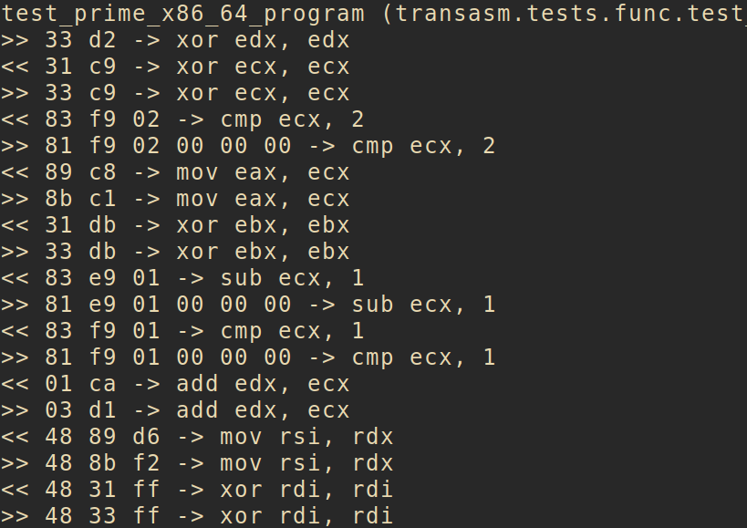
Tool 1: transasm
implementing the techniques discussed
based on capstone
there are still mutations waiting to be
found and implemented into transasm
we can use it as a mutation engine and
add more constraints

Slide 18
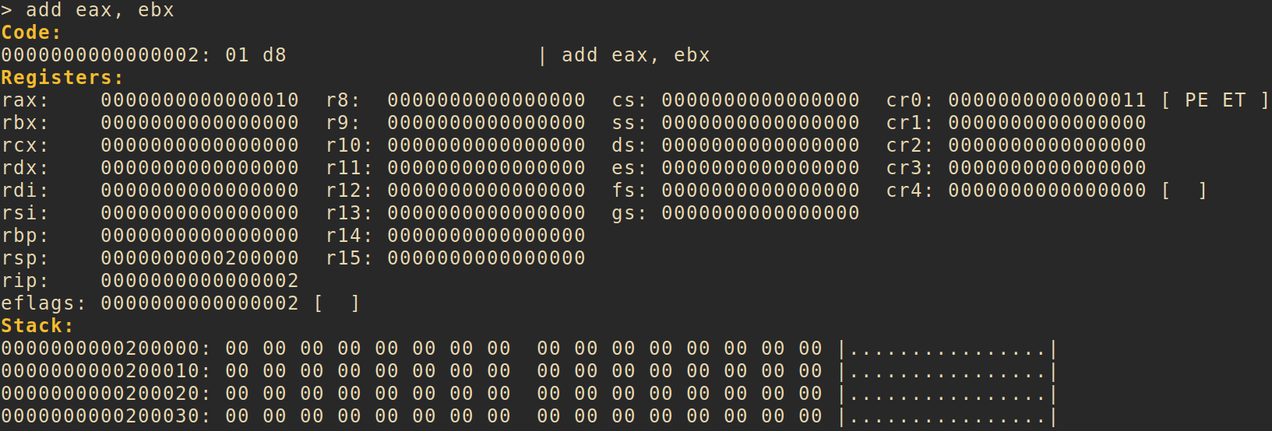
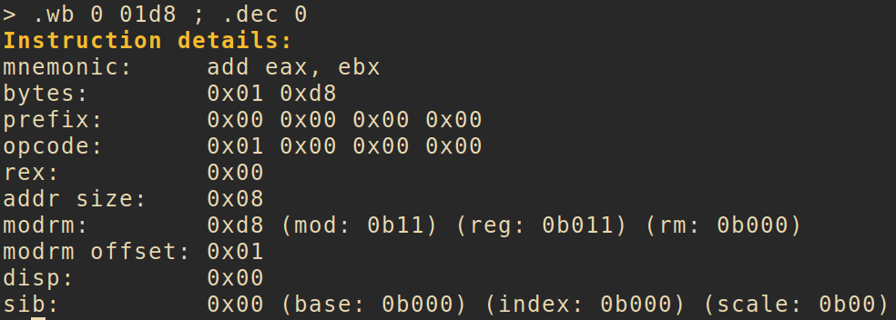
Tool 2: asmshell
ASM REPL based on capstone, keystone, unicorn

Slide 19
Key takeaways
It’s easy to get started with capstone, keystone, unicorn
x86 encoding knowledge can be reused elsewhere (minimal disassembler)

